Slide 1
Inflation Indexed Bond Valuation Introduction
David Lee
FinPricing
http://www.finpricing.com

Slide 2
Inflation Bond
Summary
Inflation Indexed Bond Introduction
The use of Inflation Indexed Bonds
Valuation
Practical Guide
A Real World Example

Slide 3
Inflation Bond
Inflation Indexed Bond Introduction
Inflation indexed bonds, also called inflation linked bonds or real return bonds, are bonds where the principal is indexed to a reference inflation index, such as Consumer Price Index (CPI).
The CPI is the proxy for inflation that measures price changes in a basket of goods and services.
The main idea of inflation indexed bonds is that investing in the bond will generate a certain real return.
Inflation indexed bonds pay a periodic coupon that is equal to the product of the daily inflation index and the nominal coupon rate.
Unlike regular (nominal) bonds, inflation indexed bonds assure that your purchasing power is maintained regardless of the future rate of inflation.

Slide 4
Inflation Bond
The use of Inflation Indexed Bonds
An inflation indexed bond is designed to hedge the inflation risk of the bond.
Since inflation indexed bonds offer investors a very high level of safety, their coupons are typically lower than high-yield bonds.
It is an important vehicle for investors whose liabilities indexed to changes in inflation or wages.
Inflation indexed bonds have favorable performance and lower volatility relative to other risk assets.
It is favorable to retirement planning and pension funds given its inflation protection feature.
Inflation indexed bonds are less liquid than regular bonds.

Slide 5
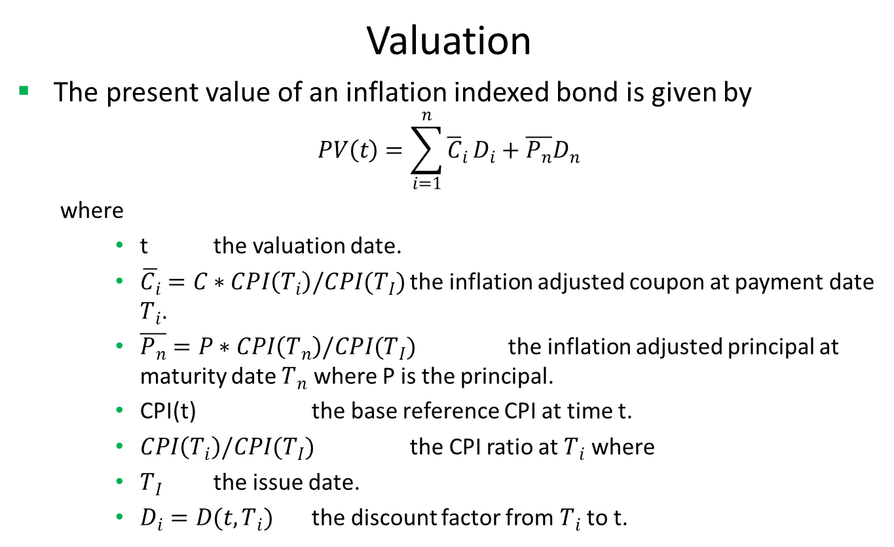
Inflation Bond
Valuation
The present value of an inflation indexed bond is given by
$$PV\left(t\right)=\sum_{i=1}^{n}{{\overline{C}}_{i}}D_{i}+\overline{P_{n}}D_{n}$$
where
t the valuation date.
$\overline{C_{i}}=C∗CPI\left(T_{i}\right)/CPI(T_{I})$ the inflation adjusted coupon at payment date $T_{i}$.
$\overline{P_{n}}=P∗CPI\left(T_{n}\right)/CPI(T_{I})$ the inflation adjusted principal at maturity date $T_{n}$ where P is the principal.
CPI(t) the base reference CPI at time t.
$CPI\left(T_{i}\right)/CPI(T_{I})$ the CPI ratio at $T_{i}$ where
$T_{I}$ the issue date.
$D_{i}=D(t,T_{i})$ the discount factor from $T_{i}$ to t.

Slide 6
Inflation Bond
Practical Guide
First construct inflation curve by bootstrapping either breakeven inflation swap rates or treasury inflation protected securities (TIPS).
Compute the base reference CPIs at the issue date and each payment date.
Adjust the coupons and principal based on CPI ratio at each payment date.
Discount all the coupons and principal to the valuation date.
The bond price is the sum of all the present values.

Slide 7
Inflation Bond
A Real World Example
Buy Sell | Buy
Calendar | NYC
Coupon Type | Fixed
Coupon | 0.00375
Currency | USD
Issue Date | 7/31/2015
Interest Accrual Date | 7/15/2015
First Coupon Date | 1/15/2016
Last Coupon Date | 1/15/2025
Maturity Date | 7/15/2025
Settlement Date | 7/31/2015
Settlement Lag | 1
Day Count | dcActAct
Payment Frequency | 6M
Pay Receive | Receive
Inflation Reference Index | CONSUMER PRICE INDEX US
Inflation Reference Index Level | 237.14365
Notional | 100

Slide 8
Thank You
You can find more information at
http://www.finpricing.com/lib/FiInflationBond.html

