Slide 1

Puttable Bond and Vaulation Dmitry Popov FinPricing http://www.finpricing.com

Slide 2
Puttable Bond
Summary
Puttable Bond Definition
The Advantages of Puttable Bonds
Puttable Bond Payoffs
Valuation Model Selection Criteria
LGM Model
LGM Assumption
LGM calibration
Valuation Implementation
A real world example

Slide 3
Puttable Bond
Puttable Bond Definition
A puttable bond is a bond in which the investor has the right to sell the bond back to the issuer at specified times (puttable dates) for a specified price (put price).
At each puttable date prior to the bond maturity, the investor may sell the bond back to its issuer and get the investment money back.
The underlying bonds can be fixed rate bonds or floating rate bonds.
A puttable bond can therefore be considered a vanilla underlying bond with an embedded Bermudan style option.
Puttable bonds protect investors. Therefore, a puttable bond normally pay the investor a lower coupon than a non-callable bond.

Slide 4
Puttable bond
Advantages of Puttable Bond
Although a puttable bond is a lower income to the investor and an uncertainty to the issuer comparing to a regular bond, it is actually quite attractive to both issuers and investors.
For investors, puttable bonds allow them to reduce interest costs at a future date should rate increase.
For issuers, puttable bonds allow them to pay a lower interest rate of return until the bonds are sold back.
If interest rates have increased since the issuer first issues the bond, the investor is like to put its current bond and reinvest it at a higher coupon.

Slide 5
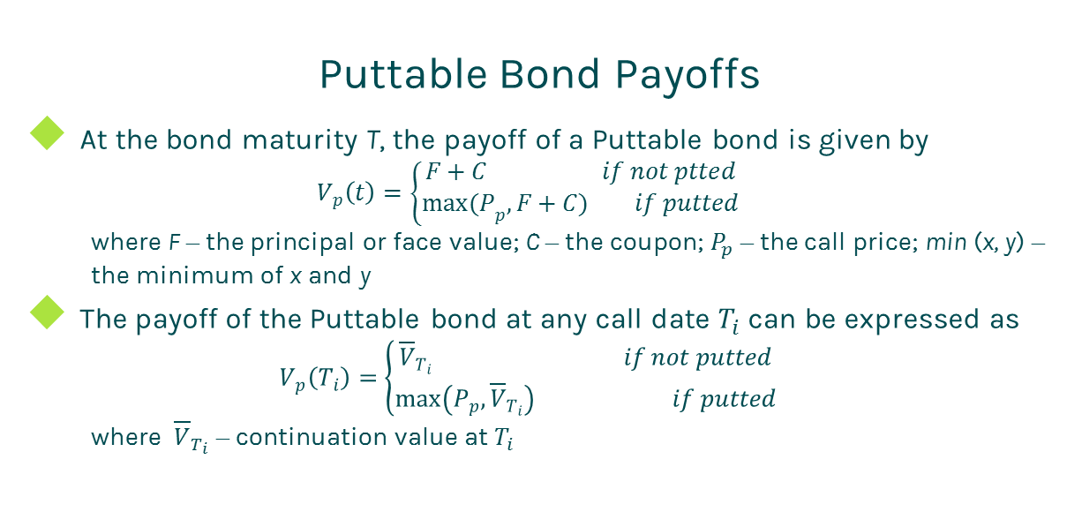
Puttable Bond
Puttable Bond Payoffs
At the bond maturity T, the payoff of a Puttable bond is given by
$$V_{p}\left(t\right)=\left\{\begin{matrix}F+C if not ptted \\ {max(P}_{p}, F+C) if putted\end{matrix}\right.$$
where F – the principal or face value; C – the coupon; $P_{p}$ – the call price; min (x, y) – the minimum of x and y
The payoff of the Puttable bond at any call date $T_{i}$ can be expressed as
$$V_{p}\left(T_{i}\right)=\left\{\begin{matrix}{\overline{V}}_{T_{i}} if not putted \\ \max\left(P_{p},{\overline{V}}_{T_{i}}\right) if putted\end{matrix}\right.$$
where ${\overline{V}}_{T_{i}}$ – continuation value at $T_{i}$

Slide 6
Puttable Bond
Model Selection Criteria
Given the valuation complexity of puttable bonds, there is no closed form solution. Therefore, we need to select an interest rate term structure model and a numerical solution to price them numerically.
The selection of interest rate term structure models
Popular interest rate term structure models:
Hull-White, Linear Gaussian Model (LGM), Quadratic Gaussian Model (QGM), Heath Jarrow Morton (HJM), Libor Market Model (LMM).
HJM and LMM are too complex.
Hull-White is inaccurate for computing sensitivities.
Therefore, we choose either LGM or QGM.

Slide 7
Puttable Bond
Model Selection Criteria (Cont)
The selection of numeric approaches
After selecting a term structure model, we need to choose a numerical approach to approximate the underlying stochastic process of the model.
Commonly used numeric approaches are tree, partial differential equation (PDE), lattice and Monte Carlo simulation.
Tree and Monte Carlo are notorious for inaccuracy on sensitivity calculation.
Therefore, we choose either PDE or lattice.
Our decision is to use LGM plus lattice.

Slide 8
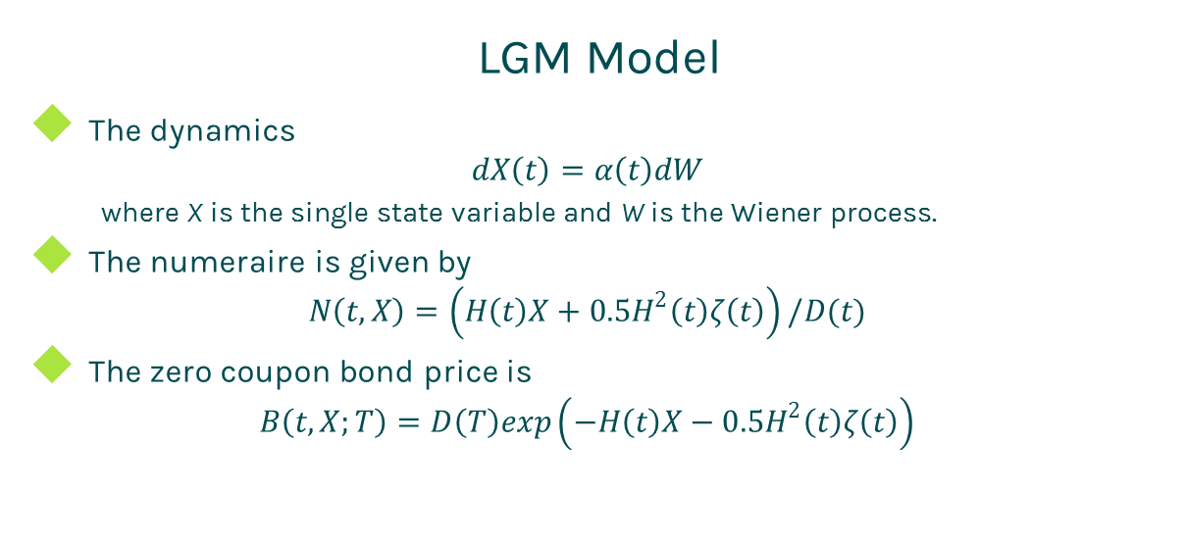
Puttable Bond
LGM Model
The dynamics
$$dX\left(t\right)=α\left(t\right)dW$$
where X is the single state variable and W is the Wiener process.
The numeraire is given by
$$N\left(t,X\right)=\left(H\left(t\right)X+0.5H^{2}\left(t\right)ζ\left(t\right)\right)/D(t)$$
The zero coupon bond price is
$$B\left(t,X;T\right)=D\left(T\right)exp\left(−H\left(t\right)X−0.5H^{2}\left(t\right)ζ\left(t\right)\right)$$

Slide 9
Puttable Bond
LGM Assumption
The LGM model is mathematically equivalent to the Hull-White model but offers
Significant improvement of stability and accuracy for calibration.
Significant improvement of stability and accuracy for sensitivity calculation.
The state variable is normally distributed under the appropriate measure.
The LGM model has only one stochastic driver (one-factor), thus changes in rates are perfected correlated.

Slide 10
Puttable Bond
LGM calibration
Match today’s curve
At time t=0, X(0)=0 and H(0)=0. Thus Z(0,0;T)=D(T). In other words, the LGM automatically fits today’s discount curve.
Select a group of market swaptions.
Solve parameters by minimizing the relative error between the market swaption prices and the LGM model swaption prices.

Slide 11
Puttable Bond
Valuation Implementation
Calibrate the LGM model.
Create the lattice based on the LGM: the grid range should cover at least 3 standard deviations.
Calculate the payoff of the puttable bond at each final note.
Conduct backward induction process iteratively rolling back from final dates until reaching the valuation date.
Compare exercise values with intrinsic values at each exercise date.
The value at the valuation date is the price of the puttable bond.

Slide 12
Puttable Bond
A real world example
Bond specification |  | Puttable schedule
Buy Sell | Buy | Put Price | Notification Date
Calendar | NYC | 100 | 1/26/2015
Coupon Type | Fixed | 100 | 7/25/2018
Currency | USD
First Coupon Date | 7/30/2013
Interest Accrual Date | 1/30/2013
Issue Date | 1/30/2013
Last Coupon Date | 1/30/2018
Maturity Date | 7/30/2018
Settlement Lag | 1
Face Value | 100
Pay Receive | Receive
Day Count | dc30360
Payment Frequency | 6
Coupon | 0.01

Slide 13
Thanks!
You can find more details at
http://www.finpricing.com/lib/IrPuttableBond.html

