Slide 1
FX Asian Option Introduction and Pricing Guide
Michael Taylor
FinPricing

Slide 2
FX Asian
An FX Asian option or Asian currency option is a special type of option contract where the payoff depends on the average of the underlying foreign exchange rate over a certain period of time. The payoff is different from the case of a European option or American option, where the payoff of the option contract depends on the underlying FX rate at exercise date.
Options give market participants many opportunities to limit risk and increase profit. Currency market fluctuations can have a lasting impact on cash flow whether it is buying a property, paying salaries, making an investment or settling invoices. By utilizing FX Asian Options, business can protect themselves against adverse movements in exchange rates.

Slide 3
FX Asian
Summary
FX Aian Option Introduction
The Use of FX Asian Options
Forex Market Convention
Valuation
Practical Guide
A Real World Example

Slide 4
FX Asian
Asian Option Introduction
An Asian option or average option is a special type of option contract where the payoff depends on the average of the underlying exchange rates over a certain period of time
The payoff is different from the case of a European option or American option, where the payoff of the option contract depends on the rate of the underlying asset at exercise date.
Asian options allow the buyer to purchase or sell the underlying asset at the average rate instead of the spot rate.
Asian options are commonly seen options over the OTC markets.
Average rate options are less expensive than regular options and are arguably more appropriate than regular options for meeting some of investment needs.

Slide 5
FX Asian
The Use of Asian Options
One advantage of Asian options is that they reduce the risk of market manipulation of the underlying instrument at maturity.
Another advantage of Asian options involves the relative cost of Asian options compared to European or American options. Because of the averaging feature, Asian options reduce the volatility inherent in the option; therefore, Asian options are typically cheaper than European or American options.
Asian options have relatively low volatility due to the averaging mechanism. They are used by traders who are exposed to the underlying asset over a period of time.

Slide 6
FX Asian
The Use of Asian Options (Cont)
The arithmetic average rate options are generally used to smooth out the impact from high volatility periods or prevent rate manipulation near the maturity date, which makes the options less expensive.
Currency options are one of the most common ways for corporations, individuals or financial institutions to hedge against adverse movements in exchange rates.
Corporations primarily use FX options to hedge uncertain future cash flows in a foreign currency. The general rule is to hedge certain foreign currency cash flows with forwards, and uncertain foreign cash flows with options.

Slide 7
FX Asian
Forex Market Convention
One of the biggest sources of confusion for those new to the FX market is the market convention. We need to make clear the meaning of the following terms in the forex market first.
FX quotation: the quotation EUR/USD 1.25 means that one Euro is exchanged for 1.25 USD. Here EUR (nominator) is the base or primary currency and USD (denominator) is the quote currency. One can convert any amount of base currency to quote currency by
QuoteCurrencyAmount = FxRate * BaseCurrencyAmount

Slide 8
FX Asian
Forex Market Convention (Cont)
Spot Days: The spot date or value date is the day the two parties actually exchange the two currencies. In other words, a currency pair requires a specification of the number of days between the quotation date (trade date) and the Spot Date on which the exchange is to take place at that quote. Spot days can be different for each currency pair, although typically it is two business days.
Holidays: Each currency pair has a set of holidays associated with it. The holidays of a currency pair is the union of the holidays of the two currencies.

Slide 9
FX Asian
Valuation
The payoff of an average rate call is max(0, X_{avg} - K) and that of an average price put is max(0, K- X_{avg}), where X_{avg} is the average rate of the underlying asset calculated over a predetermined averaging period.
If the underlying exchange rate, X, is assumed to be lognormally distributed and X_{avg} is a geometric average of the X’s, analytic formulas are available for valuing European average rate options. This is because the geometric average of a set of lognormally distributed variables is also lognormal.
When, as is nearly always the case, Asian options are defined in terms of arithmetic averages, exact analytic pricing formulas are not available. This is because the distribution of the arithmetic average of a set of lognormal distributions does not have analytically tractable properties.

Slide 10
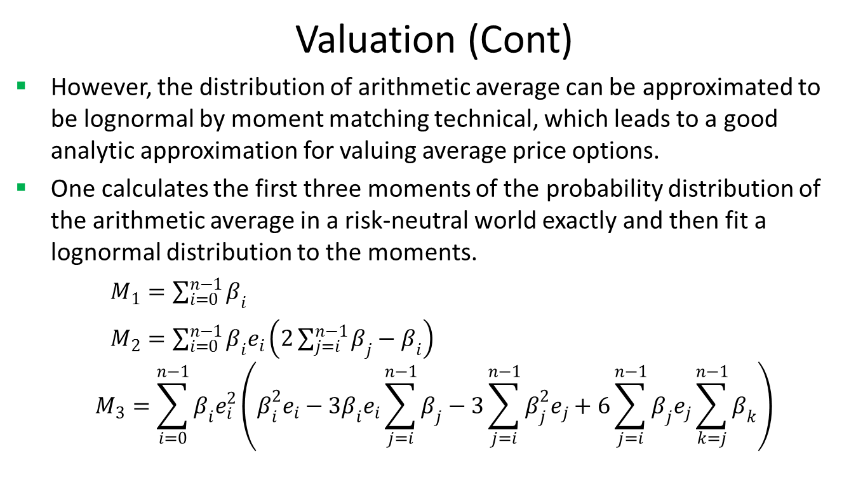
FX Asian
Valuation (Cont)
However, the distribution of arithmetic average can be approximated to be lognormal by moment matching technical, which leads to a good analytic approximation for valuing average price options.
One calculates the first three moments of the probability distribution of the arithmetic average in a risk-neutral world exactly and then fit a lognormal distribution to the moments.
$M_{1}=\sum_{i=0}^{n−1}{β_{i}}$
$M_{2}=\sum_{i=0}^{n−1}{β_{i}e_{i}\left(2\sum_{j=i}^{n−1}{β_{j}}−β_{i}\right)}$
$$M_{3}=\sum_{i=0}^{n−1}{β_{i}e_{i}^{2}\left(β_{i }^{2}e_{i}−3β_{i}e_{i}\sum_{j=i}^{n−1}{β_{j}}−3\sum_{j=i}^{n−1}{β_{j}^{2}e_{j}+6\sum_{j=i}^{n−1}{β_{j}e_{j}\sum_{k=j}^{n−1}{β_{k}}}}\right)}$$

Slide 11
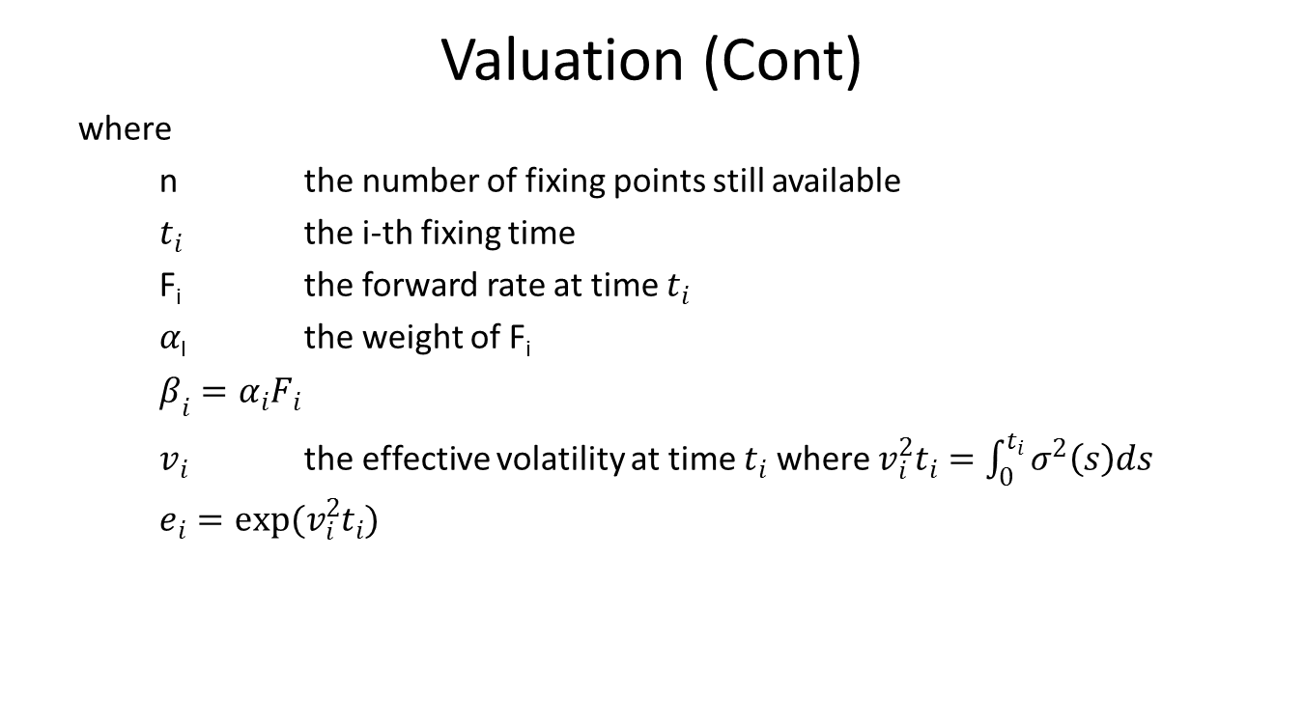
FX Asian
Valuation (Cont)
where
n the number of fixing points still available
$t_{i}$ the i-th fixing time
F_{i} the forward rate at time $t_{i}$
$α$_{I} the weight of F_{i}
$β_{i}=α_{i}F_{i}$
$v_{i}$ the effective volatility at time $t_{i}$ where $v_{i}^{2}t_{i}=\int_{0}^{t_{i}}{σ^{2}\left(s\right)ds}$
$e_{i}=exp(v_{i}^{2}t_{i})$

Slide 12
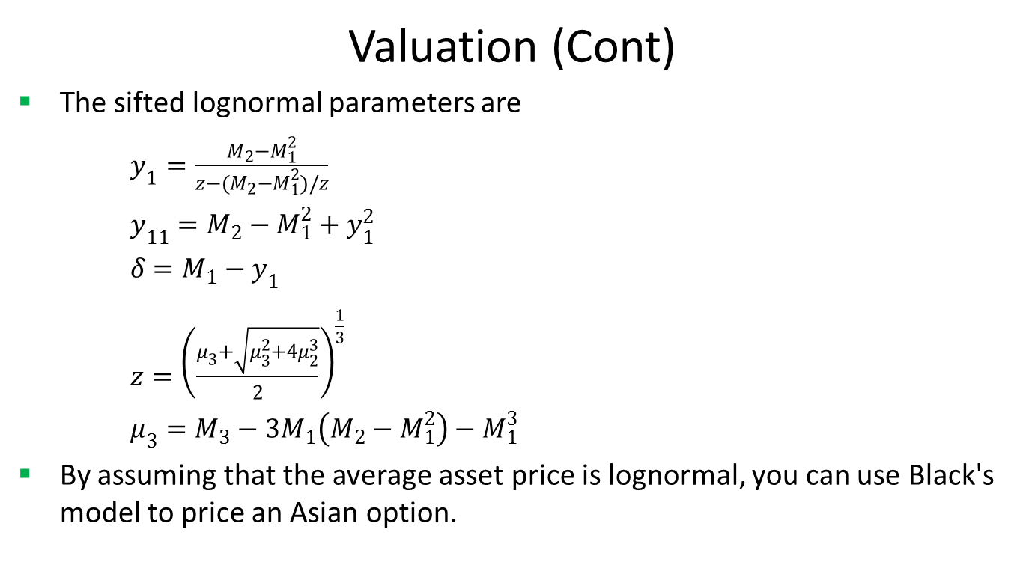
FX Asian
Valuation (Cont)
The sifted lognormal parameters are
$y_{1}=\frac{M_{2}−M_{1}^{2}}{z−(M_{2}−M_{1}^{2})/z}$
$y_{11}=M_{2}−M_{1}^{2}+y_{1}^{2}$
$δ=M_{1}−y_{1}$
$z={\left(\frac{μ_{3}+\sqrt{μ_{3}^{2}+4μ_{2}^{3}}}{2}\right)}^{\frac{1}{3}}$
$μ_{3}=M_{3}−3M_{1}\left(M_{2}−M_{1}^{2}\right)−M_{1}^{3}$
By assuming that the average asset price is lognormal, you can use Black's model to price an Asian option.

Slide 13
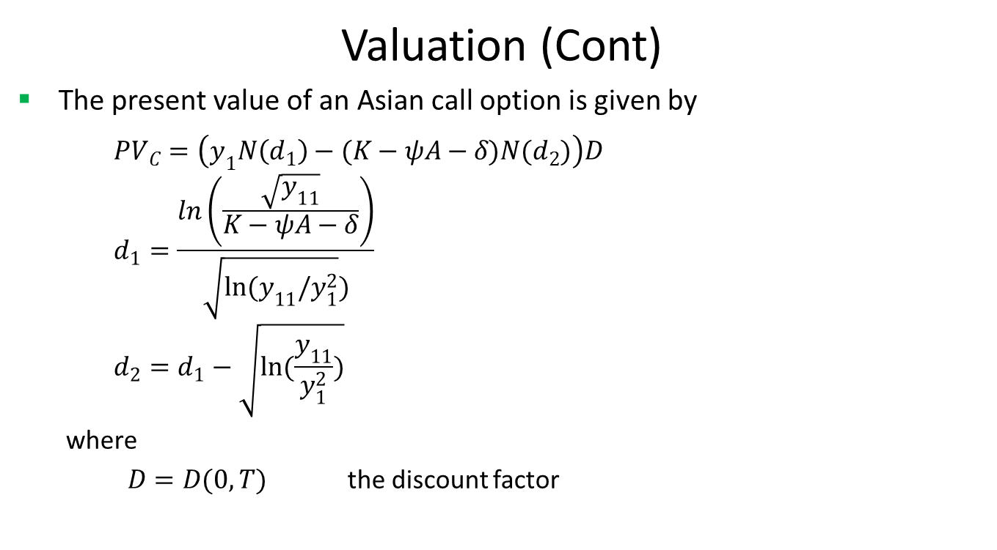
FX Asian
Valuation (Cont)
The present value of an Asian call option is given by
$${PV}_{C}=\left(y_{1}N\left(d_{1}\right)−(K−ψA−δ)N(d_{2})\right)D$$
$$d_{1}=\frac{ln\left(\frac{\sqrt{y_{11}}}{K−ψA−δ}\right)}{\sqrt{ln(y_{11}/y_{1}^{2}})}$$
$$d_{2}=d_{1}−\sqrt{ln(\frac{y_{11}}{y_{1}^{2}})}$$
where
$D=D(0,T)$ the discount factor

Slide 14
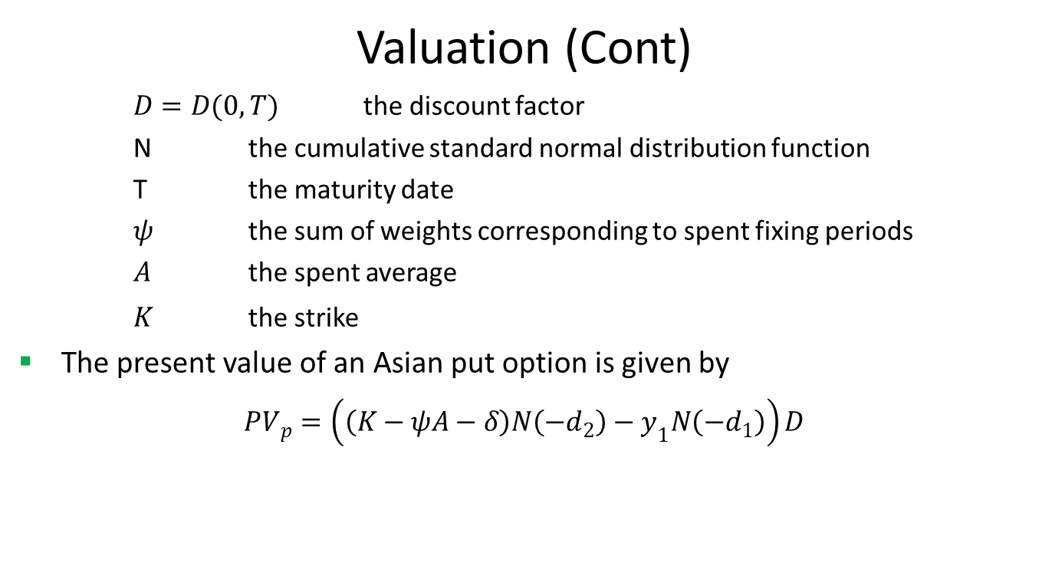
FX Asian
Valuation (Cont)
$D=D(0,T)$ the discount factor
N the cumulative standard normal distribution function
T the maturity date
$ψ$ the sum of weights corresponding to spent fixing periods
$A$ the spent average
$K$ the strike
The present value of an Asian put option is given by
$${PV}_{p}=\left(\left(K−ψA−δ\right)N\left({−d}_{2}\right)−y_{1}N\left(−d_{1}\right)\right)D$$

Slide 15
FX Asian
Practical Guide
First, you need to construct interest rate zero curves for both base and quote currencies.
The curve construction in FX world is different from the one in interest rate world.
Second, you need to construct an arbitrage-free volatility surface. FinPricing is using Vanna Volga model to construct FX volatility surface.
After that, you can use the formulas to calculate the price and risk sensitivities.

Slide 16
FX Asian
A Real World Example
Name | Value | Fixing Date | Fixing Value
Reporting Currency | USD | 1/6/2017 | 1.2283
Average Type | Rate | 1/13/2017 | 1.2219
Call Put | Put | 1/20/2017 | 1.236
Buy Sell | Sell | 1/27/2017 | 1.2554
Delivery Type | Cash | 2/3/2017 | 1.2481
Base Currency | GBP | 2/10/2017 | 1.2486
Base Currency Notional | 9300000 | 2/17/2017 | 1.24635
Underlying Currency | USD | 2/24/2017 | 1.24575
Underlying Currency Notional | 11490150 | 3/3/2017 | 1.2298
Trade Date | 1/5/2017
Maturity Date | 3/31/2017
Settlement Date | 4/4/2017
Strike and Spot Quotation | USD/GBP
Strike Value | 1.2355
Instrument | GBP/USD
Fixing Date | 3/3/2017

Slide 17
Thank You
You can find more details at
http://www.finpricing.com/lib/FxAsian.html

