Slide 1
Currency Forward or FX Forward Difinition and Pricing Guide
Michael Taylor
FinPricing

Slide 2
Currency Forward
A currency forward or FX forward contract is an agreement that allows the buyer to lock in an exchange rate the day on which the agreement is signed for a transaction that will be completed later. Forward contracts are one of the main methods used to hedge against exchange rate volatility, as they avoid the impact of currency fluctuation over the period covered by the contract.
The currency forward contracts are usually used by exporters and importers to hedge their foreign currency payments from exchange rate fluctuations. By using FX forward contracts, investors can protect costs on products and services purchased abroad and protect profit margins on products and services sold abroad by locking-in exchange rates as much as years in advance

Slide 3
Currency Forward
Summary
Currency Forward or FX Forward Introduction
The Use of Currency Forwards
Forex Market Convention
Forward FX Rate
Valuation
A Real World Example

Slide 4
Currency Forward
Currency Forward or FX Forward Introduction
A currency forward or FX forward is an agreement between two parties to exchange a certain amount of a currency for another currency at a fixed exchange rate on a fixed future date.
Currency forwards are over-the-counter (OTC) instruments. Unlike standardized FX future, a FX forward can be tailored to a particular amount and delivery period.
Currency forward settlement can either be on a cash or a delivery basis, provided that the option is mutually acceptable and has been specified beforehand in the contract.
Forward contracts are one of the main methods used to hedge against exchange rate volatility, as they avoid the impact of currency fluctuation over the period covered by the contract.

Slide 5
Currency Forward
The Use of Currency Forwards
Currency forwards are an effective hedging vehicle and also allow buyers to indicate the exact amount to be exchanged and the date on which to settle in the forward contract.
If an investor will receive a cashflow denominated in a foreign currency on some future date, that investor can lock in the current exchange rate by entering into an offsetting currency forward position that expires on the date of the cashflow.
Currency forwards can also be used to speculate and, by incurring a risk, attempt to profit from rising or falling exchange rates.
By using FX forward contracts, investors can protect costs on products and services purchased abroad or protect profit margins on products and services sold abroad lock-in exchange rates as much as years in advance

Slide 6
Currency Forward
The Use of Currency Forwards (Cont)
Currency forwards are over-the-counter (OTC) instruments.
The currency forward contracts are usually used by exporters and importers to hedge their foreign currency payments from exchange rate fluctuations.
A currency forward contract has credit risk. In the case that one of the parties is unable to fulfill its obligation, the other party will have to sign another contract with a third party, thus being exposed to market risk at that time.
By locking-in the exchange rates at which the currency will be bought, the party forfeits the opportunity of profiting from a favorable exchange rate movement.

Slide 7
Currency Forward
Forex Market Convention
One of the biggest sources of confusion for those new to the FX market is the market convention. We need to make clear the meaning of the following terms in the forex market first.
FX quotation: the quotation EUR/USD 1.25 means that one Euro is exchanged for 1.25 USD. Here EUR (nominator) is the base or primary currency and USD (denominator) is the quote currency. One can convert any amount of base currency to quote currency by
QuoteCurrencyAmount = FxRate * BaseCurrencyAmount

Slide 8
Currency Forward
Forex Market Convention (Cont)
Spot Days: The spot date or value date is the day the two parties actually exchange the two currencies. In other words, a currency pair requires a specification of the number of days between the quotation date (trade date) and the Spot Date on which the exchange is to take place at that quote. Spot days can be different for each currency pair, although typically it is two business days.
Holidays: Each currency pair has a set of holidays associated with it. The holidays of a currency pair is the union of the holidays of the two currencies.

Slide 9
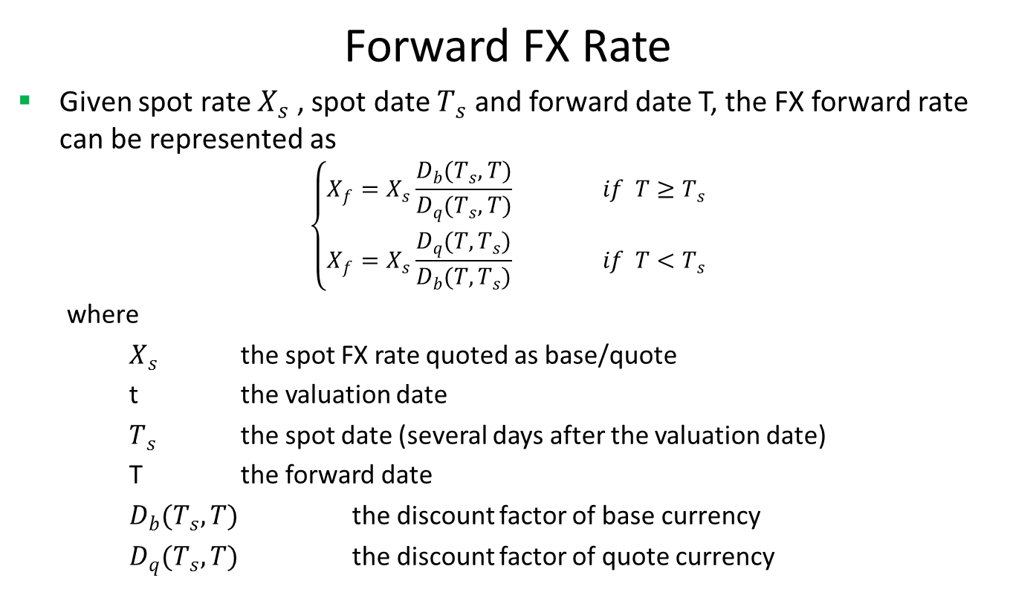
Currency Forward
Forward FX Rate
Given spot rate $X_{s}$ , spot date $T_{s}$ and forward date T, the FX forward rate can be represented as
$$\left\{\begin{matrix}X_{f}=X_{s}\frac{D_{b}(T_{s},T)}{D_{q}(T_{s},T)} if T≥T_{s} \\ X_{f}=X_{s}\frac{D_{q}(T,T_{s})}{D_{b}(T,T_{s})} if T<T_{s}\end{matrix}\right.$$
where
$X_{s}$ the spot FX rate quoted as base/quote
t the valuation date
$T_{s}$ the spot date (several days after the valuation date)
T the forward date
$D_{b}(T_{s},T)$ the discount factor of base currency
$D_{q}(T_{s},T)$ the discount factor of quote currency

Slide 10
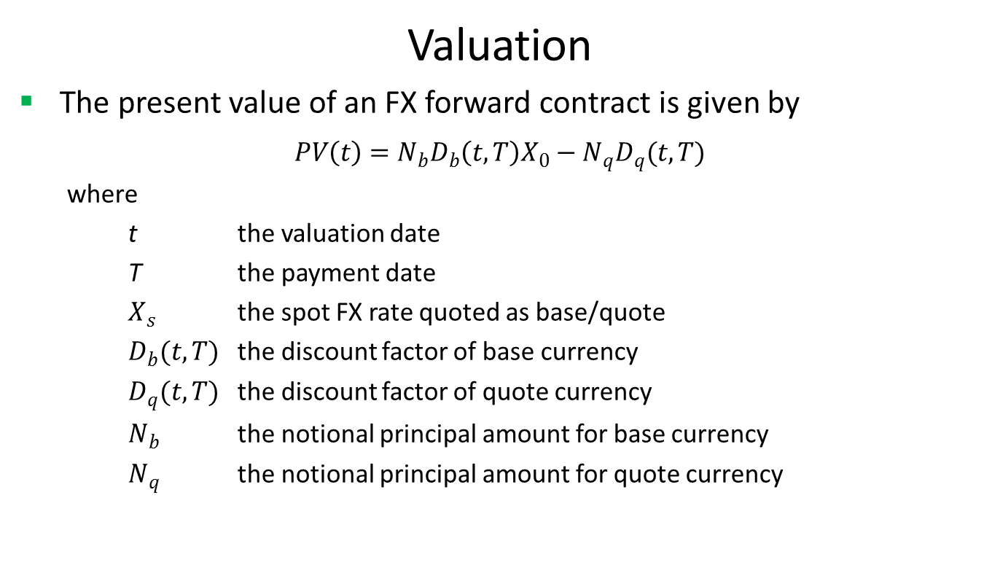
Currency Forward
Valuation
The present value of an FX forward contract is given by
$$PV\left(t\right)=N_{b}D_{b}\left(t,T\right)X_{0}−N_{q}D_{q}(t,T)$$
where
t the valuation date
T the payment date
$X_{s}$ the spot FX rate quoted as base/quote
$D_{b}(t,T)$ the discount factor of base currency
$D_{q}(t,T)$ the discount factor of quote currency
$N_{b}$ the notional principal amount for base currency
$N_{q}$ the notional principal amount for quote currency

Slide 11
Currency Forward
A Real World Example
Delivery Type | Delivery
Leg One Currency | USD
Leg One Notional | 120750
Leg Two Currency | CNY
Leg Two Notional | 826050.75
Net Price | 6.841
Buy Sell | Buy
Base Currency | USD
Underlying Currency | CNY
Quotation | USD/CNY
Trade Date | 10/25/2016
Maturity Date | 2/26/2018

Slide 12
Thank You
You can find more details at
http://www.finpricing.com/lib/FxForward.html

