Slide 1
Currency Option or FX Option Introduction and Pricing Guide
Michael Taylor
FinPricing

Slide 2
Currency Option
A currency option or FX option is a contract that gives the buyer the right, but not the obligation, to buy or sell a certain currency at a specified exchange rate on or before a specified date. Currency options are one of the most common ways for corporations, individuals or financial institutions to hedge against adverse movements in exchange rates.
Currency options are one of the most common ways for corporations, individuals or financial institutions to hedge against adverse movements in exchange rates. Corporations primarily use FX options to hedge uncertain future cash flows in a foreign currency. The general rule is to hedge certain foreign currency cash flows with forwards, and uncertain foreign cash flows with options.

Slide 3
Currency Option
Summary
Currency Option or FX Option Introduction
The Use of Currency Option
Forex Market Convention
Currency Option Payoffs
Valuation
Practical Guide
A Real World Example

Slide 4
Currency Option
Currency Option or FX Option Introduction
A currency option is a derivative contract that grants the buyer the right but not the obligation to exchange money denominated in one currency into another currency at a pre-agreed exchange rate on a specified future date.
The FX options market is the deepest, largest and most liquid market for options of any kind.
Most trading is over the counter (OTC) and is lightly regulated.
There are call options and put options. Also a currency option could be European style or American style.
Call options provide the holder the right but not the obligation to purchase an underlying currency at a specified FX rate on a future date.

Slide 5
Currency Option
Currency Option or FX Option Introduction (Cont)
Put options give the holder the right to sell an underlying currency at a specified FX rate on a future date.
A European option can be exercised only at the expiration date of the option.
An American option can be exercised anytime during its life.
FX options contain Vanilla FX option and Listed FX option. Although both have similar characteristics, they differ mainly in two respects: First, Vanilla options are traded OTC while Listed options are exchanged-traded. Secondly, the underlying of Vanilla options is FX spot while the one of Listed options is FX future. Nevertheless, their analytics are very similar.

Slide 6
Currency Option
The Use of Currency Options
Currency options are one of the most common ways for corporations, individuals or financial institutions to hedge against adverse movements in exchange rates.
Corporations primarily use FX options to hedge uncertain future cash flows in a foreign currency. The general rule is to hedge certain foreign currency cash flows with forwards, and uncertain foreign cash flows with options.
Options give market participants many opportunities to limit risk and increase profit.
Investors buy calls when they think the FX rate will rise or sell a call if they think it will fall. Selling an option is also referred to as ''writing'' an option.
Investors buy puts if they think the FX rate will fall, or sell one if they think it will rise.

Slide 7
Currency Option
The Use of Currency Options (Cont)
One of the most common reasons for using FX options is for short-term hedges of spot FX or foreign market positions. Unlike a forward contract that locks in the FX rate for a future transaction, FX options allow the investors to benefit from favorable FX rate movements.
Currency market fluctuations can have a lasting impact on cash flow whether it is buying a property, paying salaries, making an investment or settling invoices. By utilising FX Options, business can protect themselves against adverse movements in exchange rates.
FX Options are also useful tools which can be easily combined with Spot and Forward contracts to create bespoke hedging strategies.
There are many bullish, bearish and even neutral strategies that can be implemented with options contracts.

Slide 8
Currency Option
Forex Market Convention
One of the biggest sources of confusion for those new to the FX market is the market convention. We need to make clear the meaning of the following terms in the forex market first.
FX quotation: the quotation EUR/USD 1.25 means that one Euro is exchanged for 1.25 USD. Here EUR (nominator) is the base or primary currency and USD (denominator) is the quote currency. One can convert any amount of base currency to quote currency by
QuoteCurrencyAmount = FxRate * BaseCurrencyAmount

Slide 9
Currency Option
Forex Market Convention (Cont)
Spot Days: The spot date or value date is the day the two parties actually exchange the two currencies. In other words, a currency pair requires a specification of the number of days between the quotation date (trade date) and the Spot Date on which the exchange is to take place at that quote. Spot days can be different for each currency pair, although typically it is two business days.
Holidays: Each currency pair has a set of holidays associated with it. The holidays of a currency pair is the union of the holidays of the two currencies.

Slide 10
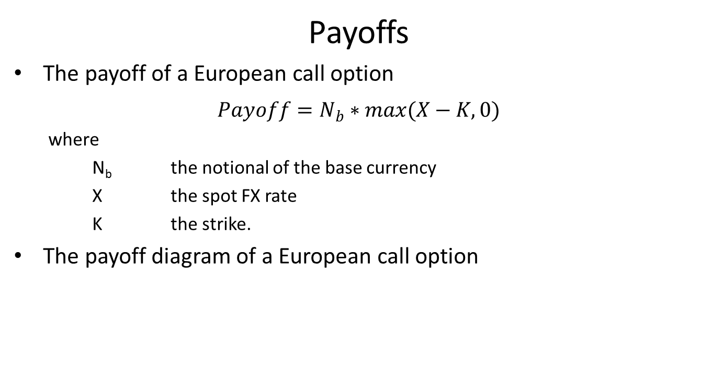
Currency Option
Payoffs
The payoff of a European call option
$$Payoff=N_{b}∗max(X−K,0)$$
where
N_{b} the notional of the base currency
X the spot FX rate
K the strike.
The payoff diagram of a European call option

Slide 11
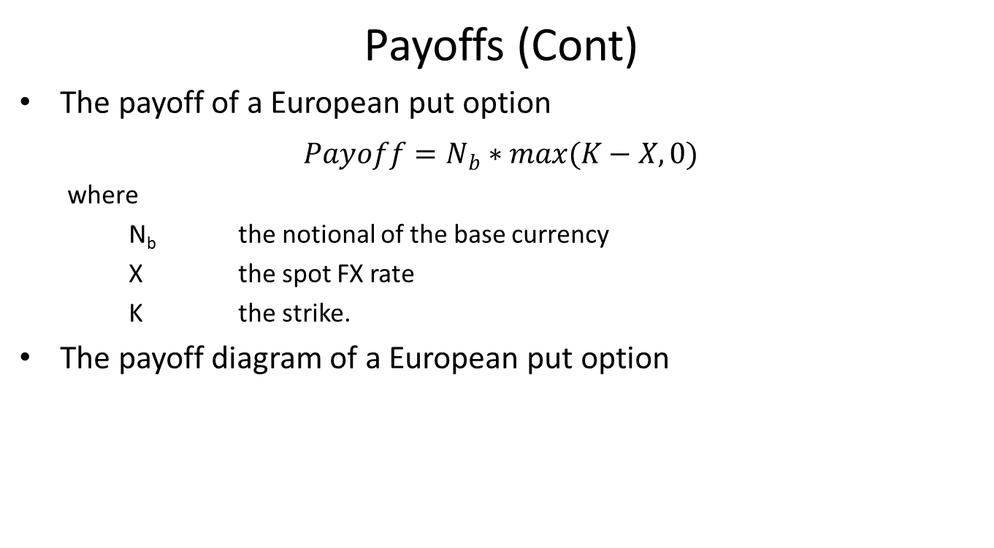
Currency Option
Payoffs (Cont)
The payoff of a European put option
$$Payoff=N_{b}∗max(K−X,0)$$
where
N_{b} the notional of the base currency
X the spot FX rate
K the strike.
The payoff diagram of a European put option

Slide 12
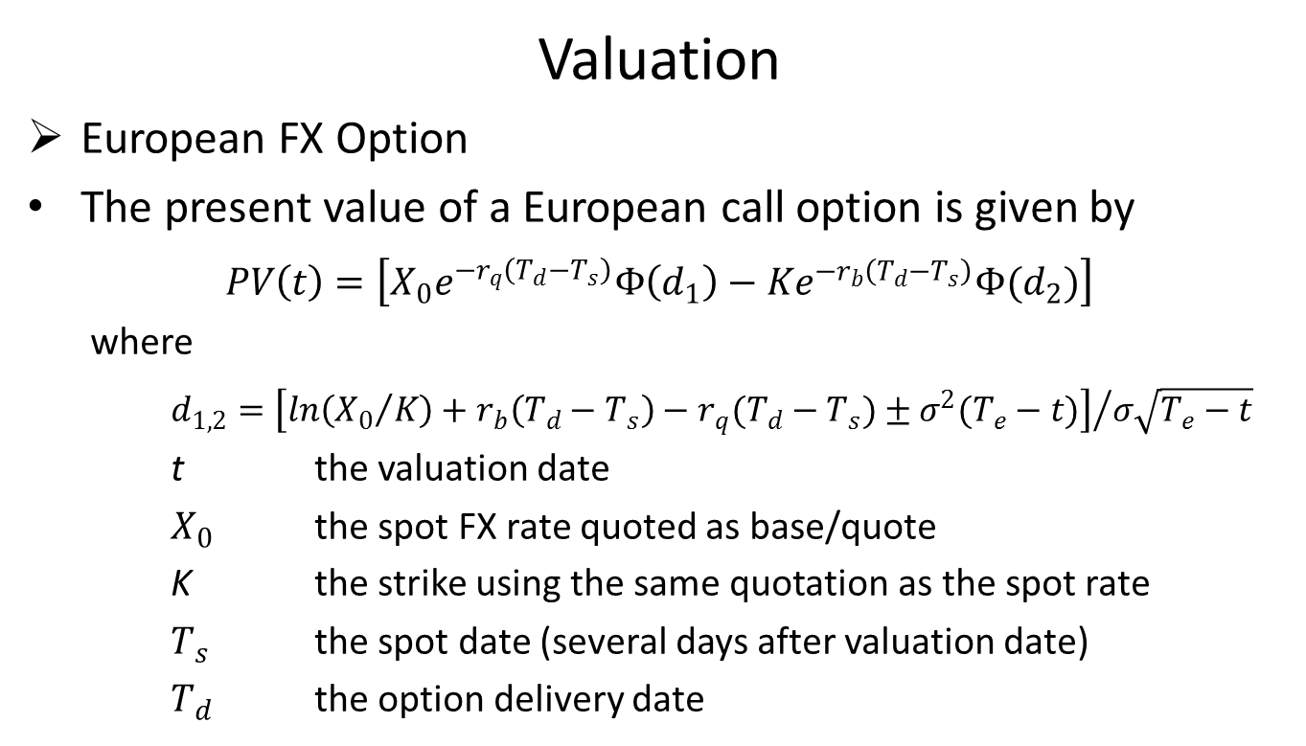
Currency Option
Valuation
European FX Option
The present value of a European call option is given by
$$PV\left(t\right)=\left[X_{0}e^{−r_{q}\left(T_{d}−T_{s}\right)}Φ\left(d_{1}\right)−Ke^{−r_{b}\left(T_{d}−T_{s}\right)}Φ(d_{2})\right]$$
where
$d_{1,2}={\left[ln\left({X_{0}}/K\right)+r_{b}\left(T_{d}−T_{s}\right)−r_{q}(T_{d}−T_{s})±σ^{2}(T_{e}−t)\right]}/{σ\sqrt{T_{e}−t}}$
t the valuation date
$X_{0}$ the spot FX rate quoted as base/quote
K the strike using the same quotation as the spot rate
$T_{s}$ the spot date (several days after valuation date)
$T_{d}$ the option delivery date

Slide 13
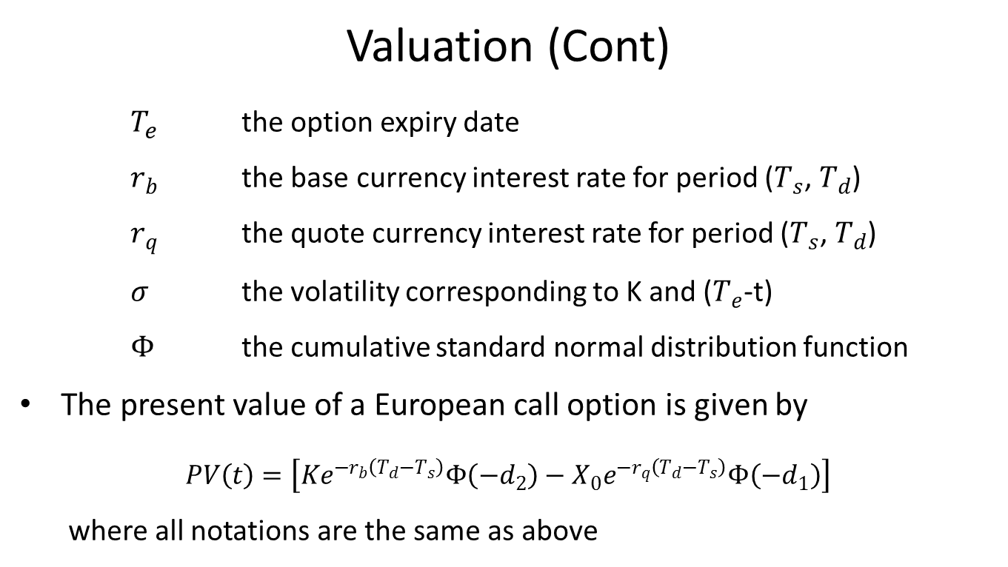
Currency Option
Valuation (Cont)
$T_{e}$ the option expiry date
$r_{b}$ the base currency interest rate for period ($T_{s}$, $T_{d}$)
$r_{q}$ the quote currency interest rate for period ($T_{s}$, $T_{d}$)
$σ$ the volatility corresponding to K and ($T_{e}$-t)
$Φ$ the cumulative standard normal distribution function
The present value of a European call option is given by
$$PV\left(t\right)=\left[Ke^{−r_{b}\left(T_{d}−T_{s}\right)}Φ\left(−d_{2}\right)−X_{0}e^{−r_{q}\left(T_{d}−T_{s}\right)}Φ\left(−d_{1}\right)\right]$$
where all notations are the same as above

Slide 14
Currency Option
Valuation (Cont)
American FX Option
FinPricing is using the Odd-Even Cox Ross Binomial model to compute prices and risk sensitivities for American-style FX OTC options.
The Odd-Even Binomial model is an extension of the Cox Ross Binomial model. Compared to Cox Ross Binomial model, the Odd-Even Binomial model provides better price accuracy. It was implemented by creating two tress, one with even number n of iterations and another with n+1 number of iterations, then taking the average of the two results. This method also helps to reduce the number of oscillations that can be observed with traditional Binomial models, where the option value depends quite heavily on the number of periods.

Slide 15
Currency Option
Practical Guide
Please note the time differences in the formulas above, which is an important factor in order to apply the Black formula to the FX market. Usually the delivery date is different from the expiry date.
First, you need to construct interest rate zero curves for both base and quote currencies.
The curve construction in FX world is different from the one in interest rate world.
Second, you need to construct an arbitrage-free volatility surface. FinPricing is using Vanna Volga model to construct FX volatility surface.
After that, you can use the formulas to calculate the price and risk sensitivities.

Slide 16
Currency Option
A Real World Example
Reporting Currency | USD
Base Currency | USD
Base Currency Notional | 1790000
Underlying Currency | JPY
Underlying Currency Notional | 200000000
Trade Date | 11/23/2016
Maturity Date | 6/9/2017
Settlement Date | 6/9/2017
Underlying Future Label | JUN 17
Call or Put | Put
Buy or Sell | Buy
Strike Quotation | USD/JPY
Strike Value | 0.895
Instrument | CME JPYUSD

Slide 17
Thank You
You can find more details at
http://www.finpricing.com/lib/FxOption.html

