Slide 1
Currency Swap or FX Swapd Difinition and Pricing Guide
Michael Taylor
FinPricing

Slide 2
Currency Swap
An FX swap or currency swap agreement is a contract in which both parties agree to exchange one currency for another currency at a spot FX rate. The agreement also stipulates to re-exchange the same amounts at a certain future date also at a forward FX rate. Many people confuse currency swaps with cross currency swaps. They are totally different. A cross currency swap is an interest rate swap in which two parties to exchange interest payments and principal on loans denominated in two different currencies.
The most common use of FX Swaps is for institutions to fund their foreign exchange balances. FX swaps are also used by importers and exporters, as well as institutional investors who wish to hedge their positions. They are also used to speculate and, by incurring a risk, attempt to profit from rising or falling exchange rates.

Slide 3
Currency Swap
Summary
Currency Swap or FX Swap Introduction
The Use of Currency Swaps
Forex Market Convention
Forward FX Rate
Valuation
A Real World Example

Slide 4
Currency Swap
Currency Swap or FX Swap Introduction
An FX swap agreement is a contract in which both parties agree to exchange one currency for another currency at a spot FX rate. The agreement also stipulates to re-exchange the same amounts at a certain future date also at a swap FX rate.
Many people confuse currency swaps with cross currency swaps. They are totally different. A cross currency swap is an interest rate swap in which two parties to exchange interest payments and principal on loans denominated in two different currencies..
In a currency swap, one party simultaneously borrows one currency and lends another currency to a second party. The repayment obligation is used as collateral and the amount of repayment is fixed at the FX forward rate.

Slide 5
Currency Swap
Currency Swap or FX Swap Introduction (cont)
FX swaps can be considered riskless collateralized borrowing/lending. The contract virtually allows you to utilize the funds you have in one currency to fund obligations denominated in a different currency, without incurring foreign exchange risk.
An FX swap is a simultaneous purchase and sale of identical amounts of one currency for another with two different value dates, normally spot to forward.
Therefore, an FX swap consists of two transactions: a spot transaction and a forward transaction.
Effectively the FX swap is two exchange contracts packed in one: a spot foreign exchange transaction, and a forward foreign exchange transaction

Slide 6
Currency Swap
The Use of Currency Swaps
A swap deal can be used if you have a currency, which you do not need before a certain time, but at the same time have a short-term need for another currency
Swap deals are used for managing currency risks, postponing the term of forward-deal and optimizing financing.
The most common use of FX Swaps is for institutions to fund their foreign exchange balances.
FX swaps are also used by importers and exporters, as well as institutional investors who wish to hedge their positions.
They are also used to speculate and, by incurring a risk, attempt to profit from rising or falling exchange rates.
Currency swaps are OTC trades and have credit risk.

Slide 7
Currency Swap
Forex Market Convention
One of the biggest sources of confusion for those new to the FX market is the market convention. We need to make clear the meaning of the following terms in the forex market first.
FX quotation: the quotation EUR/USD 1.25 means that one Euro is exchanged for 1.25 USD. Here EUR (nominator) is the base or primary currency and USD (denominator) is the quote currency. One can convert any amount of base currency to quote currency by
QuoteCurrencyAmount = FxRate * BaseCurrencyAmount

Slide 8
Currency Swap
Forex Market Convention (Cont)
Spot Days: The spot date or value date is the day the two parties actually exchange the two currencies. In other words, a currency pair requires a specification of the number of days between the quotation date (trade date) and the Spot Date on which the exchange is to take place at that quote. Spot days can be different for each currency pair, although typically it is two business days.
Holidays: Each currency pair has a set of holidays associated with it. The holidays of a currency pair is the union of the holidays of the two currencies.

Slide 9
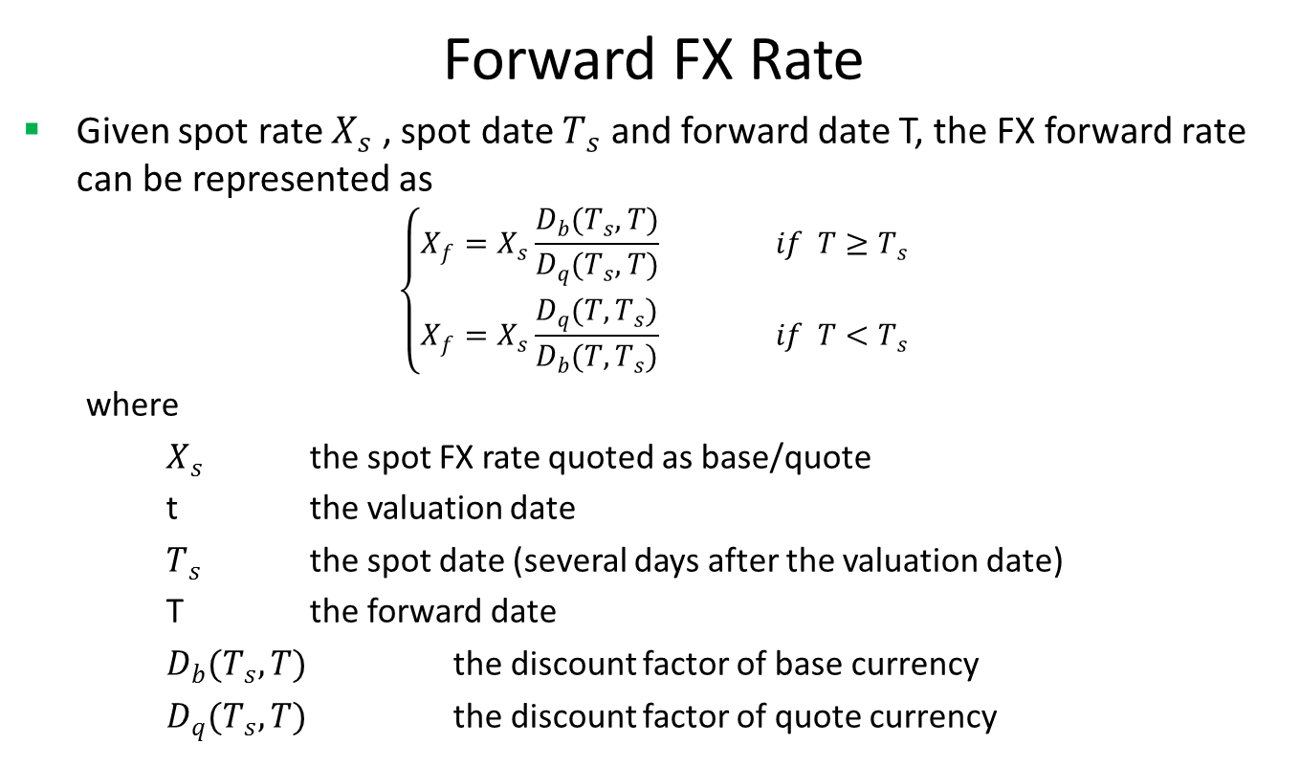
Currency Swap
Forward FX Rate
Given spot rate $X_{s}$ , spot date $T_{s}$ and forward date T, the FX forward rate can be represented as
$$\left\{\begin{matrix}X_{f}=X_{s}\frac{D_{b}(T_{s},T)}{D_{q}(T_{s},T)} if T≥T_{s} \\ X_{f}=X_{s}\frac{D_{q}(T,T_{s})}{D_{b}(T,T_{s})} if T<T_{s}\end{matrix}\right.$$
where
$X_{s}$ the spot FX rate quoted as base/quote
t the valuation date
$T_{s}$ the spot date (several days after the valuation date)
T the forward date
$D_{b}(T_{s},T)$ the discount factor of base currency
$D_{q}(T_{s},T)$ the discount factor of quote currency

Slide 10
Currency Swap
Valuation
An FX swap is a simultaneous purchase and sale of identical amounts of one currency for another with two different value dates, normally spot date and forward date.
Therefore, an FX swap has two legs – a spot transaction and a forward transaction.
In the spot leg, a particular quantity of a currency is bought or sold versus another currency at an agreed upon rate on the spot date.
In the forward leg, the same quantity of currency is then simultaneously sold or bought versus the other currency at a second agreed upon rate on the forward date.

Slide 11
Currency Swap
Valuation (Cont)
From valuation perspective, an FX swap can be viewed as a combination of two forward contracts.
In general, it has a long FX forward contract and a short one.
Typically, one leg of the outstanding contract would have already expired. Therefore, in many situations, an FX swap is equivalent to an FX forward contract.

Slide 12
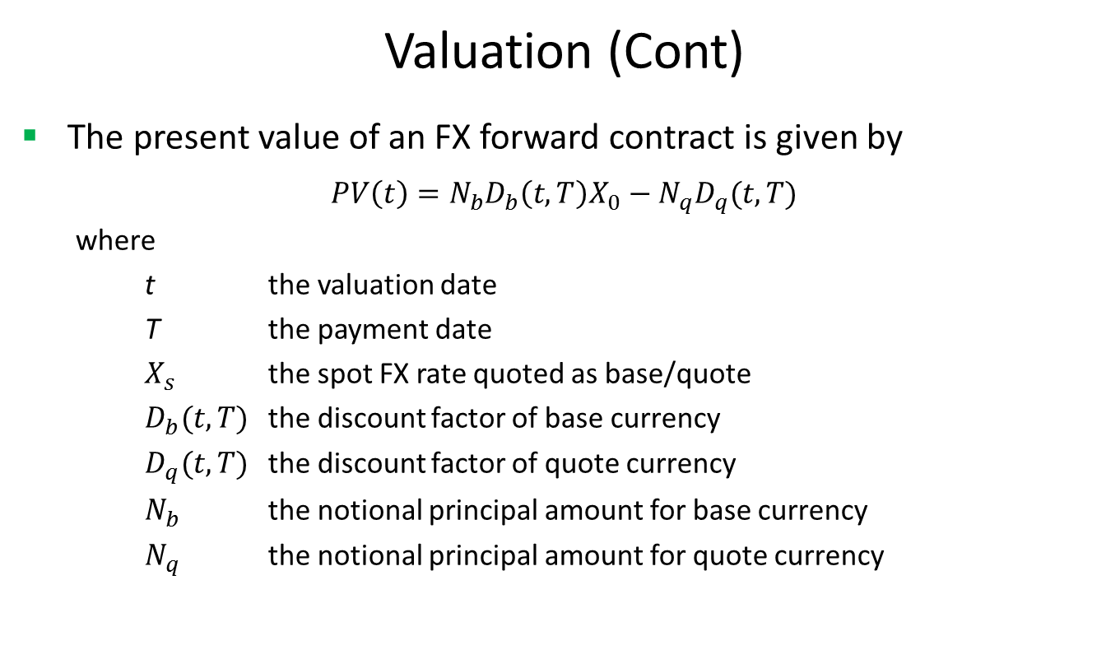
Currency Swap
Valuation (Cont)
The present value of an FX forward contract is given by
$$PV\left(t\right)=N_{b}D_{b}\left(t,T\right)X_{0}−N_{q}D_{q}(t,T)$$
where
t the valuation date
T the payment date
$X_{s}$ the spot FX rate quoted as base/quote
$D_{b}(t,T)$ the discount factor of base currency
$D_{q}(t,T)$ the discount factor of quote currency
$N_{b}$ the notional principal amount for base currency
$N_{q}$ the notional principal amount for quote currency

Slide 13
Currency Swap
A Real World Example
Delivery Type | Delivery
Leg One Currency | GBP
Leg One Notional | 10043000
Leg Two Currency | USD
Leg Two Notional | 12289368.03
Net Price | 1.223675
Buy Sell | Buy
Base Currency | GBP
Underlying Currency | USD
Instrument | GBP/USD
Spot Quotation Denominator | GBP
Spot Quotation Numerator | USD
Trade Date | 10/28/2016
Maturity Date | 11/1/2017
Settlement Date | 11/1/2017

Slide 14
Thank You
You can find more details at
http://www.finpricing.com/lib/FxSwap.html

