Slide 1
FX Touch Option Introduction and Pricing Guide
Michael Taylor
FinPricing

Slide 2
FX Touch
A touch option is the sort of option that promises a payout once the price of an underlying asset reaches or passes a predetermined level. Touch options allow investors to choose the target price, time to expiration, and the premium to be received when the target price is reached.
There are only two possible outcomes. If the barrier is broken a trader will receive the agreed full payout. If the barrier isn’t broken, the trader will lose the premium paid to the broker. Unlike vanilla calls and puts, touch options allow investors to profit from a simplified yes-or-no market forecast. Like regular call and put options, most touch option trades can be closed before expiration for a profit or a loss depending on how close the underlying market or asset is to the target price.

Slide 3
FX Touch
Summary
FX Touch Option Introduction
The Use of FX Touch Options
Forex Market Convention
FX Touch Option Payoffs
FX Touch Option Valuation
Practical Guide
A Real World Example

Slide 4
FX Touch
Touch Option Introduction
A touch option is the sort of option that promises a payout once the price of an underlying asset reaches or passes a predetermined level.
Touch options allow investors to choose the target price, time to expiration, and the premium when the target price is reached.
There are only two possible outcomes. If the barrier is broken a trader will receive the agreed full payout. If the barrier isn’t broken, the trader will lose the premium paid to the broker.
Unlike vanilla calls and puts, touch options allow investors to profit from a simplified yes-or-no market forecast.
Like regular call and put options, most touch option trades can be closed before expiration for a profit or a loss depending on how close the underlying market or asset is to the target price.

Slide 5
FX Touch
The Use of Touch Options
This type of option is popular with traders who believe the price of an underlying asset will pass a certain level in the future, and for those who aren’t sure whether the higher price level is a sustainable one.
Speculative market participants like to use touch options as bets on a rising or falling exchange rate.
Clients, who prefer to hedge, trade touch options as a rebate in order to secure themselves compensation in case their strategy doesn’t work out.
Touch options are also often integrated into structured products to increase returns on forward and interest rates

Slide 6
FX Touch
The Use of Touch Options (Cont)
They become especially useful during times of market volatility when prices might be uncertain.
An investor who chooses no touch option type is trading on the assumption that the price of their selected asset will fail to reach a specific level before the end of the expiry period.
The investor may trade touch options, if he believe that the price of their selected asset will reach a specific level before the end of the expiry period.

Slide 7
FX Touch
Forex Market Convention
One of the biggest sources of confusion for those new to the FX market is the market convention. We need to make clear the meaning of the following terms in the forex market first.
FX quotation: the quotation EUR/USD 1.25 means that one Euro is exchanged for 1.25 USD. Here EUR (nominator) is the base or primary currency and USD (denominator) is the quote currency. One can convert any amount of base currency to quote currency by
QuoteCurrencyAmount = FxRate * BaseCurrencyAmount

Slide 8
FX Touch
Forex Market Convention (Cont)
Spot Days: The spot date or value date is the day the two parties actually exchange the two currencies. In other words, a currency pair requires a specification of the number of days between the quotation date (trade date) and the Spot Date on which the exchange is to take place at that quote. Spot days can be different for each currency pair, although typically it is two business days.
Holidays: Each currency pair has a set of holidays associated with it. The holidays of a currency pair is the union of the holidays of the two currencies.

Slide 9
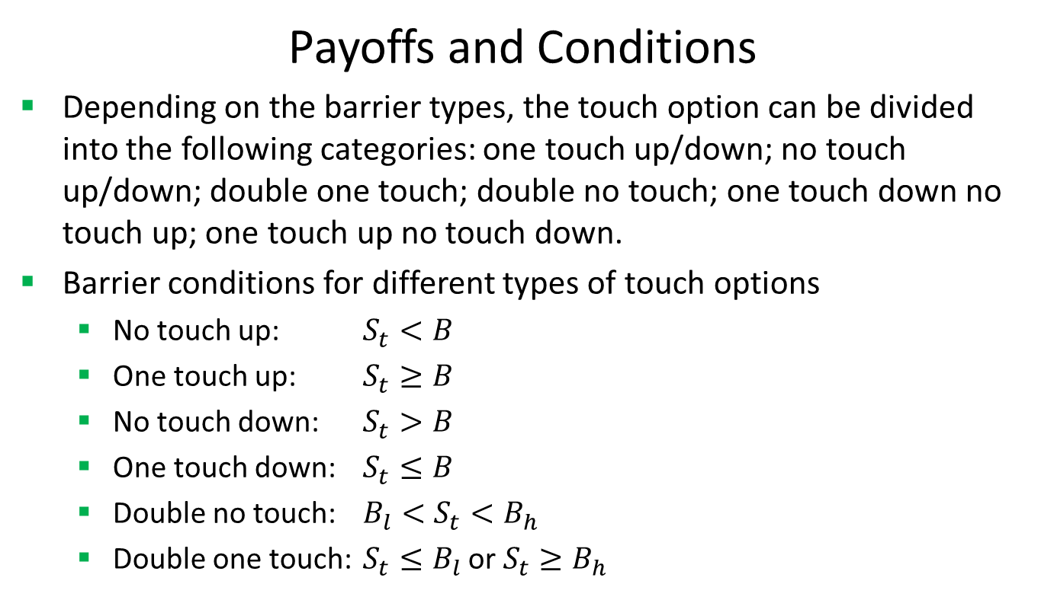
FX Touch
Payoffs and Conditions
Depending on the barrier types, the touch option can be divided into the following categories: one touch up/down; no touch up/down; double one touch; double no touch; one touch down no touch up; one touch up no touch down.
Barrier conditions for different types of touch options
No touch up: $S_{t}<B$
One touch up: $S_{t}≥B$
No touch down: $S_{t}>B$
One touch down: $S_{t}≤B$
Double no touch: ${B_{l}<S}_{t}<B_{h}$
Double one touch: $S_{t}≤B_{l}$ or $S_{t}≥B_{h}$

Slide 10
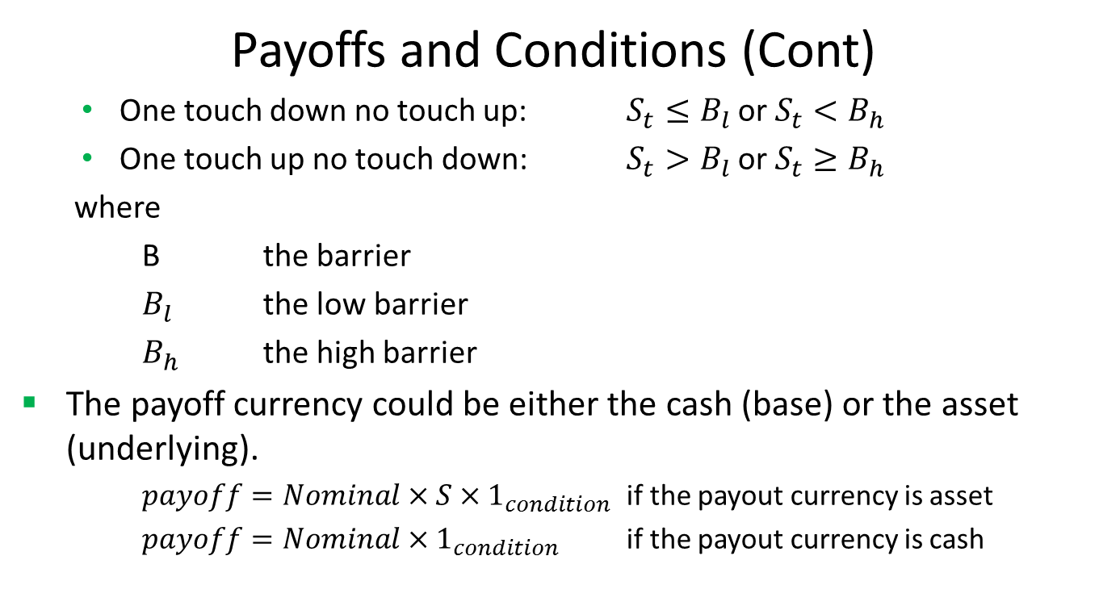
FX Touch
Payoffs and Conditions (Cont)
One touch down no touch up: $S_{t}≤B_{l}$ or $S_{t}<B_{h}$
One touch up no touch down: $S_{t}>B_{l}$ or $S_{t}≥B_{h}$
where
B the barrier
$B_{l}$ the low barrier
$B_{h}$ the high barrier
The payoff currency could be either the cash (base) or the asset (underlying).
$payoff=Nominal×S×1_{condition}$ if the payout currency is asset
$payoff=Nominal×1_{condition}$ if the payout currency is cash

Slide 11

FX Touch
Valuation
Touch and no touch options are a great way for you to further customize your trading experience. Because there are only two different outcomes that can possibly occur, these are still considered to be binary options.
The present value of a one touch option is given by

Slide 12
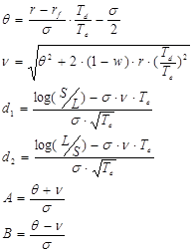
FX Touch
Valuation (Cont)

Slide 13
FX Touch
Valuation (Cont)
where
S the spot exchange rate
σ the annualized volatility of the underlying rate
r the domestic interest rate between spot date and delivery date
r_{f} the foreign interest rate between spot date and delivery date
T_{e} the expiry date
T_{d} the delivery date
ε 1 for a lower barrier, -1 for an upper barrier.
N(x) the standard normal cumulative distribution function
L the barrier level
R the domestic cash amount
w the rebate value

Slide 14
FX Touch
Practical Guide
Please note the time differences in the formulas above, which is an important factor in order to apply the formula to the FX market. Usually the delivery date is different from the expiry date.
First, you need to construct interest rate zero curves for both base and quote currencies.
The curve construction in FX world is different from the one in interest rate world.
Second, you need to construct an arbitrage-free volatility surface. FinPricing is using Vanna Volga model to construct FX volatility surface.
After that, you can use the formulas to calculate the price and risk sensitivities.

Slide 15
FX Touch
A Real World Example
Delivery Type | Delivery | Barrier Level High | 1.25
Buy Sell | Buy | Barrier Level Low | 0
Call Put | Put | Barrier Option Type | Single Down And In
Currency One | CAD | Barrier Payment Time | At Maturity
Notional One | 65000 | Rebate Amount | 0
Currency Two | USD | Barrier Window Start | 1/17/2018
Notional Two | 50000 | Barrier Window End | 1/17/2018
Strike Rate | 1.3 | Barrier Level High | 1.25
Base Currency | USD | Barrier Level Low | 0
Underlying Currency | CAD | Barrier Option Type | Single Down And In
Instrument | USD/CAD
Trade Date | 2/23/2017
Maturity Date | 1/17/2018
Settlement Date | 1/18/2018

Slide 16
Thank You
You can find more details at
http://www.finpricing.com/lib/FxTouch.html

