Slide 1

VaR Introduction II: Historical VaR Tom Mills FinPricing http://www.finpricing.com

Slide 2
Historical VaR
Summary
VaR Definition
VaR Roles
VaR Pros and Cons
VaR Approaches
Historical VaR
Historical VaR Methodology and Implementation
VaR Scaling
VaR Backtest
http://www.finpricing.com/lib/HistoricalVaR.pptx

Slide 3
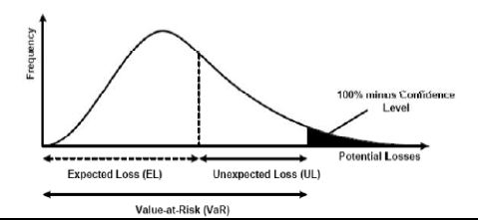
Historical VaR
Value at Risk (VaR) Definition
The maximum likely loss on a portfolio for a given probability defined as x% confidence level over N days
Pr(Loss > VaR(x%)) < 1- x%
http://www.finpricing.com/lib/HistoricalVaR.pptx

Slide 4
Historical VaR
VaR Roles
Risk measurement
Risk management
Risk control
Financial reporting
Regulatory and economic capital
http://www.finpricing.com/lib/HistoricalVaR.pptx

Slide 5
Historical VaR
VaR Pros & Cons
Pros
Regulatory measurement for market risk
Objective assessment
Intuition and clear interpretation
Consistent and flexible measurement
Cons
Doesn’t measure risk beyond the confidence level: tail risk
Non sub-additive
http://www.finpricing.com/lib/HistoricalVaR.pptx

Slide 6
Historical VaR
Three VaR Approaches
Parametric VaR
Historical VaR
Monte Carlo VaR
The presentation focuses on historical VaR.
http://www.finpricing.com/lib/HistoricalVaR.pptx

Slide 7
Historical VaR
Historical VaR
Assumption
The past is a good indicator of the near-future or history repeats itself
Pros
Simple and intuitive
Easy back and stress test
No distribution assumption
No calibration
Cons
Poor accuracy for higher confidence level and tail risk
Difficult for long horizons
Limited scenario
http://www.finpricing.com/lib/HistoricalVaR.pptx

Slide 8
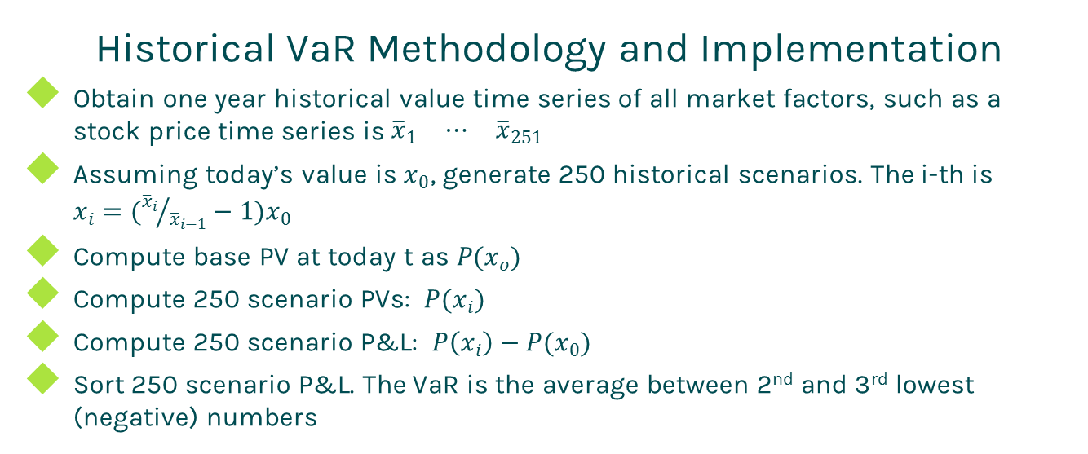
Historical VaR
Historical VaR Methodology and Implementation
Obtain one year historical value time series of all market factors, such as a stock price time series is $\begin{matrix}{\overline{x}}_{1} & ⋯ & {\overline{x}}_{251}\end{matrix}$
Assuming today’s value is $x_{0}$, generate 250 historical scenarios. The i-th is $x_{i}=({{\overline{x}}_{i}}/{{\overline{x}}_{i−1}}−1)x_{0}$
Compute base PV at today t as $P(x_{o})$
Compute 250 scenario PVs: $P(x_{i})$
Compute 250 scenario P&L: $P\left(x_{i}\right)−P(x_{0})$
Sort 250 scenario P&L. The VaR is the average between 2nd and 3rd lowest (negative) numbers
http://www.finpricing.com/lib/HistoricalVaR.pptx

Slide 9
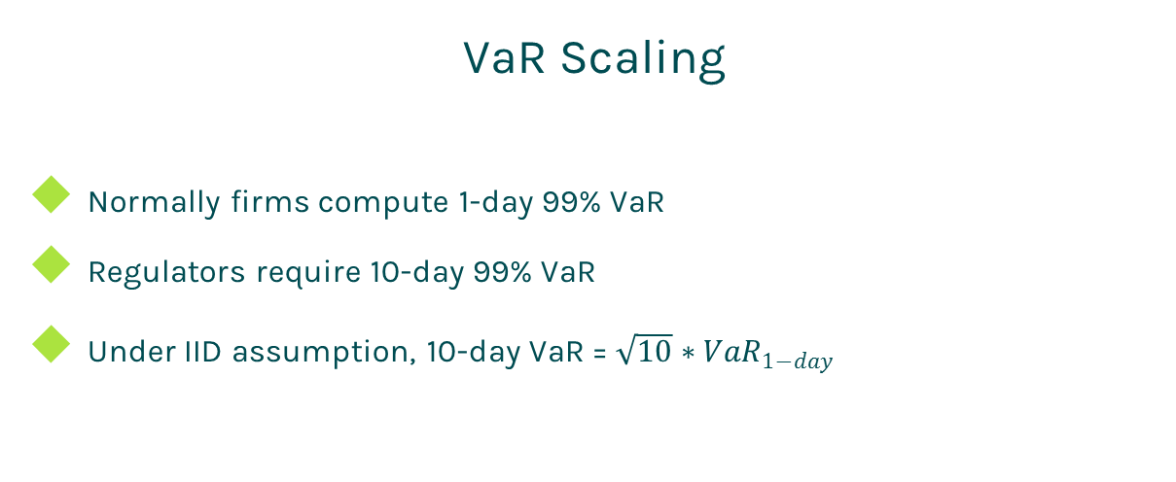
Historical VaR
VaR Scaling
Normally firms compute 1-day 99% VaR
Regulators require 10-day 99% VaR
Under IID assumption, 10-day VaR = $\sqrt{10}∗{VaR}_{1−day}$
http://www.finpricing.com/lib/HistoricalVaR.pptx

Slide 10
Historical VaR
VaR Backtest
The only way to verify a VaR system is to backtest
At a certain day, compute hypothetic P&L. If (hypothetic P&L > VaR) ➔ breach, otherwise, ok
Hypothetic P&L is computed by holding valuation date and portfolio unchanged
In one year period,
If number of breaches is 0-4, the VaR system is in Green zone
If number of breaches is 5-9, the VaR system is in Yellow zone
If number of breaches is 10 or more, the VaR system is in Red zone
http://www.finpricing.com/lib/HistoricalVaR.pptx

Slide 11
Thanks!
You can find more online presentations at
http://www.finpricing.com/paperList.html

