Slide 1

Amortizing and Accreting Caps and Floors Vaulation Alan White FinPricing

Slide 2
Amortizing Cap/Floor
Summary
Interest Rate Amortizing and Accreting Cap and Floor Introduction
The Use of Amortizing or Accreting Caps and Floors
Caplet and Floorlet Payoffs
Valuation
Practical Notes
A real world example

Slide 3
Amortizing Cap/Floor
Amortizing /Accreting Caps and Floors Introduction
An interest rate cap is a financial contract between two parties that provides an interest rate ceiling or cap on the floating rate payments.
An interest rate cap actually consists of a series of European call options (caplets) on interest rates.
An amortizing cap is an interest rate cap whose notional principal amount declines during the life of the contract.
An accreting cap is an interest rate cap whose notional principal amount increases during the life of the contract.

Slide 4
Amortizing Cap/Floor
Amortizing /Accreting Caps and Floors Introduction (Cont)
An interest rate floor is a financial contract between two parties that provides an interest rate “floor” on the floating rate payments.
An interest rate floor consists of a series of European put options (floorlets) on interest rates.
An amortizing floor is an interest rate floor whose notional principal amount declines during the life of the contract.
An accreting floor is an interest rate floor whose notional principal amount increases during the life of the contract.

Slide 5
Amortizing Cap/Floor
The Use of Amortizing /Accreting Caps and Floors
Amortizing caps and floors are primarily used to hedge loans whose principal declines on a scheduled basis.
An accreting cap or floor is primarily used to hedge construction loans whose principal increases on a scheduled basis to meet the expanding working capital requirements.
Amortizing caps are frequently purchased by issuers of floating rate debt where the loan principal declines during the life.
Accreting caps are frequently purchased by issuers of floating rate debt where the loan principal increases during the life.

Slide 6
Amortizing Cap/Floor
The Use of Amortizing /Accreting Caps and Floors
Amortizing floors are frequently purchased by purchasers of floating rate debt where the loan principal declines during the life.
Amortizing floors are frequently purchased by purchasers of floating rate debt where the loan principal increases during the life.
The amortizing/accreting cap holders wish to protect themselves from the increased financing costs that would result from fluctuation in interest rates.
The amortizing/accreting floor holders wish to protect themselves from the loss of income that would result from a decrease in interest rates.

Slide 7

Amortizing Cap/Floor
Caplet Payoff
The payoff of a caplet
$$Payoff=N∗τ∗max(R−K,0)$$
where N – notional; R – realized interest rate; K – strike; $τ$ – day count fraction.
Payoff diagram

Slide 8

Amortizing Cap/Floor
Floorlet Payoff
The payoff of a floorlet is given by
$$Payoff=N∗τ∗max(K−R,0)$$
where N – notional; R – realized interest rate; K – strike; $τ$ – day count fraction.
Payoff diagram

Slide 9
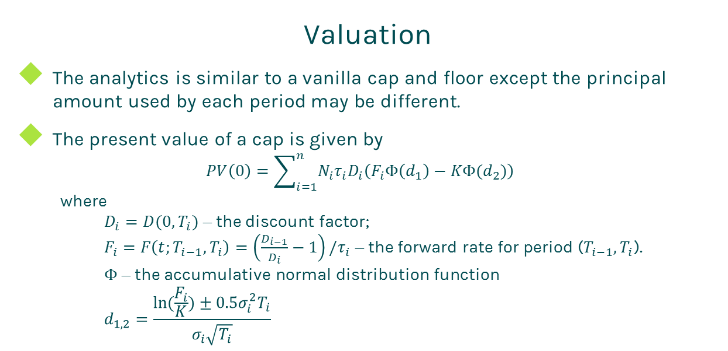
Amortizing Cap
Valuation
The analytics is similar to a vanilla cap and floor except the principal amount used by each period may be different.
The present value of a cap is given by
$$PV\left(0\right)=\sum_{i=1}^{n}{N_{i}τ_{i}D_{i}\left(F_{i}Φ\left(d_{1}\right)−KΦ(d_{2})\right)}$$
where
$D_{i}=D(0,T_{i})$ – the discount factor;
$F_{i}=F\left(t;T_{i−1},T_{i}\right)=\left(\frac{D_{i−1}}{D_{i}}−1\right)/τ_{i}$ – the forward rate for period ($T_{i−1},T_{i}$).
$Φ$ – the accumulative normal distribution function
$$d_{1,2}=\frac{ln⁡(\frac{F_{i}}{K})±0.5σ_{i}^{2}T_{i}}{σ_{i}\sqrt{T_{i}}}$$

Slide 10
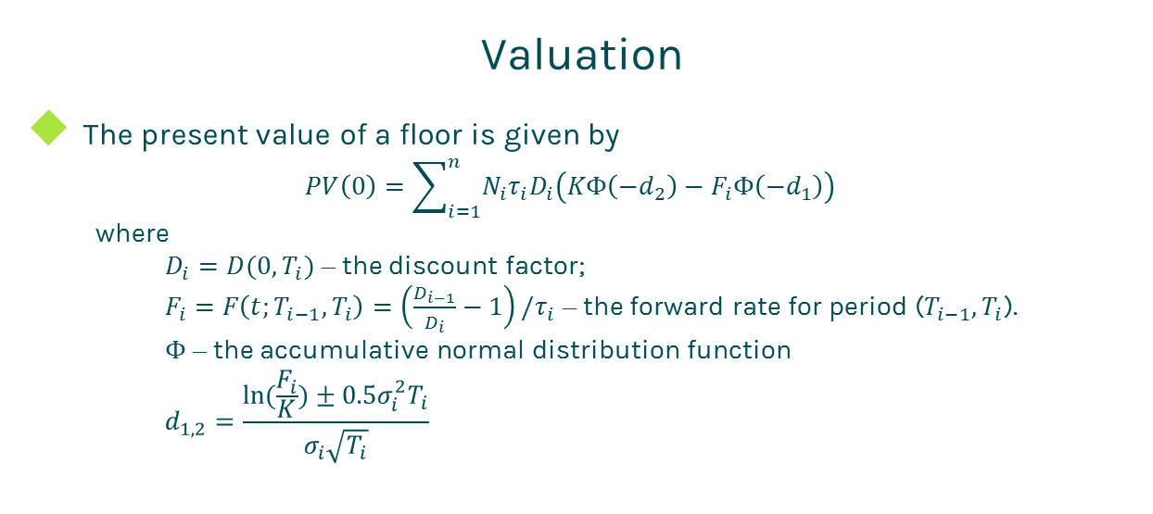
Amortizing Cap/Floor
Valuation
The present value of a floor is given by
$$PV\left(0\right)=\sum_{i=1}^{n}{N_{i}τ_{i}D_{i}\left(KΦ\left({−d}_{2}\right)−F_{i}Φ\left({−d}_{1}\right)\right)}$$
where
$D_{i}=D(0,T_{i})$ – the discount factor;
$F_{i}=F\left(t;T_{i−1},T_{i}\right)=\left(\frac{D_{i−1}}{D_{i}}−1\right)/τ_{i}$ – the forward rate for period ($T_{i−1},T_{i}$).
$Φ$ – the accumulative normal distribution function
$$d_{1,2}=\frac{ln⁡(\frac{F_{i}}{K})±0.5σ_{i}^{2}T_{i}}{σ_{i}\sqrt{T_{i}}}$$

Slide 11
Amortizing Cap/Floor
Practical Notes
Amortizing and accreting caps are valued via the Black model in the market.
The forward rate is simply compounded.
The first key to value a cap is to generate the cash flows. The cash flow generation is based on the start time, end time and payment frequency, plus calendar (holidays), business convention (e.g., modified following, following, etc.) and whether sticky month end.
Then you need to construct interest zero rate curve by bootstrapping the most liquid interest rate instruments in the market. The most common used yield curve is continuously compounded.

Slide 12
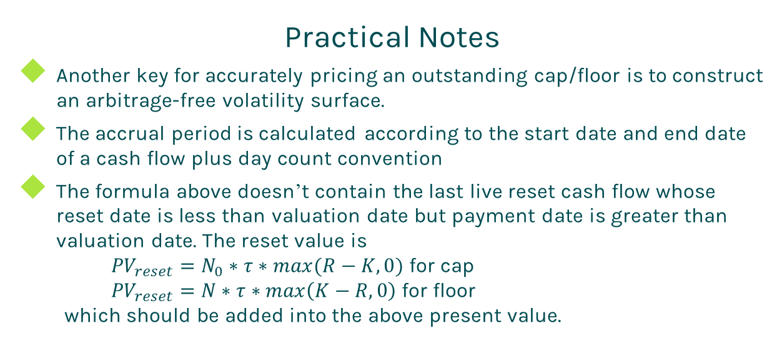
Amortizing Cap/Floor
Practical Notes
Another key for accurately pricing an outstanding cap/floor is to construct an arbitrage-free volatility surface.
The accrual period is calculated according to the start date and end date of a cash flow plus day count convention
The formula above doesn’t contain the last live reset cash flow whose reset date is less than valuation date but payment date is greater than valuation date. The reset value is
${PV}_{reset}=N_{0}∗τ∗max(R−K,0)$ for cap
${PV}_{reset}=N∗τ∗max\left(K−R,0\right)$ for floor
which should be added into the above present value.

Slide 13
Amortizing Cap/Floor
A Real World Example
Cap Terms and Conditions |  | Notional Schedule
Buy Sell | Sell | 9000000 | 2/6/2015
Cap or Floor | Cap | 8785714.29 | 3/31/2015
Strike | 0.025 | 8464285.72 | 6/30/2015
Trade Date | 2/6/2015 | 8142857.15 | 9/30/2015
Start Date | 2/6/2015 | 7821428.58 | 12/31/2015
Maturity Date | 2/4/2019 | 7500000.01 | 3/31/2016
Currency | USD | 7178571.44 | 6/30/2016
Day Count | dcAct360 | 6857142.87 | 9/30/2016
Rate type | Float | 6535714.3 | 12/30/2016
Notional | 9000000 | 6214285.73 | 3/31/2017
Pay Receive | Pay | 5892857.16 | 6/30/2017
Payment Frequency | 1M | 5571428.59 | 9/29/2017
Index Tenor | 1M | 5250000.02 | 12/29/2017
Index Type | LIBOR | 4928571.45 | 3/30/2018

Slide 14
Thanks!
You can find more details at
http://www.finpricing.com/lib/IrAmortizingCap.html

