Slide 1

Amortizing and Accreting Swap Vaulation Pratical Guide Alan White FinPricing http://www.finpricing.com

Slide 2
Amortizing Swap
Summary
Interest Rate Amortizing or Accreting Swap Introduction
The Use of Amortizing or Accreting Swap
Valuation
Practical Notes
A real world example

Slide 3
Amortizing Swap
Amortizing or Accreting Swap Introduction
An amortizing swap is an interest rate swap whose notional principal amount declines during the life of the contract
An accreting swap is an interest rate swap whose notional principal amount increases instead.
The notional amount changes could be one leg or two legs, but typically on a fixed schedule.
The notional principal is tied to an underlying financial instrument with a declining principal, such as a mortgage or an increasing principal, such as a construction fund.

Slide 4
Amortizing Swap
The Use of Amortizing or Accreting Swap
The notional principal of an amortizing swap is tied to an underlying financial instrument with a declining principal, such as a mortgage.
On the other hand, the notional amount of an accreting swap is tied to an underlying instrument with an increasing principal, such as a construction fund.
The notional principal schedule of an amortizing or an accreting swap may decrease or increase at the same rate as the underlying instrument.
Both amortizing and accreting swaps can be used to reduce or increase exposure to fluctuations in interest rates.

Slide 5
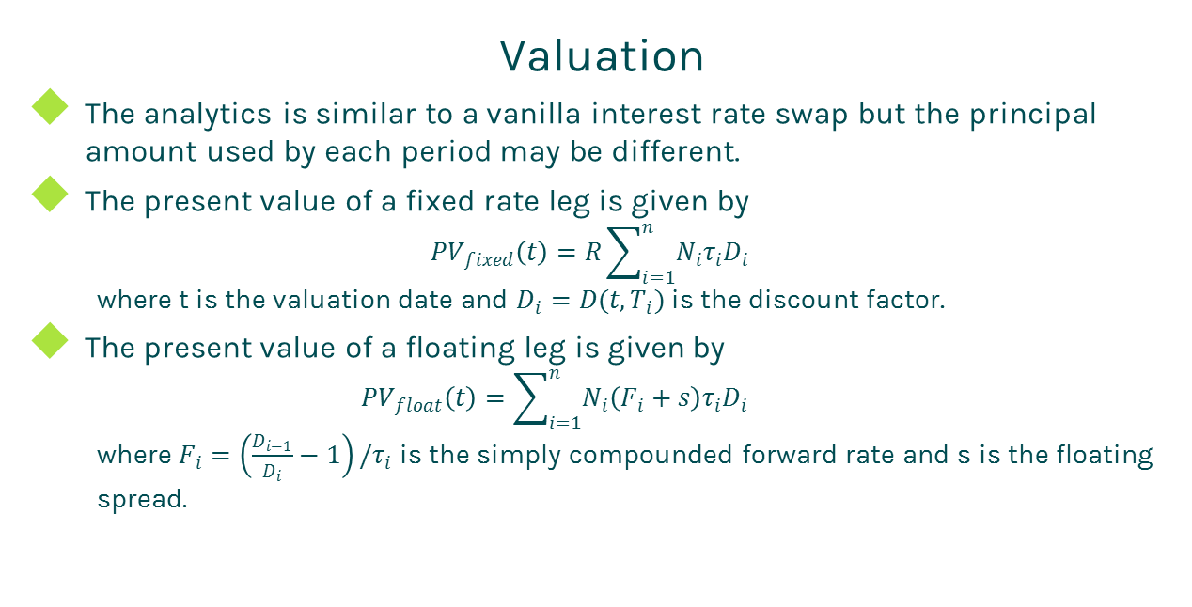
Amortizing Swap
Valuation
The analytics is similar to a vanilla interest rate swap but the principal amount used by each period may be different.
The present value of a fixed rate leg is given by
$${PV}_{fixed}\left(t\right)=R\sum_{i=1}^{n}{N_{i}τ_{i}D_{i}}$$
where t is the valuation date and $D_{i}=D(t,T_{i})$ is the discount factor.
The present value of a floating leg is given by
$${PV}_{float}\left(t\right)=\sum_{i=1}^{n}{N_{i}\left(F_{i}+s\right)τ_{i}D_{i}}$$
where $F_{i}=\left(\frac{D_{i−1}}{D_{i}}−1\right)/τ_{i}$ is the simply compounded forward rate and s is the floating spread.

Slide 6
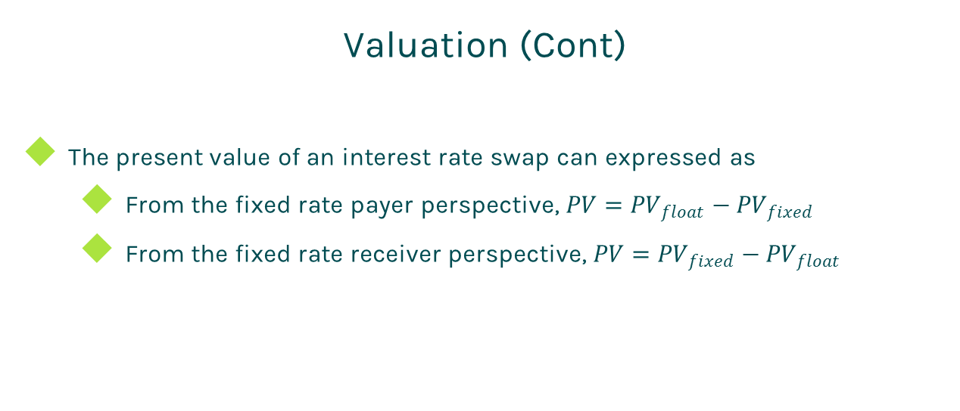
Amortizing Swap
Valuation (Cont)
The present value of an interest rate swap can expressed as
From the fixed rate payer perspective, $PV={PV}_{float}−{PV}_{fixed}$
From the fixed rate receiver perspective, $PV={PV}_{fixed}−{PV}_{float}$

Slide 7
Amortizing Swap
Practical Notes
First of all, you need to generate accurate cash flows for each leg. The cash flow generation is based on the start time, end time and payment frequency of the leg, plus calendar (holidays), business convention (e.g., modified following, following, etc.) and whether sticky month end.
We assume that accrual periods are the same as reset periods and payment dates are the same as accrual end dates in the above formulas for brevity. But in fact, they are different due to different market conventions. For example, index periods can overlap each other but swap cash flows are not allowed to overlap.
The accrual period is calculated according to the start date and end date of a cash flow plus day count convention

Slide 8
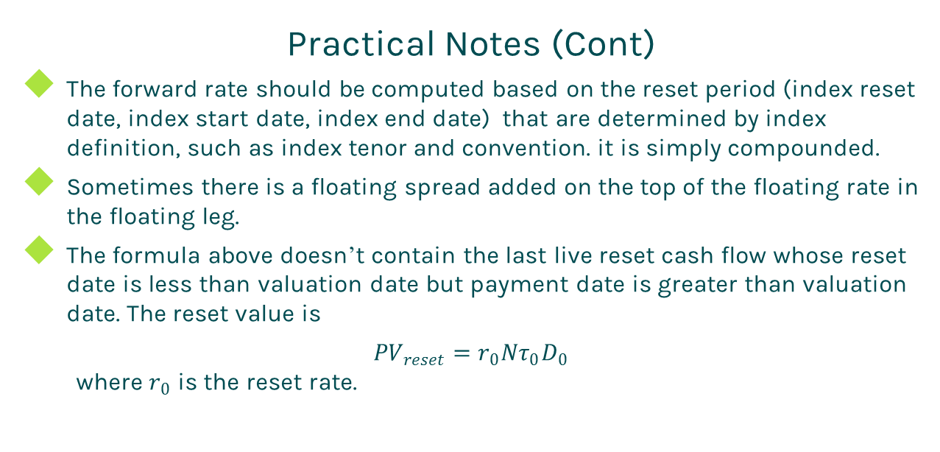
Amortizing Swap
Practical Notes (Cont)
The forward rate should be computed based on the reset period (index reset date, index start date, index end date) that are determined by index definition, such as index tenor and convention. it is simply compounded.
Sometimes there is a floating spread added on the top of the floating rate in the floating leg.
The formula above doesn’t contain the last live reset cash flow whose reset date is less than valuation date but payment date is greater than valuation date. The reset value is
${PV}_{reset}=r_{0}Nτ_{0}D_{0}$
where $r_{0}$ is the reset rate.

Slide 9
Amortizing Swap
Practical Notes (Cont)
The present value of the reset cash flow should be added into the present value of the floating leg.
Some dealers take bid-offer spreads into account. In this case, one should use the bid curve constructed from bid quotes for forwarding and the offer curve built from offer quotes for discounting.

Slide 10
Amortizing Swap
A Real World Example
Fixed Leg Specification |  | Floating Leg Specification |  | Notional Schedule
Currency | USD | Currency | USD | 6100520 | 9/1/2015
Day Count | dcAct360 | Day Count | dcAct360 | 6075492 | 10/1/2015
Leg Type | Fixed | Leg Type | Float | 6050464 | 11/1/2015
Notional | 6100520 | Notional | 6100520 | 6024284 | 12/1/2015
Pay Receive | Receive | Pay Receive | Pay | 5998104 | 1/1/2016
Payment Frequency | 1M | Payment Frequency | 1M | 5971924 | 2/1/2016
Start Date | 9/1/2015 | Start Date | 9/1/2015 | 5945744 | 3/1/2016
End Date | 4/3/2023 | End Date | 4/3/2023 | 5919564 | 4/1/2016
Fixed Rate | 0.0245 | Spread | 0 | 5893384 | 5/1/2016
 |  | Index Specification |  | 5867204 | 6/1/2016
 |  | Index Type | LIBOR | 5841024 | 7/1/2016
 |  | Index Tenor | 1M | 5814844 | 8/1/2016
 |  | Index DayCount | dcAct360 | 5788664 | 9/1/2016

Slide 11
Thanks!
You can find more details at
http://www.finpricing.com/lib/IrAmortizingSwap.html

