Slide 1
Interest Rate Basis Curve Construction and Bootstrapping Guide
Michael Taylor
FinPricing

Slide 2
Basis Curve
The term structure of an interest rate basis curve is defined as the relationship between the basis zero rate and it’s maturity. Basis curves are used as the forecast curves for pricing interest rate products. The increase in basis spreads has resulted in large impacts on non-standard instruments.
The basis curve construction methodology is based on the most liquid market instruments. Normally a basis curve is divided into two parts. The short end of the term structure is determined using LIBOR rates and the remaining is derived using basis swaps.

Slide 3
Basis Curve
Summary
Basis Curve Introduction
Basis Curve Construction and Bootstrapping Overview
Interpolation
Optimization

Slide 4
Yield Curve
Basis Curve Introduction
The term structure of an interest rate basis curve is defined as the relationship between the basis zero rate and it’s maturity.
Basis curves are used as the forecast curves for pricing interest rate products.
Typical basis curves are 1-month LIBOR, 6-month LIBOR or 12-month LIBOR, FedFund and Prime Rate curves.
The 3 month LIBOR curve is usually referred to as the base curve in the market.
The increase in basis spreads has resulted in large impacts on non-standard instruments.

Slide 5
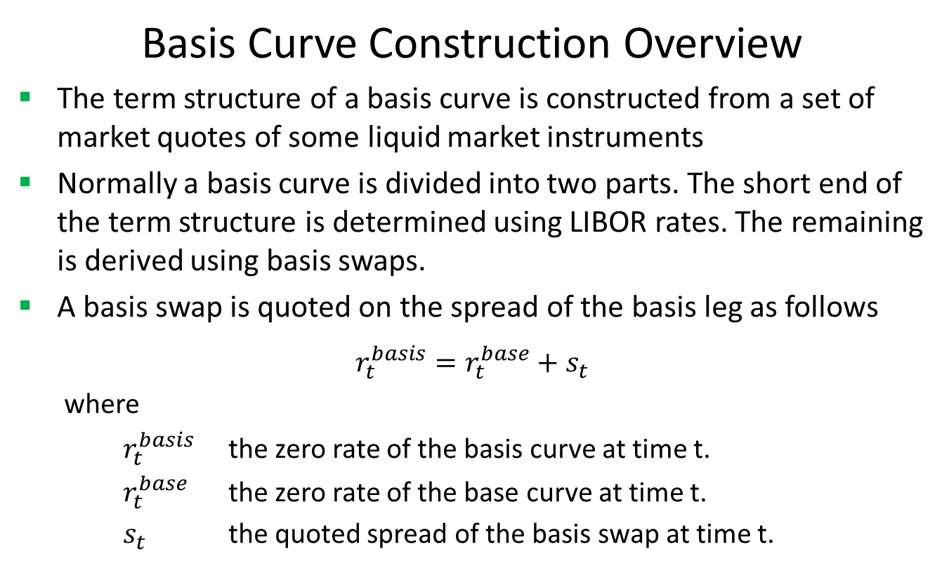
Basis Curve
Basis Curve Construction Overview
The term structure of a basis curve is constructed from a set of market quotes of some liquid market instruments
Normally a basis curve is divided into two parts. The short end of the term structure is determined using LIBOR rates. The remaining is derived using basis swaps.
A basis swap is quoted on the spread of the basis leg as follows
$$r_{t}^{basis}=r_{t}^{base}+s_{t}$$
where
$r_{t}^{basis}$ the zero rate of the basis curve at time t.
$r_{t}^{base}$ the zero rate of the base curve at time t.
$s_{t}$ the quoted spread of the basis swap at time t.

Slide 6
Basis Curve
Basis Curve Construction Overview (Cont)
The objective of the bootstrap algorithm is to find the zero yield or discount factor for each maturity point and cash flow date sequentially so that all basis curve instruments can be priced back to the market quotes.
All bootstrapping methods build up the term structure from shorter maturities to longer ones.
The basis swap valuation model can be found at http://www.finpricing.com/lib/IrSwap.html
First you need to construct the base curve as guided at http://www.finpricing.com/lib/IrCurve.html

Slide 7
Basis Curve
Basis Curve Construction Overview (Cont)
Assuming that we have had all the yields of a 6-month LIBOR curve up to 4 years and now need to derive up to 5 years.
Let x be the yield at 5 years.
Use an interpolation methd to get yields at 4.5 years as Ax
Given the 5 year market basis swap spread, we can use a root-finding algorithm to solve the x that makes the value of the 5 year inception basis swap equal to zero.
Now we get all yields or equivalent discount factors up to 5 years
Repeat the above procedure till the longest basis swap maturity.
There are two keys in yield curve construction: interpolation and optimization for root finding.

Slide 8
Basis Curve
Interpolation
Most popular interpolation algorithms in curve bootstrapping are linear, log-linear and cubic spline.
The selected interpolation rule can be applied to either zero rates or discount factors.
Some critics argue that some of these simple interpolations cannot generate smooth forward rates and the others may be able to produce smooth forward rates but fail to match the market quotes.
Also they cannot guarantee the continuity and positivity of forward rates.

Slide 9
Basis Curve
Interpolation (Cont)
The monotone convex interpolation is more rigorous. It meets the following essential criteria:
Replicate the quotes of all input underlying instruments.
Guarantee the positivity of the implied forward rates
Produce smooth forward curves.
Although the monotone convex interpolation rule sounds almost perfectly, it is not very popular with practitioners.

Slide 10
Basis Curve
Optimization
As described above, the bootstrapping process needs to solve a yield using a root finding algorithm.
In other words, it needs an optimization solution to match the prices of curve-generated instruments to their market quotes.
FinPricing employs the Levenberg-Marquardt algorithm for root finding, which is very common in curve construction.
Another popular algorithm is the Excel Solver, especially in Excel application.

Slide 11
Thank You
You can find more details at
http://www.finpricing.com/lib/IrBasisCurve.html

