Slide 1

Basis Swap Vaulation Pratical Guide Alan White FinPricing http://www.finpricing.com

Slide 2
Basis Swap
Summary
Interest Rate Basis Swap Introduction
The Use of Interest Rate Basis Swap
Basis Swap or Basis Swaplet Payoff
Valuation
Practical Notes
A real world example

Slide 3
Basis Swap
Interest Rate Basis Swap Introduction
A basis swaps is an interest rate swap that involves the exchange of two floating rates, where the floating rate payments are referenced to different bases.
Both legs of a basis swap are floating but derived from different index rates (e.g. LIBOR 1-month vs 3-month).
Basis swaps are settled in the form of periodic floating interest rate payments.
Basis swaps are quoted as a spread over a reference index. For example, 3-month LIBOR is frequently used as a reference. Spreads are quoted over it.

Slide 4
Basis Swap
The Use of Interest Rate Basis Swap
A basis swap can be used to limit interest rate risk that a firm faces as a result of having different lending and borrowing rates.
Basis swaps help investors to mitigate basis risk that is a type of risk associated with imperfect hedging.
Firms also utilize basis swaps to hedge the divergence of different rates.
Basis swaps could involve many different kinds of reference rates for the floating payments, such as 3-month LIBOR, 1-month LIBOR, 6-month LIBOR, prime rate, etc.
There is an active market for basis swaps.

Slide 5
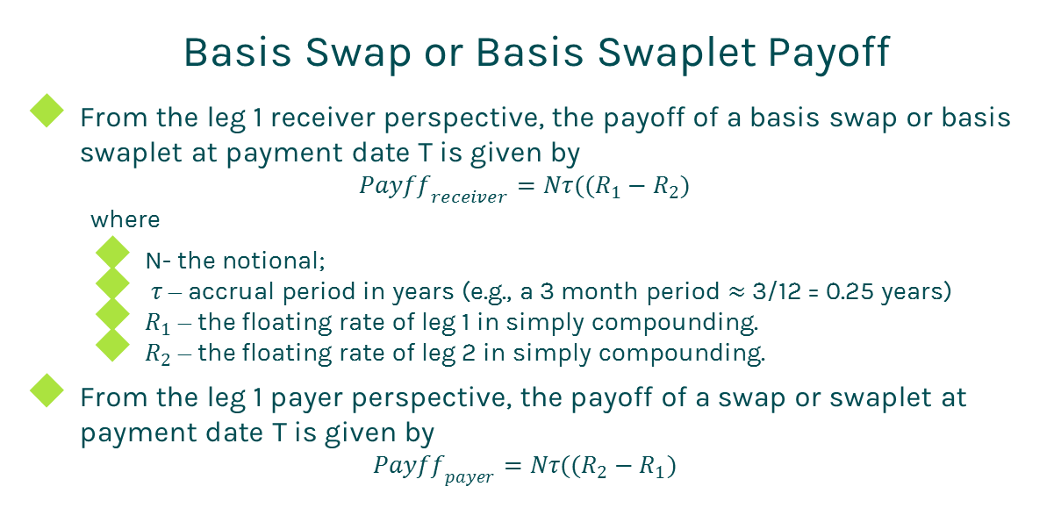
Basis Swap
Basis Swap or Basis Swaplet Payoff
From the leg 1 receiver perspective, the payoff of a basis swap or basis swaplet at payment date T is given by
$${Payff}_{receiver}=Nτ((R_{1}−R_{2})$$
where
N- the notional;
$τ$ – accrual period in years (e.g., a 3 month period $≈$ 3/12 = 0.25 years)
$R_{1}$ – the floating rate of leg 1 in simply compounding.
$R_{2}$ – the floating rate of leg 2 in simply compounding.
From the leg 1 payer perspective, the payoff of a swap or swaplet at payment date T is given by
$${Payff}_{payer}=Nτ((R_{2}−R_{1})$$

Slide 6
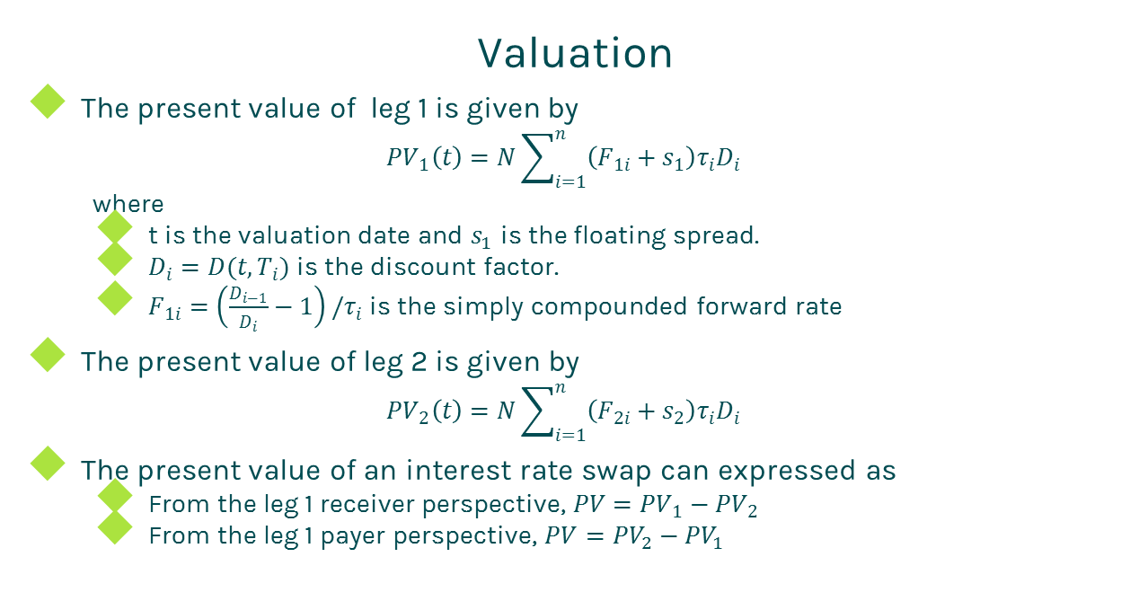
Basis Swap
Valuation
The present value of leg 1 is given by
$${PV}_{1}\left(t\right)=N\sum_{i=1}^{n}{\left(F_{1i}+s_{1}\right)τ_{i}D_{i}}$$
where
t is the valuation date and $s_{1}$ is the floating spread.
$D_{i}=D(t,T_{i})$ is the discount factor.
$F_{1i}=\left(\frac{D_{i−1}}{D_{i}}−1\right)/τ_{i}$ is the simply compounded forward rate
The present value of leg 2 is given by
$${PV}_{2}\left(t\right)=N\sum_{i=1}^{n}{\left(F_{2i}+s_{2}\right)τ_{i}D_{i}}$$
The present value of an interest rate swap can expressed as
From the leg 1 receiver perspective, $PV={PV}_{1}−{PV}_{2}$
From the leg 1 payer perspective, $PV={PV}_{2}−{PV}_{1}$

Slide 7
Basis Swap
Practical Notes
First of all, you need to generate accurate cash flows for each leg. The cash flow generation is based on the start time, end time and payment frequency of the leg, plus calendar (holidays), business convention (e.g., modified following, following, etc.) and whether sticky month end.
We assume that accrual periods are the same as reset periods and payment dates are the same as accrual end dates in the above formulas for brevity. But in fact, they are different due to different market conventions. For example, index periods can overlap each other but swap cash flows are not allowed to overlap.
The accrual period is calculated according to the start date and end date of a cash flow plus day count convention

Slide 8
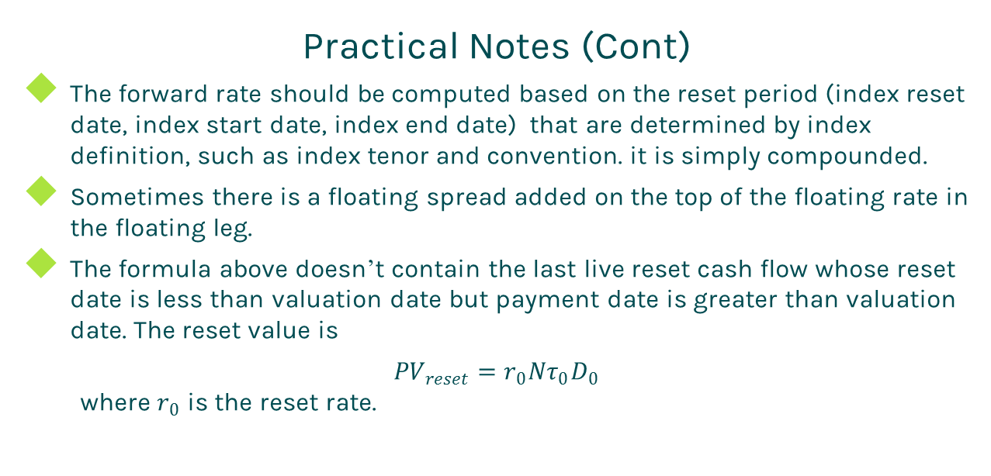
Basis Swap
Practical Notes (Cont)
The forward rate should be computed based on the reset period (index reset date, index start date, index end date) that are determined by index definition, such as index tenor and convention. it is simply compounded.
Sometimes there is a floating spread added on the top of the floating rate in the floating leg.
The formula above doesn’t contain the last live reset cash flow whose reset date is less than valuation date but payment date is greater than valuation date. The reset value is
${PV}_{reset}=r_{0}Nτ_{0}D_{0}$
where $r_{0}$ is the reset rate.

Slide 9
Basis Swap
Practical Notes (Cont)
The present value of the reset cash flow should be added into the present value of the floating leg.
Some dealers take bid-offer spreads into account. In this case, one should use the bid curve constructed from bid quotes for forwarding and the offer curve built from offer quotes for discounting.

Slide 10
Basis Swap
A Real World Example
Leg 1 Specification |  | Leg 2 Specification
Currency | USD | Currency | USD
Day Count | dcAct360 | Day Count | dcAct360
Leg Type | Float | Leg Type | Float
Notional | 10000000 | Notional | 10000000
Pay Receive | Receive | Pay Receive | Pay
Payment Frequency | 6M | Payment Frequency | 6M
Start Date | 7/16/2015 | Start Date | 7/16/2015
End Date | 7/16/2020 | End Date | 7/16/2020
Spread | 0.0020625 | Spread | 0
Index Specification |  | Index Specification
Index Type | LIBOR | Index Type | LIBOR
Index Tenor | 3M | Index Tenor | 6M
Index Day Count | dcAct360 | Index Day Count | dcAct360

Slide 11
Thanks!
You can find more details at
http://www.finpricing.com/lib/IrBasisSwap.html

