Slide 1

Interest Rate Cancelable Swap Valuation and Risk Dmitry Popov FinPricing http://www.finpricing.com

Slide 2
Cancelable Swap
Summary
Cancelable Swap Definition
Bermudan Swaption Payoffs
Valuation Model Selection Criteria
LGM Model
LGM Assumption
LGM calibration
Valuation Implementation
A real world example

Slide 3
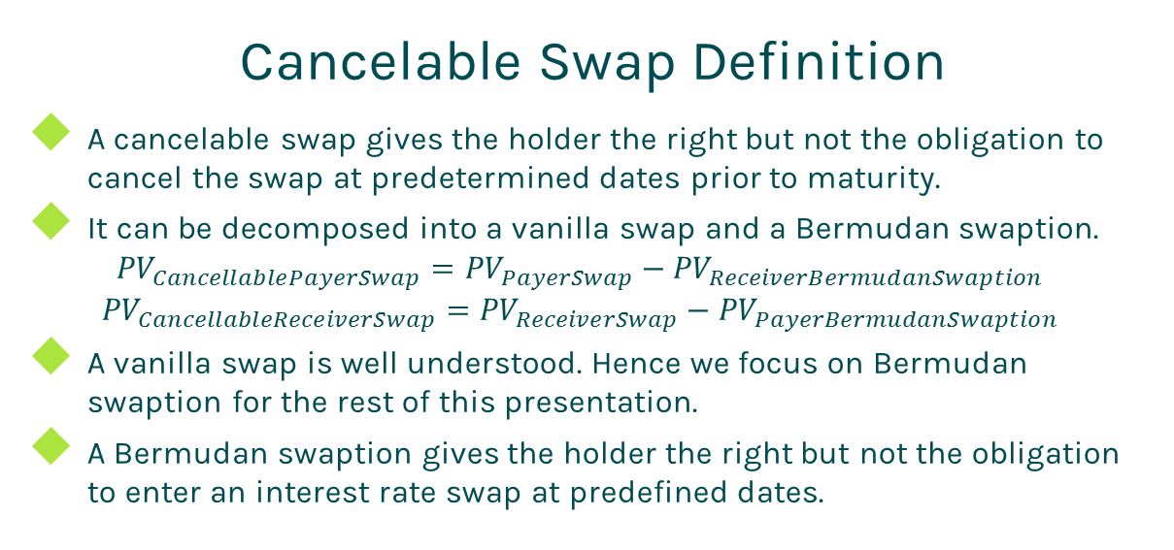
Cancelable Swap
Cancelable Swap Definition
A cancelable swap gives the holder the right but not the obligation to cancel the swap at predetermined dates prior to maturity.
It can be decomposed into a vanilla swap and a Bermudan swaption.
$${PV}_{CancellablePayerSwap}={PV}_{PayerSwap}−{PV}_{ReceiverBermudanSwaption}$$
$${PV}_{CancellableReceiverSwap}={PV}_{ReceiverSwap}−{PV}_{PayerBermudanSwaption}$$
A vanilla swap is well understood. Hence we focus on Bermudan swaption for the rest of this presentation.
A Bermudan swaption gives the holder the right but not the obligation to enter an interest rate swap at predefined dates.

Slide 4
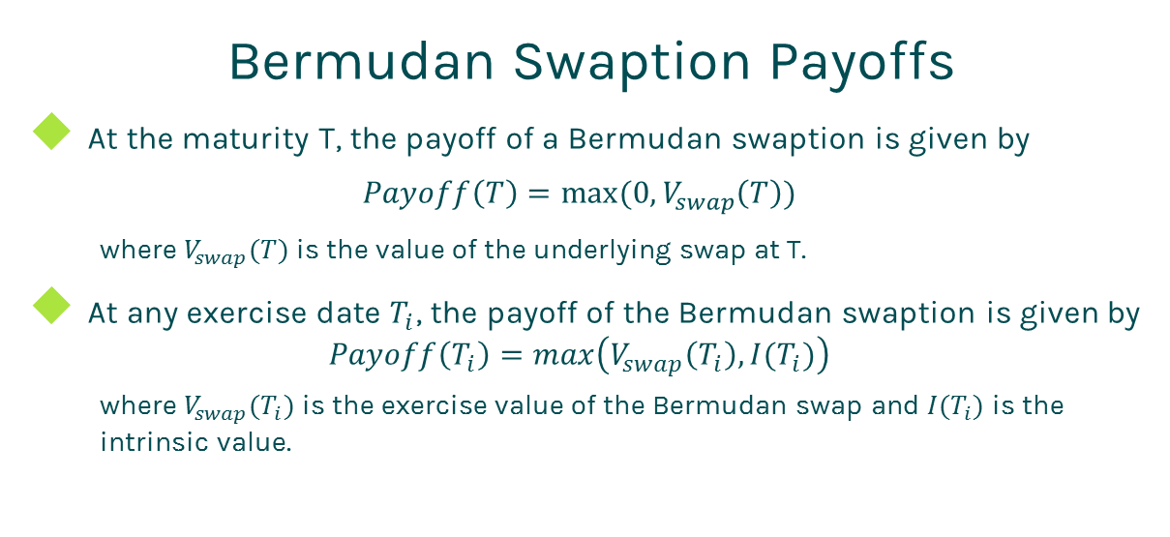
Cancelable Swap
Bermudan Swaption Payoffs
At the maturity T, the payoff of a Bermudan swaption is given by
$$Payoff\left(T\right)=max(0,V_{swap}\left(T\right))$$
where $V_{swap}(T)$ is the value of the underlying swap at T.
At any exercise date $T_{i}$, the payoff of the Bermudan swaption is given by
$$Payoff\left(T_{i}\right)=max\left(V_{swap}\left(T_{i}\right),I(T_{i})\right)$$
where $V_{swap}(T_{i})$ is the exercise value of the Bermudan swap and $I(T_{i})$ is the intrinsic value.

Slide 5
Cancelable Swap
Model Selection Criteria
Given the complexity of Bermudan swaption valuation, there is no closed form solution. Therefore, we need to select an interest rate term structure model and a numeric solution to price Bermudan swaptions numerically.
The selection of interest rate term structure models
Popular interest rate term structure models:
Hull-White, Linear Gaussian Model (LGM), Quadratic Gaussian Model (QGM), Heath Jarrow Morton (HJM), Libor Market Model (LMM).
HJM and LMM are too complex.
Hull-White is inaccurate for computing sensitivities.
Therefore, we choose either LGM or QGM.

Slide 6
Cancelable Swap
Model Selection Criteria (Cont)
The selection of numeric approaches
After selecting a term structure model, we need to choose a numeric approach to approximate the underlying stochastic process of the model.
Commonly used numeric approaches are tree, partial differential equation (PDE), lattice and Monte Carlo simulation.
Tree and Monte Carlo are notorious for inaccuracy on sensitivity calculation.
Therefore, we choose either PDE or lattice.
Our decision is to use LGM plus lattice.

Slide 7
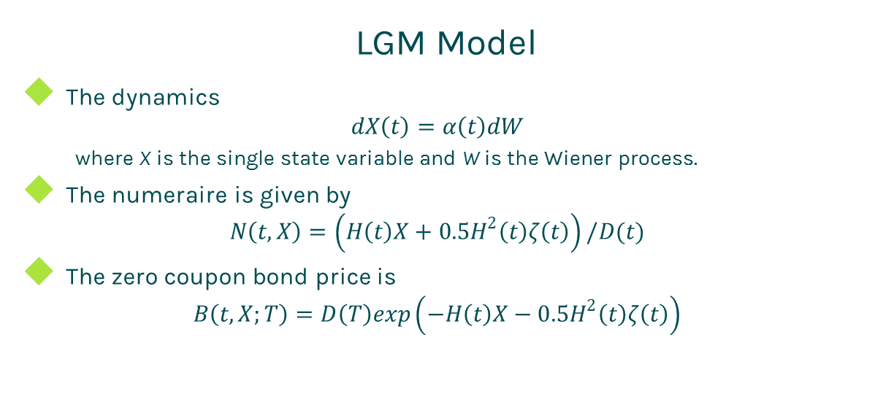
Cancelable Swap
LGM Model
The dynamics
$$dX\left(t\right)=α\left(t\right)dW$$
where X is the single state variable and W is the Wiener process.
The numeraire is given by
$$N\left(t,X\right)=\left(H\left(t\right)X+0.5H^{2}\left(t\right)ζ\left(t\right)\right)/D(t)$$
The zero coupon bond price is
$$B\left(t,X;T\right)=D\left(T\right)exp\left(−H\left(t\right)X−0.5H^{2}\left(t\right)ζ\left(t\right)\right)$$

Slide 8
Cancelable Swap
LGM Assumption
The LGM model is mathematically equivalent to the Hull-White model but offers
Significant improvement of stability and accuracy for calibration.
Significant improvement of stability and accuracy for sensitivity calculation.
The state variable is normally distributed under the appropriate measure.
The LGM model has only one stochastic driver (one-factor), thus changes in rates are perfected correlated.

Slide 9
Cancelable Swap
LGM calibration
Match today’s curve
At time t=0, X(0)=0 and H(0)=0. Thus Z(0,0;T)=D(T). In other words, the LGM automatically fits today’s discount curve.
Select a group of market swaptions.
Solve parameters by minimizing the relative error between the market swaption prices and the LGM model swaption prices.

Slide 10
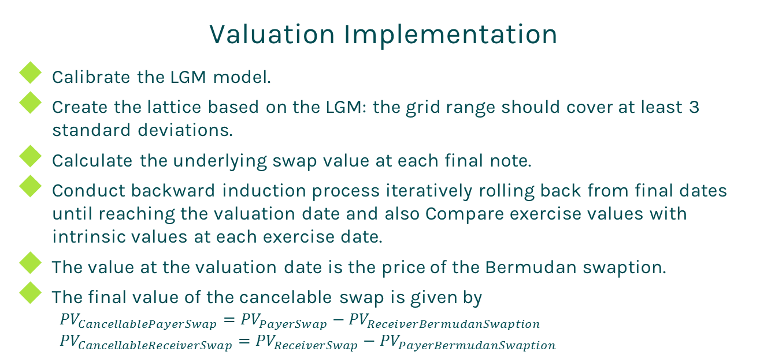
Cancelable Swap
Valuation Implementation
Calibrate the LGM model.
Create the lattice based on the LGM: the grid range should cover at least 3 standard deviations.
Calculate the underlying swap value at each final note.
Conduct backward induction process iteratively rolling back from final dates until reaching the valuation date and also Compare exercise values with intrinsic values at each exercise date.
The value at the valuation date is the price of the Bermudan swaption.
The final value of the cancelable swap is given by
$${PV}_{CancellablePayerSwap}={PV}_{PayerSwap}−{PV}_{ReceiverBermudanSwaption}$$
$${PV}_{CancellableReceiverSwap}={PV}_{ReceiverSwap}−{PV}_{PayerBermudanSwaption}$$

Slide 11
Cancelable Swap
A real world example
cancelable swap definition
Counterparty | xxx
Buy or sell | Buy
Payer or receiver | Payer
Currency | USD
Settlement | Physical
Trade date | 9/12/2012
Underlying swap definition | Leg 1 | Leg2
Day Count | dcAct360 | dcAct360
Leg Type | Fixed | Float
Notional | 250000 | 250000
Payment Frequency | 1 | 1
Pay Receive | Receive | Pay
Start Date | 9/14/2012 | 9/14/2012
End Date | 9/14/2022 | 9/14/2022
Fix rate | 0.0398 | NA
Index Type | NA | LIBOR
Index Tenor | NA | 1M
Index Day Count | NA | dcAct360
Exercise Schedules
Exercise Type | Notification Date |  | Settlement Date
Call | 1/12/2017 |  | 1/14/2017
Call | 1/10/2018 |  | 1/14/2018

Slide 12
Thanks!
You can find more details at
http://www.finpricing.com/lib/IrCancelableSwap.html

