Slide 1

Interest Rate Caps and Floors Vaulation Alan White FinPricing

Slide 2
Cap
Summary
Interest Rate Cap and Floor Introduction
The Use of Caps and Floors
Caplet and floorlet Payoffs
Valuation
Practical Notes
A real world example

Slide 3
Cap
Interest Rate Cap and Floor Introduction
An interest rate cap is a financial contract between two parties that provides an interest rate ceiling or cap on the floating rate payments.
An interest rate cap actually consists of a series of European call options (caplets) on interest rates.
The buyer receives payments at the end of each period when the interest rate exceeds the strike. The payment frequency could be monthly, quarterly or semiannually.
An interest rate floor is a financial contract between two parties that provides an interest rate floor on the floating rate payments.

Slide 4
Cap
Interest Rate Cap and Floor Introduction (Cont)
An interest rate floor actually consists of a series of European put options (floorlets) on interest rates.
The buyer receives payments at the end of each period when the interest rate falls below the strike. The payment frequency could be monthly, quarterly or semiannually.
The exercise is done automatically that is different from any other types of options.
The buyer needs to pay an up-front premium to the seller.

Slide 5
Cap
The Use of Caps and Floors
Caps are frequently purchased by issuers of floating rate debt who wish to protect themselves from the increased financing costs that would result from a rise in interest rates.
Floors are frequently purchased by purchasers of floating rate debt who wish to protect themselves from the loss of income that would result from a decline in interest rates.
Investors use caps and floors to hedge against the risk associated with floating interest rate.
Cap holders will benefit from any risk in interest rates above the strike, while floor holders will benefit from any risk in interest rates above the strike.

Slide 6
Cap
The Use of Caps and Floors (Cont)
Cap holders get a payment when the underlying interest rate exceeds a specified strike rate.
For example, let the strike be 2.0%. The cap buyer would get paid if LIBOR rose above 2.0%; otherwise, he would receive nothing if LIBOR fell below it.
The floor holders get a payment when the underlying interest rate falls below a specified strike rate.
For example, let the strike be 2.0%. The floor buyer would get paid if LIBOR fell below 2.0%; otherwise, he would receive nothing if LIBOR rose above it.

Slide 7

Cap
Caplet Payoff
The payoff of a caplet
$$Payoff=N∗τ∗max(R−K,0)$$
where N – notional; R – realized interest rate; K – strike; $τ$ – day count fraction.
Payoff diagram

Slide 8

Cap
Floorlet Payoff
The payoff of a floorlet
$$Payoff=N∗τ∗max(K−R,0)$$
where N – notional; R – realized interest rate; K – strike; $τ$ – day count fraction.
Payoff diagram

Slide 9
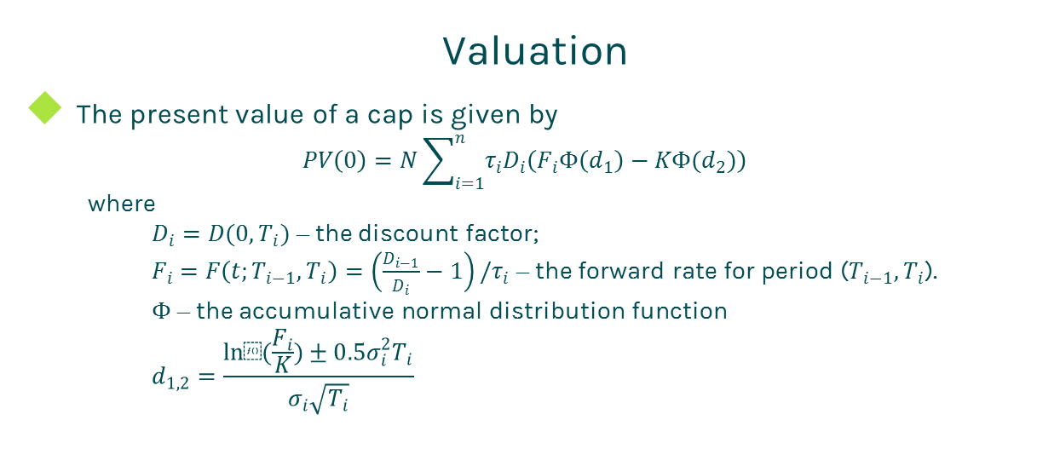
Cap
Valuation
The present value of a cap is given by
$$PV\left(0\right)=N\sum_{i=1}^{n}{τ_{i}D_{i}\left(F_{i}Φ\left(d_{1}\right)−KΦ(d_{2})\right)}$$
where
$D_{i}=D(0,T_{i})$ – the discount factor;
$F_{i}=F\left(t;T_{i−1},T_{i}\right)=\left(\frac{D_{i−1}}{D_{i}}−1\right)/τ_{i}$ – the forward rate for period ($T_{i−1},T_{i}$).
$Φ$ – the accumulative normal distribution function
$$d_{1,2}=\frac{ln⁡(\frac{F_{i}}{K})±0.5σ_{i}^{2}T_{i}}{σ_{i}\sqrt{T_{i}}}$$

Slide 10
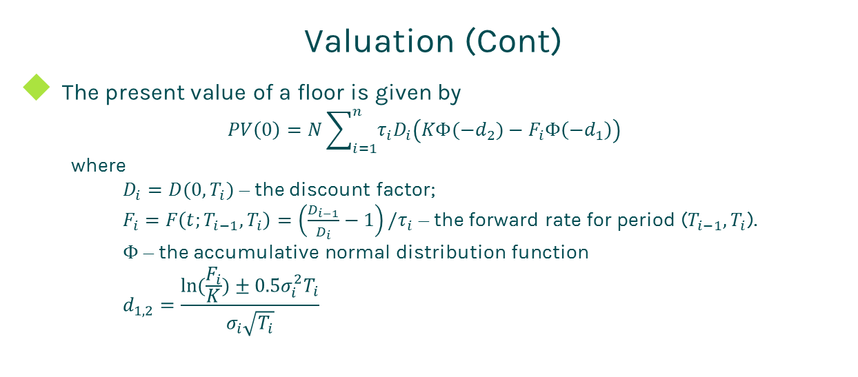
Cap
Valuation (Cont)
The present value of a floor is given by
$$PV\left(0\right)=N\sum_{i=1}^{n}{τ_{i}D_{i}\left(KΦ(−d_{2})−F_{i}Φ\left(−d_{1}\right)\right)}$$
where
$D_{i}=D(0,T_{i})$ – the discount factor;
$F_{i}=F\left(t;T_{i−1},T_{i}\right)=\left(\frac{D_{i−1}}{D_{i}}−1\right)/τ_{i}$ – the forward rate for period ($T_{i−1},T_{i}$).
$Φ$ – the accumulative normal distribution function
$$d_{1,2}=\frac{ln⁡(\frac{F_{i}}{K})±0.5σ_{i}^{2}T_{i}}{σ_{i}\sqrt{T_{i}}}$$

Slide 11
Cap
Practical Notes
Interest rate caps are valued via the Black model in the market.
The forward rate is simply compounded.
The first key to value a cap is to generate the cash flows. The cash flow generation is based on the start time, end time and payment frequency, plus calendar (holidays), business convention (e.g., modified following, following, etc.) and whether sticky month end.
Then you need to construct interest zero rate curve by bootstrapping the most liquid interest rate instruments in the market. The most common used yield curve is continuously compounded.

Slide 12
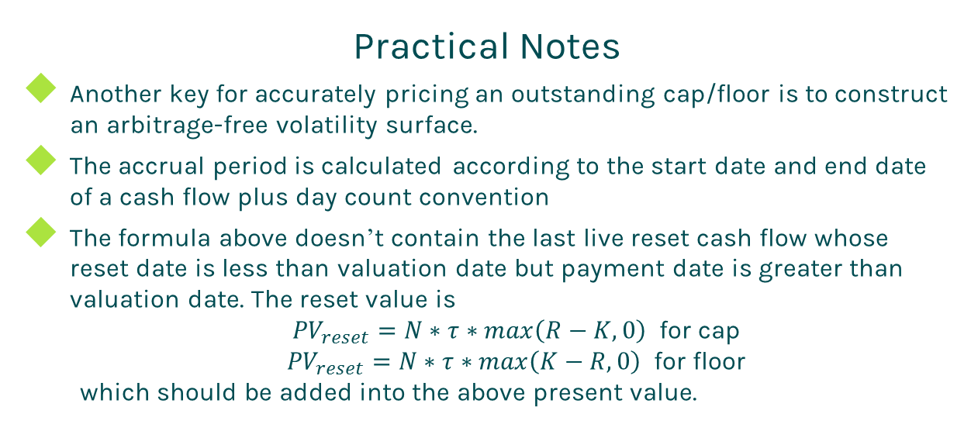
Cap
Practical Notes
Another key for accurately pricing an outstanding cap/floor is to construct an arbitrage-free volatility surface.
The accrual period is calculated according to the start date and end date of a cash flow plus day count convention
The formula above doesn’t contain the last live reset cash flow whose reset date is less than valuation date but payment date is greater than valuation date. The reset value is
${PV}_{reset}=N∗τ∗max\left(R−K,0\right)$ for cap
${PV}_{reset}=N∗τ∗max\left(K−R,0\right)$ for floor
which should be added into the above present value.

Slide 13
Cap
A Real World Example
Buy Sell | Sell
Cap or Floor | Cap
Strike | 0.035
Trade Date | 1/11/2016
Start Date | 1/13/2016
Maturity Date | 1/2/2019
Currency | USD
Day Count | dcAct360
Rate type | Float
Notional | 15090000
Pay Receive | Pay
Payment Frequency | 1M
Index Tenor | 1M
Index Type | LIBOR

Slide 14
Thanks!
You can find more details at
http://www.finpricing.com/lib/IrCap.html

