Slide 1

Interest Rate Capped Swap Valuation and Risk Dmitry Popov FinPricing http://www.finpricing.com

Slide 2
Capped Swap
Summary
Capped Swap Definition
Floored Swap Definition
Valuation
A real world example

Slide 3
Capped Swap
Capped Swap Definition
A capped swap is an interest rate swap with a cap where the floating rate of the swap is capped at a certain level.
It limits the risk of the floating rate payer to adverse movements in interest rates.
Given the optionality, an up-front fee or premium has to be paid by the floating rate payer.
A capped swap can be decomposed as an interest rate swap plus an interest rate cap.

Slide 4
Capped Swap
Floored Swap Definition
A floored swap is an interest rate swap with a floor where the floating rate of the swap is floored at a certain level.
It limits the risk of the floating rate receiver to adverse movements in interest rates.
Given the optionality, an up-front fee or premium has to be paid by the floating rate receiver.
A floored swap can be decomposed as an interest rate swap plus an interest rate floor.

Slide 5
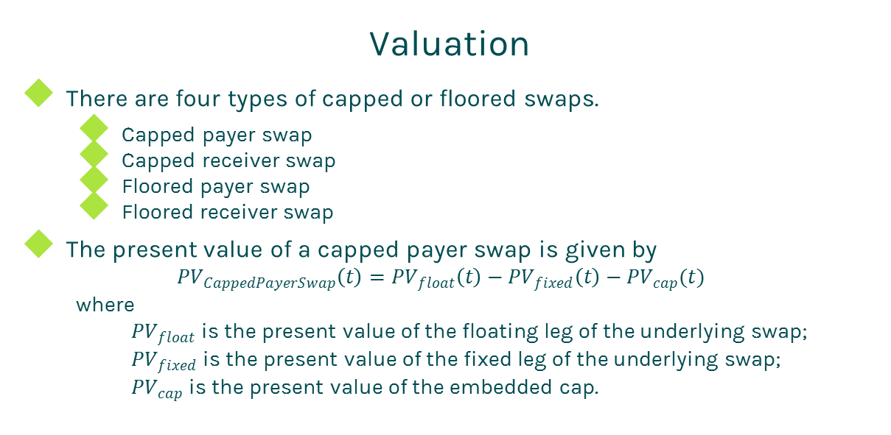
Capped Swap
Valuation
There are four types of capped or floored swaps.
Capped payer swap
Capped receiver swap
Floored payer swap
Floored receiver swap
The present value of a capped payer swap is given by
$${PV}_{CappedPayerSwap}\left(t\right)={PV}_{float}\left(t\right)−{PV}_{fixed}\left(t\right)−{PV}_{cap}(t)$$
where
${PV}_{float}$ is the present value of the floating leg of the underlying swap;
${PV}_{fixed}$ is the present value of the fixed leg of the underlying swap;
${PV}_{cap}$ is the present value of the embedded cap.

Slide 6
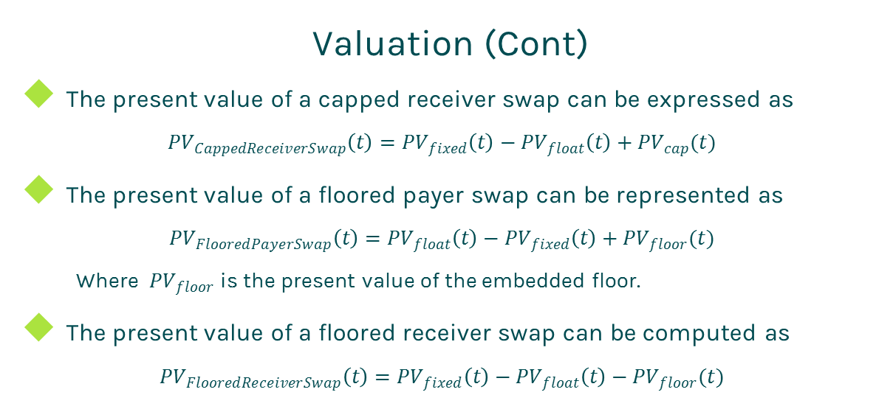
Capped Swap
Valuation (Cont)
The present value of a capped receiver swap can be expressed as
$${PV}_{CappedReceiverSwap}\left(t\right)={PV}_{fixed}\left(t\right)−{PV}_{float}\left(t\right)+{PV}_{cap}(t)$$
The present value of a floored payer swap can be represented as
$${PV}_{FlooredPayerSwap}\left(t\right)={PV}_{float}\left(t\right)−{PV}_{fixed}\left(t\right)+{PV}_{floor}(t)$$
Where ${PV}_{floor}$ is the present value of the embedded floor.
The present value of a floored receiver swap can be computed as
$${PV}_{FlooredReceiverSwap}\left(t\right)={PV}_{fixed}\left(t\right)−{PV}_{float}\left(t\right)−{PV}_{floor}(t)$$

Slide 7
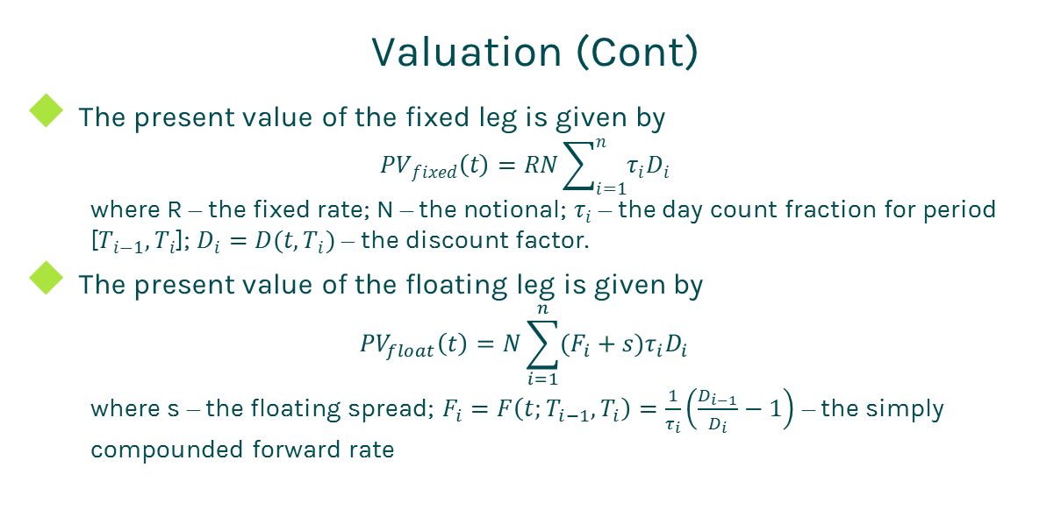
Capped Swap
Valuation (Cont)
The present value of the fixed leg is given by
$${PV}_{fixed}\left(t\right)=RN\sum_{i=1}^{n}{τ_{i}D_{i}}$$
where R – the fixed rate; N – the notional; $τ_{i}$ – the day count fraction for period [$T_{i−1},T_{i}$]; $D_{i}=D(t,T_{i})$ – the discount factor.
The present value of the floating leg is given by
$${PV}_{float}\left(t\right)=N\sum_{i=1}^{n}{(F_{i}+s)τ_{i}D_{i}}$$
where s – the floating spread; $F_{i}=F\left(t;T_{i−1},T_{i}\right)=\frac{1}{τ_{i}}\left(\frac{D_{i−1}}{D_{i}}−1\right)$ – the simply compounded forward rate

Slide 8
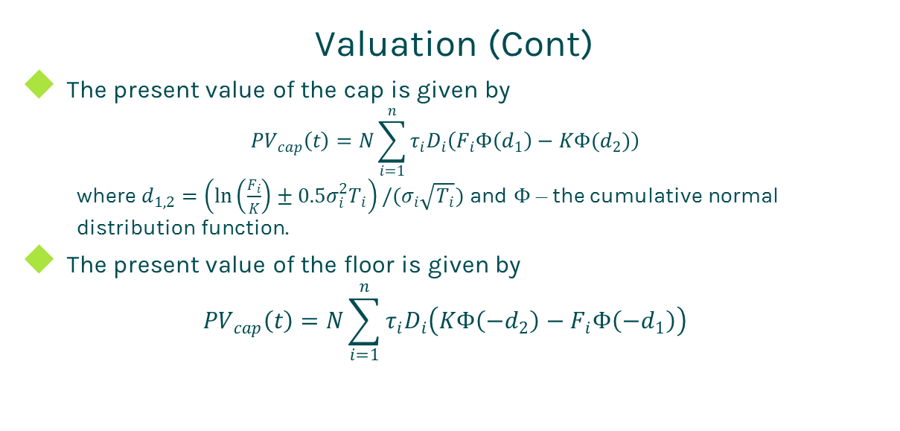
Capped Swap
Valuation (Cont)
The present value of the cap is given by
$${PV}_{cap}\left(t\right)=N\sum_{i=1}^{n}{τ_{i}D_{i}\left(F_{i}Φ\left(d_{1}\right)−KΦ(d_{2})\right)}$$
where $d_{1,2}=\left(\ln\left(\frac{F_{i}}{K}\right)±0.5σ_{i}^{2}T_{i}\right)/(σ_{i}\sqrt{T_{i}})$ and $Φ$ – the cumulative normal distribution function.
The present value of the floor is given by
$${PV}_{cap}\left(t\right)=N\sum_{i=1}^{n}{τ_{i}D_{i}\left(KΦ\left(−d_{2}\right)−F_{i}Φ\left({−d}_{1}\right)\right)}$$

Slide 9
Capped Swap
A real world example
Cap/Floor specification |  | Underlying swap specification
Buy Sell | Buy | Leg 1 |  | Leg 2
Cap Floor | Floor | Currency | USD | Currency | USD
Strike | 0.001 | Day Count | dcAct360 | Day Count | dcAct360
Trade Date | 11/3/2016 | Leg Type | Fixed | Leg Type | Float
Start Date | 11/4/2016 | Notional | 200000000 | Notional | 200000000
Maturity Date | 11/2/2020 | Payment Freq | 1M | Payment Freq | 1M
Currency | USD | Pay Receive | Pay | Pay Receive | Receive
Day Count | dcAct360 | Star tDate | 11/4/2016 | Start Date | 11/4/2016
Notional | 200000000 | End Date | 11/1/2020 | End Date | 11/1/2020
Pay Receive | Receive | Fixed Rate | 0.01043 | Spread | 0
Payment Freq | 1M |  |  | Index specification
Index specification |  |  |  | Type | LIBOR
Day count | dcAct360 |  |  | Tenor | 1M
Tenor | 1M |  |  | Day Count | dcAct360
Type | LIBOR

Slide 10
Thanks!
You can find more details at
http://www.finpricing.com/lib/IrCappedSwap.html

