Slide 1

Compounding Swap Vaulation Pratical Guide Alan White FinPricing http://www.finpricing.com

Slide 2
Compounding Swap
Summary
Compounding Swap Introduction
Compounding Swap or Compounding Swaplet Payoff
Valuation
Practical Notes
A real world example

Slide 3
Compounding Swap
Compounding Swap Introduction
A compounding swap is an interest rate swap in which interest, instead of being paid, compounds forward until the next payment date.
Compounding swaps can be valued by assuming that the forward rates are realized.
Normally the calculation period of a compounding swap is smaller than the payment period. For example, a swap has 6-month payment period and 1-month calculation period (or 1-month index tenor).
An overnight index swap (OIS) is a typical compounding swap.

Slide 4
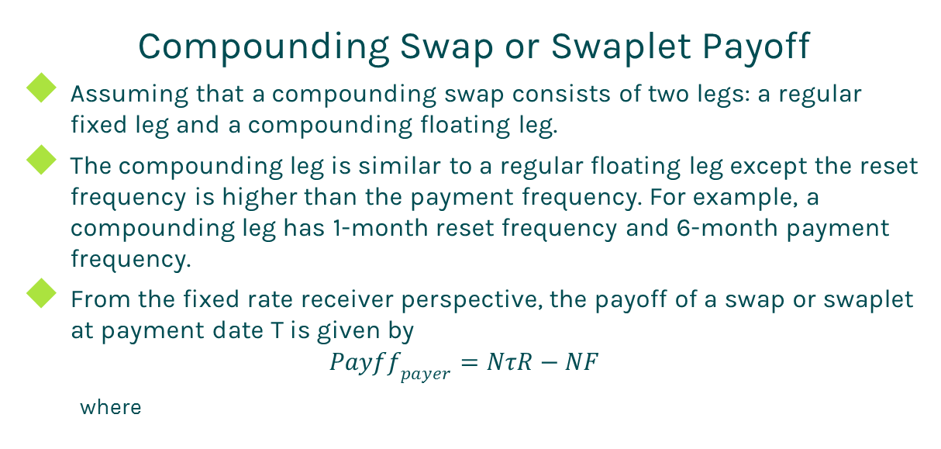
Compounding Swap
Compounding Swap or Swaplet Payoff
Assuming that a compounding swap consists of two legs: a regular fixed leg and a compounding floating leg.
The compounding leg is similar to a regular floating leg except the reset frequency is higher than the payment frequency. For example, a compounding leg has 1-month reset frequency and 6-month payment frequency.
From the fixed rate receiver perspective, the payoff of a swap or swaplet at payment date T is given by
$${Payff}_{payer}=NτR−NF$$
where

Slide 5
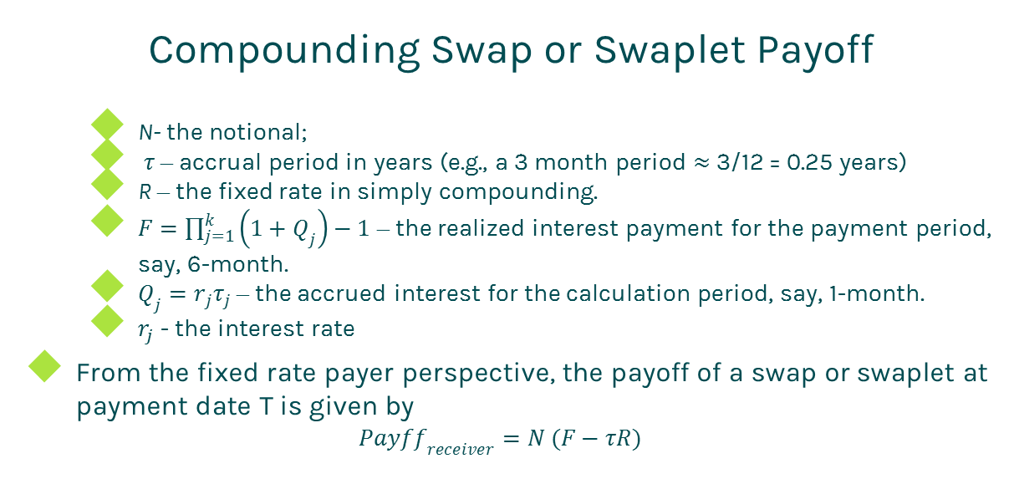
Compounding Swap
Compounding Swap or Swaplet Payoff
N- the notional;
$τ$ – accrual period in years (e.g., a 3 month period $≈$ 3/12 = 0.25 years)
R – the fixed rate in simply compounding.
$F=\prod_{j=1}^{k}{\left(1+Q_{j}\right)−1}$ – the realized interest payment for the payment period, say, 6-month.
$Q_{j}=r_{j}τ_{j}$ – the accrued interest for the calculation period, say, 1-month.
$r_{j}$ - the interest rate
From the fixed rate payer perspective, the payoff of a swap or swaplet at payment date T is given by
$${Payff}_{receiver}=N (F−τR)$$

Slide 6
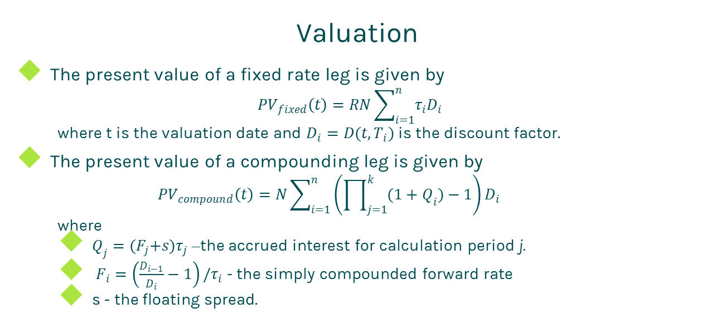
Compounding Swap
Valuation
The present value of a fixed rate leg is given by
$${PV}_{fixed}\left(t\right)=RN\sum_{i=1}^{n}{τ_{i}D_{i}}$$
where t is the valuation date and $D_{i}=D(t,T_{i})$ is the discount factor.
The present value of a compounding leg is given by
$${PV}_{compound}\left(t\right)=N\sum_{i=1}^{n}{\left(\prod_{j=1}^{k}{(1+Q_{i}})−1\right)D_{i}}$$
where
$Q_{j}={(F}_{j}+s)τ_{j}$ –the accrued interest for calculation period j.
$F_{i}=\left(\frac{D_{i−1}}{D_{i}}−1\right)/τ_{i}$ - the simply compounded forward rate
s - the floating spread.

Slide 7
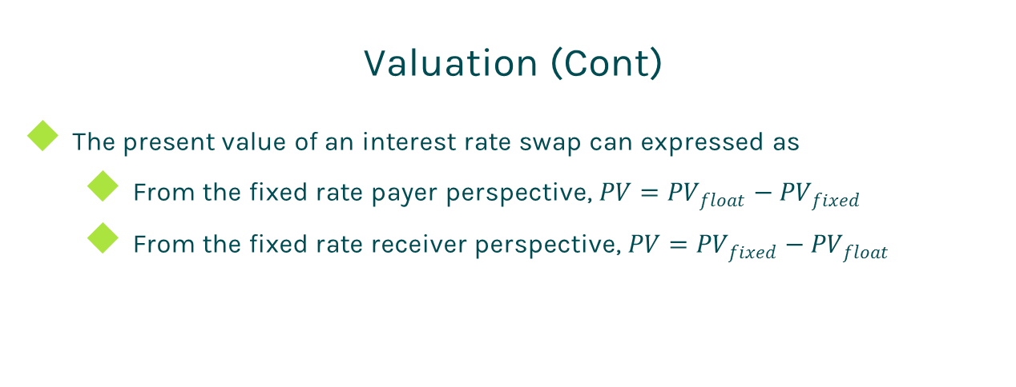
Compounding Swap
Valuation (Cont)
The present value of an interest rate swap can expressed as
From the fixed rate payer perspective, $PV={PV}_{float}−{PV}_{fixed}$
From the fixed rate receiver perspective, $PV={PV}_{fixed}−{PV}_{float}$

Slide 8
Compounding Swap
Practical Notes
First of all, you need to generate accurate cash flows for each leg. The cash flow generation is based on the start time, end time and payment frequency of the leg, plus calendar (holidays), business convention (e.g., modified following, following, etc.) and whether sticky month end.
We assume that accrual periods are the same as reset periods and payment dates are the same as accrual end dates in the above formulas for brevity. But in fact, they are different due to different market conventions. For example, index periods can overlap each other but swap cash flows are not allowed to overlap.
The accrual period is calculated according to the start date and end date of a cash flow plus day count convention

Slide 9
Compounding Swap
Practical Notes (Cont)
The forward rate should be computed based on the reset period (index reset date, index start date, index end date) that are determined by index definition, such as index tenor and convention. it is simply compounded.
Sometimes there is a floating spread added on the top of the floating rate in the floating leg.
The present value of the reset cash flow should be added into the present value of the floating leg.
Some dealers take bid-offer spreads into account. In this case, one should use the bid curve constructed from bid quotes for forwarding and the offer curve built from offer quotes for discounting.

Slide 10
Compounding Swap
A Real World Example
Leg 1 Specification |  | Leg 2 Specification
Currency | USD | Currency | USD
Day Count | dcAct360 | Day Count | dcAct360
Leg Type | Fixed | Leg Type | Float
Notional | 5000000 | Notional | 5000000
Pay Receive | Receive | Pay Receive | Pay
Payment Frequency | 6M | Payment Frequency | 6M
Start Date | 7/1/2015 | Start Date | 7/1/2015
End Date | 3/1/2023 | End Date | 3/1/2023
Fixed Rate | 0.0455 | Spread | 0
 |  | Index Specification
 |  | Index Type | LIBOR
 |  | Index Tenor | 1M
 |  | Index Day Count | dcAct360

Slide 11
Thanks!
You can find more details at
http://www.finpricing.com/lib/IrCompoundingSwap.html

