Slide 1
How to Construct and Bootstrap Yield Curve
Michael Taylor
FinPricing

Slide 2
Yield Curve
The term structure of interest rates, also known as yield curve, is defined as the relationship between the yield-to-maturity on a zero coupon bond and the bond’s maturity. Zero yield curves play an essential role in the valuation of all financial products.
Yield curves can be derived from government bonds or LIBOR/swap instruments. The LIBOR/swap term structure offers several advantages over government curves, and is a robust tool for pricing and hedging financial products. Correlations among governments and other fixed-income products have declined, making the swap term structure a more efficient hedging and pricing vehicle.

Slide 3
Yield Curve
Summary
Yield Curve Introduction
Yield Curve Construction and Bootstrapping Overview
Interpolation
Optimization

Slide 4
Yield Curve
Yield Curve Introduction
The term structure of interest rates, also known as yield curve, is defined as the relationship between the yield-to-maturity on a zero coupon bond and the bond’s maturity.
Zero yield curves play an essential role in the valuation of all financial products.
Yield curves can be derived from government bonds or LIBOR/swap instruments.
The LIBOR/swap term structure offers several advantages over government curves, and is a robust tool for pricing and hedging financial products.

Slide 5
Yield Curve
Yield Curve Introduction (Cont)
Correlations among governments and other fixed-income products have declined, making the swap term structure a more efficient hedging and pricing vehicle.
With the supply of government issues declining, LIBOR/swap markets are more liquid and efficient than government debt markets.
LIBOR curves constructed from the most liquid interest rate instruments have become the standard funding curves in the market.
The 3 month LIBOR curve is the base yield curve in the market.

Slide 6
Yield Curve
Yield Curve Introduction (Cont)
The term structure of zero rates is constructed from a set of market quotes of some liquid market instruments such as short term cash instruments, middle term futures or forward rate agreement (FRA), long term swaps and spreads.
Prior to the 2007 financial crisis, financial institutions performed valuation and risk management of any interest rate derivative on a given currency using a single-curve approach. This approach consisted of building a unique curve and using it for both discounting and forecasting cashflows.

Slide 7
Yield Curve
Yield Curve Introduction (Cont)
However, after the financial crisis, basis swap spreads were no longer negligible and the market was characterized by a sort of segmentation. Consequently, market practitioners started to use a new valuation approach referred to as multicurve approach, which is characterized by a unique discounting curve and multiple forecasting curves
The current methodology in capital markets for marking to market securities and derivatives is to estimate and discount future cash flows using rates derived from the appropriate term structure. The yield term structure is increasingly used as the foundation for deriving relative term structures and as a benchmark for pricing and hedging.

Slide 8
Yield Curve
Yield Curve Construction Overview
Yield curves are derived or bootstrapped from observed market instruments that represent the most liquid and dominant interest rate products for certain time horizons.
Normally the curve is divided into three parts. The short end of the term structure is determined using LIBOR rates. The middle part of the curve is constructed using Eurodollar futures or forward rate agreements (FRA). The far end is derived using mid swap rates.
The objective of the bootstrap algorithm is to find the zero yield or discount factor for each maturity point and cash flow date sequentially so that all curve instruments can be priced back to the market quotes.

Slide 9
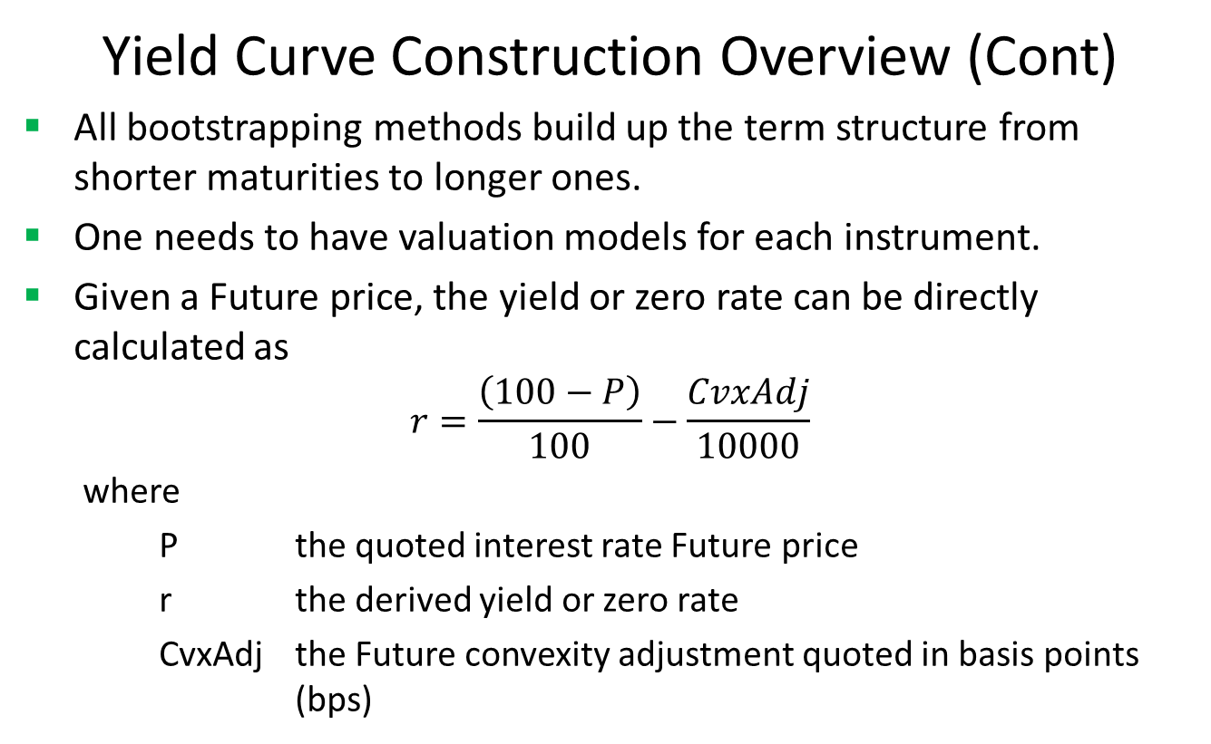
Yield Curve
Yield Curve Construction Overview (Cont)
All bootstrapping methods build up the term structure from shorter maturities to longer ones.
One needs to have valuation models for each instrument.
Given a Future price, the yield or zero rate can be directly calculated as
$$r=\frac{\left(100−P\right)}{100}−\frac{CvxAdj}{10000}$$
where
P the quoted interest rate Future price
r the derived yield or zero rate
CvxAdj the Future convexity adjustment quoted in basis points (bps)

Slide 10
Yield Curve
Yield Curve Construction Overview (Cont)
The swap pricing model is introduced as http://www.finpricing.com/lib/IrSwap.html
Assuming that we have all yields up to 4 years and now need to derive up to 5 years.
Let x be the yield at 5 years.
Use an interpolation methd to get yields at 4.25, 4.5 and 4.75 years as Ax, Bx, Cx,Dx.
Given the 5 year market swap rate, we can use a root-finding algorithm to solve the x that makes the value of the 5 year inception swap equal to zero.
Therefore we get all yields or equivalent discount factors up to 5 years

Slide 11
Yield Curve
Yield Curve Construction Overview (Cont)
Repeat the above procedure till the longest swap maturity.
There are two keys in yield curve construction: interpolation and root finding.

Slide 12
Yield Curve
Interpolation
Most popular interpolation algorithms in curve bootstrapping are linear, log-linear and cubic spline.
The selected interpolation rule can be applied to either zero rates or discount factors.
Some critics argue that some of these simple interpolations cannot generate smooth forward rates and the others may be able to produce smooth forward rates but fail to match the market quotes.
Also they cannot guarantee the continuity and positivity of forward rates.

Slide 13
Yield Curve
Interpolation (Cont)
The monotone convex interpolation is more rigorous. It meets the following essential criteria:
Replicate the quotes of all input underlying instruments.
Guarantee the positivity of the implied forward rates
Produce smooth forward curves.
Although the monotone convex interpolation rule sounds almost perfectly, it is not very popular with practitioners.

Slide 14
Yield Curve
Optimization
As described above, the bootstrapping process needs to solve a yield using a root finding algorithm.
In other words, it needs an optimization solution to match the prices of curve-generated instruments to their market quotes.
FinPricing employs the Levenberg-Marquardt algorithm for root finding, which is very common in curve construction.
Another popular algorithm is the Excel Solver, especially in Excel application.

Slide 15
Thank You
You can find more details at
http://www.finpricing.com/lib/IrCurve.html

