Slide 1

Interest Rate Floors and Vaulation Alan White FinPricing http://www.finpricing.com

Slide 2
Floor
Summary
Interest Rate Floor Introduction
The Benefits of a Floor
Floorlet Payoff
Valuation
Practical Notes
A real world example

Slide 3
Floor
Interest Rate Floor Introduction
An interest rate floor is a financial contract between two parties that provides an interest rate floor on the floating rate payments.
An interest rate floor actually consists of a series of European put options (floorlets) on interest rates.
The buyer receives payments at the end of each period when the interest rate falls below the strike. The payment frequency could be monthly, quarterly or semiannually.
The exercise is done automatically that is different from any other types of options.
The buyer needs to pay an up-front premium to the seller.

Slide 4
Floor
The Benefits of a Floor
Floors are frequently purchased by purchasers of floating rate debt who wish to protect themselves from the loss of income that would result from a decline in interest rates.
A floor is a guarantee of a future interest rate. Investors use floor to hedge against the risk associated with floating interest rate.
Investors will benefit from any risk in interest rates below the strike.
The holder gets a payment when the underlying interest rate falls below a specified strike rate.
For example, let the strike be 2.0%. The buyer would get paid if LIBOR fell below 2.0%; otherwise, he would receive nothing if LIBOR rose above it.

Slide 5

Floor
Floorlet Payoff
The payoff of a floorlet
$$Payoff=N∗τ∗max(K−R,0)$$
where N – notional; R – realized interest rate; K – strike; $τ$ – day count fraction.
Payoff diagram

Slide 6
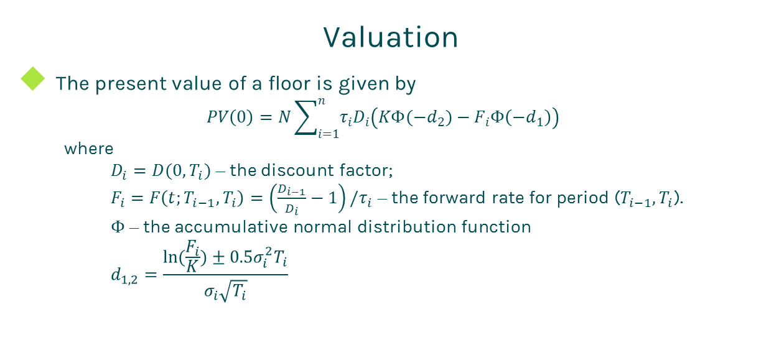
Floor
Valuation
The present value of a floor is given by
$$PV\left(0\right)=N\sum_{i=1}^{n}{τ_{i}D_{i}\left(KΦ(−d_{2})−F_{i}Φ\left(−d_{1}\right)\right)}$$
where
$D_{i}=D(0,T_{i})$ – the discount factor;
$F_{i}=F\left(t;T_{i−1},T_{i}\right)=\left(\frac{D_{i−1}}{D_{i}}−1\right)/τ_{i}$ – the forward rate for period ($T_{i−1},T_{i}$).
$Φ$ – the accumulative normal distribution function
$$d_{1,2}=\frac{ln⁡(\frac{F_{i}}{K})±0.5σ_{i}^{2}T_{i}}{σ_{i}\sqrt{T_{i}}}$$

Slide 7
Floor
Practical Notes
Interest rate floors are valued via the Black model in the market.
The forward rate is simply compounded.
The first key to value a floor is to generate the cash flows. The cash flow generation is based on the start time, end time and payment frequency, plus calendar (holidays), business convention (e.g., modified following, following, etc.) and whether sticky month end.
Then you need to construct interest zero rate curve by bootstrapping the most liquid interest rate instruments in the market. The most common used yield curve is continuously compounded.

Slide 8
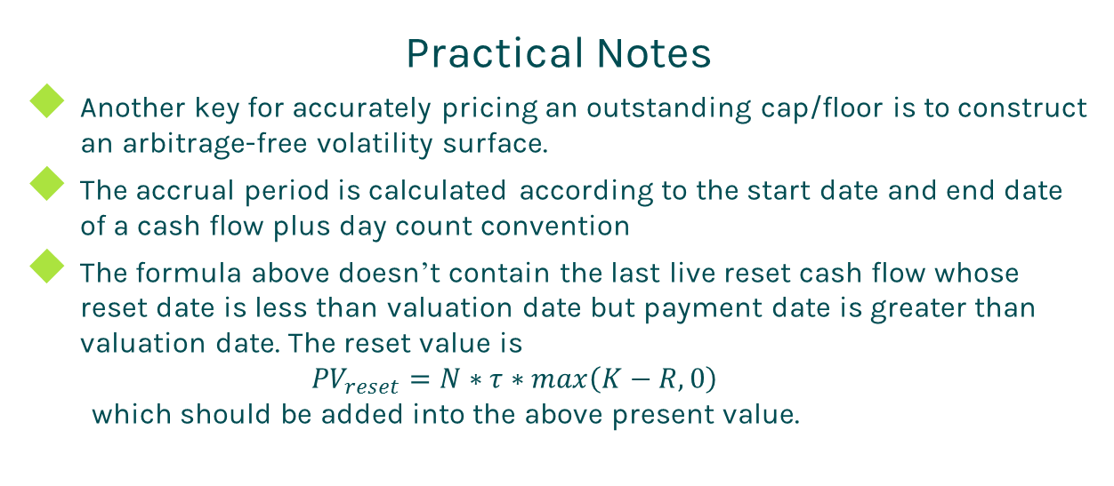
Floor
Practical Notes
Another key for accurately pricing an outstanding cap/floor is to construct an arbitrage-free volatility surface.
The accrual period is calculated according to the start date and end date of a cash flow plus day count convention
The formula above doesn’t contain the last live reset cash flow whose reset date is less than valuation date but payment date is greater than valuation date. The reset value is
$${PV}_{reset}=N∗τ∗max\left(K−R,0\right)$$
which should be added into the above present value.

Slide 9
Floor
A Real World Example
Buy Sell | Buy
Strike | 0.025
Trade Date | 1/11/2016
Start Date | 1/13/2016
Maturity Date | 1/2/2019
Currency | USD
Day Count | dcAct360
Rate type | Float
Notional | 15090000
Pay Receive | Pay
Payment Frequency | 1M
Index Tenor | 1M
Index Type | LIBOR

Slide 10
Thanks!
You can find more details at
http://www.finpricing.com/lib/IrFloor.html

