Slide 1

Forward Rate Agreement (FRA) Product and Valuation Alan White FinPricing http://www.finpricing.com

Slide 2
FRA
Summary
Forward Rate Agreement (FRA) Introduction
The Use of FRA
FRA Payoff
Valuation
Practical Guide
A real world example

Slide 3
FRA
FRA Introduction
A FRA is a forward contract between two parties in which one party will pay a fixed rate while the other party will pay a reference rate for a set future period.
FRAs are cash-settled OTC derivatives with the payment based on the net difference between the floating (reference) rate and the fixed rate in the contract.
Similar to a swap, a FRA has two legs associating with each party: a fixed leg and a floating leg. But each leg only has one cash flow.
The party paying the fixed rate is usually referred to as the buyer, while the party receiving the floating rate is referred to as the seller.
FRAs are money market instruments that are liquid in all major currencies.

Slide 4
FRA
The Use of FRA
A FRA can be used to hedge future interest rate exposure.
The buyer hedges against the risk of rising interest rate whereas the seller hedges against the risk of falling interest rates.
In other words, the buyer locks in the interest rate to protect against the increase of interest rates while the seller protects against the possible decrease of interest rates.
A speculator can also use FRAs to make bets on future directional changes in interest rates.
Market participants can also take advantage of price differences between an FRA and other interest rate instruments.

Slide 5
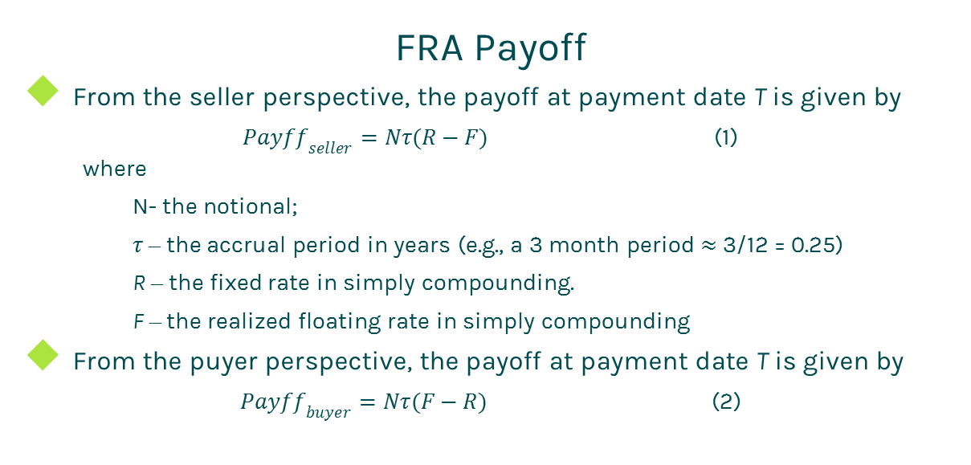
FRA
FRA Payoff
From the seller perspective, the payoff at payment date T is given by
${Payff}_{seller}=Nτ(R−F)$ (1)
where
N- the notional;
$τ$ – the accrual period in years (e.g., a 3 month period $≈$ 3/12 = 0.25)
R – the fixed rate in simply compounding.
F – the realized floating rate in simply compounding
From the puyer perspective, the payoff at payment date T is given by
${Payff}_{buyer}=Nτ(F−R)$ (2)

Slide 6
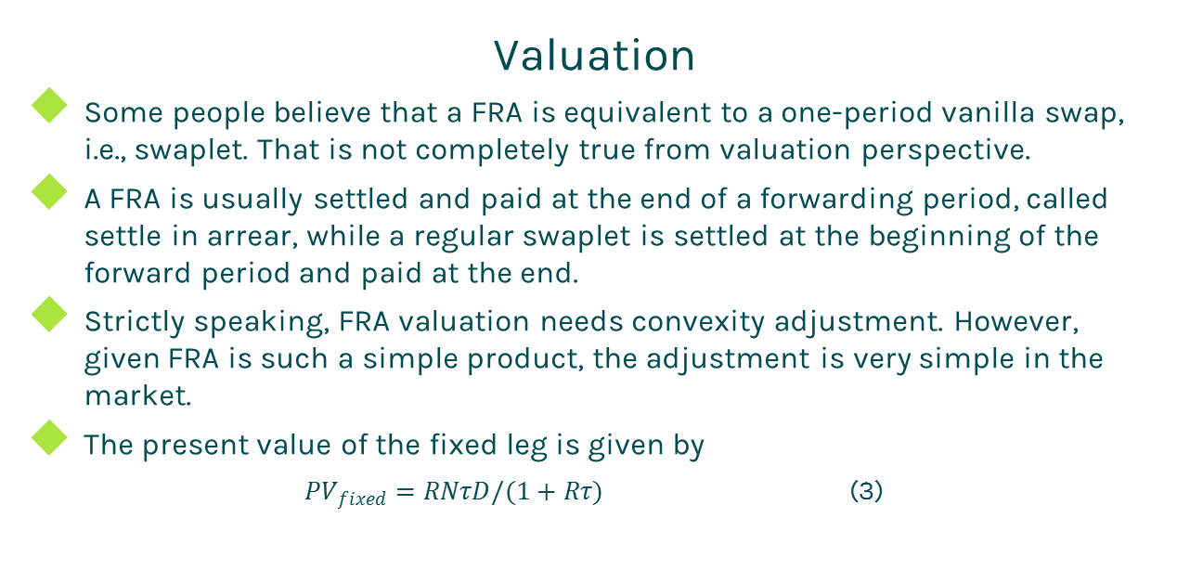
FRA
Valuation
Some people believe that a FRA is equivalent to a one-period vanilla swap, i.e., swaplet. That is not completely true from valuation perspective.
A FRA is usually settled and paid at the end of a forwarding period, called settle in arrear, while a regular swaplet is settled at the beginning of the forward period and paid at the end.
Strictly speaking, FRA valuation needs convexity adjustment. However, given FRA is such a simple product, the adjustment is very simple in the market.
The present value of the fixed leg is given by
${PV}_{fixed}=RNτD/(1+Rτ)$ (3)

Slide 7
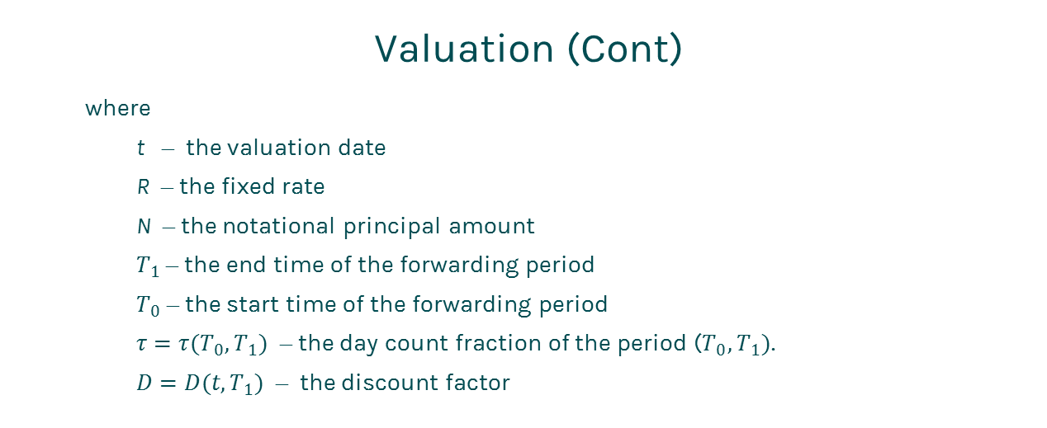
FRA
Valuation (Cont)
where
t – the valuation date
R – the fixed rate
N – the notational principal amount
$T_{1}$ – the end time of the forwarding period
$T_{0}$ – the start time of the forwarding period
$τ=τ(T_{0},T_{1})$ – the day count fraction of the period ($T_{0},T_{1})$.
$D=D(t,T_{1})$ – the discount factor

Slide 8
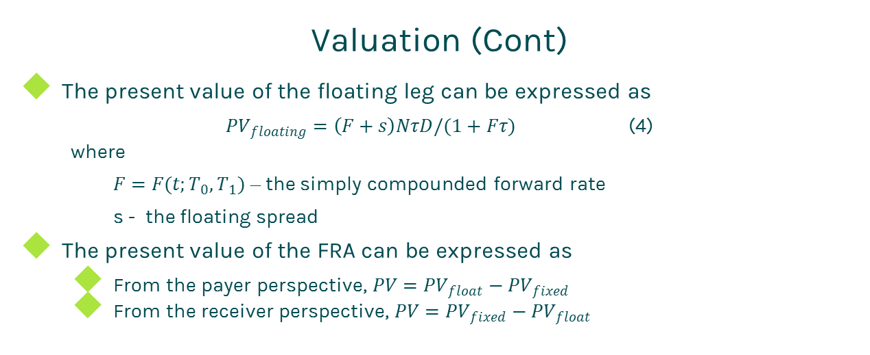
FRA
Valuation (Cont)
The present value of the floating leg can be expressed as
${PV}_{floating}=\left(F+s\right)NτD/(1+Fτ)$ (4)
where
$F=F(t;T_{0},T_{1})$ – the simply compounded forward rate
s - the floating spread
The present value of the FRA can be expressed as
From the payer perspective, $PV={PV}_{float}−{PV}_{fixed}$
From the receiver perspective, $PV={PV}_{fixed}−{PV}_{float}$

Slide 9
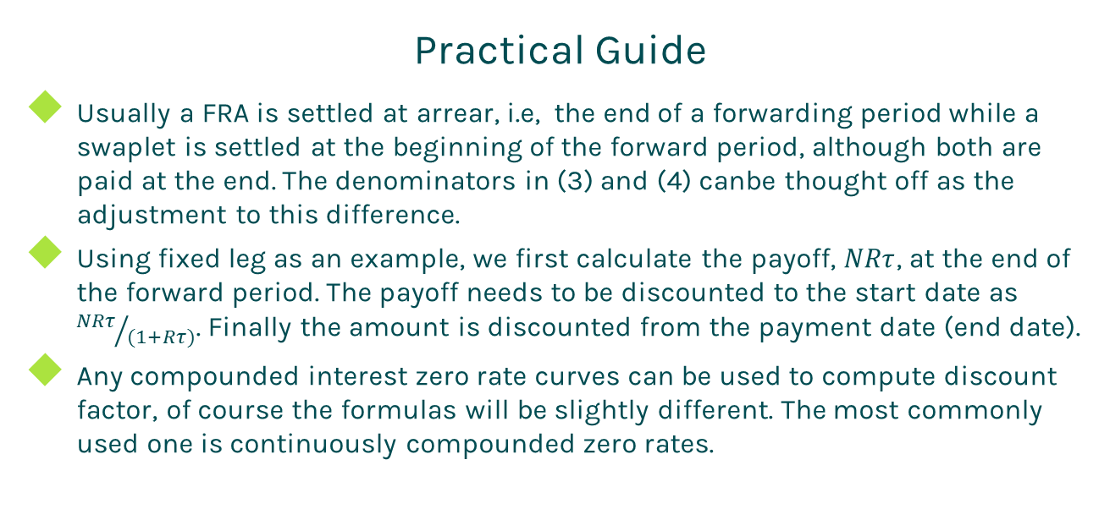
FRA
Practical Guide
Usually a FRA is settled at arrear, i.e, the end of a forwarding period while a swaplet is settled at the beginning of the forward period, although both are paid at the end. The denominators in (3) and (4) canbe thought off as the adjustment to this difference.
Using fixed leg as an example, we first calculate the payoff, $NRτ$, at the end of the forward period. The payoff needs to be discounted to the start date as ${NRτ}/{(1+Rτ)}$. Finally the amount is discounted from the payment date (end date).
Any compounded interest zero rate curves can be used to compute discount factor, of course the formulas will be slightly different. The most commonly used one is continuously compounded zero rates.

Slide 10
FRA
Practical Guide (Cont)
To use the formula, you need to compute simply compounded forward rate instead of other compounding types.
The accrual period is calculated according to the start date and end date of a cash flow plus day count convention
We assume that accrual periods are the same as forwarding periods and payment dates are the same as accrual end dates in the above formulas for brevity. But in fact, they are slightly different due to different market conventions.

Slide 11
FRA
A Real World Example
Leg 1 Specification |  | Leg 2 Specification
Currency | USD | Currency | USD
Day Count | dcAct360 | Day Count | dcAct360
Leg Type | Fixed | Leg Type | Float
Notional | 250000000 | Notional | 250000000
Pay Receive | Pay | Pay Receive | Receive
Start Date | 4/7/2017 | Start Date | 4/7/2017
End Date | 10/10/2017 | End Date | 10/10/2017
Settlement Date | 10/10/2017 | Settlement Date | 10/10/2017
Fixed Rate | 0.014399 | Spread | -0.014399
 |  | Index Specification
 |  | Type | LIBOR
 |  | Tenor | 6M
 |  | Day Count | dcAct360

Slide 12
Thanks!
You can find more details at
http://www.finpricing.com/lib/IrFra.html

