Slide 1

Interest Rate Futures and Valuation Dmitry Popov FinPricing http://www.finpricing.com

Slide 2
Interest Rate Future
Summary
Interest Rate Future Definition
Advantages of trading interest rate futures
Valuation
A real world example

Slide 3
Interest Rate Future
Interest Rate Future Definition
An interest rate future is a contract between the buyer and seller to deliver an interest rate asset at a specified rate on a specified date.
The future allows the buyer and seller to lock in the price of the interest rate asset at a future date.
Interest rate futures are usually traded in an exchange.
It is used to hedge against adverse changes in interest rates.
Interest rate futures are mainly listed for 3-month Eurodollar, 1-month LIBOR, 1-month banker’s acceptance futures and 3-month banker’s acceptance futures.

Slide 4
Interest Rate Future
Advantages of trading interest rate futures
Interest rate futures are used to hedge against interest rate risk.
Investors can use interest rate futures to secure an interest rate for money it plans to borrow or lend in the future.
Futures markets tend to be more liquid than underlying cash markets.
Other benefits
Price transparency and liquidity
Immediate execution and confirmation
Reduction of counterparty risk
Centralized clearing.

Slide 5
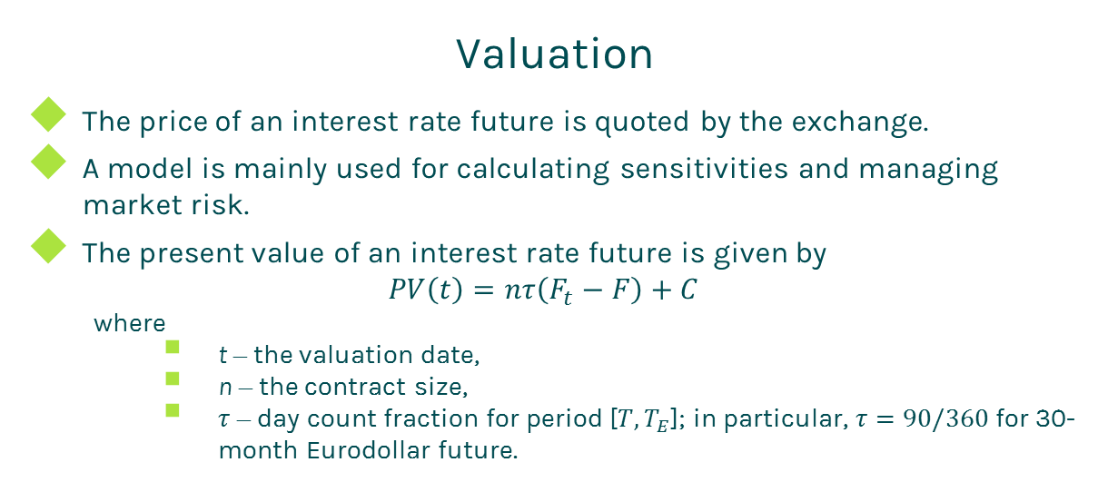
Interest Rate Future
Valuation
The price of an interest rate future is quoted by the exchange.
A model is mainly used for calculating sensitivities and managing market risk.
The present value of an interest rate future is given by
$$PV\left(t\right)=nτ\left(F_{t}−F\right)+C$$
where
t – the valuation date,
n – the contract size,
$τ$ – day count fraction for period [${T,T}_{E}$]; in particular, $τ=90/360$ for 30-month Eurodollar future.

Slide 6
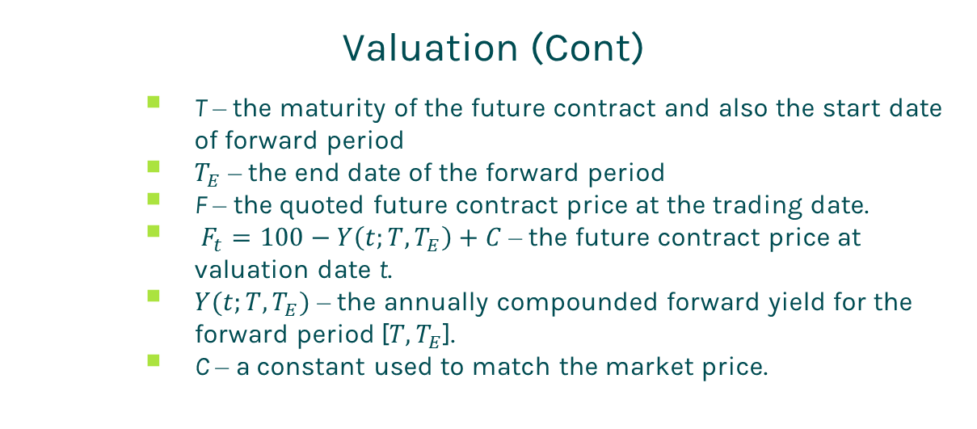
Interest Rate Future
Valuation (Cont)
T – the maturity of the future contract and also the start date of forward period
$T_{E}$ – the end date of the forward period
F – the quoted future contract price at the trading date.
$F_{t}=100−Y\left(t;T,T_{E}\right)+C$ – the future contract price at valuation date t.
$Y(t;T,T_{E})$ – the annually compounded forward yield for the forward period [${T,T}_{E}$].
C – a constant used to match the market price.

Slide 7
Interest Rate Future
A Real World Example
Interest rate future specification
Buy Sell | Buy
Currency | USD
Contract Size | 10000
First Delivery Date | 5/30/2018
Last Delivery Date | 6/29/2018
Future Maturity Date | 6/18/2018
Tenor | 3M
Future Ticker | EDM18
Future Ticker Size | 100
Future Ticker Value | 25
Number of Contract | 100
Quote Price | 98.405
Trade Date | 12/2/2016

Slide 8
Thanks!
You can find more details at
http://www.finpricing.com/lib/IrFuture.html

