Slide 1

Interest Rate Future Options and Valuation Dmitry Popov FinPricing http://www.finpricing.com

Slide 2
Interest Rate Future Option
Summary
Interest Rate Future Option Definition
Advantages of Trading Interest Rate Future Options
Valuation
A Real World Example

Slide 3
Interest Rate Future Option
Interest Rate Future Option Definition
An interest rate future option gives the holder the right but not the obligation to buy or sell an interest rate future at a specified price on a specified date.
Interest rate future options are usually traded in an exchange.
It is used to hedge against adverse changes in interest rates.
The buyer normally can exercise the option on any business day (American style) prior to expiration by giving notice to the exchange.
Option sellers (writers) receive a fixed premium upfront and in return are obligated to buy or sell the underlying asset at a specified price.
Option writers are exposed to unlimited liability.

Slide 4
Interest Rate Future Option
Advantages of Trading Interest Rate Futures Options
An investor who expected short-term interest rates to decline would also be expecting the price of the future contracts to increase. Thus, they might be inclined to purchase a 3-month Eurodollar futures call option to speculate on their belief.
The advantage of future options over options of a spot asset stems from the liquidity of futures contracts.
Futures markets tend to be more liquid than underlying cash markets.
Interest rate futures options are leveraged instruments.

Slide 5
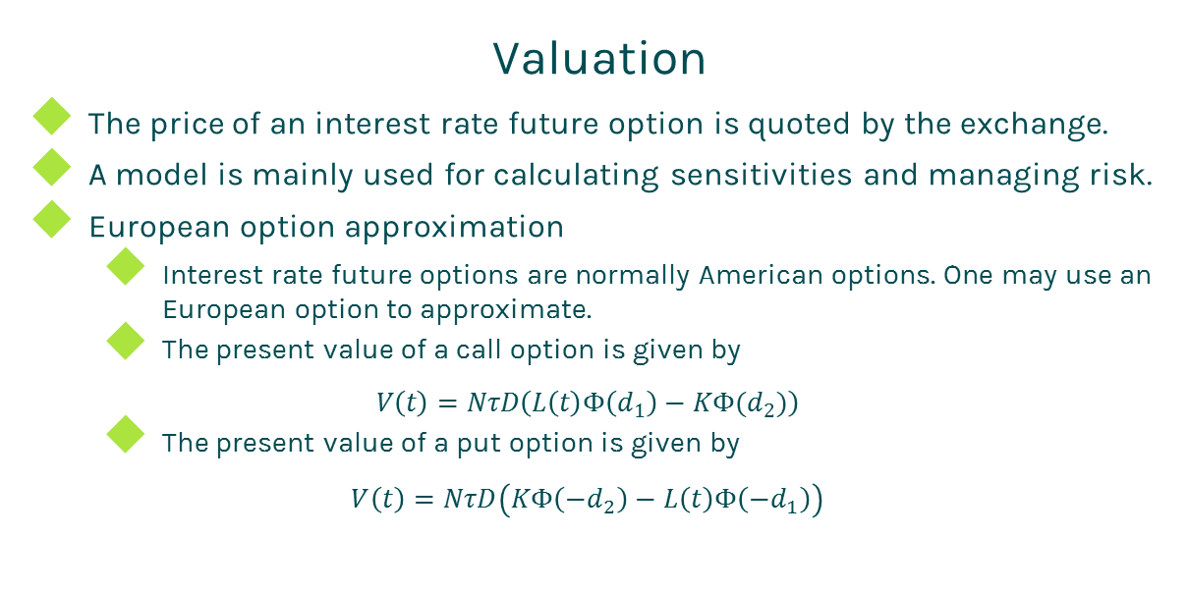
Interest Rate Future Option
Valuation
The price of an interest rate future option is quoted by the exchange.
A model is mainly used for calculating sensitivities and managing risk.
European option approximation
Interest rate future options are normally American options. One may use an European option to approximate.
The present value of a call option is given by
$$V\left(t\right)=NτD\left(L\left(t\right)Φ\left(d_{1}\right)−KΦ(d_{2})\right)$$
The present value of a put option is given by
$$V\left(t\right)=NτD\left(KΦ\left(−d_{2}\right)−L\left(t\right)Φ\left({−d}_{1}\right)\right)$$

Slide 6
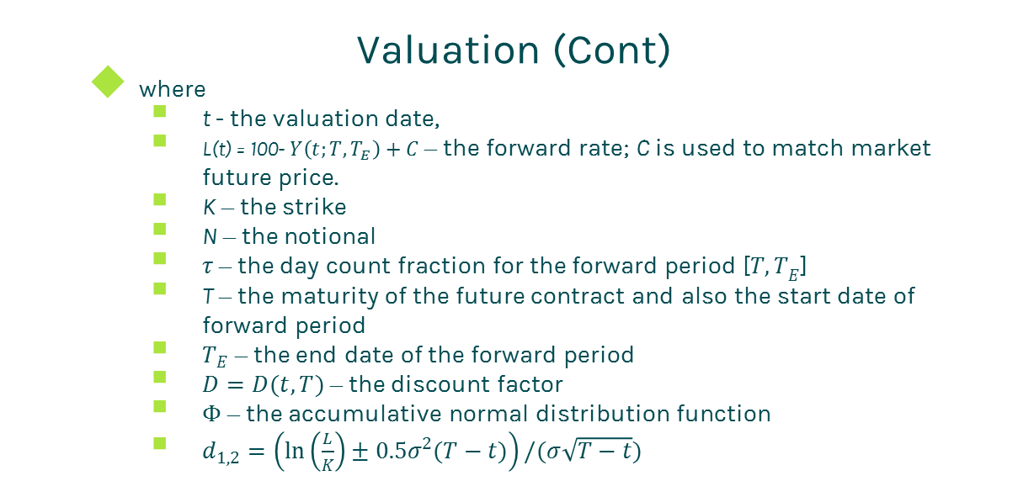
Interest Rate Future Option
Valuation (Cont)
where
t - the valuation date,
L(t) = 100- $Y\left(t;T,T_{E}\right)+C$ – the forward rate; C is used to match market future price.
K – the strike
N – the notional
$τ$ – the day count fraction for the forward period [${T,T}_{E}$]
T – the maturity of the future contract and also the start date of forward period
$T_{E}$ – the end date of the forward period
$D=D(t,T)$ – the discount factor
$Φ$ – the accumulative normal distribution function
$d_{1,2}=\left(\ln\left(\frac{L}{K}\right)±0.5σ_{}^{2}(T−t)\right)/(σ\sqrt{T−t})$

Slide 7
Interest Rate Future Option
Valuation (Cont)
American option
Price interest rate future options as American options
Tree, PDE or lattice can be used to price an American option
Given interest rate future options are simple products, we use Black Scholes dynamics plus binomial tree to price an American interest rate future option.

Slide 8
Interest Rate Future Option
A Real World Example
Future option specification |  | Underlying future specification
Quote Price | 0.05 | Contract Size | 10000
Trade Date | 11/23/2016 | First Delivery Date | 5/30/2017
Option Maturity Date | 6/19/2017 | Last Delivery Date | 6/30/2017
Settlement Amount | -62500 | Future Maturity Date | 6/19/2017
Settlement Date | 11/23/2016 | Tenor | 3M
Strike | 98.75 | Future Ticker | EDM17
Option Ticker | EDM17P 98.75 | Future Ticker Size | 100
Call Put | Put | Number of Contract | 500
Currency | USD
Buy Sell | Buy

Slide 9
Thanks!
You can find more details at
http://www.finpricing.com/lib/IrFutureOption.html

