Slide 1

Interest Rate Swap Vaulation Pratical Guide Alan White FinPricing http://www.finpricing.com

Slide 2
Swap
Summary
Interest Rate Swap Introduction
The Use of Interest Rate Swap
Swap or Swaplet Payoff
Valuation
Practical Notes
A real world example

Slide 3
Swap
Interest Rate Swap Introduction
An interest rate swap is an agreement between two parties to exchange future interest rate payments over a set period of time.
An interest rate swap consists of a series of payment periods, called swaplets.
Vanilla Interest Rate Swaps involve the exchange of a fixed interest rate for a floating rate, or vice versa.
There are two legs associated with each party: a fixed leg and a floating leg.
Swaps are OTC derivatives that bear counterparty credit risk.

Slide 4
Swap
The Use of Interest Rate Swap
Swaps are the most popular OTC derivatives that are generally used to manage exposure to fluctuations in interest rates.
Swaps can also be used to obtain a marginally lower interest rate. Thus they are often utilized by a firm that can borrow money easily at one type of interest rate but prefers a different type.
Swaps allow investors to adjust interest rate exposure and offset interest rate risk.
Speculators use swaps to speculate on the movement of interest rates.
More and more swaps are cleared through central counterparties (CCPs) nowadays.

Slide 5
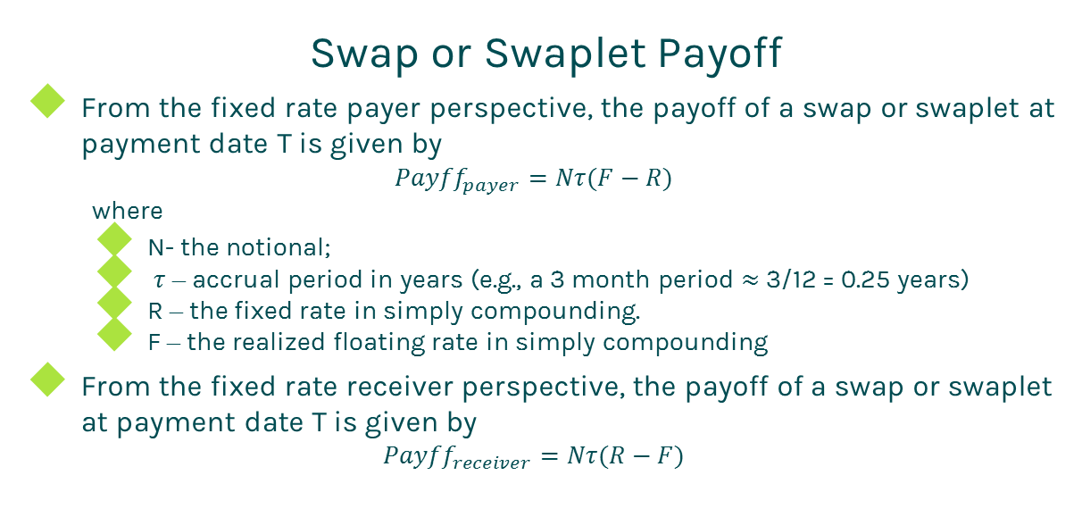
Swap
Swap or Swaplet Payoff
From the fixed rate payer perspective, the payoff of a swap or swaplet at payment date T is given by
$${Payff}_{payer}=Nτ(F−R)$$
where
N- the notional;
$τ$ – accrual period in years (e.g., a 3 month period $≈$ 3/12 = 0.25 years)
R – the fixed rate in simply compounding.
F – the realized floating rate in simply compounding
From the fixed rate receiver perspective, the payoff of a swap or swaplet at payment date T is given by
$${Payff}_{receiver}=Nτ(R−F)$$

Slide 6
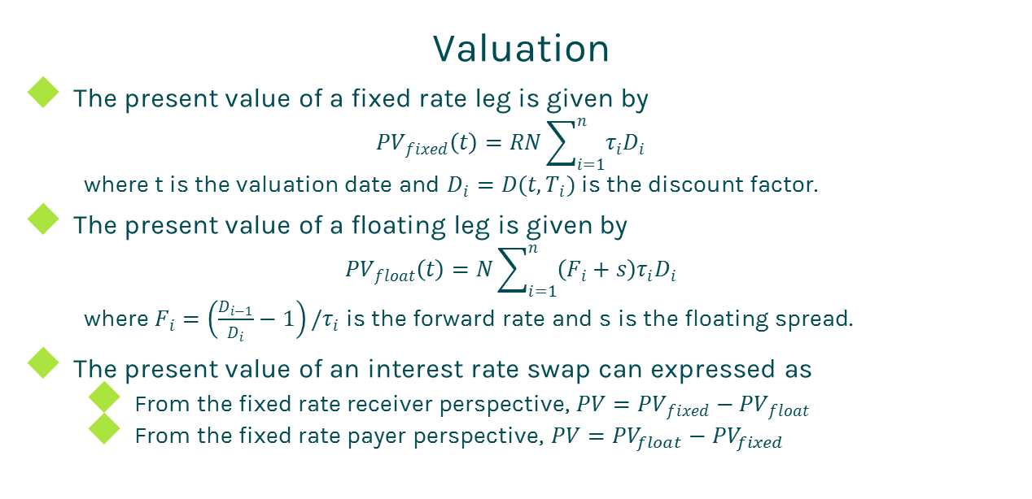
Swap
Valuation
The present value of a fixed rate leg is given by
$${PV}_{fixed}\left(t\right)=RN\sum_{i=1}^{n}{τ_{i}D_{i}}$$
where t is the valuation date and $D_{i}=D(t,T_{i})$ is the discount factor.
The present value of a floating leg is given by
$${PV}_{float}\left(t\right)=N\sum_{i=1}^{n}{\left(F_{i}+s\right)τ_{i}D_{i}}$$
where $F_{i}=\left(\frac{D_{i−1}}{D_{i}}−1\right)/τ_{i}$ is the forward rate and s is the floating spread.
The present value of an interest rate swap can expressed as
From the fixed rate receiver perspective, $PV={PV}_{fixed}−{PV}_{float}$
From the fixed rate payer perspective, $PV={PV}_{float}−{PV}_{fixed}$

Slide 7
Swap
Practical Notes
First of all, you need to generate accurate cash flows for each leg. The cash flow generation is based on the start time, end time and payment frequency of the leg, plus calendar (holidays), business convention (e.g., modified following, following, etc.) and whether sticky month end.
We assume that accrual periods are the same as reset periods and payment dates are the same as accrual end dates in the above formulas for brevity. But in fact, they are different due to different market conventions. For example, index periods can overlap each other but swap cash flows are not allowed to overlap.
The accrual period is calculated according to the start date and end date of a cash flow plus day count convention

Slide 8
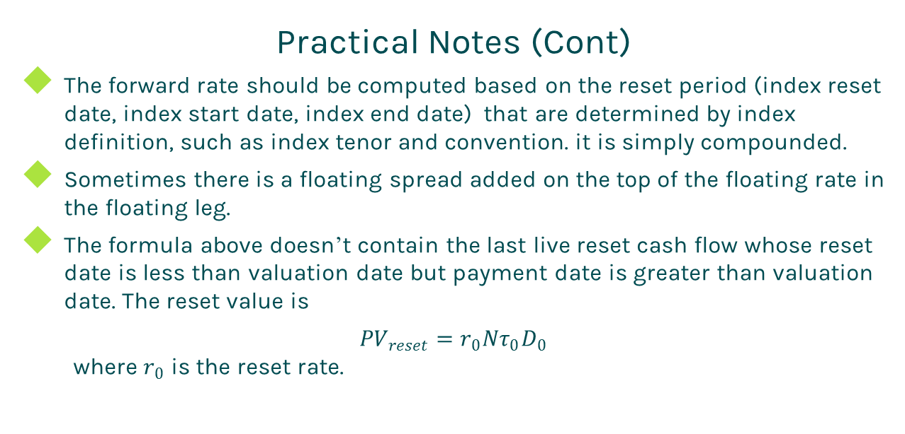
Swap
Practical Notes (Cont)
The forward rate should be computed based on the reset period (index reset date, index start date, index end date) that are determined by index definition, such as index tenor and convention. it is simply compounded.
Sometimes there is a floating spread added on the top of the floating rate in the floating leg.
The formula above doesn’t contain the last live reset cash flow whose reset date is less than valuation date but payment date is greater than valuation date. The reset value is
${PV}_{reset}=r_{0}Nτ_{0}D_{0}$
where $r_{0}$ is the reset rate.

Slide 9
Swap
Practical Notes (Cont)
The present value of the reset cash flow should be added into the present value of the floating leg.
Some dealers take bid-offer spreads into account. In this case, one should use the bid curve constructed from bid quotes for forwarding and the offer curve built from offer quotes for discounting.

Slide 10
Swap
A Real World Example
Leg 1 Specification |  | Leg 2 Specification
Currency | USD | Currency | USD
Day Count | dcAct360 | Day Count | dcAct360
Leg Type | Fixed | Leg Type | Float
Notional | 5000000 | Notional | 5000000
Pay Receive | Receive | Pay Receive | Pay
Payment Frequency | 1M | Payment Frequency | 1M
Start Date | 7/1/2015 | Start Date | 7/1/2015
End Date | 3/1/2023 | End Date | 3/1/2023
Fixed Rate | 0.0455 | Spread | 0
 |  | Index Specification
 |  | Index Type | LIBOR
 |  | Index Tenor | 1M
 |  | Index Day Count | dcAct360

Slide 11
Thanks!
You can find more details at
http://www.finpricing.com/lib/IrSwap.html

