Slide 1

Swaption Product and Vaulation Alan White FinPricing http://www.finpricing.com

Slide 2
Swaption
Summary
Interest Rate Swaption Introduction
The Use of Swaption
Swaption Payoff
Valuation
Practical Guide
A real world example

Slide 3
Swaption
Swaption Introduction
An interest rate (European) swaption is an OTC option that grants its owner the right but not the obligation to enter the underlying swap.
There are two types of swaptions: a payer swaption and a receiver swaption.
A payer swaption is also called a right-to-pay swaption that allows its holder to exercise into a swap where the holder pays fixed rates and receives floating rates
A receiver swaption is also called right-to-receive swaption that allows its holders to exercise into a swap where the holder receives fixed rates and pays floating rates.
Swaptions provide clients with a guarantee that the fixed rate of interest they will pay or receive at some of future time will not exceed certain level.

Slide 4
Swaption
The Use of Swaption
Market participants use swaptions to manage interest rate risk arising from their business.
A firm might buy a payer swaption if it wants protection from rising interest rates.
A corporation holding a mortgage portfolio might buy a receiver swaption to protect against decreasing interest rates that might lead to mortgage prepayment.
A company believing that interest rates will not increase much might sell a payer swaption to earn the premium.
An institution believing that interest rates will not decrease much might sell a receiver swaption to earn the premium.

Slide 5
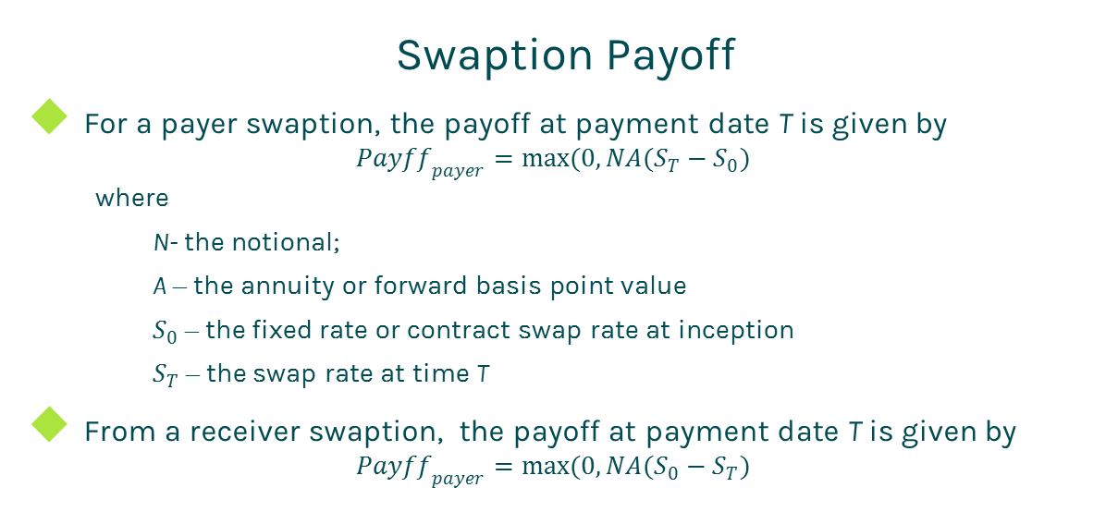
Swaption
Swaption Payoff
For a payer swaption, the payoff at payment date T is given by
$${Payff}_{payer}=max(0,NA(S_{T}−S_{0})$$
where
N- the notional;
A – the annuity or forward basis point value
$S_{0}$ – the fixed rate or contract swap rate at inception
$S_{T}$ – the swap rate at time T
From a receiver swaption, the payoff at payment date T is given by
$${Payff}_{payer}=max(0,NA(S_{0}−S_{T})$$

Slide 6
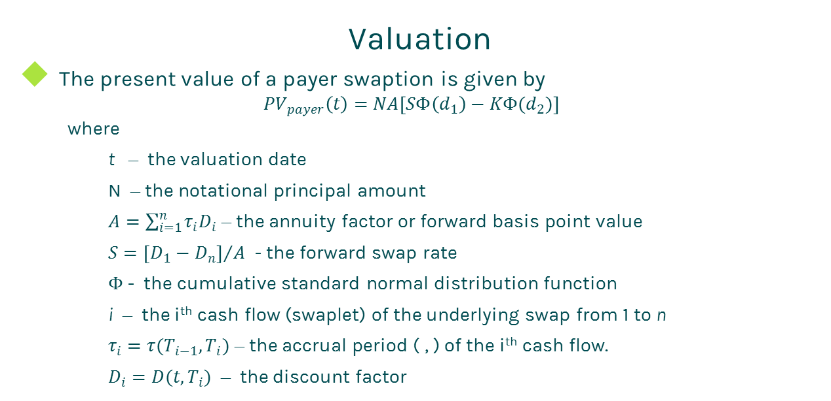
Swaption
Valuation
The present value of a payer swaption is given by
$${PV}_{payer}\left(t\right)=NA\left[SΦ\left(d_{1}\right)−KΦ(d_{2})\right]$$
where
t – the valuation date
N – the notational principal amount
$A=\sum_{i=1}^{n}{τ_{i}D_{i}}$ – the annuity factor or forward basis point value
$S={\left[D_{1}−D_{n}\right]}/A$ - the forward swap rate
$Φ$ - the cumulative standard normal distribution function
i – the i^{th} cash flow (swaplet) of the underlying swap from 1 to n
$τ_{i}=τ(T_{i−1},T_{i})$ – the accrual period ( , ) of the i^{th} cash flow.
$D_{i}=D(t,T_{i})$ – the discount factor

Slide 7

Swaption
Valuation (Cont)
The present value of a receiver swaption can be expressed as
$${PV}_{payer}\left(t\right)=NA\left[KΦ\left({−d}_{2}\right)−SΦ\left({−d}_{1}\right)\right]$$
where all notations are the same as (1)

Slide 8
Swaption
Practical Guide
A swaption contract contains terms and conditions of the swaption and the underlying swap. For example, it specifies two maturities: swaption maturity and underlying swap maturity.
The valuation model for pricing a swaption is the Black formula that assumes the underlying swap rate follows a log-normal process.
First, one needs to generate the cash flows of the underlying swap. The generation is based on the start time, end time and payment frequency of each leg, plus calendar (holidays), business convention (e.g., modified following, following, etc.) and whether sticky month end.

Slide 9
Swaption
Practical Guide
The accrual period is calculated according to the start date and end date of a cash flow plus day count convention
Any compounded interest zero rate curves can be used to compute discount factor, of course the formulas will be slightly different. The most common used one is continuously compounded zero rates.
The other key for accurately pricing an outstanding swaption is to construct an arbitrage-free volatility surface. Unlike a cap/floor volatility surface that is 3 dimensional (maturity – strike – volatility), a swaption volatility surface is 4 dimensional (swaption maturity – underlying swap tenor – strike – volatility).

Slide 10
Swaption
A Real World Example
Swaption Specification |  | Underlying Swap Specification
Buy Sell | Buy | Leg 1 Specification |  | Leg 2 Specification
Pay Receive | Pay | Currency | USD | Currency | USD
Notification Lag | 2 | Day Count | dc30360 | Day Count | dcAct360
Settlement | Cash | Leg Type | Fixed | Leg Type | Float
Exercise Type | Call | Notional | 25000000 | Notional | 25000000
Notification Date | 4/30/2020 | Pay Receive | Pay | Pay Receive | Receive
Settlement Date | 5/5/2020 | Payment Freq | 6 | Payment Freq | 3
Forward Premium Amount | 3375000 | Start Date | 5/5/2020 | Start Date | 5/5/2020
Premium Pay Receive | Pay | End Date | 5/5/2030 | End Date | 5/5/2030
Forward Premium Date | 5/5/2020 | Fixed Rate | 0.02855 | Spread | 0
 |  |  |  | Index Specification
 |  |  |  | Type | LIBOR
 |  |  |  | Tenor | 3M
 |  |  |  | Day Count | dcAct360

Slide 11
Thanks!
You can find more details at
http://www.finpricing.com/lib/IrSwaption.html

