Slide 1

VaR Introduction III: Monte Carlo VaR Tom Mills FinPricing http://www.finpricing.com

Slide 2
Monte Carlo VaR
Summary
VaR Definition
VaR Roles
VaR Pros and Cons
VaR Approaches
Monte Carlo VaR
Monte Carlo VaR Methodology and Implementation
VaR Scaling
VaR Backtest
http://www.finpricing.com/lib/MonteCarloVaR.pptx

Slide 3
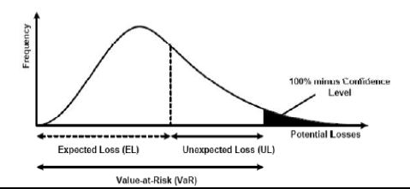
Monte Carlo VaR
Value at Risk (VaR) Definition
The maximum likely loss on a portfolio for a given probability defined as x% confidence level over N days
Pr(Loss > VaR(x%)) < 1- x%
http://www.finpricing.com/lib/MonteCarloVaR.pptx

Slide 4
Monte Carlo VaR
VaR Roles
Risk measurement
Risk management
Risk control
Financial reporting
Regulatory and economic capital
http://www.finpricing.com/lib/MonteCarloVaR.pptx

Slide 5
Monte Carlo VaR
VaR Pros & Cons
Pros
Regulatory measurement for market risk
Objective assessment
Intuition and clear interpretation
Consistent and flexible measurement
Cons
Doesn’t measure risk beyond the confidence level: tail risk
Non sub-additive
http://www.finpricing.com/lib/MonteCarloVaR.pptx

Slide 6
Monte Carlo VaR
Three VaR Approaches
Parametric VaR
Historical VaR
Monte Carlo VaR
The presentation focuses on historical VaR.
http://www.finpricing.com/lib/MonteCarloVaR.pptx

Slide 7
Monte Carlo VaR
Monte Carlo VaR
Assumption
Assuming market factors follow certain stochastic processes.
Pros
Easy back and stress test
Good for high confidence level and tail risk
Cons
Dependent on distribution assumption
Calibration required
Extensive computation
http://www.finpricing.com/lib/MonteCarloVaR.pptx

Slide 8
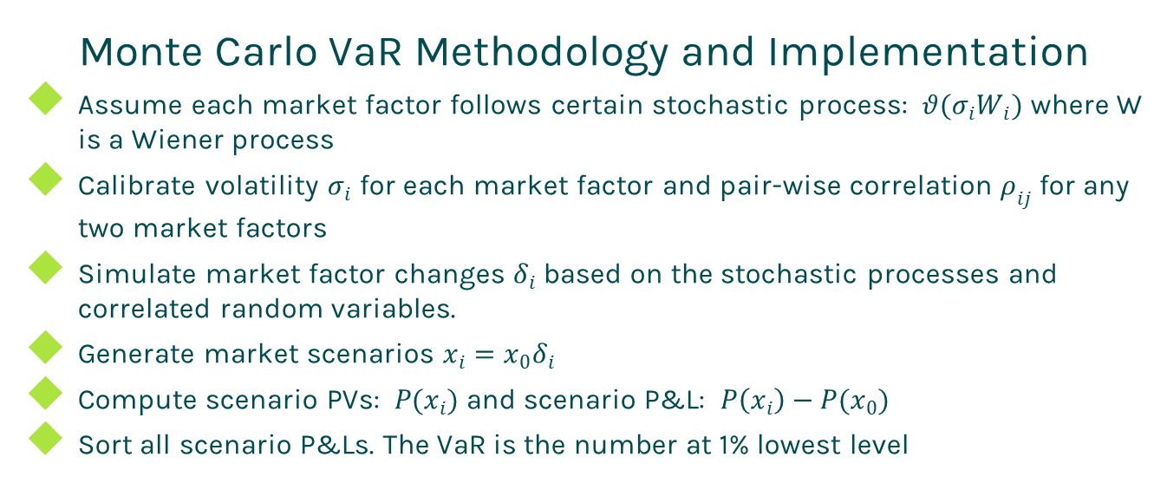
Monte Carlo VaR
Monte Carlo VaR Methodology and Implementation
Assume each market factor follows certain stochastic process: $θ(σ_{i}W_{i})$ where W is a Wiener process
Calibrate volatility $σ_{i}$ for each market factor and pair-wise correlation $ρ_{ij}$ for any two market factors
Simulate market factor changes $δ_{i}$ based on the stochastic processes and correlated random variables.
Generate market scenarios $x_{i}=x_{0}δ_{i}$
Compute scenario PVs: $P(x_{i})$ and scenario P&L: $P\left(x_{i}\right)−P(x_{0})$
Sort all scenario P&Ls. The VaR is the number at 1% lowest level
http://www.finpricing.com/lib/MonteCarloVaR.pptx

Slide 9
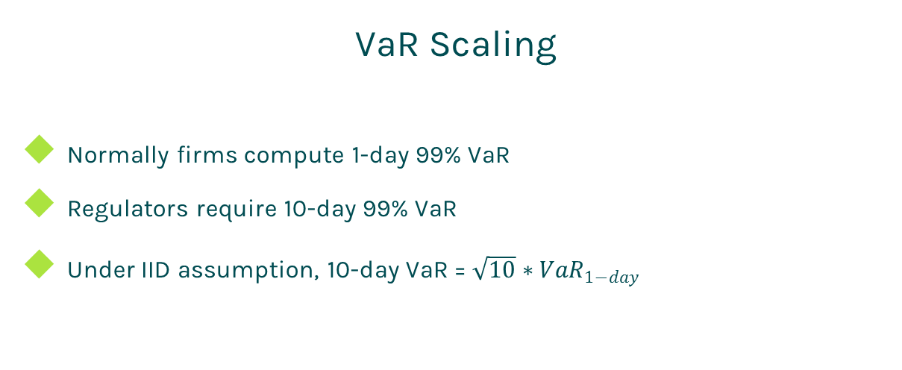
Monte Carlo VaR
VaR Scaling
Normally firms compute 1-day 99% VaR
Regulators require 10-day 99% VaR
Under IID assumption, 10-day VaR = $\sqrt{10}∗{VaR}_{1−day}$
http://www.finpricing.com/lib/MonteCarloVaR.pptx

Slide 10
Monte Carlo VaR
VaR Backtest
The only way to verify a VaR system is to backtest
At a certain day, compute hypothetic P&L. If (hypothetic P&L > VaR) ➔ breach, otherwise, ok
Hypothetic P&L is computed by holding valuation date and portfolio unchanged
In one year period,
If number of breaches is 0-4, the VaR system is in Green zone
If number of breaches is 5-9, the VaR system is in Yellow zone
If number of breaches is 10 or more, the VaR system is in Red zone
http://www.finpricing.com/lib/MonteCarloVaR.pptx

Slide 11
Thanks!
You can find more online presentations at
http://www.finpricing.com/paperList.html

