Slide 1

VaR Introduction I: Parametric VaR Tom Mills FinPricing http://www.finpricing.com

Slide 2
Parametric VaR
Summary
VaR Definition
VaR Roles
VaR Pros and Cons
VaR Approaches
Parametric VaR
Parametric VaR Methodology
Parametric VaR Implementation
VaR Scaling
VaR Backtest
http://www.finpricing.com/lib/ParametricVaR.pptx

Slide 3
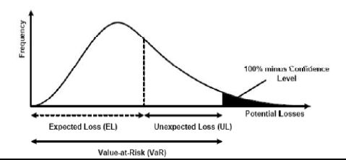
Parametric VaR
Value at Risk (VaR) Definition
The maximum likely loss on a portfolio for a given probability defined as x% confidence level over N days
Pr(Loss > VaR(x%)) < 1- x%
http://www.finpricing.com/lib/ParametricVaR.pptx

Slide 4
Parametric VaR
VaR Roles
Risk measurement
Risk management
Risk control
Financial reporting
Regulatory and economic capital
http://www.finpricing.com/lib/ParametricVaR.pptx

Slide 5
Parametric VaR
VaR Pros & Cons
Pros
Regulatory measurement for market risk
Objective assessment
Intuition and clear interpretation
Consistent and flexible measurement
Cons
Doesn’t measure risk beyond the confidence level: tail risk
Non sub-additive
http://www.finpricing.com/lib/ParametricVaR.pptx

Slide 6
Parametric VaR
Three VaR Approaches
Parametric VaR
Historical VaR
Monte Carlo VaR
The presentation focuses on parametric VaR.
http://www.finpricing.com/lib/ParametricVaR.pptx

Slide 7
Parametric VaR
Parametric VaR
Assumption
Asset returns follow normal distribution
Pros
Fast and simple calculation
Intuitive
Cons
Poor accuracy for non-linear products
Second order approximation
Hard to incorporate stress test
http://www.finpricing.com/lib/ParametricVaR.pptx

Slide 8



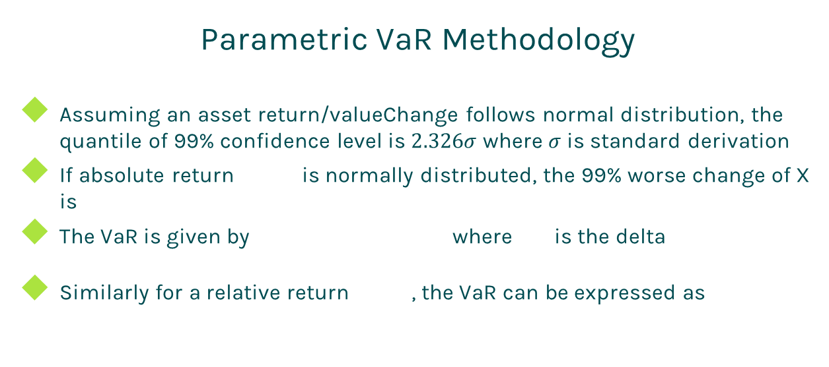
Parametric VaR
Parametric VaR Methodology
Assuming an asset return/valueChange follows normal distribution, the quantile of 99% confidence level is $2.326σ$ where $σ$ is standard derivation
If absolute return is normally distributed, the 99% worse change of X is
The VaR is given by where is the delta
Similarly for a relative return , the VaR can be expressed as
http://www.finpricing.com/lib/ParametricVaR.pptx

Slide 9
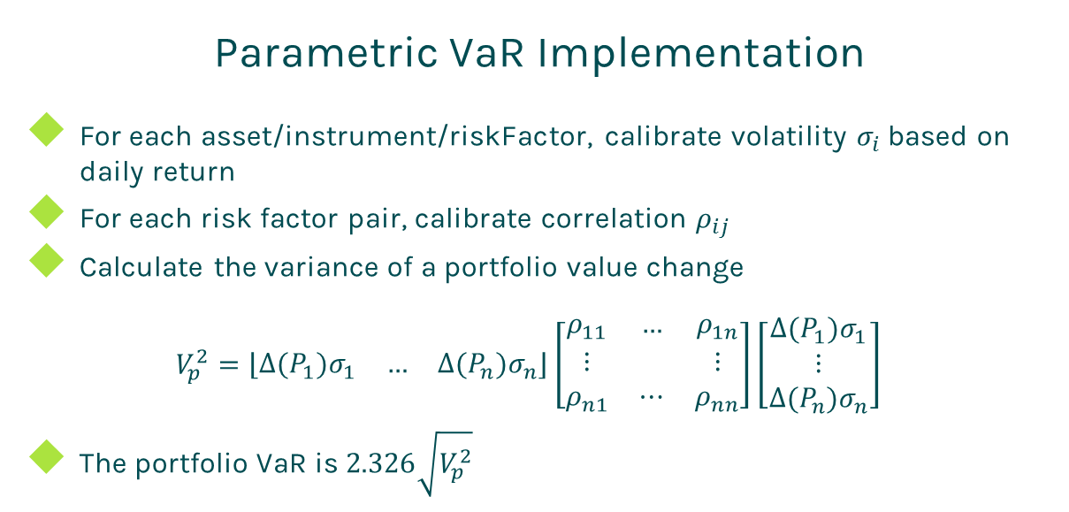
Parametric VaR
Parametric VaR Implementation
For each asset/instrument/riskFactor, calibrate volatility $σ_{i}$ based on daily return
For each risk factor pair, calibrate correlation $ρ_{ij}$
Calculate the variance of a portfolio value change
$$V_{p}^{2}=\left\lfloor \begin{matrix}∆{(P}_{1})σ_{1} & … & ∆(P_{n})σ_{n}\end{matrix}\right\rfloor \left[\begin{matrix}ρ_{11} & … & ρ_{1n} \\ ⋮ & & ⋮ \\ ρ_{n1} & ⋯ & ρ_{nn}\end{matrix}\right]\left[\begin{matrix}∆{(P}_{1})σ_{1} \\ ⋮ \\ ∆(P_{n})σ_{n}\end{matrix}\right]$$
The portfolio VaR is $2.326\sqrt{V_{p}^{2}}$
http://www.finpricing.com/lib/ParametricVaR.pptx

Slide 10
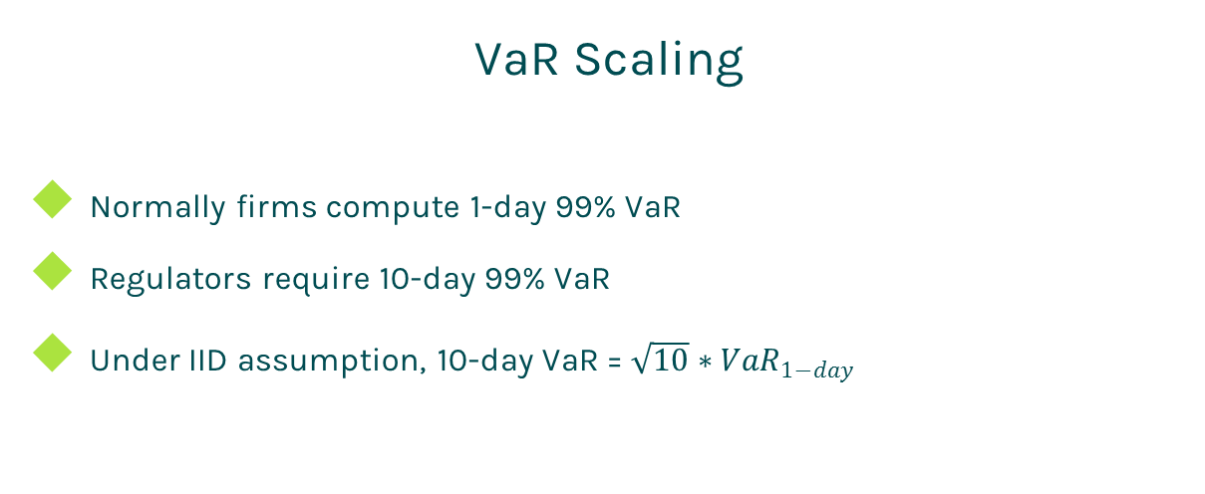
Parametric VaR
VaR Scaling
Normally firms compute 1-day 99% VaR
Regulators require 10-day 99% VaR
Under IID assumption, 10-day VaR = $\sqrt{10}∗{VaR}_{1−day}$
http://www.finpricing.com/lib/ParametricVaR.pptx

Slide 11
Parametric VaR
VaR Backtest
The only way to verify a VaR system is to backtest
At a certain day, compute hypothetic P&L. If (hypothetic P&L > VaR) ➔ breach, otherwise, ok
Hypothetic P&L is computed by holding valuation date and portfolio unchanged
In one year period,
If number of breaches is 0-4, the VaR system is in Green zone
If number of breaches is 5-9, the VaR system is in Yellow zone
If number of breaches is 10 or more, the VaR system is in Red zone
http://www.finpricing.com/lib/ParametricVaR.pptx

Slide 12
Thanks!
You can find more online presentations at
http://www.finpricing.com/paperList.html

