Slide 1

Counterparty Credit Risk Alex Yang FinPricing http://www.finpricing.com

Slide 2
CCR
Summary
Counterparty Credit Risk Definition
Counterparty Credit Risk Measures
Close Out
Master Agreement
CSA Agreement
Final Credit Exposure

Slide 3
CCR
Counterperty Credit Risk (CCR) Definition
Counterparty credit risk refers to the risk that a counterparty to a bilateral financial derivative contract may fail to fulfill its contractual obligation causing financial loss to the non-defaulting party.
Only over-the-counter (OTC) derivatives and financial security transactions (FSTs) (e.g., repos) are subject to counterparty risk.
If one party of a contract defaults, the non-defaulting party will find a similar contract with another counterparty in the market to replace the default one. That is why counterparty credit risk sometimes is referred to as replacement risk.
The replacement cost is the MTM value of a counterparty portfolio at the time of the counterparty default.

Slide 4
CCR
Counterperty Credit Risk Measures
Credit exposure (CE) is the cost of replacing or hedging a contract at the time of default. The CE of a typical interest rate swap is shown below

Slide 5
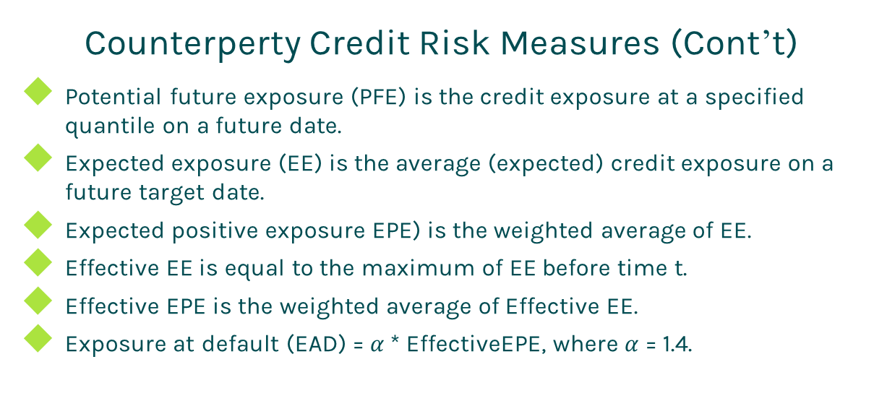
CCR
Counterperty Credit Risk Measures (Cont’t)
Potential future exposure (PFE) is the credit exposure at a specified quantile on a future date.
Expected exposure (EE) is the average (expected) credit exposure on a future target date.
Expected positive exposure EPE) is the weighted average of EE.
Effective EE is equal to the maximum of EE before time t.
Effective EPE is the weighted average of Effective EE.
Exposure at default (EAD) = $α$ * EffectiveEPE, where $α$ = 1.4.

Slide 6
CCR
Close Out
If a contract value > 0 to a bank at the time of default, the bank
closes out the position and receives nothing from the defaulting counterparty;
then enters a similar contract with another party and pays the contract value.
The exposure is the replacement cost, i.e., the contract value
If the contract value < 0 to the bank at the time of default, the bank
closes out the position and pays contract value to the defaulting counterparty
then enters a similar contract with another party and receives the contract value.
The net loss is zero.
Thus the credit exposure can be expressed as
E(t) = max(V(t), 0)

Slide 7
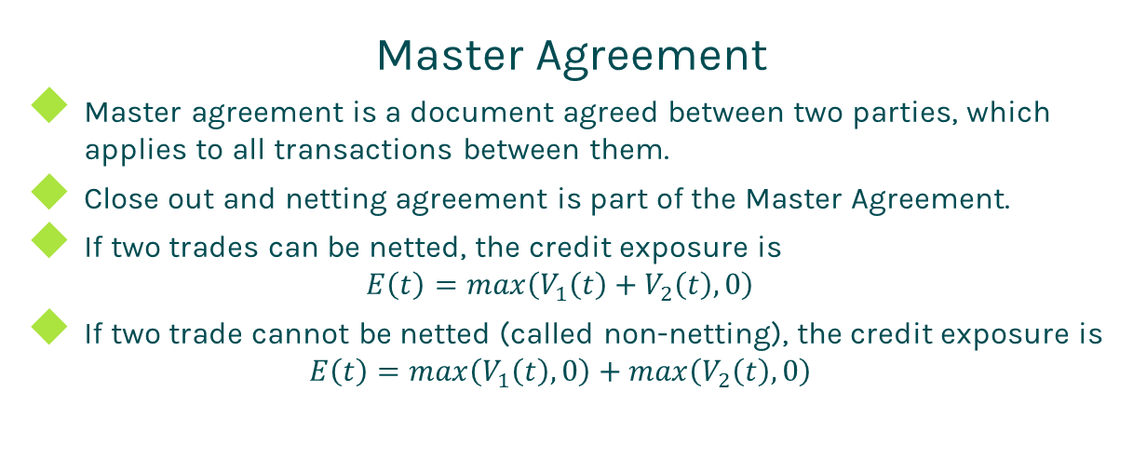
CCR
Master Agreement
Master agreement is a document agreed between two parties, which applies to all transactions between them.
Close out and netting agreement is part of the Master Agreement.
If two trades can be netted, the credit exposure is
$$E\left(t\right)=max\left(V_{1}\left(t\right)+V_{2}\left(t\right), 0\right)$$
If two trade cannot be netted (called non-netting), the credit exposure is
$$E\left(t\right)=max\left(V_{1}\left(t\right), 0\right)+max\left(V_{2}\left(t\right), 0\right)$$

Slide 8
CCR
CSA Agreement
Credit Support Annex (CSA) or Margin Agreement or Collateral Agreement is a legal document that regulates collateral posting.
Trades under a CSA should be also under a netting agreement, but not vice verse.
It defines a variety of terms related to collateral posting:
Threshold
Minimum transfer amount (MTA)
Independent amount (or initial margin or haircut)

Slide 9
CCR
CSA Agreement (Cont’d)
The credit exposure of the interest rate swap after taking CSA into account can be illustrated as

Slide 10
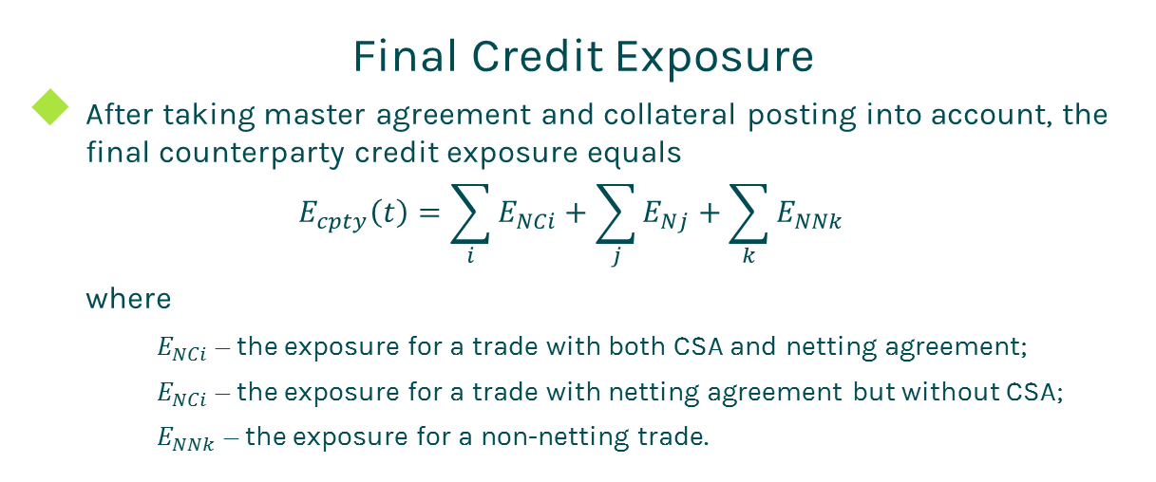
CCR
Final Credit Exposure
After taking master agreement and collateral posting into account, the final counterparty credit exposure equals
$$E_{cpty}\left(t\right)=\sum_{i}{E_{NCi}+\sum_{j}{E_{Nj}+\sum_{k}{E_{NNk}}}}$$
where
$E_{NCi}$ – the exposure for a trade with both CSA and netting agreement;
$E_{NCi}$ – the exposure for a trade with netting agreement but without CSA;
$E_{NNk}$ – the exposure for a non-netting trade.

Slide 11
Thanks!
You can find more details at
http://www.finpricing.com/lib/ccr.pdf

