Slide 1

Counterparty Credit Risk Simulation Alex Yang FinPricing http://www.finpricing.com

Slide 2
CCR Simulation
Summary
Counterparty Credit Risk Definition
Counterparty Credit Risk Measures
Monte Carlo Simulation
Interest Rate Curve Simulation
FX Rate Simulation
Equity Price Simulation
Commodity Simulation
Implied Volatility Simulation

Slide 3
CCR Simulation
Counterperty Credit Risk (CCR) Definition
Counterparty credit risk refers to the risk that a counterparty to a bilateral financial derivative contract may fail to fulfill its contractual obligation causing financial loss to the non-defaulting party.
Only over-the-counter (OTC) derivatives and financial security transactions (FSTs) (e.g., repos) are subject to counterparty risk.
If one party of a contract defaults, the non-defaulting party will find a similar contract with another counterparty in the market to replace the default one. That is why counterparty credit risk sometimes is referred to as replacement risk.
The replacement cost is the MTM value of a counterparty portfolio at the time of the counterparty default.

Slide 4
CCR Simulation
Counterperty Credit Risk Measures
Credit exposure (CE) is the cost of replacing or hedging a contract at the time of default.
Credit exposure in future is uncertain (stochastic) so that Monte Carlo simulation is needed.
Other measures, such as potential future exposure (PFE), expected exposure (EE), expected positive exposure (EPE), effective EE, effective EPE and exposure at default (EAD), can be derived from CE,

Slide 5
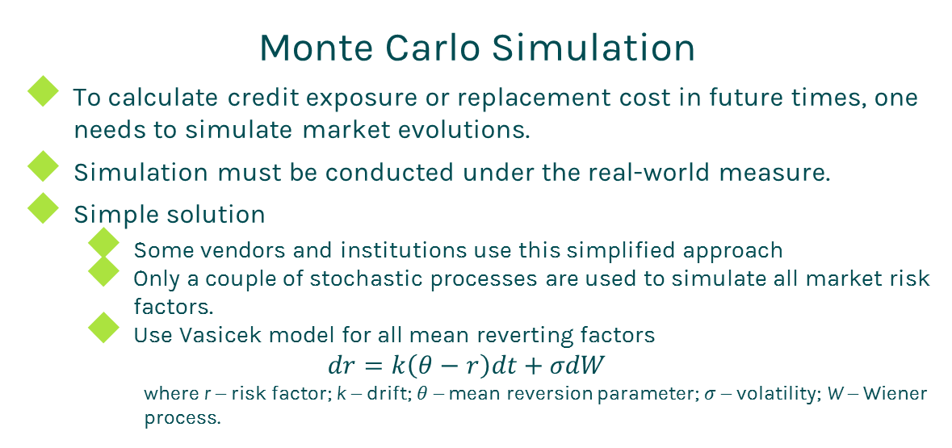
CCR Simulation
Monte Carlo Simulation
To calculate credit exposure or replacement cost in future times, one needs to simulate market evolutions.
Simulation must be conducted under the real-world measure.
Simple solution
Some vendors and institutions use this simplified approach
Only a couple of stochastic processes are used to simulate all market risk factors.
Use Vasicek model for all mean reverting factors
$$dr=k\left(θ−r\right)dt+σdW$$
where r – risk factor; k – drift; $θ$ – mean reversion parameter; $σ$ – volatility; W – Wiener process.

Slide 6
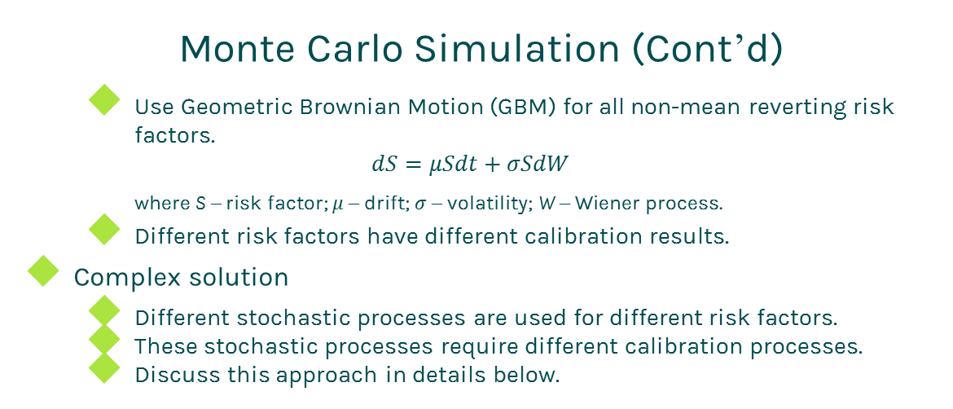
CCR Simulation
Monte Carlo Simulation (Cont’d)
Use Geometric Brownian Motion (GBM) for all non-mean reverting risk factors.
$$dS=μSdt+σSdW$$
where S – risk factor; $μ$ – drift; $σ$ – volatility; W – Wiener process.
Different risk factors have different calibration results.
Complex solution
Different stochastic processes are used for different risk factors.
These stochastic processes require different calibration processes.
Discuss this approach in details below.

Slide 7
CCR Simulation
Interest rate curve simulation
Simulate yield curves (zero rate curves) or swap curves.
There are many points in a yield curve, e.g., 1d, 1w, 2w 1m, etc. One can use Principal Component Analysis (PCA) to reduce risk factors from 20 points, for instance, into 3 point drivers.
Using PCA, you only need to simulate 3 drivers for each curve. But please remember you need to convert 3 drivers back to 20-point curve at each path and each time step.

Slide 8
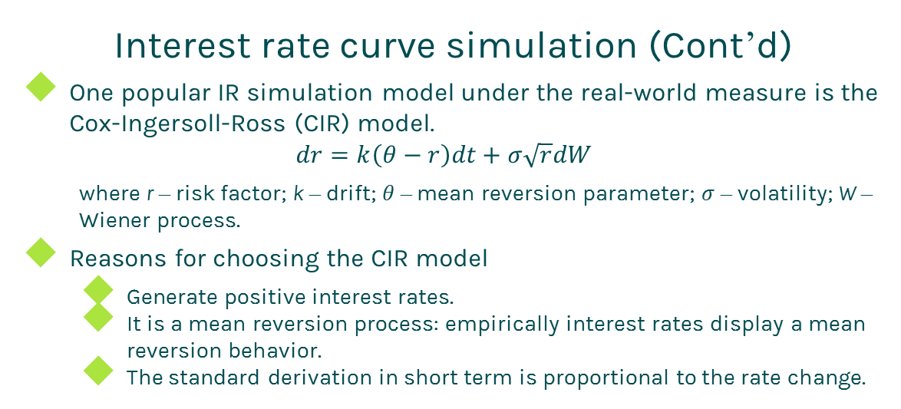
CCR Simulation
Interest rate curve simulation (Cont’d)
One popular IR simulation model under the real-world measure is the Cox-Ingersoll-Ross (CIR) model.
$$dr=k\left(θ−r\right)dt+σ\sqrt{r}dW$$
where r – risk factor; k – drift; $θ$ – mean reversion parameter; $σ$ – volatility; W – Wiener process.
Reasons for choosing the CIR model
Generate positive interest rates.
It is a mean reversion process: empirically interest rates display a mean reversion behavior.
The standard derivation in short term is proportional to the rate change.

Slide 9
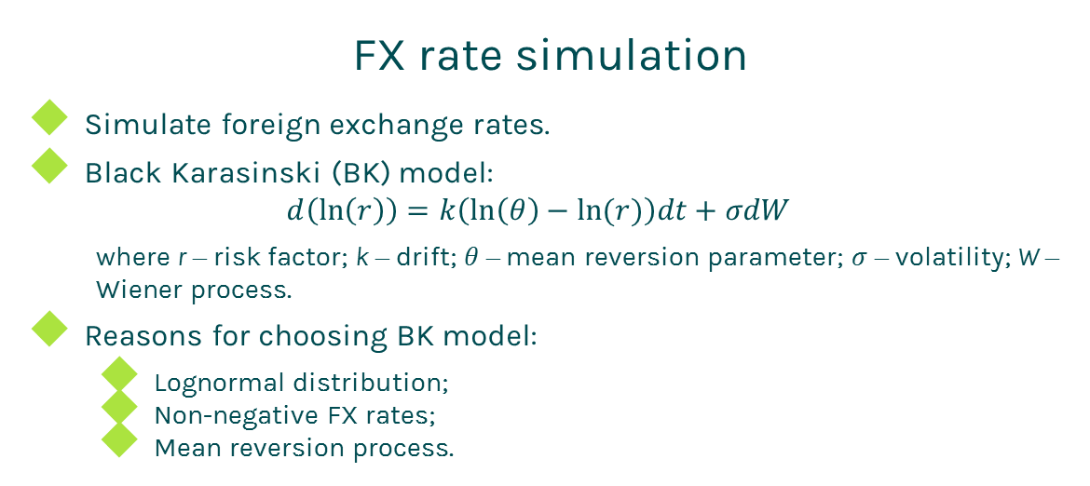
CCR Simulation
FX rate simulation
Simulate foreign exchange rates.
Black Karasinski (BK) model:
$$d\left(\ln\left(r\right)\right)=k\left(\ln\left(θ\right)−ln(r)\right)dt+σdW$$
where r – risk factor; k – drift; $θ$ – mean reversion parameter; $σ$ – volatility; W – Wiener process.
Reasons for choosing BK model:
Lognormal distribution;
Non-negative FX rates;
Mean reversion process.

Slide 10
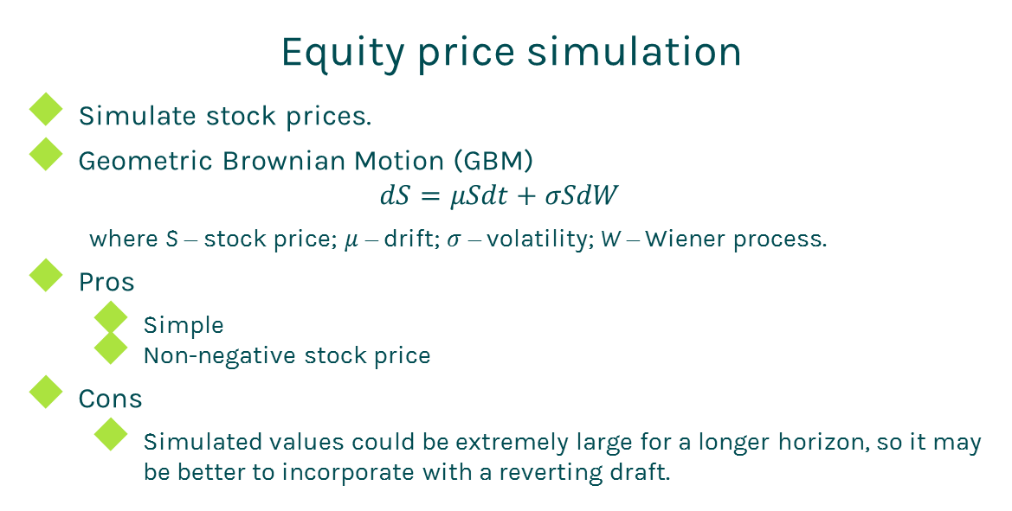
CCR Simulation
Equity price simulation
Simulate stock prices.
Geometric Brownian Motion (GBM)
$$dS=μSdt+σSdW$$
where S – stock price; $μ$ – drift; $σ$ – volatility; W – Wiener process.
Pros
Simple
Non-negative stock price
Cons
Simulated values could be extremely large for a longer horizon, so it may be better to incorporate with a reverting draft.

Slide 11
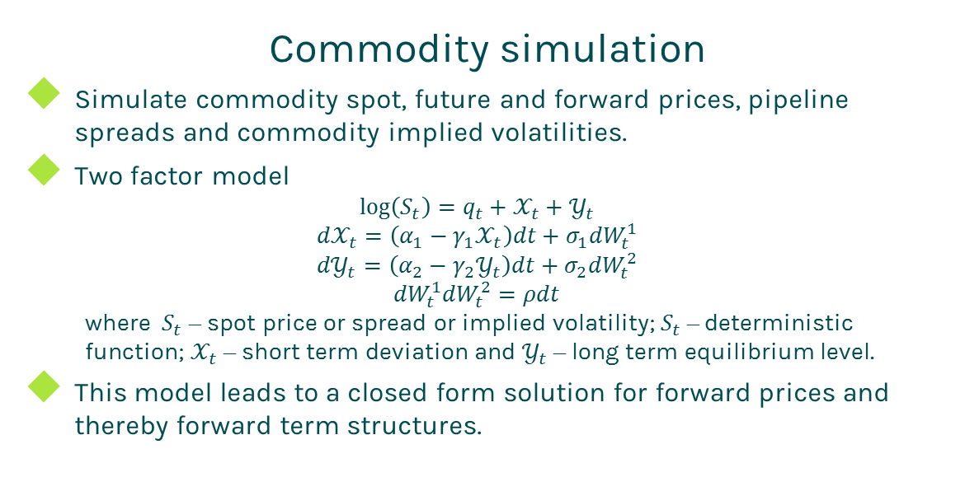
CCR Simulation
Commodity simulation
Simulate commodity spot, future and forward prices, pipeline spreads and commodity implied volatilities.
Two factor model
$$\log\left(S_{t}\right)=q_{t}+𝒳_{t}+𝒴_{t}$$
$${d𝒳}_{t}=\left(α_{1}−γ_{1}𝒳_{t}\right)dt+σ_{1}{dW}_{t}^{1}$$
$${d𝒴}_{t}=\left(α_{2}−γ_{2}𝒴_{t}\right)dt+σ_{2}{dW}_{t}^{2}$$
$${dW}_{t}^{1}{dW}_{t}^{2}=ρdt$$
where $S_{t}$ – spot price or spread or implied volatility; $S_{t}$ – deterministic function; $𝒳_{t}$ – short term deviation and $𝒴_{t}$ – long term equilibrium level.
This model leads to a closed form solution for forward prices and thereby forward term structures.

Slide 12
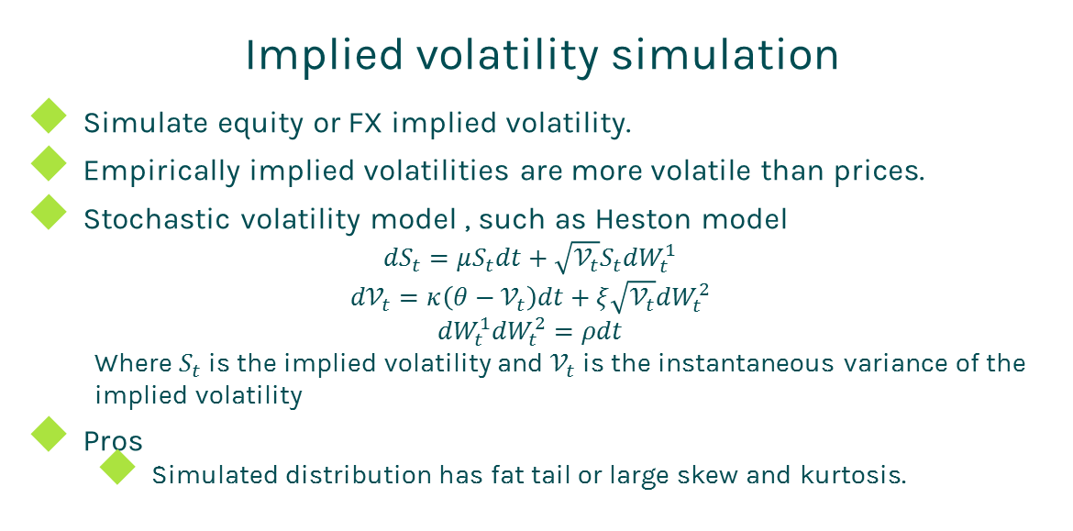
CCR Simulation
Implied volatility simulation
Simulate equity or FX implied volatility.
Empirically implied volatilities are more volatile than prices.
Stochastic volatility model , such as Heston model
$${dS}_{t}=μS_{t}dt+\sqrt{𝒱_{t}}S_{t}{dW}_{t}^{1}$$
$${d𝒱}_{t}=κ\left(θ−𝒱_{t}\right)dt+ξ\sqrt{𝒱_{t}}{dW}_{t}^{2}$$
$${dW}_{t}^{1}{dW}_{t}^{2}=ρdt$$
Where $S_{t}$ is the implied volatility and $𝒱_{t}$ is the instantaneous variance of the implied volatility
Pros
Simulated distribution has fat tail or large skew and kurtosis.

Slide 13
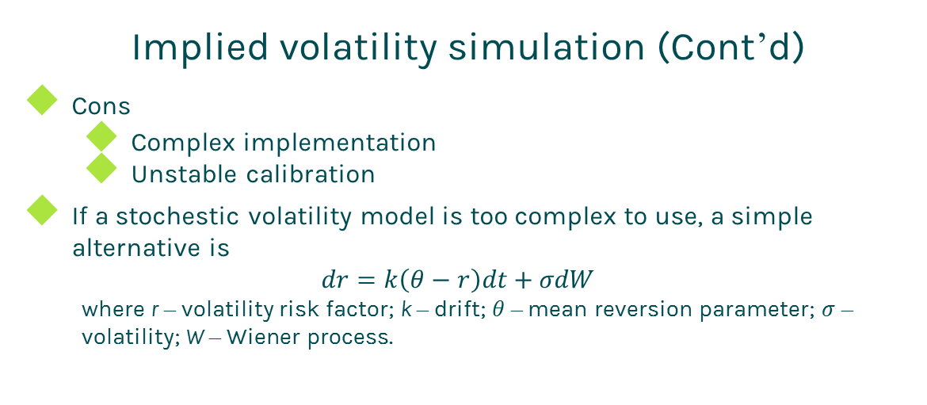
CCR Simulation
Implied volatility simulation (Cont’d)
Cons
Complex implementation
Unstable calibration
If a stochestic volatility model is too complex to use, a simple alternative is
$$dr=k\left(θ−r\right)dt+σdW$$
where r – volatility risk factor; k – drift; $θ$ – mean reversion parameter; $σ$ – volatility; W – Wiener process.

Slide 14
Thanks!
You can find more details at
http://www.finpricing.com/lib/ccrSimulation.pdf

