Slide 1

Collateral Management and Counterparty Credit Risk Alex Yang FinPricing http://www.finpricing.com

Slide 2
Collateral
Summary
Collateral Definition
Special Treatments in the Derivatives Market
Benefits of Collateral Posting
Collateral Arrangement Forms
Credit Support Annex (CSA)
Valuation under Collateral Arrangement
Credit Exposure under Collateral Arrangement

Slide 3
Collateral
Collateral Definition
Collateral is a property or an asset that a borrower offers as a way for a lender to secure the loan.
Collateral arrangement is a risk reduction tool that mitigates risk by improving recorvery and reducing credit exposure.
Collateral doesn’t turn a bad counterparty into a good one and doesn’t eliminate credit risk. Instead, it just reduces the loss at the default time.
Collateral management is an essential element in the plumbing of the financial system.
Collateral assets: mainly cash; also equities, bonds, MBS, debt instruments.

Slide 4
Collateral
Special Treatments in the Derivatives Market
The Bankruptcy code generally prevents creditors from seizing assets of a firm in bankruptcy. This provision is called the “automatic stay”.
The code affords a special treatment to financial derivative contracts, which exempts these contracts from the “automatic stay”.
The special treatment is also called a safe harbor.
The safe harbor allows counterparties to terminate derivative contracts with a debtor in bankruptcy and seize the underlying collaterals.

Slide 5
Collateral
Benefits of Collateral Posting
Reduce credit risk.
Free credit lines with existing counterparties.
Increase business with counterparties.
Expand the range of counterparties.
Equalize the disparity in counterparty creditworthiness.

Slide 6
Collateral
Collateral Arrangement Forms
There are two types of collateral arrangement: pledge and title transfer.
Pledge
The giver posts collateral to the taker.
The giver still owns the collateral.
If the giver defaults, the taker can take the cash or sell the securities.
It is widely used in US.
Title Transfer
The taker owns the collateral.
The giver is only entitled to the return of fungible securities and/or repayment of cash.
It is widely used in the stock-lending and repo market.

Slide 7
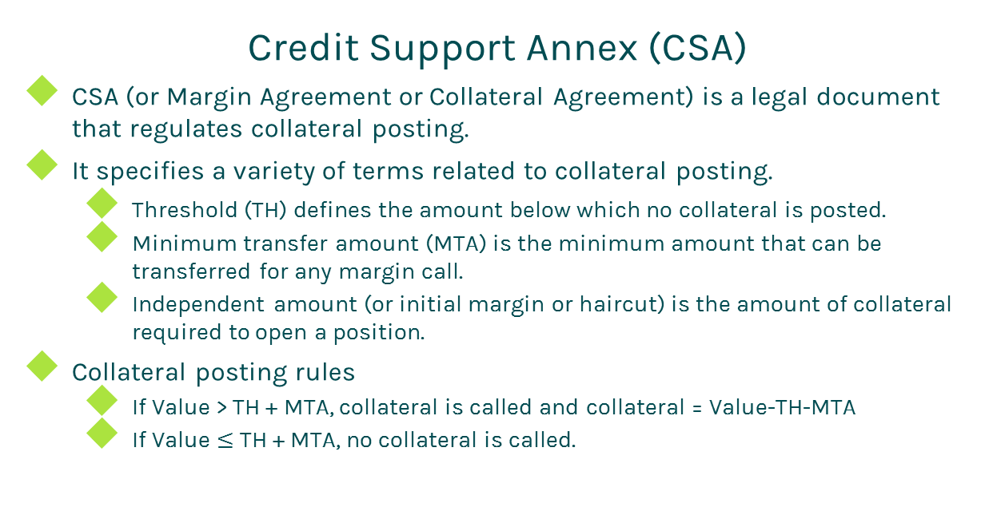
Collateral
Credit Support Annex (CSA)
CSA (or Margin Agreement or Collateral Agreement) is a legal document that regulates collateral posting.
It specifies a variety of terms related to collateral posting.
Threshold (TH) defines the amount below which no collateral is posted.
Minimum transfer amount (MTA) is the minimum amount that can be transferred for any margin call.
Independent amount (or initial margin or haircut) is the amount of collateral required to open a position.
Collateral posting rules
If Value > TH + MTA, collateral is called and collateral = Value-TH-MTA
If Value $≤$ TH + MTA, no collateral is called.

Slide 8
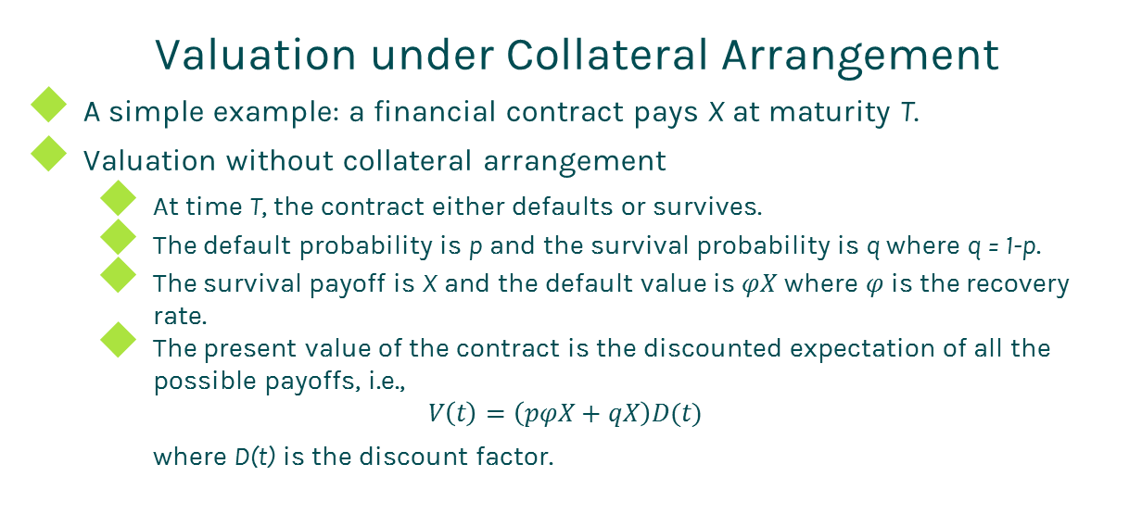
Collateral
Valuation under Collateral Arrangement
A simple example: a financial contract pays X at maturity T.
Valuation without collateral arrangement
At time T, the contract either defaults or survives.
The default probability is p and the survival probability is q where q = 1-p.
The survival payoff is X and the default value is $φX$ where $φ$ is the recovery rate.
The present value of the contract is the discounted expectation of all the possible payoffs, i.e.,
$$V\left(t\right)=\left(pφX+qX\right)D(t)$$
where D(t) is the discount factor.

Slide 9
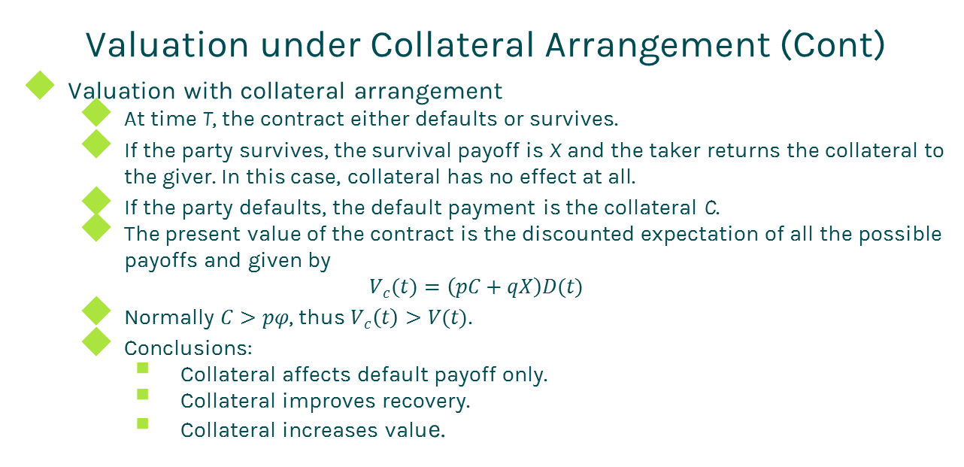
Collateral
Valuation under Collateral Arrangement (Cont)
Valuation with collateral arrangement
At time T, the contract either defaults or survives.
If the party survives, the survival payoff is X and the taker returns the collateral to the giver. In this case, collateral has no effect at all.
If the party defaults, the default payment is the collateral C.
The present value of the contract is the discounted expectation of all the possible payoffs and given by
$$V_{c}(t)=\left(pC+qX\right)D(t)$$
Normally $C>pφ$, thus $V_{c}\left(t\right)>V(t)$.
Conclusions:
Collateral affects default payoff only.
Collateral improves recovery.
Collateral increases value.

Slide 10
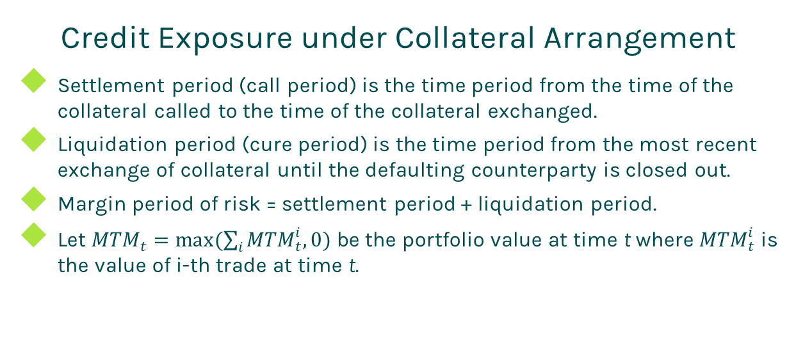
Collateral
Credit Exposure under Collateral Arrangement
Settlement period (call period) is the time period from the time of the collateral called to the time of the collateral exchanged.
Liquidation period (cure period) is the time period from the most recent exchange of collateral until the defaulting counterparty is closed out.
Margin period of risk = settlement period + liquidation period.
Let ${MTM}_{t}=max(\sum_{i}{{MTM}_{t}^{i}, 0)}$ be the portfolio value at time t where ${MTM}_{t}^{i}$ is the value of i-th trade at time t.

Slide 11
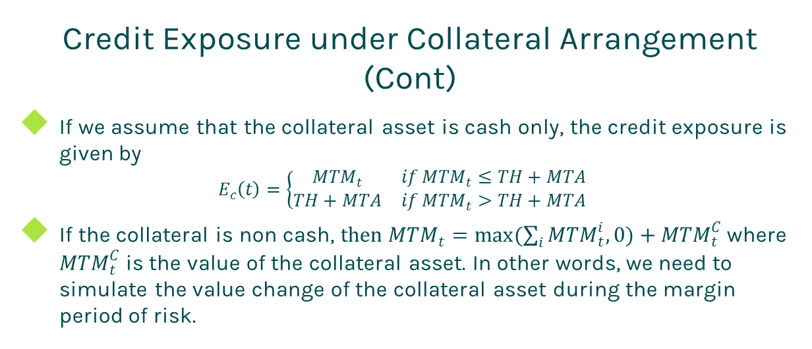
Collateral
Credit Exposure under Collateral Arrangement (Cont)
If we assume that the collateral asset is cash only, the credit exposure is given by
$$E_{c}\left(t\right)=\left\{\begin{matrix}{MTM}_{t} & if {MTM}_{t}≤TH+MTA \\ TH+MTA & if {MTM}_{t}>TH+MTA\end{matrix}\right.$$
If the collateral is non cash, $then {MTM}_{t}=max(\sum_{i}{{MTM}_{t}^{i}, 0)+{MTM}_{t}^{C}}$ where ${MTM}_{t}^{C}$ is the value of the collateral asset. In other words, we need to simulate the value change of the collateral asset during the margin period of risk.

Slide 12
Collateral
Credit Exposure under Collateral Arrangement (Cont)
The credit exposure of an uncollateralized interest rate swap is shown below

Slide 13
Collateral
Credit Exposure under Collateral Arrangement (Cont)
The credit exposure of a collateralized interest rate swap is shown below

Slide 14
Thanks!
You can find more details at
http://www.finpricing.com/lib/collateral.html

