Slide 1

Credit Value Adjustment (CVA) Introduction Alex Yang FinPricing http://www.finpricing.com

Slide 2
CVA Introduction
Summary
CVA History
CVA Definition
Risk Free Valuation
Risky Valuation
http://www.finpricing.com/lib/cva.pptx

Slide 3
CVA Introduction
CVA History
Current market practice
Discounting using the LIBOR or risk-free curves
Using risk-free value for pricing, hedging, P&L
Real counterparty reality
Having different credit qualities from LIBOR
Having risk of default
ISA 39 (International Accounting Standard)
Requiring CVA in 2000 (mandatory)
Finance and Accounting owning CVA
Receiving a little attention in the beginning
Becoming significant risk after financial crises
http://www.finpricing.com/lib/cva.pptx

Slide 4
CVA Introduction
CVA Definition
Definition
CVA = Risk free value – True (risky) value
Benefits
Quantifying counterparty risk as a single P&L number
Dynamically managing, pricing, and hedging counterparty risk
Notes
CVA is a topic of valuation and requires accurate pricing and risk-neutral measure
Risk-free valuation is what we use every day. Risky valuation is less explored and less transparent
http://www.finpricing.com/lib/cva.pptx

Slide 5

CVA Introduction
Risk-Free Valuation
The risk-free valuation is what brokers quote or what trading systems or models normally report.
A simple example to illustrate
A zero coupon bond paying X at T
The risk-free value
where r is risk-free interest rate and
is risk-free discount factor
http://www.finpricing.com/lib/cva.pptx

Slide 6
CVA Introduction
Risky Valuation
Default Modeling
Structural models
Studying default based on capital structure of a firm
Reduced form models
Characterizing default as a jump (Poisson) process
Market practitioners prefer the reduced form models due to
Mathematical tractability
Consistency with market observations as risk-neutral default probabilities can be backed out from bond prices and CDS spreads
http://www.finpricing.com/lib/cva.pptx

Slide 7
CVA Introduction
Risky Valuation (Continuously Defaultable)
The same simple example: a zero coupon bond paying X at T
The risk value
where
r is risk-free interest rate and s is credit spread
is risk adjusted discounting factor
CVA by defintion
http://www.finpricing.com/lib/cva.pptx

Slide 8


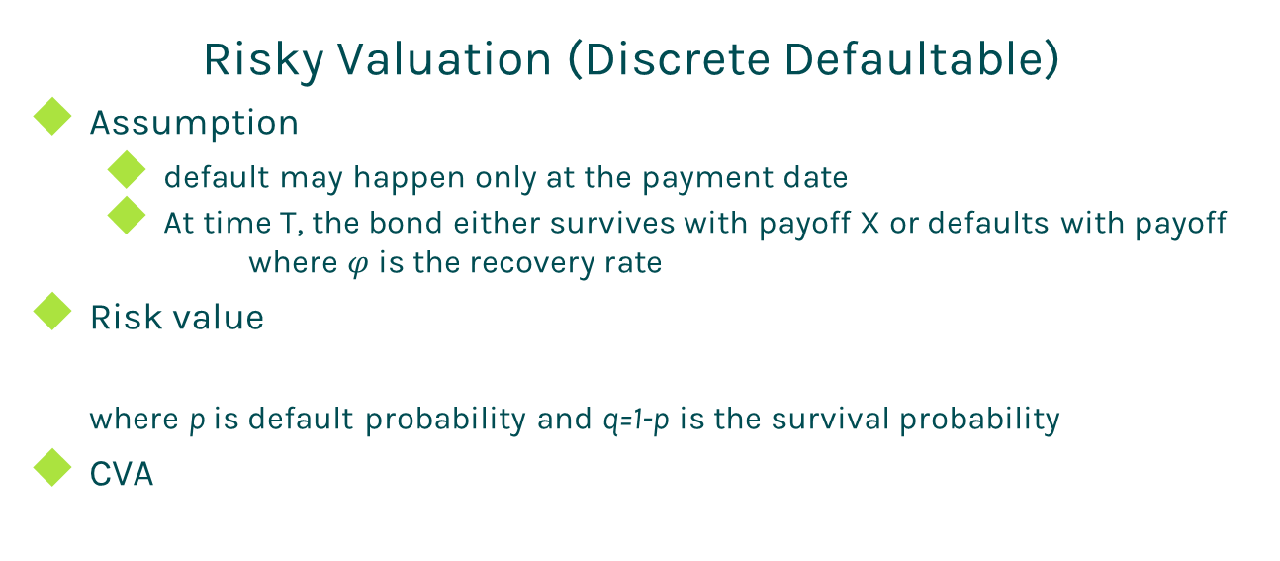
CVA Introduction
Risky Valuation (Discrete Defaultable)
Assumption
default may happen only at the payment date
At time T, the bond either survives with payoff X or defaults with payoff
where $φ$is the recovery rate
Risk value
where p is default probability and q=1-p is the survival probability
CVA
http://www.finpricing.com/lib/cva.pptx

Slide 9
Thanks!
You can find more online presentations at
http://www.finpricing.com/paperList.html

