Slide 1

Credit Valuation Adjustment and Funding Valuation Adjustment Alex Yang FinPricing http://www.finpricing.com

Slide 2
CVA FVA
Summary
Credit Valuation Adjustment (CVA) Definition
Funding Valuation Adjustment (FVA) Definition
CVA and FVA Calculation: Credit Exposure Approach
CVA and FVA Calculation: Least Square Monte Carlo Approach
Master Agreement
CSA Agreement
Risk Neutral Simulation
Credit Exposure Approach Implementation
Least Square Monte Carlo Approach Implementation

Slide 3
CVA FVA
CVA Definition
CVA is defined as the difference between the risk-free portfolio value and the true/risky portfolio value
CVA is the market price of counterparty credit risk
In practice, CVA should be computed at portfolio level. That m.eans calculation should take Master agreement and CSA agreement into account.

Slide 4
CVA FVA
FVA Definition
FVA is introduced to capture the incremental costs of funding uncollateralized derivatives.
FVA is the difference between the rate paid for the collateral to the bank’s treasury and rate paid by the clearinghouse.
FVA can be thought of as a hedging cost or benefit arising from the mismatch between an uncollateralized derivative and a collateralized hedge in the interdealer market.
FVA should be also calculated at portfolio level.

Slide 5
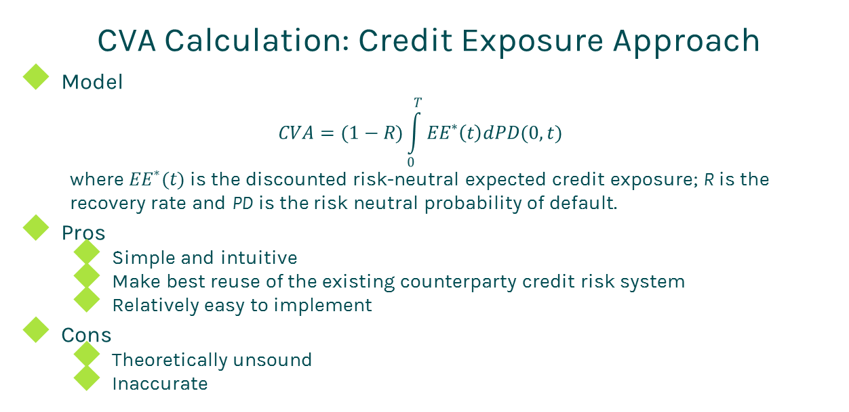
CVA FVA
CVA Calculation: Credit Exposure Approach
Model
$$CVA=(1−R)\int_{0}^{T}{{EE}^{∗}\left(t\right)dPD(0,t)}$$
where ${EE}^{∗}(t)$ is the discounted risk-neutral expected credit exposure; R is the recovery rate and PD is the risk neutral probability of default.
Pros
Simple and intuitive
Make best reuse of the existing counterparty credit risk system
Relatively easy to implement
Cons
Theoretically unsound
Inaccurate

Slide 6
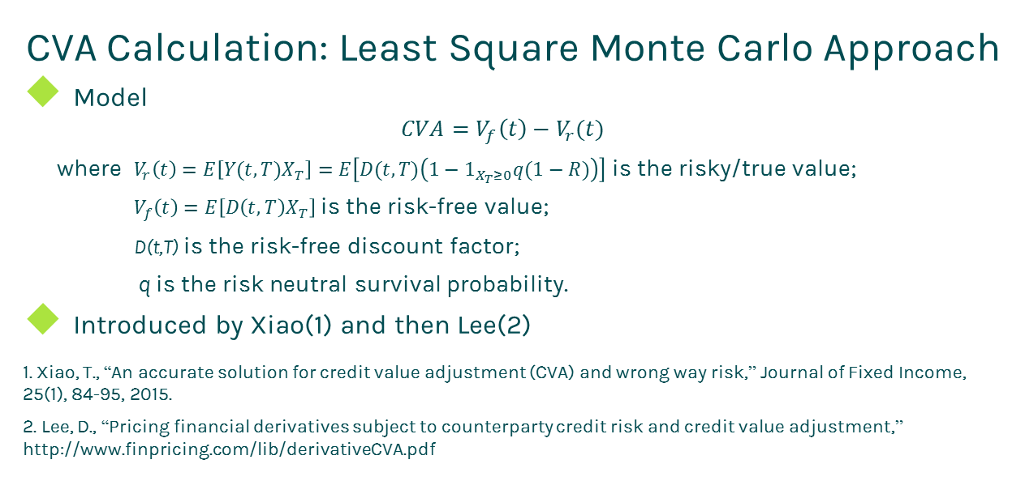
CVA FVA
CVA Calculation: Least Square Monte Carlo Approach
Model
$$CVA=V_{f}\left(t\right)−V_{r}(t)$$
where $V_{r}\left(t\right)=E\left[Y(t,T)X_{T}\right]=E\left[D(t,T)\left(1−1_{X_{T}≥0}q(1−R)\right)\right]$ is the risky/true value;
$V_{f}\left(t\right)=E\left[D\left(t,T\right)X_{T}\right]$ is the risk-free value;
D(t,T) is the risk-free discount factor;
q is the risk neutral survival probability.
Introduced by Xiao(1) and then Lee(2)
1. Xiao, T., “An accurate solution for credit value adjustment (CVA) and wrong way risk,” Journal of Fixed Income, 25(1), 84-95, 2015.
2. Lee, D., “Pricing financial derivatives subject to counterparty credit risk and credit value adjustment,” http://www.finpricing.com/lib/derivativeCVA.pdf

Slide 7
CVA FVA
CVA Calculation: Least Square Monte Carlo Approach (Cont’d)
Pros
Theoretically sound: can be rigorously proved.
Accurate valuation
Valuation is performed by Longstaff-Schwartz least squares Monte Carlo approach.
Cons
Calculation procedure is different from credit exposure computation.
Hardly reuse the existing credit exposure system.

Slide 8
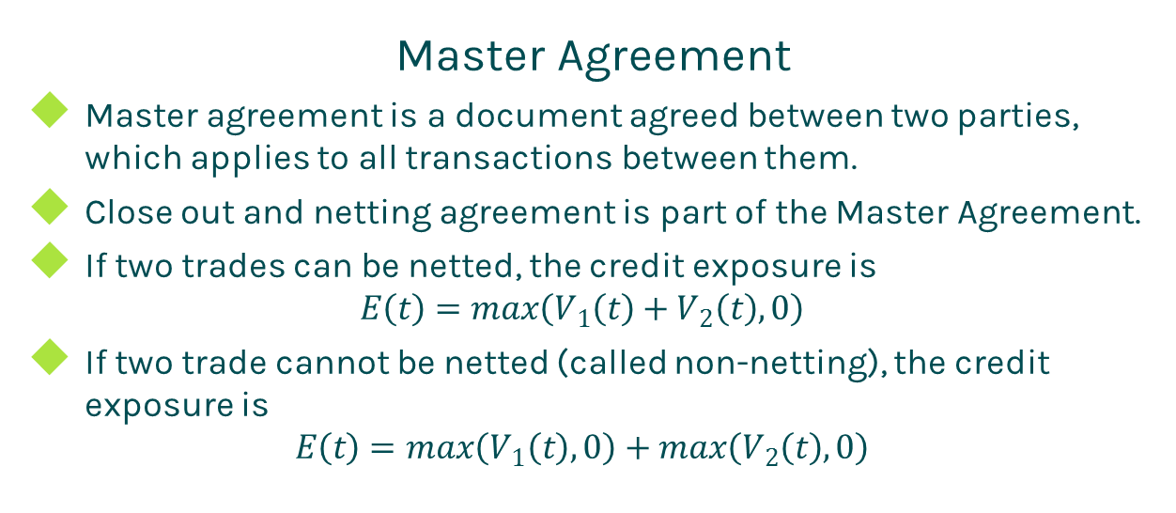
CVA FVA
Master Agreement
Master agreement is a document agreed between two parties, which applies to all transactions between them.
Close out and netting agreement is part of the Master Agreement.
If two trades can be netted, the credit exposure is
$$E\left(t\right)=max\left(V_{1}\left(t\right)+V_{2}\left(t\right), 0\right)$$
If two trade cannot be netted (called non-netting), the credit exposure is
$$E\left(t\right)=max\left(V_{1}\left(t\right), 0\right)+max\left(V_{2}\left(t\right), 0\right)$$

Slide 9
CVA FVA
CSA Agreement
Credit Support Annex (CSA) or Margin Agreement or Collateral Agreement is a legal document that regulates collateral posting.
Trades under a CSA should be also under a netting agreement, but not vice verse.
It defines a variety of terms related to collateral posting.
Threshold
Minimum transfer amount (MTA)
Independent amount (or initial margin or haircut)

Slide 10
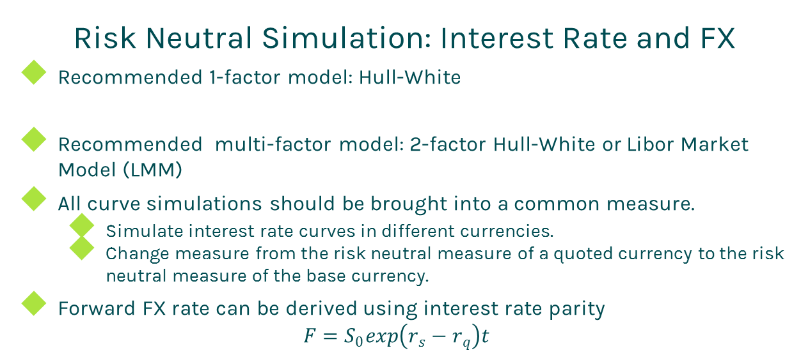
CVA FVA
Risk Neutral Simulation: Interest Rate and FX
Recommended 1-factor model: Hull-White
Recommended multi-factor model: 2-factor Hull-White or Libor Market Model (LMM)
All curve simulations should be brought into a common measure.
Simulate interest rate curves in different currencies.
Change measure from the risk neutral measure of a quoted currency to the risk neutral measure of the base currency.
Forward FX rate can be derived using interest rate parity
$$F=S_{0}exp\left(r_{s}−r_{q}\right)t$$

Slide 11

CVA FVA
Risk Neutral Simulation: Equity Price
Geometric Brownian Motion (GBM)
Pros
Simple
Non-negative stock price
Cons
Simulated values could be extremely large for a longer horizon.

Slide 12
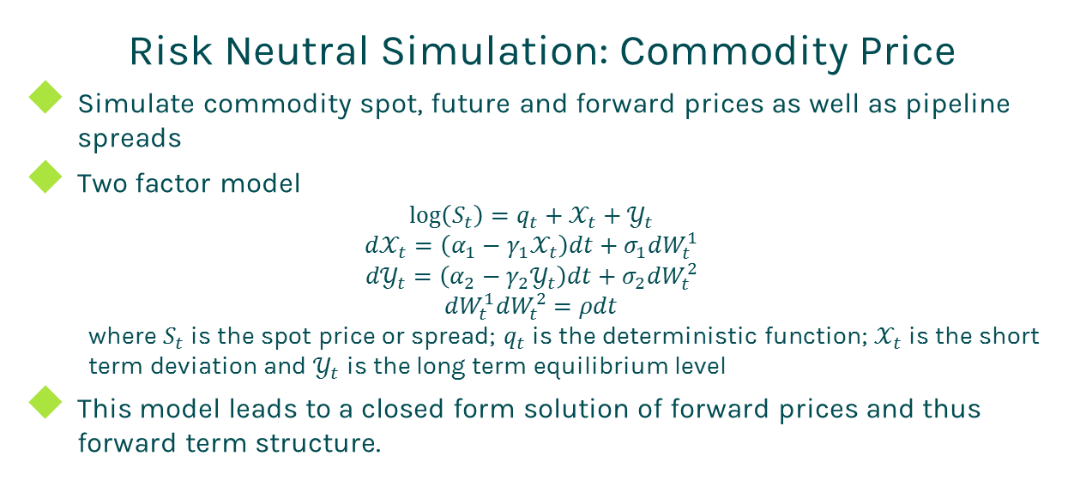
CVA FVA
Risk Neutral Simulation: Commodity Price
Simulate commodity spot, future and forward prices as well as pipeline spreads
Two factor model
$$\log\left(S_{t}\right)=q_{t}+𝒳_{t}+𝒴_{t}$$
$${d𝒳}_{t}=\left(α_{1}−γ_{1}𝒳_{t}\right)dt+σ_{1}{dW}_{t}^{1}$$
$${d𝒴}_{t}=\left(α_{2}−γ_{2}𝒴_{t}\right)dt+σ_{2}{dW}_{t}^{2}$$
$${dW}_{t}^{1}{dW}_{t}^{2}=ρdt$$
where $S_{t}$ is the spot price or spread; $q_{t}$ is the deterministic function; $𝒳_{t}$ is the short term deviation and $𝒴_{t}$ is the long term equilibrium level
This model leads to a closed form solution of forward prices and thus forward term structure.

Slide 13
CVA FVA
Risk Neutral Simulation: Volatility
In the risk neutral world, the volatility is embedded in the price simulation.
Thus, there is no need to simulate implied volatilities.

Slide 14
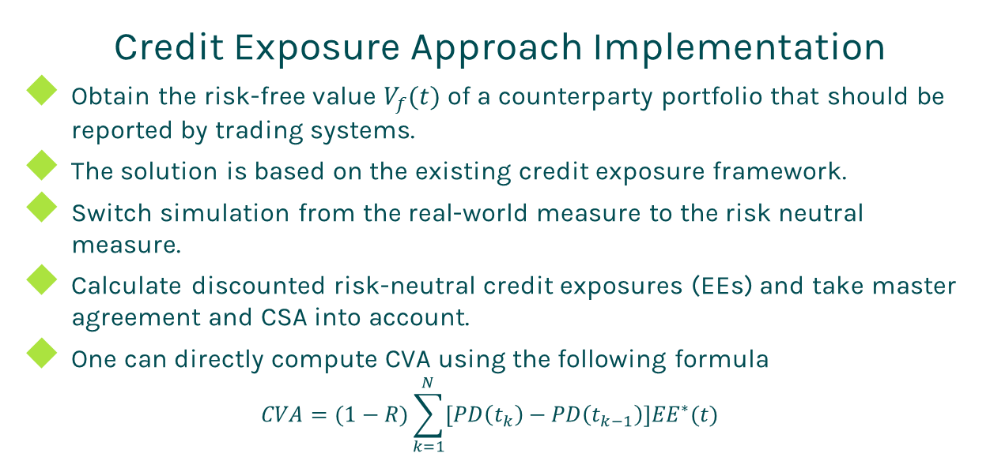
CVA FVA
Credit Exposure Approach Implementation
Obtain the risk-free value $V_{f}(t)$ of a counterparty portfolio that should be reported by trading systems.
The solution is based on the existing credit exposure framework.
Switch simulation from the real-world measure to the risk neutral measure.
Calculate discounted risk-neutral credit exposures (EEs) and take master agreement and CSA into account.
One can directly compute CVA using the following formula
$$CVA=(1−R)\sum_{k=1}^{N}{\left[PD\left(t_{k}\right)−PD\left(t_{k−1}\right)\right]{EE}^{∗}(t)}$$

Slide 15
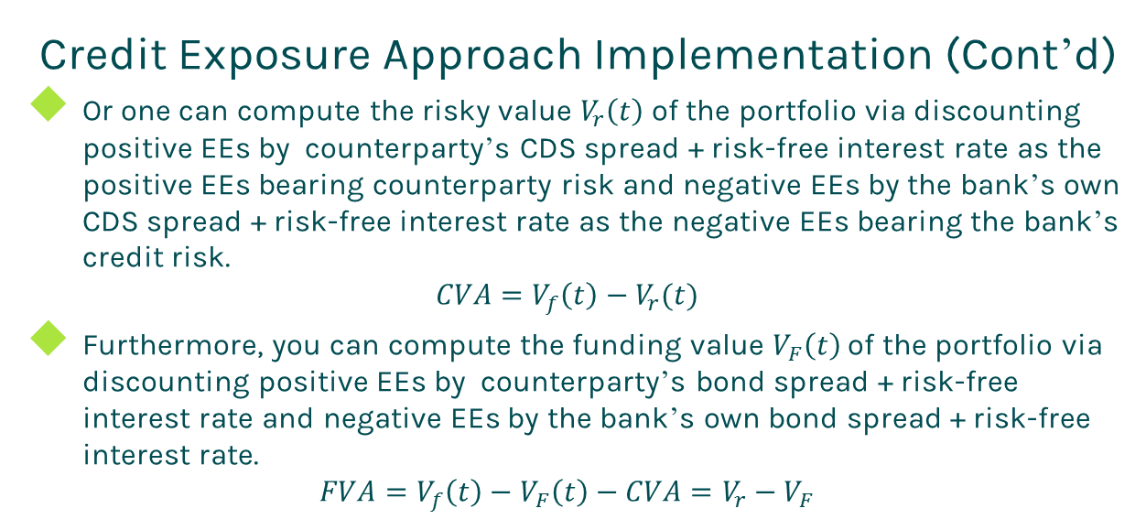
CVA FVA
Credit Exposure Approach Implementation (Cont’d)
Or one can compute the risky value $V_{r}\left(t\right)$ of the portfolio via discounting positive EEs by counterparty’s CDS spread + risk-free interest rate as the positive EEs bearing counterparty risk and negative EEs by the bank’s own CDS spread + risk-free interest rate as the negative EEs bearing the bank’s credit risk.
$$CVA=V_{f}\left(t\right)−V_{r}(t)$$
Furthermore, you can compute the funding value $V_{F}\left(t\right)$ of the portfolio via discounting positive EEs by counterparty’s bond spread + risk-free interest rate and negative EEs by the bank’s own bond spread + risk-free interest rate.
$$FVA=V_{f}\left(t\right)−V_{F}\left(t\right)−CVA=V_{r}−V_{F}$$

Slide 16
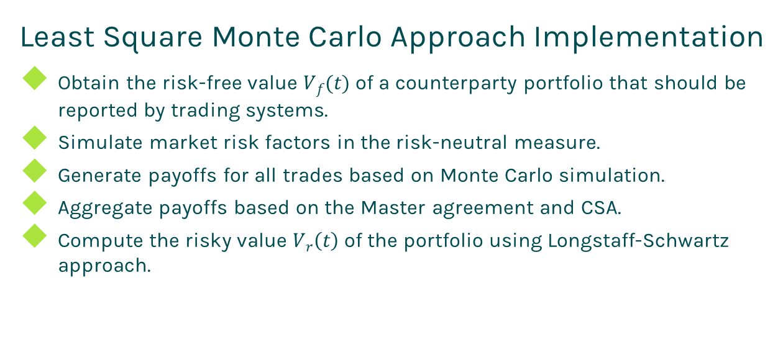
CVA FVA
Least Square Monte Carlo Approach Implementation
Obtain the risk-free value $V_{f}(t)$ of a counterparty portfolio that should be reported by trading systems.
Simulate market risk factors in the risk-neutral measure.
Generate payoffs for all trades based on Monte Carlo simulation.
Aggregate payoffs based on the Master agreement and CSA.
Compute the risky value $V_{r}\left(t\right)$ of the portfolio using Longstaff-Schwartz approach.

Slide 17
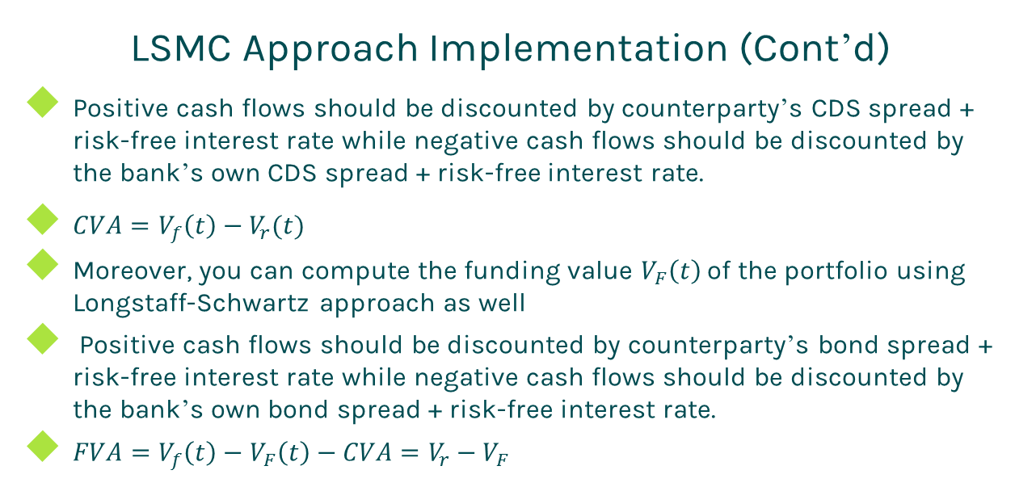
CVA FVA
LSMC Approach Implementation (Cont’d)
Positive cash flows should be discounted by counterparty’s CDS spread + risk-free interest rate while negative cash flows should be discounted by the bank’s own CDS spread + risk-free interest rate.
$CVA=V_{f}\left(t\right)−V_{r}(t)$
Moreover, you can compute the funding value $V_{F}\left(t\right)$ of the portfolio using Longstaff-Schwartz approach as well
Positive cash flows should be discounted by counterparty’s bond spread + risk-free interest rate while negative cash flows should be discounted by the bank’s own bond spread + risk-free interest rate.
$FVA=V_{f}\left(t\right)−V_{F}\left(t\right)−CVA=V_{r}−V_{F}$

Slide 18
Thanks!
You can find more details at
http://www.finpricing.com/lib/cvaFva.pdf

