Slide 1

FRTB: Standardised Approach Tom Mills FinPricing http://www.finpricing.com

Slide 2
FRTB SA
Summary
FRTB Definition
FRTB vs Basel 2.5
FRTB Main Features
FRTB Approaches
FRTB Standardised Approach (SA)
FRTB SA: Sensitivity Based Risk Charge
FRTB SA: Default Risk Charge
FRTB SA: Residual Risk Add-on

Slide 3
FRTB SA
FRTB definition
The Fundamental Review of the Trading Book (FRTB) is a new Basel committee framework for the next generation market risk.
FRTB is inspired by the undercapitalisation of trading book exposures witnessed during the financial crisis.
It aims to address shortcoming of the current Basel 2.5 market risk capital framework.

Slide 4
FRTB SA
FRTB vs Basel 2.5
Standardised Approach
FRTB
Sensitivity based risk charge + Default risk charge + Residual risk add-on
Basel 2.5
Standardised capital charge
Internal Model Approach
FRTB
Expected shortfall + Default risk charge + Non-modellable risk factors
Basel 2.5
VaR + Stress VaR + Incremental Risk Charge (IRC)

Slide 5
FRTB SA
FRTB Main Features
Clear definition of the boundary between the trading book and the banking book
An overhaul of the internal model approach (IMA) to focus on tail risk
An overhaul of the standardized approach (sa) to make it more risk sensitive and explicitly capture default risk and other residual risks
Inclusion of liquidity horizons explicitly for different asset classes.

Slide 6
FRTB SA
FRTB approaches
Standardized approach (SA): a regulator-set approach
Sensitivity-based risk charge (SBRC)
Default risk charge (DRC-SA)
Residual add-on (RAD)
Internal model approach (IMA): a bank’s own approach
Expected shortfall (ES)
Default risk charge (DRC-IMA)
Non-modellable risk factors (NMRF)
This presentation focuses on standardized approach

Slide 7
FRTB SA
FRTB Standardized Approach
3 risk measures: Delta, Vega and Curvature
7 risk classes
General interest rate risk (GII)
Credit spread risk
Credit spread risk: non-correlated securitisation
Credit spread risk: correlated securitisation
Equity risk
Commodity risk
Foreign exchange risk
Sensitivity based risk charge should be calculated separately for each risk class and each risk measure.

Slide 8
FRTB SA
FRTB Standardized Approach (cont’d)
Reporting hierarchy: portfolio, desk, bank
Total risk charge
Total = sensitivity-based risk charge + default risk charge + residual add-on
For example
An equity desk has equity risk and interest rate risk only, the total risk charge is given by
Total = equity Delta risk charge + equity Vega risk charge
+ equity Curvature risk charge + general interest rate Delta risk charge
+ default risk charge + residual add-on

Slide 9
FRTB SA
FRTB SA: Sensitivity Based Risk Charge
Required sensitivities
Delta: the first order derivative with respect to underlying price
Vega: the first order derivative with respect to implied volatility
Curvature: equivalent to the sum of all high-order derivatives with respect to underlying price
Sensitivity notes
Delta: all trading products have Deltas.
Vega and Curvature: only non-linear products (e.g., options) have Vega and Curvature.

Slide 10
FRTB SA
FRTB SA: Sensitivity Based Risk Charge (cont’d)
Sensitivity calculation
Clearly define all Delta and Curvature calculation but not Vega.
Interest rate deltas are computed based on yield rates (or zero coupon rates) rather than liquid instrument quotes (e.g., swap rates, futures).
Curvature is a new measurement that is equal to shocked value change minus Delta.
Bucket and risk factor
Sensitivities should be divided into buckets and risk factors within each risk measure and each risk class.
Risk weight: a risk weight is defined for each risk factor.
Risk correlation: correlations are specified between risk factors and between buckets.

Slide 11
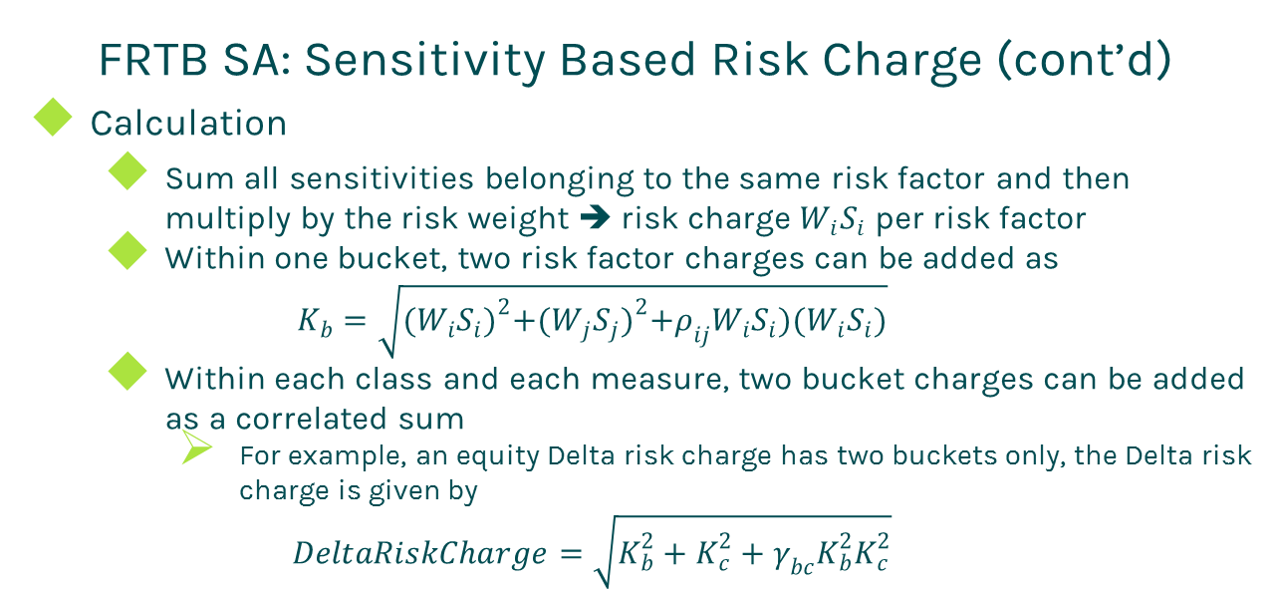
FRTB SA
FRTB SA: Sensitivity Based Risk Charge (cont’d)
Calculation
Sum all sensitivities belonging to the same risk factor and then multiply by the risk weight ➔ risk charge $W_{i}S_{i}$ per risk factor
Within one bucket, two risk factor charges can be added as
$$K_{b}=\sqrt{{(W_{i}S_{i})}^{2}+{(W_{j}S_{j})}^{2}+ρ_{ij}W_{i}S_{i})(W_{i}S_{i})}$$
Within each class and each measure, two bucket charges can be added as a correlated sum
For example, an equity Delta risk charge has two buckets only, the Delta risk charge is given by
$$DeltaRiskCharge=\sqrt{K_{b}^{2}+K_{c}^{2}+γ_{bc}K_{b}^{2}K_{c}^{2}}$$

Slide 12
FRTB SA
FRTB SA: Default Risk Charge
Scope
Debt instruments
Equity products
Securitisation products
Calculation procedure
Determine jump-to-default (JTD) loss amount
Offset the JTD amounts of long and short exposures with respect to the same obligor
Discount the net short exposures by a hedge benefit ratio
Apply default risk weights to exposures to arrive at the DRC

Slide 13
FRTB SA
FRTB SA: Residual Add-on
The following trade types bearing residual risk
Traded in incomplete markets
Gap risk: such as path dependent options (barrier, Asian, digital, Bermudan, etc.)
Correlation risk: such as multiple underlying options (basket, best, spread, basis, quote, etc.)
Behavioural risk: such as mortgage
Calculation
RAD = notional * factor (1% or 0.1%)

Slide 14
Thanks!
You can find more online presentations at
http://www.finpricing.com/paperList.html

