Slide 1

Initial Margin: Standardized Approach Tom Mills FinPricing http://www.finpricing.com

Slide 2
Initial Margin
Summary
Margin Introduction
Initial Margin Scope
Initial Margin Calculation hierarchy
Sensitivity Calculation
Initial Margin Calculation

Slide 3
Initial Margin
Margin Introduction
Margin is collateral that one party needs to deposit with a broker or an exchange to cover some or all of the credit risk.
Initial Margin is the amount of collateral required to open a position.
Maintenance Margin is the minimum amount of collateral required to keep the position open after inception.
Margin Balance = Asset value – Borrowed fund
Margin Call: if (Margin balance) < (Maintenance margin), the broker issues a margin call that requires the investor to bring the margin balance back to initial margin.

Slide 4
Initial Margin
Initial Margin Scope
Initial margin calculation is counterparty-portfolio-based.
Initial margin calculation in a bank contains non-cleared OTC derivatives only as cleared products are already coverred by Exchanges
Derivative trades belonging to a counterparty will be divided into a cleared portfolio and a non-cleared portfolio. The initial margin is computed for the non-cleared portfolio.

Slide 5
Initial Margin
Initial Margin Calculation hierarchy
Calculation is conducted from the lowest level to the highest one:
risk factor –> risk bucket →risk measure → risk class → product class → final initial margin
Define 4 product classes
Interest Rates and Foreign Exchange Product (RatesFX)
Credit Product
Equity Product
Commodity Product

Slide 6
Initial Margin
Initial Margin Calculation hierarchy (Cont’d)
Define 6 risk classes
Interest Rate
Credit (Qualifying): non-securitization and simple securitization
Credit (Non-Qualifying): complex securitization
Equity
Commodity
FX
Define 3 risk measures
Delta
Vega
Curvature

Slide 7
Initial Margin
Initial Margin Calculation hierarchy (Cont’d)
Define risk buckets
Interest rate bucket: based on currency (USD, EUR, CAD, …)
Credit bucket: based on credit quality (sovereign, financial, technology, …)
Equity bucket: based on sector (financial, industrial, …)
Commodity bucket: based on commodity type (crude, gas, …)
FX: each FX rate is a bucket
Define risk factors
Interest rate curve: 12 yields per curve
Credit curve: 5 spreads per credit cuve
Equity: spot price
Commodity: spot price
FX: spot exchange rate

Slide 8
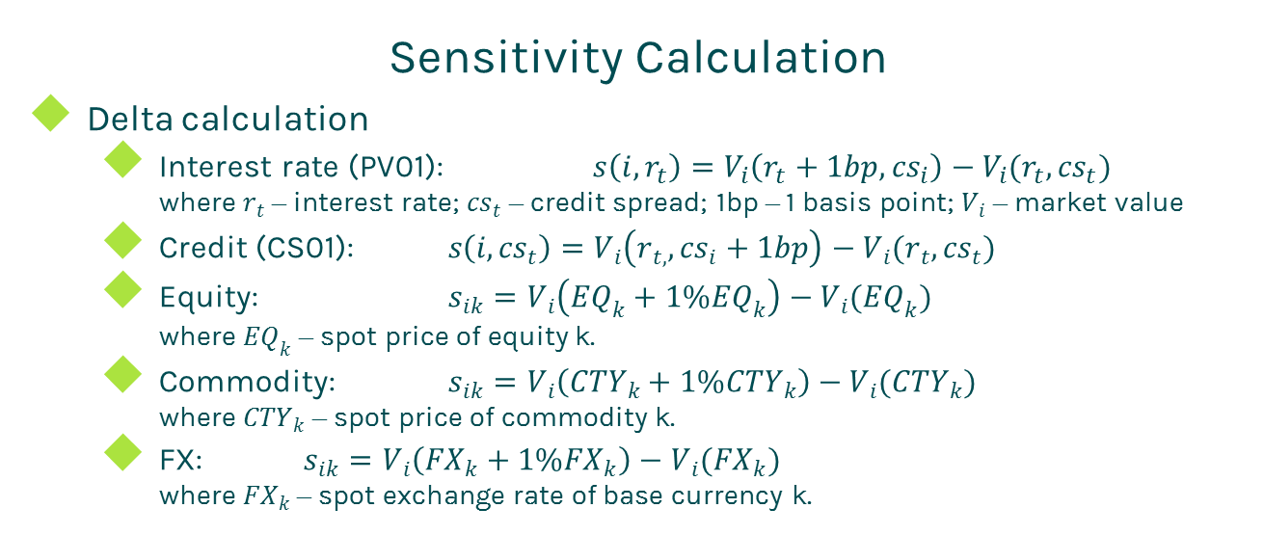
Initial Margin
Sensitivity Calculation
Delta calculation
Interest rate (PV01): $s\left(i,r_{t}\right)=V_{i}\left(r_{t}+1bp,{cs}_{i}\right)−V_{i}(r_{t},{cs}_{t})$
where $r_{t}$ – interest rate; ${cs}_{t}$ – credit spread; 1bp – 1 basis point; $V_{i}$ – market value
Credit (CS01): $s\left(i,{cs}_{t}\right)=V_{i}\left(r_{t,},{cs}_{i}+1bp\right)−V_{i}(r_{t},{cs}_{t})$
Equity: $s_{ik}=V_{i}\left({EQ}_{k}+1\%{EQ}_{k}\right)−V_{i}({EQ}_{k})$
where ${EQ}_{k}$ – spot price of equity k.
Commodity: $s_{ik}=V_{i}\left({CTY}_{k}+1\%{CTY}_{k}\right)−V_{i}({CTY}_{k})$
where ${CTY}_{k}$ – spot price of commodity k.
FX: $s_{ik}=V_{i}\left({FX}_{k}+1\%{FX}_{k}\right)−V_{i}({FX}_{k})$
where ${FX}_{k}$ – spot exchange rate of base currency k.

Slide 9


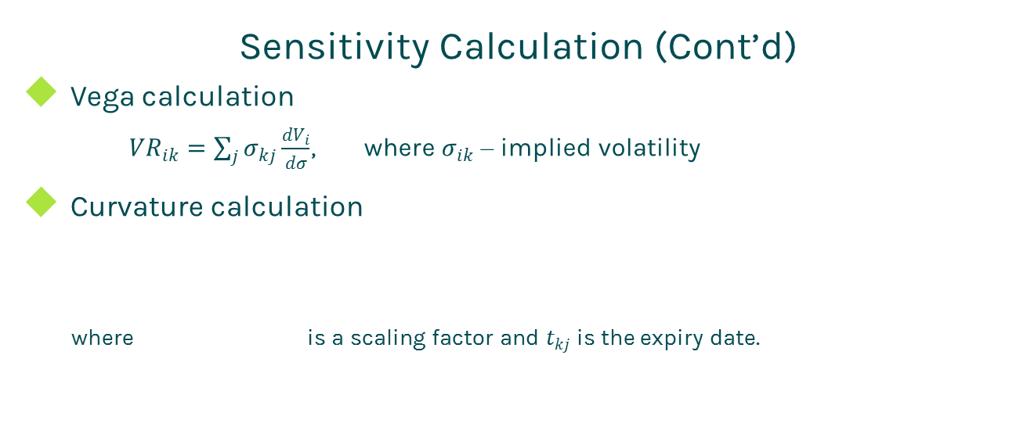
Initial Margin
Sensitivity Calculation (Cont’d)
Vega calculation
${VR}_{ik}=\sum_{j}{σ_{kj}\frac{{dV}_{i}}{dσ}}$, where $σ_{ik}$ – implied volatility
Curvature calculation
where is a scaling factor and $t_{kj}$ is the expiry date.

Slide 10

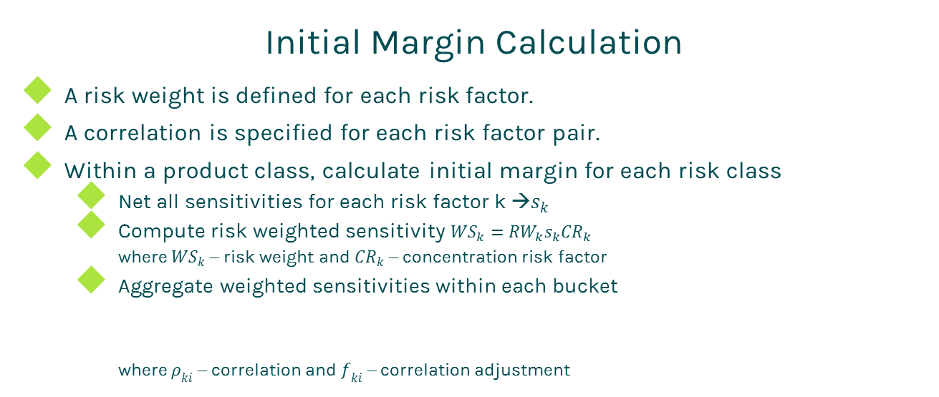
Initial Margin
Initial Margin Calculation
A risk weight is defined for each risk factor.
A correlation is specified for each risk factor pair.
Within a product class, calculate initial margin for each risk class
Net all sensitivities for each risk factor k →$s_{k}$
Compute risk weighted sensitivity ${WS}_{k}={RW}_{k}s_{k}{CR}_{k}$
where ${WS}_{k}$ – risk weight and ${CR}_{k}$ – concentration risk factor
Aggregate weighted sensitivities within each bucket
where $ρ_{ki}$ – correlation and $f_{ki}$ – correlation adjustment

Slide 11
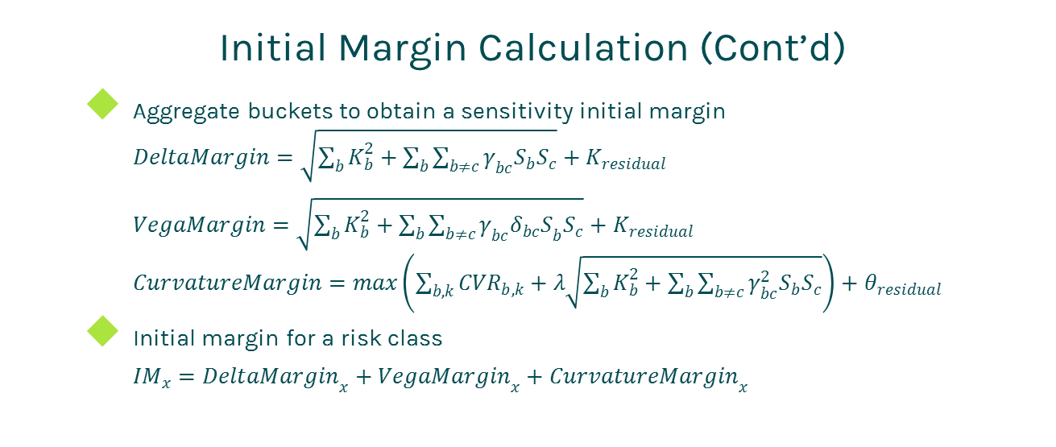
Initial Margin
Initial Margin Calculation (Cont’d)
Aggregate buckets to obtain a sensitivity initial margin
$DeltaMargin=\sqrt{\sum_{b}{K_{b}^{2}}+\sum_{b}{\sum_{b≠c}{γ_{bc}S_{b}S_{c}}}}+K_{residual}$
$VegaMargin=\sqrt{\sum_{b}{K_{b}^{2}}+\sum_{b}{\sum_{b≠c}{γ_{bc}{δ_{bc}S}_{b}S_{c}}}}+K_{residual}$
$CurvatureMargin=max\left(\sum_{b,k}{{CVR}_{b,k}}+λ\sqrt{\sum_{b}{K_{b}^{2}}+\sum_{b}{\sum_{b≠c}{γ_{bc}^{2}S_{b}S_{c}}}}\right)+θ_{residual}$
Initial margin for a risk class
${IM}_{x}={DeltaMargin}_{x}+{VegaMargin}_{x}+{CurvatureMargin}_{x}$

Slide 12
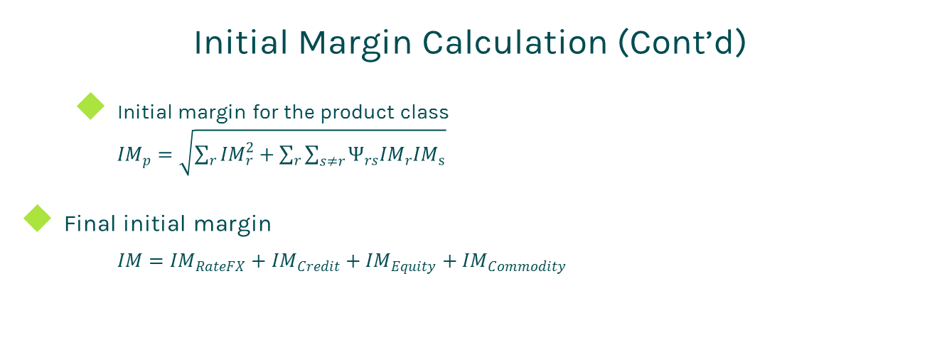
Initial Margin
Initial Margin Calculation (Cont’d)
Initial margin for the product class
${IM}_{p}=\sqrt{\sum_{r}{{IM}_{r}^{2}}+\sum_{r}{\sum_{s≠r}{Ψ_{rs}{IM}_{r}{IM}_{s}}}}$
Final initial margin
$IM={IM}_{RateFX}+{IM}_{Credit}+{IM}_{Equity}+{IM}_{Commodity}$

Slide 13
Thanks!
You can find more online presentations at
http://www.finpricing.com/paperList.html

