Slide 1

Incremental Risk Charge (IRC) Tom Mills FinPricing http://www.finpricing.com

Slide 2
IRC
Summary
Market Risk Types
IRC Definition
IRC Scope
IRC Main Features
Default and Migration Simulation
Constant level of risk
Implementation

Slide 3
IRC
Market Risk Types
General market risk
Idiosyncratic or specific risk: such as equity specific risk and debt specific risk
Even risk (e.g., default or migration): IRC is intended to capture even risk

Slide 4
IRC
IRC Definition
The incremental risk charge (IRC) is a new regulatory requirement from the Basel Committee in response to the financial crisis.
IRC supplements existing Value-at-Risk (VaR) and captures the loss due to default and migration events at a 99.9% confidence level over a one-year capital horizon.
IRC Scope
Debt instruments are subject to IRC.
Credit products, including structured credit, are included in IRC.

Slide 5
IRC
IRC Main Features
Liquidity is explicitly modeled in IRC through liquidity horizon and constant level of risk.
Constant level of risk assumption
Hold portfolio constant over liquidity horizon
Rebalance any default, downgraded, or upgraded positions at the beginning of each liquidity horizon
Roll over any matured positions at the beginning of each horizon
Default and migration need to be simulated for one-year horizon.
Concentration measures the degree of a portfolio diversification.
For example, if a significant number of issuers belong to a certain category, the portfolio is a concentrated one.

Slide 6

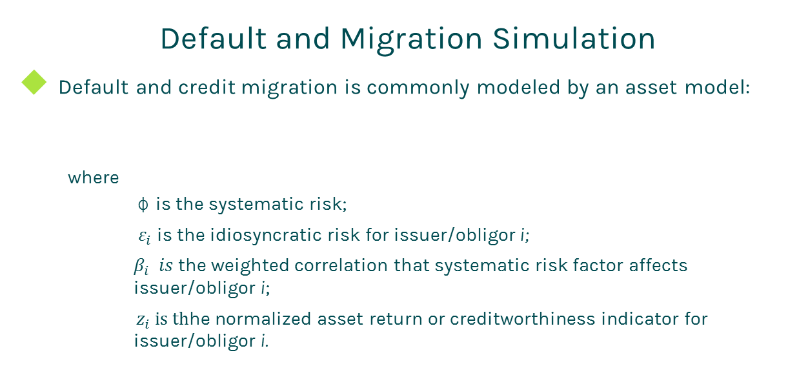
IRC
Default and Migration Simulation
Default and credit migration is commonly modeled by an asset model:
where
φ is the systematic risk;
$ε_{i}$ is the idiosyncratic risk for issuer/obligor i;
$β_{i} is$ the weighted correlation that systematic risk factor affects issuer/obligor i;
${ z}_{i} is th$he normalized asset return or creditworthiness indicator for issuer/obligor i.

Slide 7
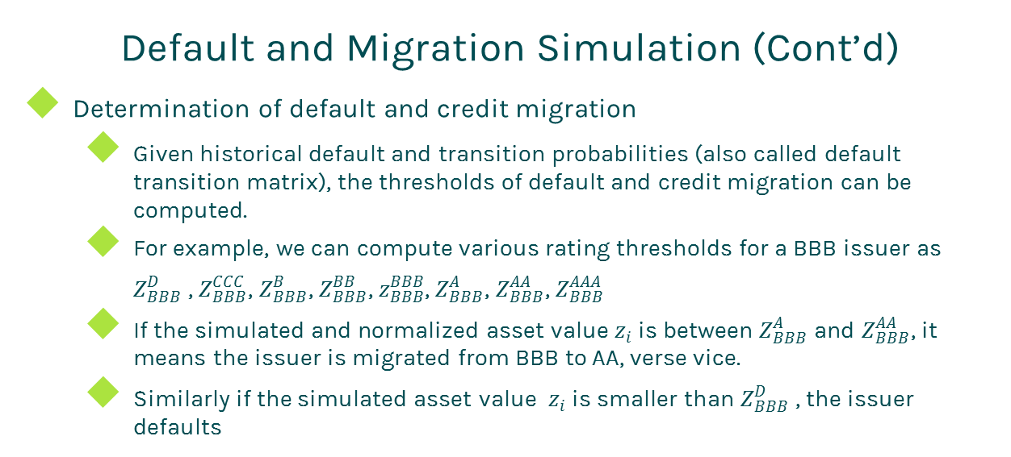
IRC
Default and Migration Simulation (Cont’d)
Determination of default and credit migration
Given historical default and transition probabilities (also called default transition matrix), the thresholds of default and credit migration can be computed.
For example, we can compute various rating thresholds for a BBB issuer as
$Z_{BBB}^{D}$ , $Z_{BBB}^{CCC}$, $Z_{BBB}^{B}$, $Z_{BBB}^{BB}$, $z_{BBB}^{BBB}$, $Z_{BBB}^{A}$, $Z_{BBB}^{AA}$, $Z_{BBB}^{AAA}$
If the simulated and normalized asset value $z_{i}$ is between $Z_{BBB}^{A}$ and $Z_{BBB}^{AA}$, it means the issuer is migrated from BBB to AA, verse vice.
Similarly if the simulated asset value $z_{i}$ is smaller than $Z_{BBB}^{D}$ , the issuer defaults

Slide 8
IRC
Constant level of risk
The constant level of risk reflects recognition by regulators that securities/derivatives held in the trading book are generally much more liquid than those in the banking book.
We interpret constant level of risk as constant loss distribution, i.e.,
The same loss distribution over each liquidity horizon
The same rating over each liquidity horizon
The same risk metrics over each liquidity horizon
For example, the liquidity horizon for a portfolio is 3 months. That means the bank holds its portfolio components constant for 3 months and then rebalances it by replacing any default or downgraded or upgraded positions so that the portfolio is returned to the initial level of risk.

Slide 9
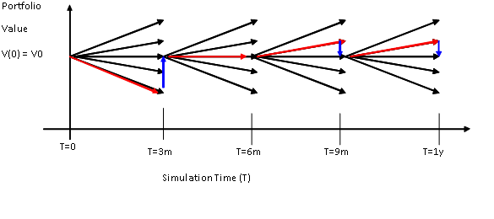
IRC
Constant level of risk (Cont’d)
The process is repeated four times to arrive at 1-year shown as
In Monte Carlo context, this can be modeled by drawing 4 times from the single-period loss distribution measured over the liquidity horizon.
The advantages of this assumption
Avoid the complexity of rebalancing and roll-over
Reduce computation significantly

Slide 10
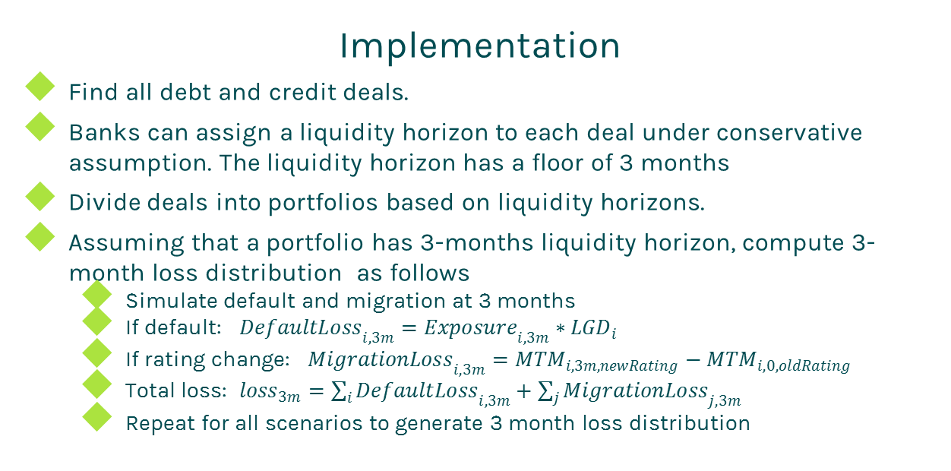
IRC
Implementation
Find all debt and credit deals.
Banks can assign a liquidity horizon to each deal under conservative assumption. The liquidity horizon has a floor of 3 months
Divide deals into portfolios based on liquidity horizons.
Assuming that a portfolio has 3-months liquidity horizon, compute 3-month loss distribution as follows
Simulate default and migration at 3 months
If default: ${DefaultLoss}_{i,3m}={Exposure}_{i,3m}∗{LGD}_{i}$
If rating change: ${MigrationLoss}_{i,3m}={MTM}_{i,3m,newRating}−{MTM}_{i,0,oldRating}$
Total loss: ${loss}_{3m}=\sum_{i}{{DefaultLoss}_{i,3m}+\sum_{j}{{MigrationLoss}_{j,3m}}}$
Repeat for all scenarios to generate 3 month loss distribution

Slide 11
IRC
Implementation (Cont’d)
Based on the constant level of risk assumption, the 3-6 months, 6-9 months and 9-12 months loss distributions are just the copy of 0-3 months lost distribution.
The 1-year loss distribution is the convolution of 4 copies of the first 3-month loss distribution.
IRC = 99.9% quantile of the 1-year loss distribution

Slide 12
Thanks!
You can find more online details at
http://www.finpricing.com/lib/irc.pdf

