Slide 1

Financial Market Introduction Alex Yang FinPricing http://www.finpricing.com

Slide 2
Market
Summary
Financial Market Definition
Financial Return
Price Determination
No Arbitrage and Risk Neutral Measure
Fixed Income and Interest Rate Market
Currency or FX Market
Equity Market
Historical Volatility vs Implied Volatility

Slide 3
Market
Financial Market Definition
A financial market is a market where people trade financial products.
Types of financial markets
Fixed income and interest rate market
Currency market
Equity market
Commodity market
Credit market
There are the spot market and the derivative market within each market above.

Slide 4
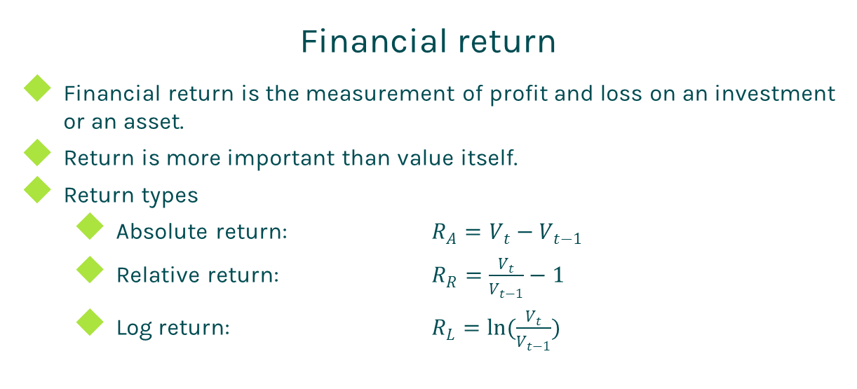
Market
Financial return
Financial return is the measurement of profit and loss on an investment or an asset.
Return is more important than value itself.
Return types
Absolute return: $R_{A}=V_{t}−V_{t−1}$
Relative return: $R_{R}=\frac{V_{t}}{V_{t−1}}−1$
Log return: $R_{L}=ln(\frac{V_{t}}{V_{t−1}})$

Slide 5
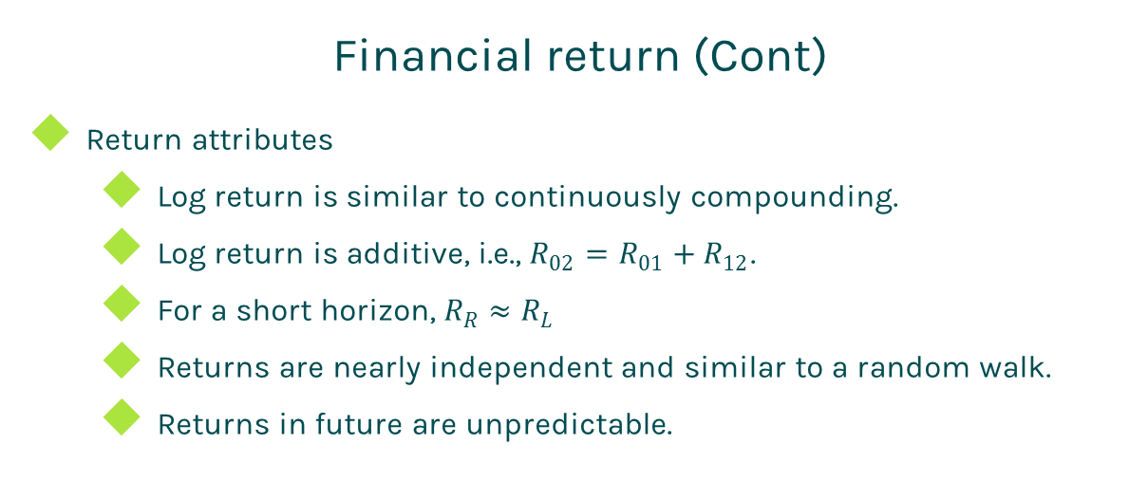
Market
Financial return (Cont)
Return attributes
Log return is similar to continuously compounding.
Log return is additive, i.e., $R_{02}=R_{01}+R_{12}$.
For a short horizon, $R_{R}≈R_{L}$
Returns are nearly independent and similar to a random walk.
Returns in future are unpredictable.

Slide 6
Market
Price Determination
Actual market price determination
Determined by supply and demand.
Gauged in the real-world measure.
Supply side determination factors:
Transaction costs
Liquidity
Risk/reward preferences of suppliers
Capital availability
Tax rules
Differential information

Slide 7
Market
Price Determination (Cont)
Demand side determination factors:
Transaction costs
Liquidity
Accounting
Tax rules
Model price determination
Determined by model and calibration.
Gauged in the risk neutral measure.
If a trade has the market price, then
Model is mainly used to compute risk, such as sensitivities.
The model price should be calibrated to the market price.
If a trade doesn’t have a market price, then
Model price is used for transaction.
Model should be calibrated to Vanilla products.

Slide 8
Market
No Arbitrage and Risk Neutral Measure
No arbitrage
The law of one price: The same cash flow should have the same price.
It is impossible to invest 0 today and receive positive tomorrow.
Two portfolios having the same payoff at a given future date must have the same price today.
Risk neutral probability measure or simply risk neutral measure
Risk neutral probability measure is no arbitrage.
The Arrow security prices are so-called risk neutral probabilities.
A risk-neutral probability is not a real mathematical probability.
These prices are called probabilities as they fulfill the criteria of probabilities so that the probability theory can be used.
In finance, Martingale measure is equivalent to risk neutral measure

Slide 9
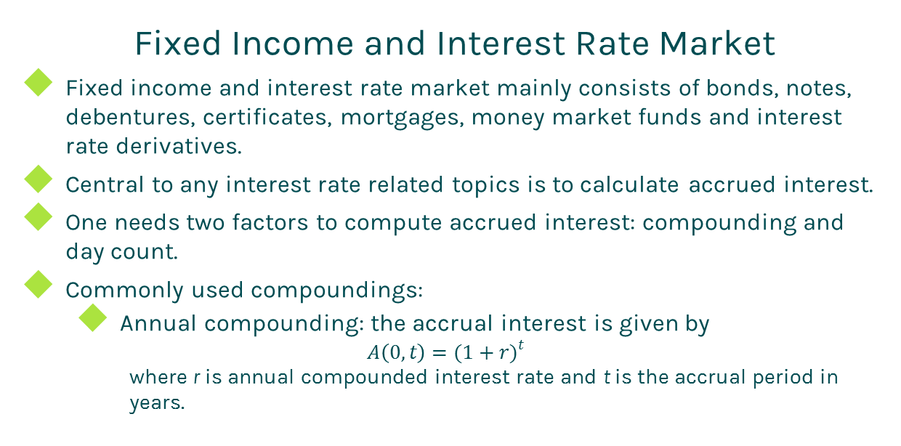
Market
Fixed Income and Interest Rate Market
Fixed income and interest rate market mainly consists of bonds, notes, debentures, certificates, mortgages, money market funds and interest rate derivatives.
Central to any interest rate related topics is to calculate accrued interest.
One needs two factors to compute accrued interest: compounding and day count.
Commonly used compoundings:
Annual compounding: the accrual interest is given by
$$A\left(0,t\right)={(1+r)}^{t}$$
where r is annual compounded interest rate and t is the accrual period in years.

Slide 10
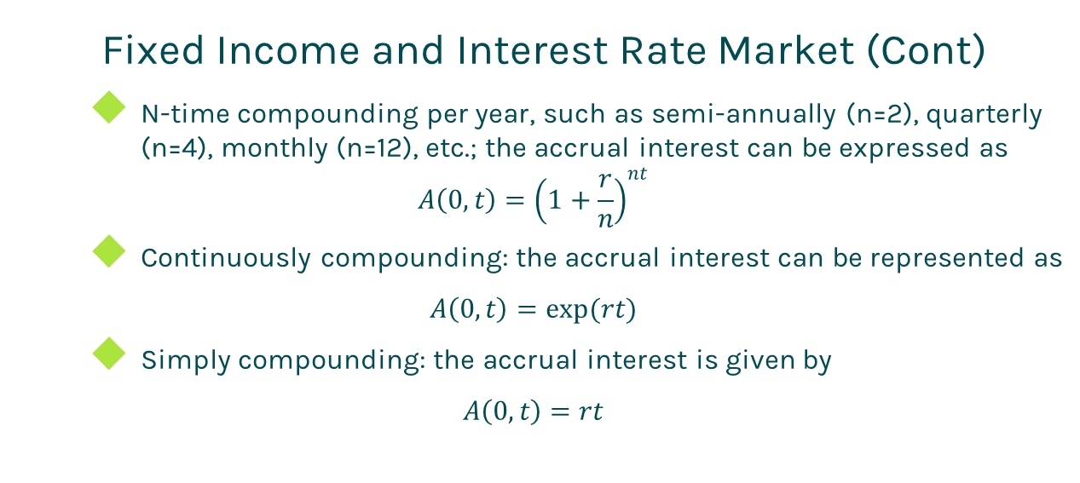
Market
Fixed Income and Interest Rate Market (Cont)
N-time compounding per year, such as semi-annually (n=2), quarterly (n=4), monthly (n=12), etc.; the accrual interest can be expressed as
$$A\left(0,t\right)={\left(1+\frac{r}{n}\right)}^{nt}$$
Continuously compounding: the accrual interest can be represented as
$$A\left(0,t\right)=exp(rt)$$
Simply compounding: the accrual interest is given by
$$A\left(0,t\right)=rt$$

Slide 11
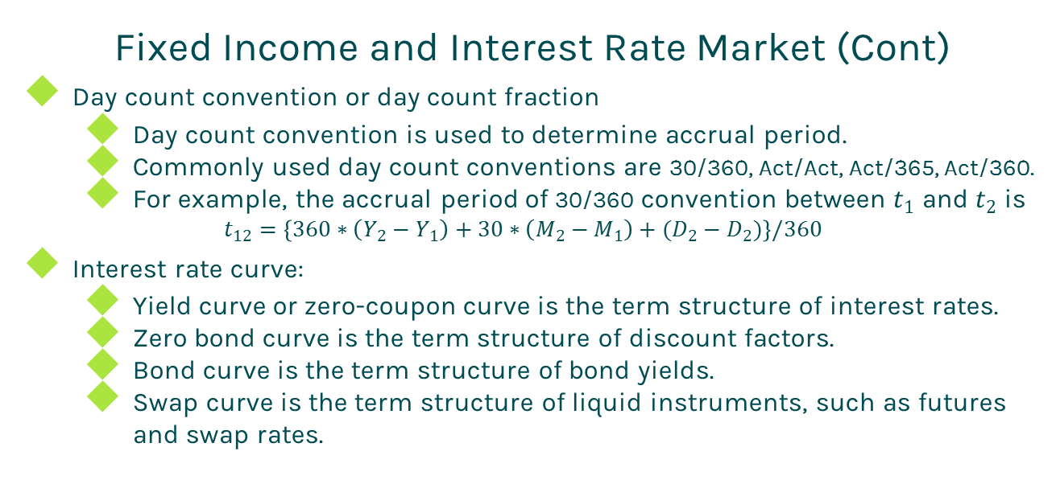
Market
Fixed Income and Interest Rate Market (Cont)
Day count convention or day count fraction
Day count convention is used to determine accrual period.
Commonly used day count conventions are 30/360, Act/Act, Act/365, Act/360.
For example, the accrual period of 30/360 convention between $t_{1}$ and $t_{2}$ is
$$t_{12}=\left\{360∗\left(Y_{2}−Y_{1}\right)+30∗\left(M_{2}−M_{1}\right)+(D_{2}−D_{2})\right\}/360$$
Interest rate curve:
Yield curve or zero-coupon curve is the term structure of interest rates.
Zero bond curve is the term structure of discount factors.
Bond curve is the term structure of bond yields.
Swap curve is the term structure of liquid instruments, such as futures and swap rates.

Slide 12
Market
Currency or FX Market
Currency market convention is one of the biggest sources of confusion for those new to the market.
FX quotation
The quotation 1.25 EUR/USD means that one Euro is exchanged for 1.25 USD.
In this case, EUR (nominator) is the base currency and USD (denominator) is the quoted currency.
Spot date
The spot date or value date is the day in which the two parties actually exchange the two currencies.
A currency pair requires a specification of the number of days between trade date and spot date, typically 2 business days.

Slide 13
Market
Equity Market
Equity price is quoted by Exchanges.
Dividend convention
Record date or cut-off date is the date of dividend payment eligibility. The shareholders of record as of the record date will be entitled to receive the dividend.
Ex-dividend date is set exactly 2 business days before the record date. On and after the ex-dividend date, a buyer of the stock will not receive the dividend.
The stock price usually drops at the ex-dividend date.
Dividend types:
Discrete dividend.
Dividend yield or continuous dividend.

Slide 14
Market
Historical Volatility vs Implied Volatility
Historical volatility
It is the standard deviation of the time series of an asset return.
It is calculated under the real world measure.
Implied volatility
It is a model parameter used to back up the market price.
It is derived under the risk neutral measure.
Implied volatilities could be bigger or smaller than historical volatilities.

Slide 15
Thanks!
You can find more details at
http://www.finpricing.com/lib/market.pdf

