Slide 1

Market Risk Economic Capital Alex Yang FinPricing http://www.finpricing.com

Slide 2
Market Risk EC
Summary
Background
Economic Capital (EC) Definition
Economic Capital vs Regulatory Capital
Economic Capital Calculation
Economic Capital Scaling Methodology
Economic Capital Result

Slide 3
Market Risk EC
Background
Financial business is exposed to many types of risk due to the nature of business.
To guard against the risk, financial institutions must hold capital in proportion to the potential risk.
Market risk economic capital is intended to capture the value change due to changes in market risk factors.

Slide 4
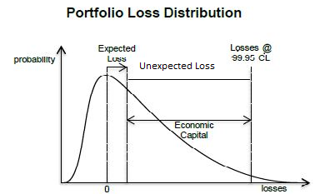
Market Risk EC
Economic Capital (EC) Definition
Economic loss is the loss in economic due to market movement.
EC is intended to cover unexpected losses rather than expected loss, illustrated as follows.

Slide 5
Market Risk EC
Economic Capital vs Regulatory Capital
Economic Capital (EC)
EC is an internal measure for internal risk control purpose.
EC is statistically measured for 1-year time period at 99.95% confidence level (consistent with the probability of default (0.05%) targeted by most institutions)
Regulatory Capital (RC)
RC is an external measure used by regulators.
RC is statistically measured for 10-day time period at 99% confidence level

Slide 6
Market Risk EC
Economic Capital Calculation
Economic Capital falls into the category of Value at Risk (VaR) measures as both try to capture value change due to market movement.
Most institutions use the existing VaR system to compute economic capital.
VaR system computes the market risk of 1-day time period at 99% confidence level, while EC measures the market risk of 1-year time period at 99.95 confidence level
Scaling methodology is the key to compute economic capital, i.e., scaling from 1-day to 1-year and from 99% to 99.95%

Slide 7
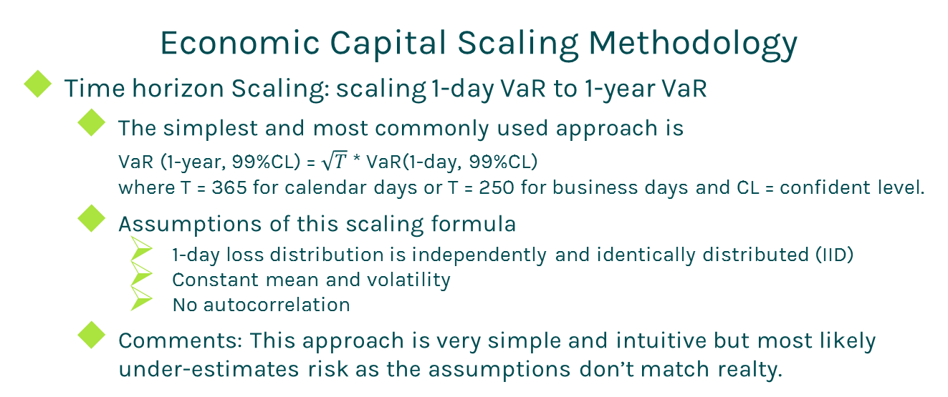
Market Risk EC
Economic Capital Scaling Methodology
Time horizon Scaling: scaling 1-day VaR to 1-year VaR
The simplest and most commonly used approach is
VaR (1-year, 99%CL) = $\sqrt{T}$ * VaR(1-day, 99%CL)
where T = 365 for calendar days or T = 250 for business days and CL = confident level.
Assumptions of this scaling formula
1-day loss distribution is independently and identically distributed (IID)
Constant mean and volatility
No autocorrelation
Comments: This approach is very simple and intuitive but most likely under-estimates risk as the assumptions don’t match realty.

Slide 8
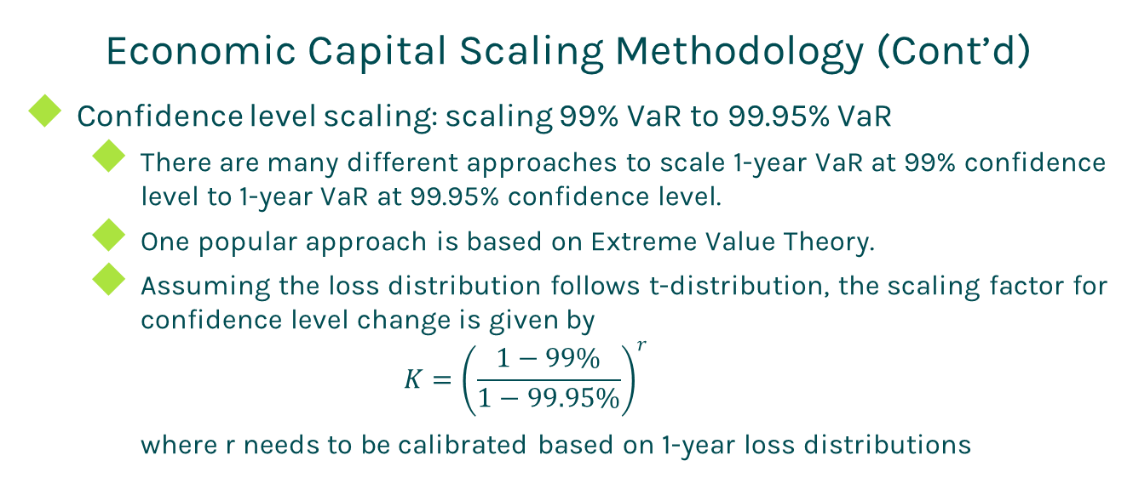
Market Risk EC
Economic Capital Scaling Methodology (Cont’d)
Confidence level scaling: scaling 99% VaR to 99.95% VaR
There are many different approaches to scale 1-year VaR at 99% confidence level to 1-year VaR at 99.95% confidence level.
One popular approach is based on Extreme Value Theory.
Assuming the loss distribution follows t-distribution, the scaling factor for confidence level change is given by
$$K={\left(\frac{1−99\%}{1−99.95\%}\right)}^{r}$$
where r needs to be calibrated based on 1-year loss distributions

Slide 9
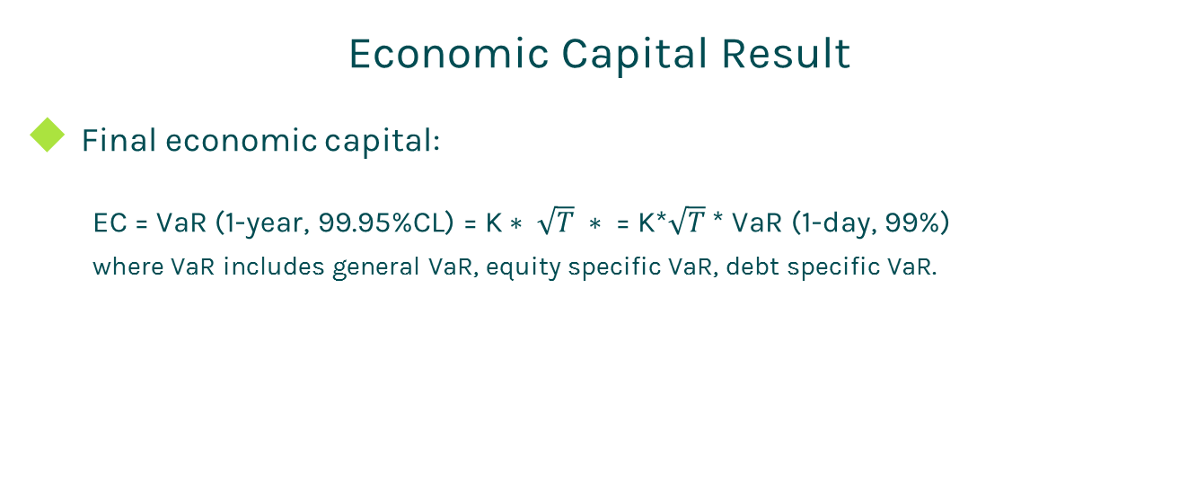
Market Risk EC
Economic Capital Result
Final economic capital:
EC = VaR (1-year, 99.95%CL) = K$∗ \sqrt{T} ∗$ = K*$\sqrt{T}$* VaR (1-day, 99%)
where VaR includes general VaR, equity specific VaR, debt specific VaR.

Slide 10
Thanks!
You can find more online presentations at
http://www.finpricing.com/paperList.html

