Slide 1

Financial Sensitivity Alex Yang FinPricing http://www.finpricing.com

Slide 2
Sensitivity
Summary
Financial Sensitivity Definition
Delta Definition
Vega Definition
Gamma Definition
Theta Definition
Curvature Definition
Option Sensitivity Pattern
Sensitivity Hedging
Sensitivity Profit & Loss (P&L)
Backbone Adjustment

Slide 3
Sensitivity
Financial Sensitivity Definition
Financial sensitivity is the measure of the value reaction of a financial instrument to changes in underlying factors.
The value of a financial instrument is impacted by many factors, such as interest rate, stock price, implied volatility, time, etc.
Financial sensitivities are also called Greeks, such as Delta, Gamma, Vega and Theta.
Financial sensitivities are risk measures that are more important than fair values.
They are vital for risk management: isolating risk, hedging risk, explaining profit and loss, etc.

Slide 4
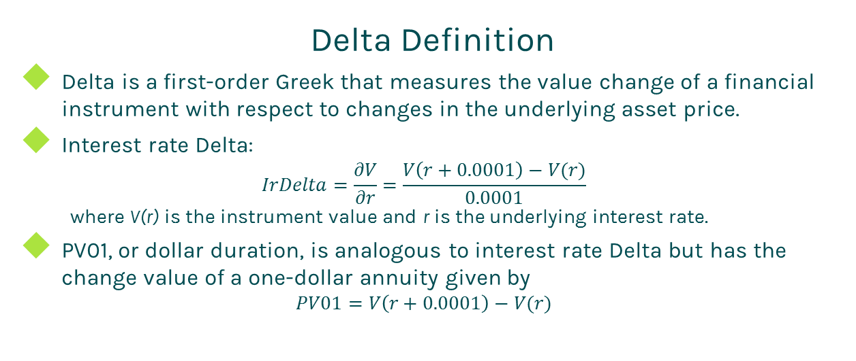
Sensitivity
Delta Definition
Delta is a first-order Greek that measures the value change of a financial instrument with respect to changes in the underlying asset price.
Interest rate Delta:
$$IrDelta=\frac{∂V}{∂r}=\frac{V\left(r+0.0001\right)−V(r)}{0.0001}$$
where V(r) is the instrument value and r is the underlying interest rate.
PV01, or dollar duration, is analogous to interest rate Delta but has the change value of a one-dollar annuity given by
$$PV01=V\left(r+0.0001\right)−V(r)$$

Slide 5
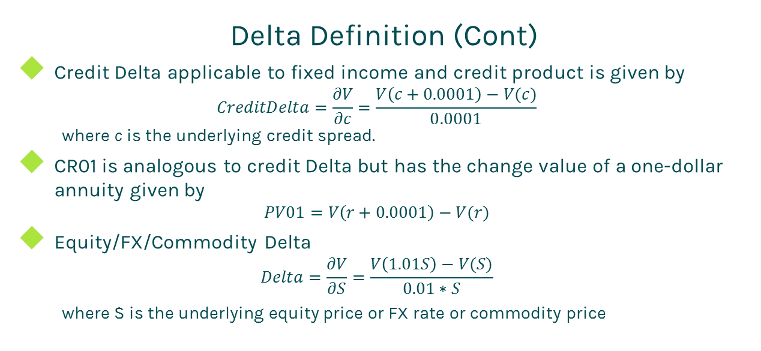
Sensitivity
Delta Definition (Cont)
Credit Delta applicable to fixed income and credit product is given by
$$CreditDelta=\frac{∂V}{∂c}=\frac{V\left(c+0.0001\right)−V(c)}{0.0001}$$
where c is the underlying credit spread.
CR01 is analogous to credit Delta but has the change value of a one-dollar annuity given by
$$PV01=V\left(r+0.0001\right)−V(r)$$
Equity/FX/Commodity Delta
$$Delta=\frac{∂V}{∂S}=\frac{V\left(1.01S\right)−V(S)}{0.01∗S}$$
where S is the underlying equity price or FX rate or commodity price

Slide 6
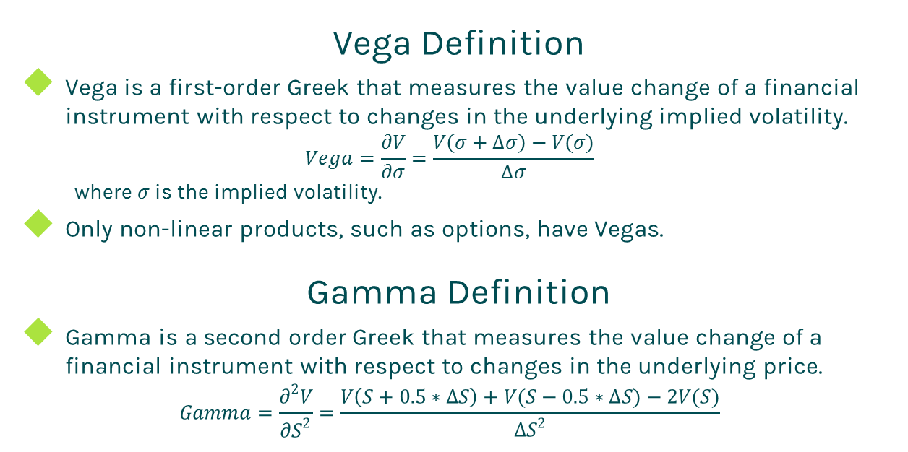
Sensitivity
Vega Definition
Vega is a first-order Greek that measures the value change of a financial instrument with respect to changes in the underlying implied volatility.
$$Vega=\frac{∂V}{∂σ}=\frac{V\left(σ+∆σ\right)−V(σ)}{∆σ}$$
where $σ$ is the implied volatility.
Only non-linear products, such as options, have Vegas.
Gamma Definition
Gamma is a second order Greek that measures the value change of a financial instrument with respect to changes in the underlying price.
$$Gamma=\frac{∂^{2}V}{{∂S}^{2}}=\frac{V\left(S+0.5∗∆S\right)+V(S−0.5∗∆S)−2V(S)}{{∆S}^{2}}$$

Slide 7
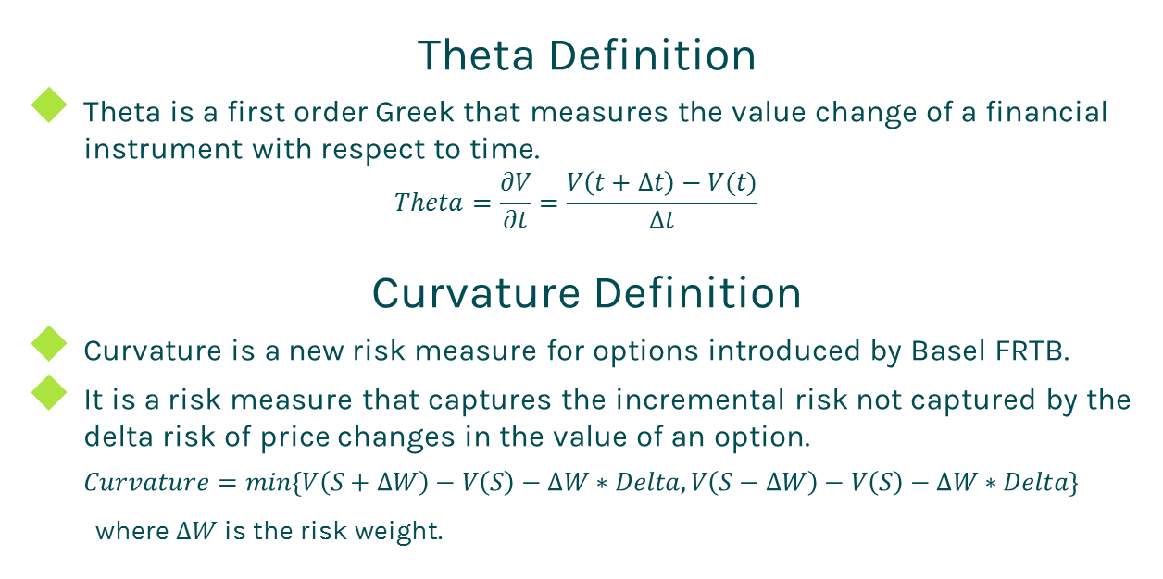
Sensitivity
Theta Definition
Theta is a first order Greek that measures the value change of a financial instrument with respect to time.
$$Theta=\frac{∂V}{∂t}=\frac{V\left(t+∆t\right)−V(t)}{∆t}$$
Curvature Definition
Curvature is a new risk measure for options introduced by Basel FRTB.
It is a risk measure that captures the incremental risk not captured by the delta risk of price changes in the value of an option.
$$Curvature=min\left\{V\left(S+∆W\right)−V\left(S\right)−∆W∗Delta, V\left(S−∆W\right)−V\left(S\right)−∆W∗Delta\right\}$$
where $∆W$ is the risk weight.

Slide 8
Sensitivity
Option Sensitivity Pattern
Sensitivity behaviors are critical for managing risk.
Gamma
Gamma behavior in relation to time to maturity shown below.
Gamma has a greater effect on shorter dated options.

Slide 9
Sensitivity
Option Sensitivity Pattern (Cont)
Gamma behavior in relation to moneyness shown below.
Gamma has the greatest impact on at-the-money options.

Slide 10
Sensitivity
Option Sensitivity Pattern (Cont)
Vega
Vega behavior in relation to time to maturity shown below.
Vega has a greater effect on longer dated options.

Slide 11
Sensitivity
Option Sensitivity Pattern (Cont)
Vega behavior in relation to moneyness shown below.
Vega has the greatest impact on at-the-money options.

Slide 12
Sensitivity
Option Sensitivity Pattern (Cont)
Theta or time decay
Theta is normally negative except some deeply in-the-money deals.
Theta behavior in relation to time to maturity shown below.
Theta has a greater effect on shorter dated options.

Slide 13
Sensitivity
Option Sensitivity Pattern (Cont)
Theta behavior in relation to moneyness shown below.
Theta has the biggest impact on at-the-money options.

Slide 14
Sensitivity
Sensitivity Hedging
The objective of hedging is to have a lower price volatility that eliminates both downside risk (loss) and upside profit.
Hedging is a double-edged sword.
The profit of a broker or an investment bank comes from spread rather than market movement. Thus it is better to hedge all risks.
Delta is normally hedged.
Vega can be hedged by using options.
Gamma is hardly hedged in real world.

Slide 15
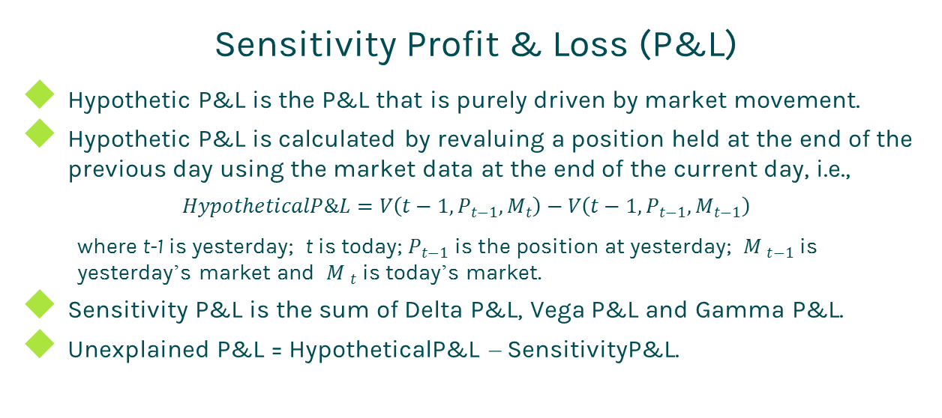
Sensitivity
Sensitivity Profit & Loss (P&L)
Hypothetic P&L is the P&L that is purely driven by market movement.
Hypothetic P&L is calculated by revaluing a position held at the end of the previous day using the market data at the end of the current day, i.e.,
$$HypotheticalP\&L=V\left(t−1, P_{t−1},M_{t}\right)−V\left(t−1, P_{t−1},M_{t−1}\right)$$
where t-1 is yesterday; t is today; $P_{t−1}$ is the position at yesterday; ${M }_{t−1}$ is yesterday’s market and ${M }_{t}$ is today’s market.
Sensitivity P&L is the sum of Delta P&L, Vega P&L and Gamma P&L.
Unexplained P&L = HypotheticalP&L – SensitivityP&L.

Slide 16
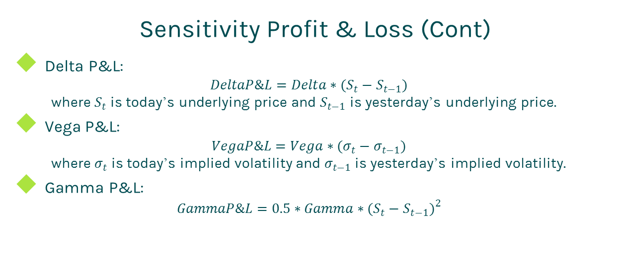
Sensitivity
Sensitivity Profit & Loss (Cont)
Delta P&L:
$$DeltaP\&L=Delta∗(S_{t}−S_{t−1})$$
where $S_{t}$ is today’s underlying price and $S_{t−1}$ is yesterday’s underlying price.
Vega P&L:
$$VegaP\&L=Vega∗(σ_{t}−σ_{t−1})$$
where $σ_{t}$ is today’s implied volatility and $σ_{t−1}$ is yesterday’s implied volatility.
Gamma P&L:
$$GammaP\&L=0.5∗Gamma∗{(S_{t}−S_{t−1})}^{2}$$

Slide 17
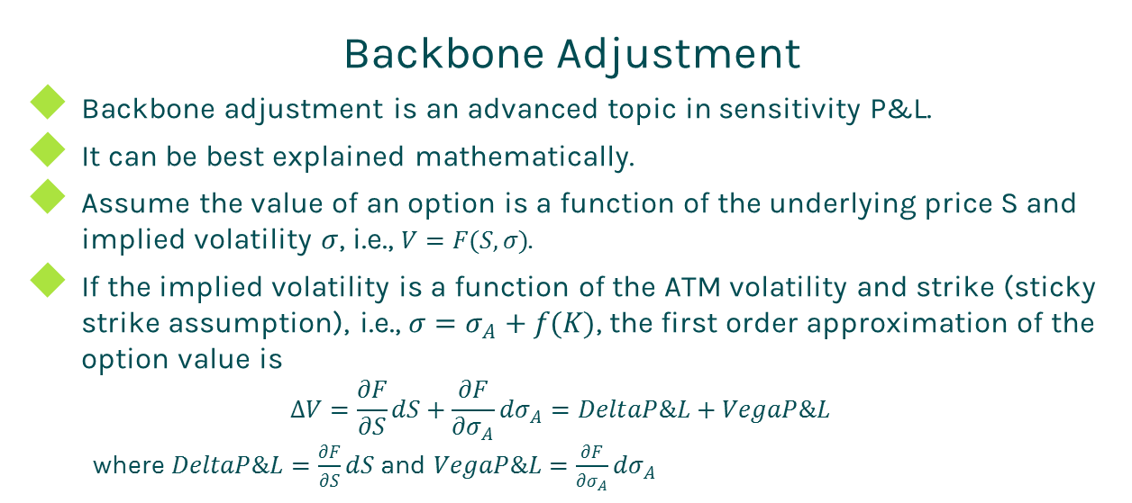
Sensitivity
Backbone Adjustment
Backbone adjustment is an advanced topic in sensitivity P&L.
It can be best explained mathematically.
Assume the value of an option is a function of the underlying price S and implied volatility $σ$, i.e., $V=F(S,σ)$.
If the implied volatility is a function of the ATM volatility and strike (sticky strike assumption), i.e., $σ=σ_{A}+f(K)$, the first order approximation of the option value is
$$∆V=\frac{∂F}{∂S}dS+\frac{∂F}{{∂σ}_{A}}{dσ}_{A}=DeltaP\&L+VegaP\&L$$
where $DeltaP\&L=\frac{∂F}{∂S}dS$ and $VegaP\&L=\frac{∂F}{{∂σ}_{A}}{dσ}_{A}$

Slide 18
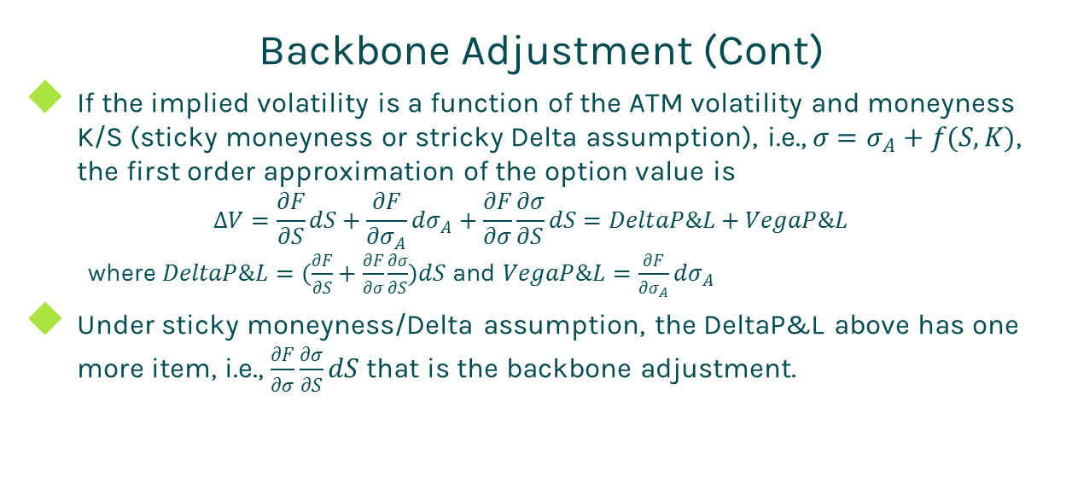
Sensitivity
Backbone Adjustment (Cont)
If the implied volatility is a function of the ATM volatility and moneyness K/S (sticky moneyness or stricky Delta assumption), i.e., $σ=σ_{A}+f(S,K)$, the first order approximation of the option value is
$$∆V=\frac{∂F}{∂S}dS+\frac{∂F}{{∂σ}_{A}}{dσ}_{A}+\frac{∂F}{∂σ}\frac{∂σ}{∂S}dS=DeltaP\&L+VegaP\&L$$
where $DeltaP\&L=(\frac{∂F}{∂S}+\frac{∂F}{∂σ}\frac{∂σ}{∂S})dS$ and $VegaP\&L=\frac{∂F}{{∂σ}_{A}}{dσ}_{A}$
Under sticky moneyness/Delta assumption, the DeltaP&L above has one more item, i.e., $\frac{∂F}{∂σ}\frac{∂σ}{∂S}dS$ that is the backbone adjustment.

Slide 19
Thanks!
You can find more details at
http://www.finpricing.com/lib/sensitivity.pdf

