Slide 1
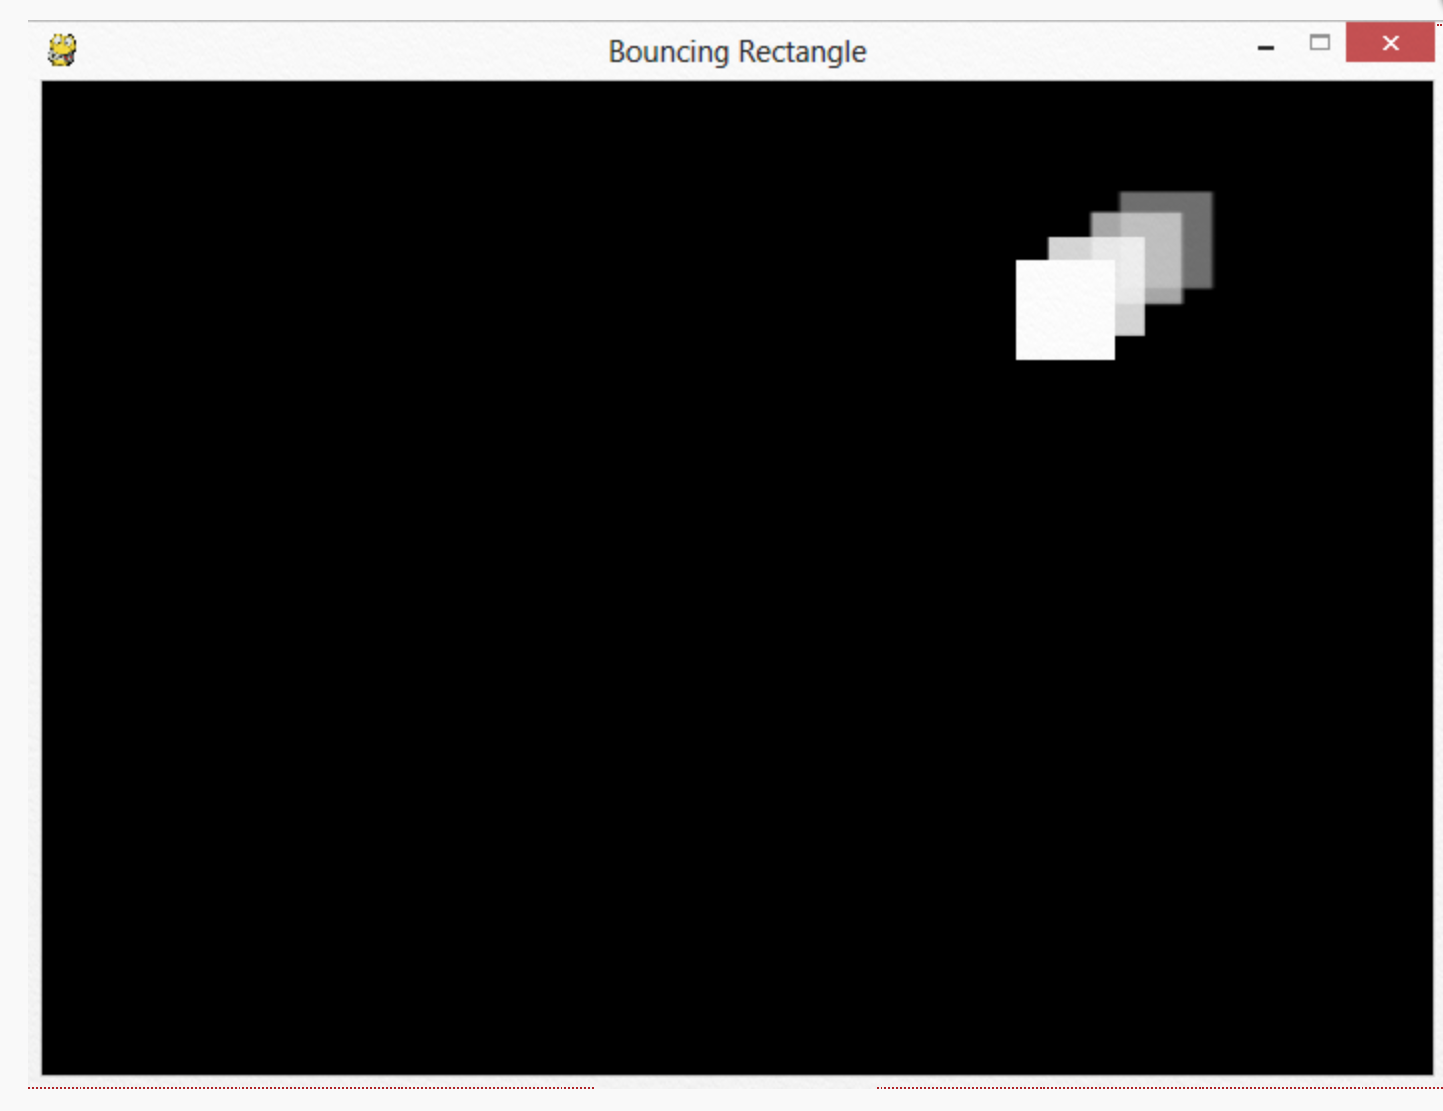
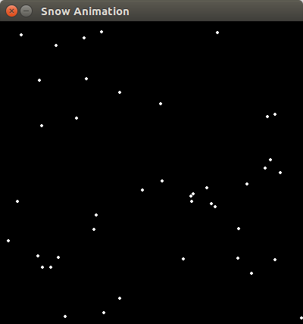
Animation – Bouncing Square
Square that bounces around inside window
Falling snow

Slide 2
Who am I?
Tim Hood
Software Engineer, Computer Programmer, Coder, Developer
BAE Systems in Yeovil, ~300 people
Coding aircraft, ship, communications, website and mobile phone software for 30 years

Slide 3
The Bouncing Square
Start with the WingIDE
New file copy of template code “bounce.py”
So how will the code work - 6 stages
Display basic window, 700 x 500
Black window with white square, 50 x 50
Move square to the right
Move down and right
Bounce when hit edges of window
Add inner red square

Slide 4
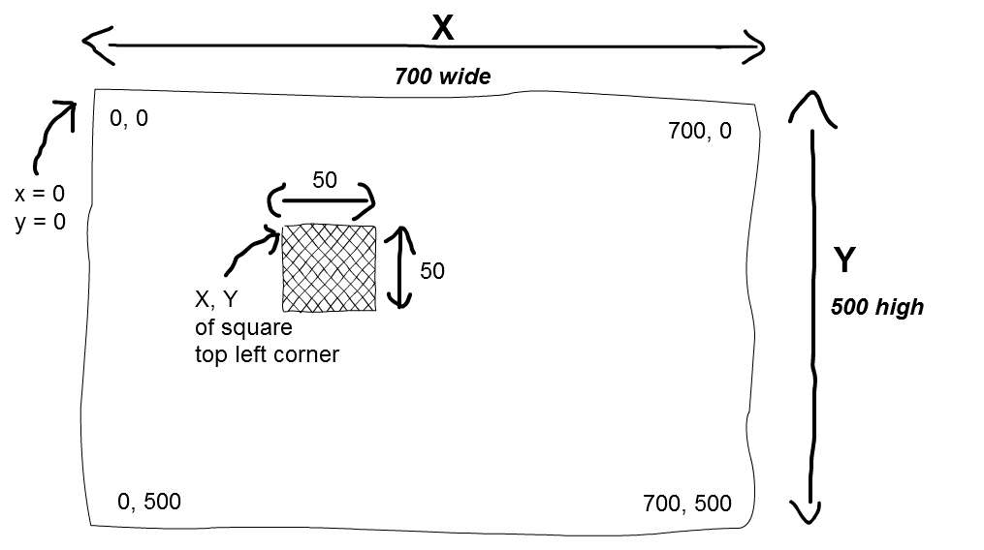
X and Y coordinates of screen

Slide 5
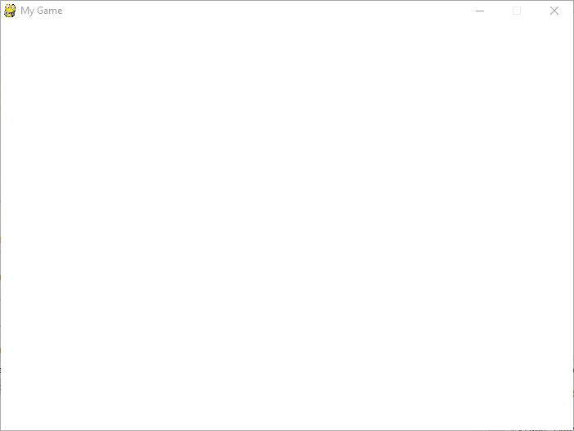
Copy existing template file
Copy existing Python file to your PC
From <path to existing file …. /bounce.py>
To <C:/…./bounce.py>
Open file in WingIDE
and run it
get a blank white
window
Close window click
[X] in corner

Slide 6


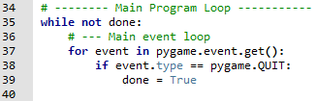
What does the code do?
Lines 15 - 16
define some
colours
Line 23
sets size of the
window
width, height
Lines 35 – 58
loops until you
click the [X]

Slide 7
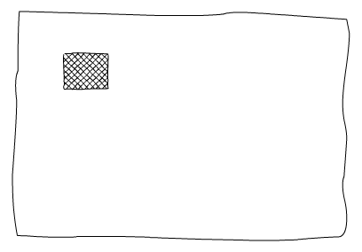
Draw the white square

Slide 8
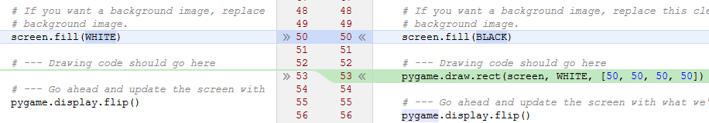
Draw the white square
Change the code highlighted below
Background changes from WHITE to BLACK
Insert new line to draw 'square'
Square is actually a WHITE rectangle
[50, 50, 50, 50] is [x, y, width, height]

Slide 9
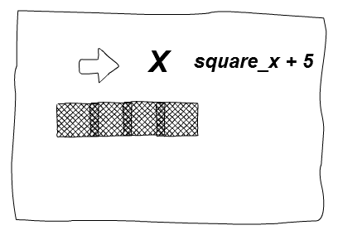
Move the square to the right

Slide 10


Move the square to the right
Variable 'square_x' above while loop is 'x' coordinate of square
Use 'square_x' when draw the 'square'
Increase 'square_x' inside the loop by 1 slow, if increase by 5 goes faster

Slide 11
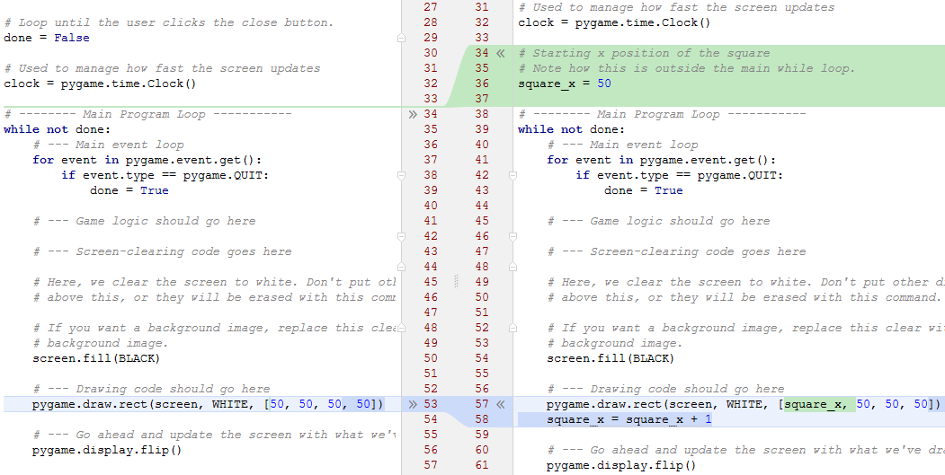
Move the square to the right

Slide 12
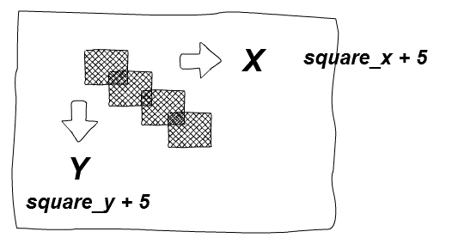
Move the square down & to the right

Slide 13


Move the square down & to the right
Variable 'square_y' above while loop is 'y' coordinate of square
Use 'square_y' when draw the 'square'
Increase 'square_y' inside the loop by 1 slow, if increase by 5 goes faster

Slide 14
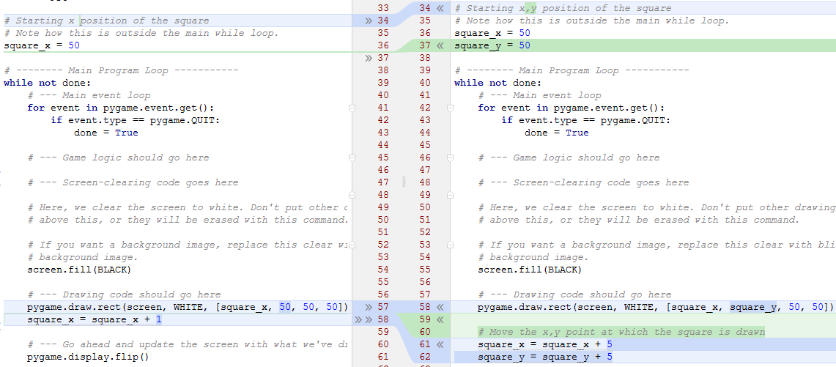
Move the square down & to the right

Slide 15
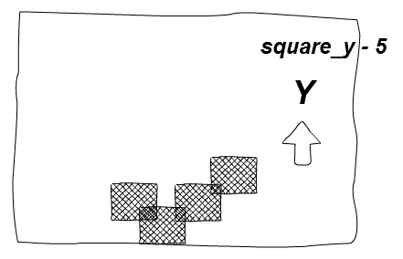
Bounce off edges

Slide 16
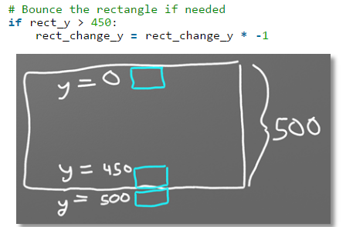
Bounce off edges

Slide 17
Animating Snow
Copy ready made Python file from here <….>
Very similar to 'bouncing square', 400 x 400
50 snow flakes start at random x, y position
Flakes are small circles which fall, y = y + 1
At the bottom of the screen, y > 400
Set 'y' to be < 0, off top of screen
Set 'x' to be random 0 .. 400
Run it and see ...

