Slide 1

Game Design:
Scratch
April 6, 2015

Slide 2

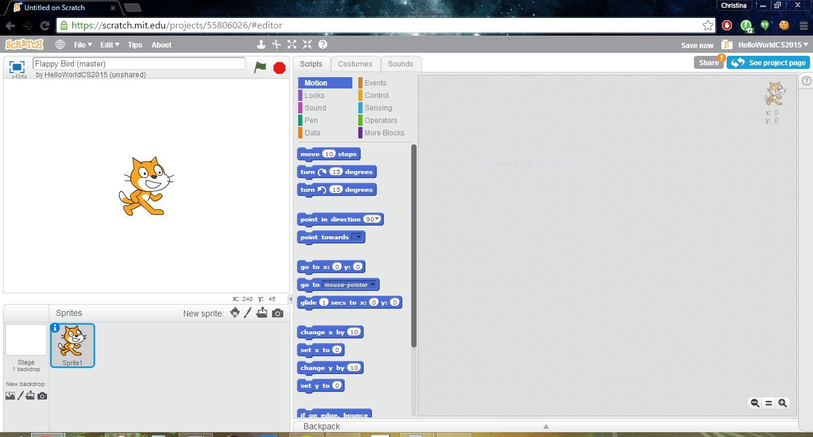
Motions
Notes:
Sprites are the characters of this game world you will be creating. By dragging these blocks on to the blanks space, you will be able to tell sprites what to do, like move 10 steps, turn, whatever.

Slide 3
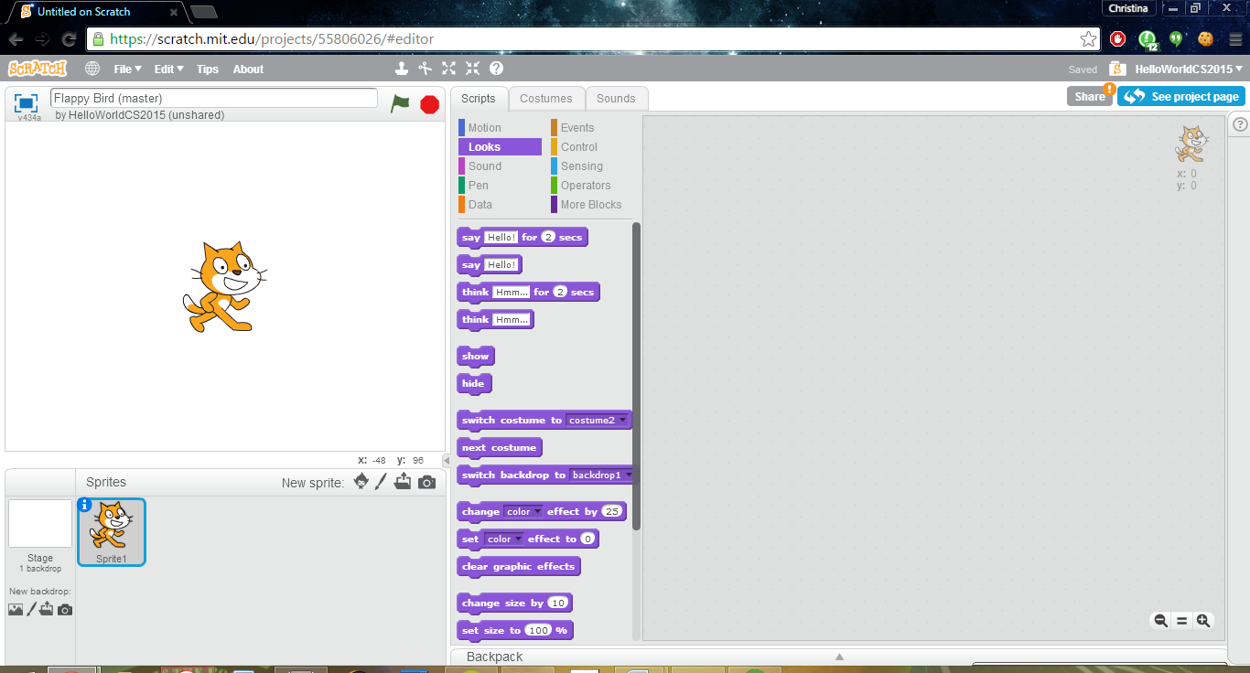
Looks
Notes:
Looks for a sprite can change its appearance. We will be using this soon to make the character say “Hello, World”

Slide 4
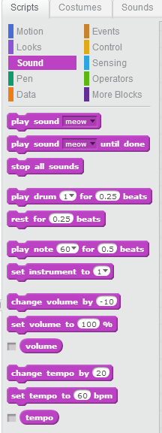
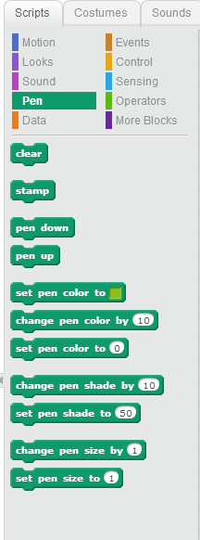
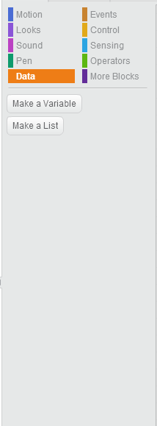
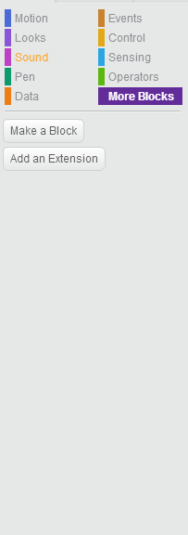
Sounds/Pen/Data/More Blocks
Notes:
We won’t be using these options today, but you can definitely explore these by yourself later. The sound actions can make the sprites say different things. The pen blocks can be used to design a drawing game. Data includes different variables, which can be used to store information.

Slide 5
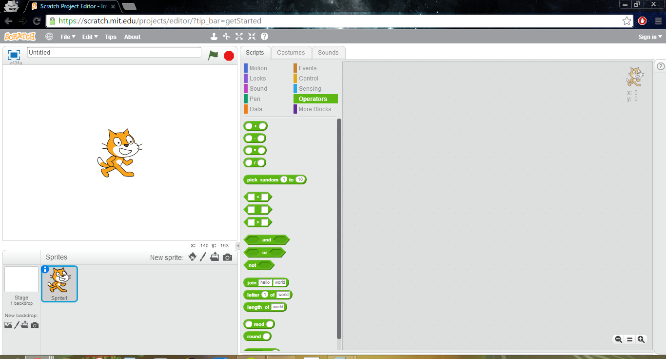
Operators
Notes:
Operators include basic math, like addition, subtraction, division, and multiplication. It can be used to compare one value to another value and se if it’s greater than, less than, or equal to. For the flappy bird game, we will use it to create a random number between 1 and 3.

Slide 6
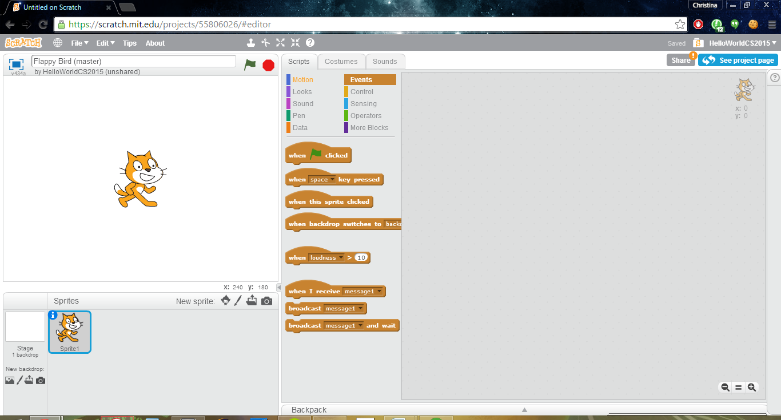
Events
Notes:
Events are checks to see if something happened. We’ll be using the “when the green flag is clicked” button everytime we want to start the game or program so it runs to the same place every time. We’ll also be using the “when space key is pressed” to make the bird fly up.

Slide 7
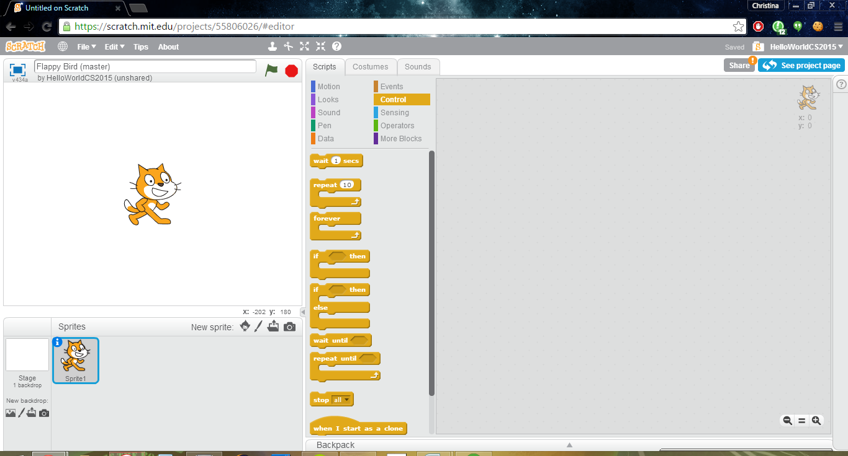
Control
Notes:
Control decides when something will happen. With an if block, you can decide that if something is true, then something else. For the Flappy Bird game, we will be using this to check if the bird hits the green pipes. If it does hit the pipe, then the game stops. Additionally, we also use forever block to repeat things forever. In the Flappy Bird game, we will be using this to make sure the bird is always falling (unless you hit the space bar), and you also want to make sure that the green pipes are always moving forever.

Slide 8
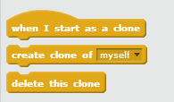
Clones
Notes:
Clones are duplicates of the same sprite. These blocks are part of the control section, and we will be using them in the Flappy Bird Game to basically copy and paste the green pipes.

Slide 9
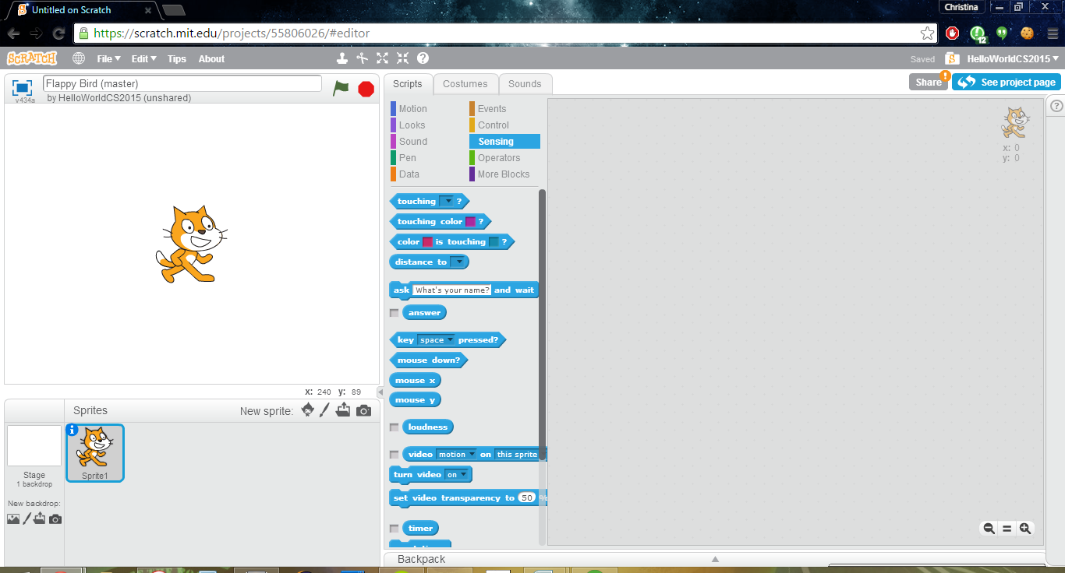
Sensors
Notes:
Sensors detect different things in the game. With Flappy Bird, we’ll use it to check if the bird is hitting the pipes

Slide 10
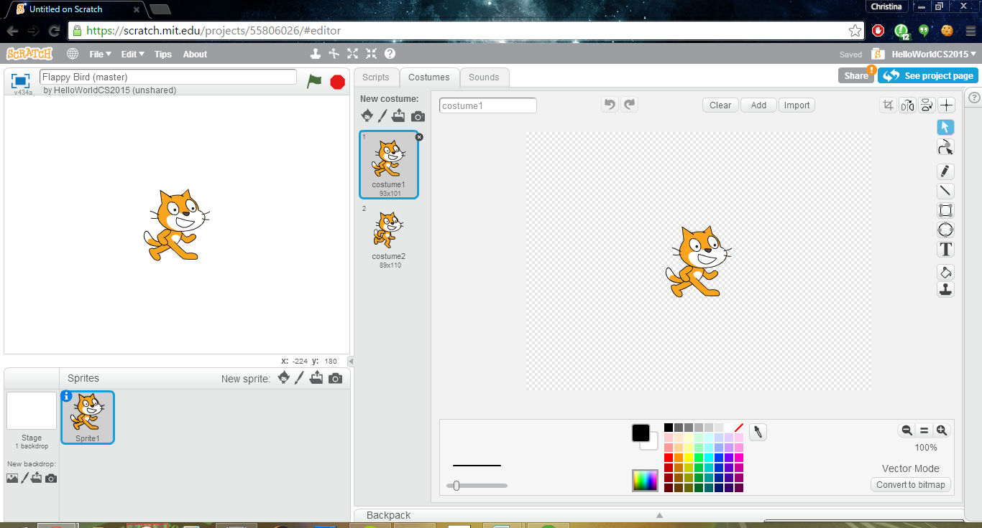
Costumes
Notes:
Costumes are different versions of the same sprite. We’ll be using this to create different versions of the green pipes: when the hole is really high up, when the hole is in the middle, when the hole is near the bottom, whatever.

Slide 11
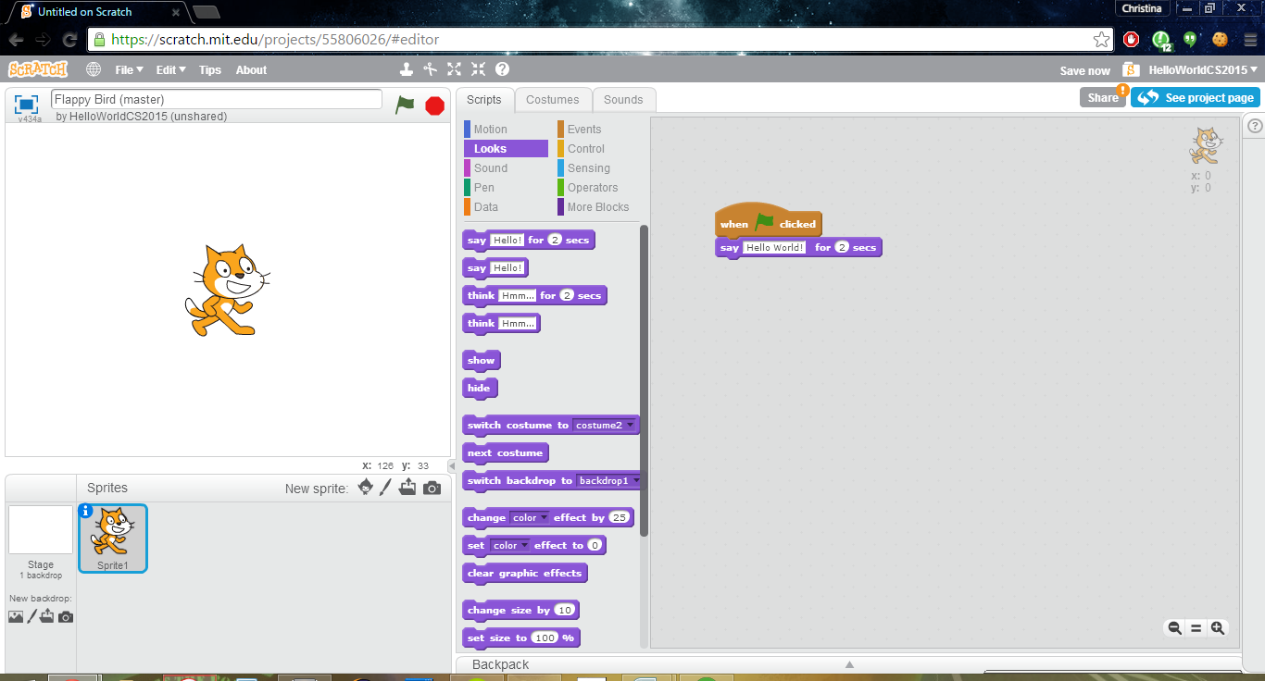
Hello World
Notes:
For the first project, you will be making Scratch the cat say “Hello World!” for 2 seconds when you click the green flag. It’s just two blocks, and they’re color coded to make things easy. If you need help, please raise your hand!
…
Congrats, you just wrote your first computer program!

Slide 12
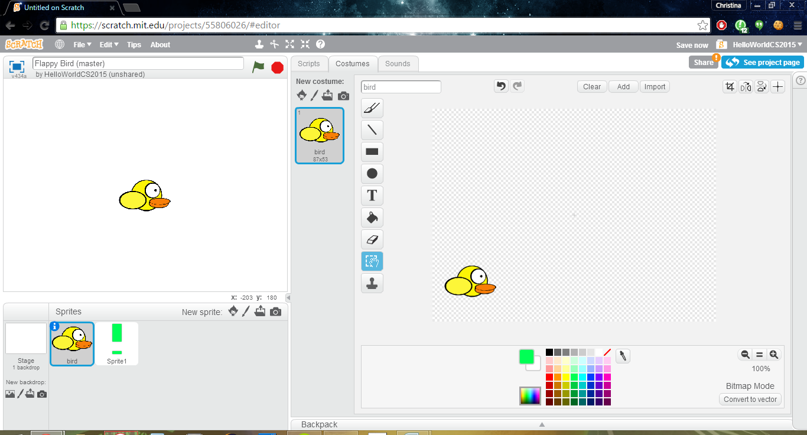
Bird Sprite
Notes:
Go on My Network>Rasel>HelloWorld, find bird.png and upload it. You just made your first sprite! Resize your bird so it will be small enough to fit through the pipe holes.

Slide 13
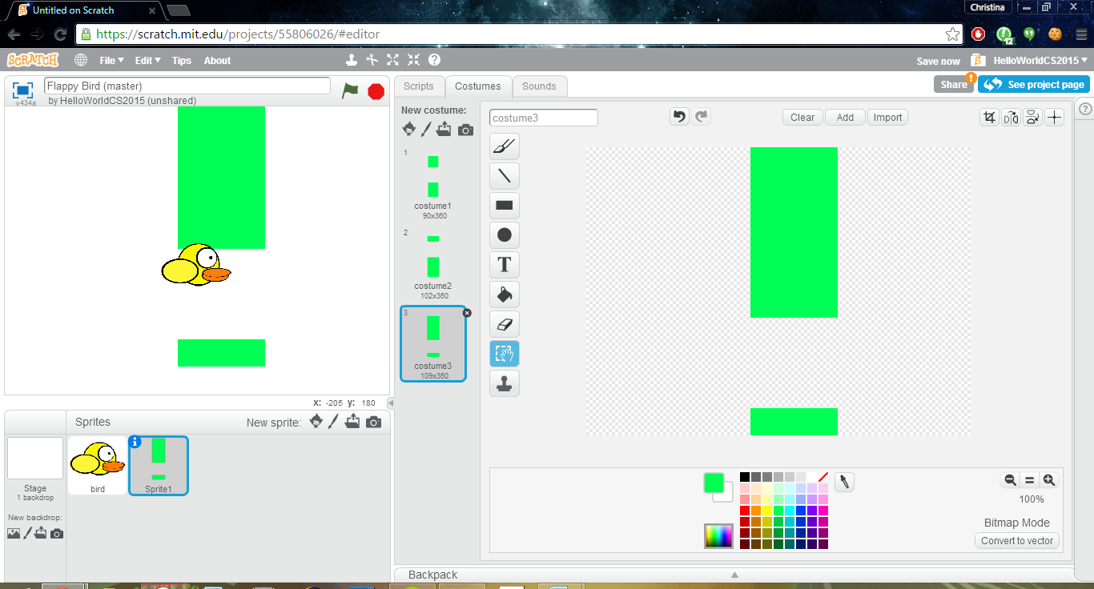
Pipe sprite (and costumes)
Notes:
We will manually be making the pipes, which the bird will have to fly through. By New Sprite, click on the paint brush. Then, make a vertical rectangle. Make sure that it’s solid, and has a hole in the middle. To make a hole, use the select tool to pick a space, then delete it. Make two other costumes: one with the hole by the top, and one with the hole by the bottom.

Slide 14
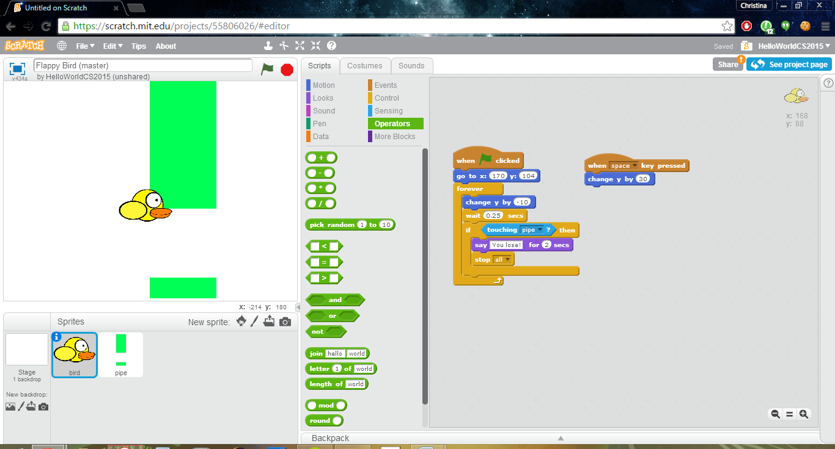
Bird code
Notes:
Starting the game
Reset the bird’s position so it always starts in the middle
Make the bird always falls a little by making it move “negative” -10 in a forever loop
The bird falls down really fast, so before running the loop again, we’re going to make the computer wait 0.25 seconds to slow things down a little
When the user hits the space bar, then the bird should fly up 30
If hitting the pipe or the bottom or the top of the screen, the bird should say you lose, then everything should stop moving

Slide 15
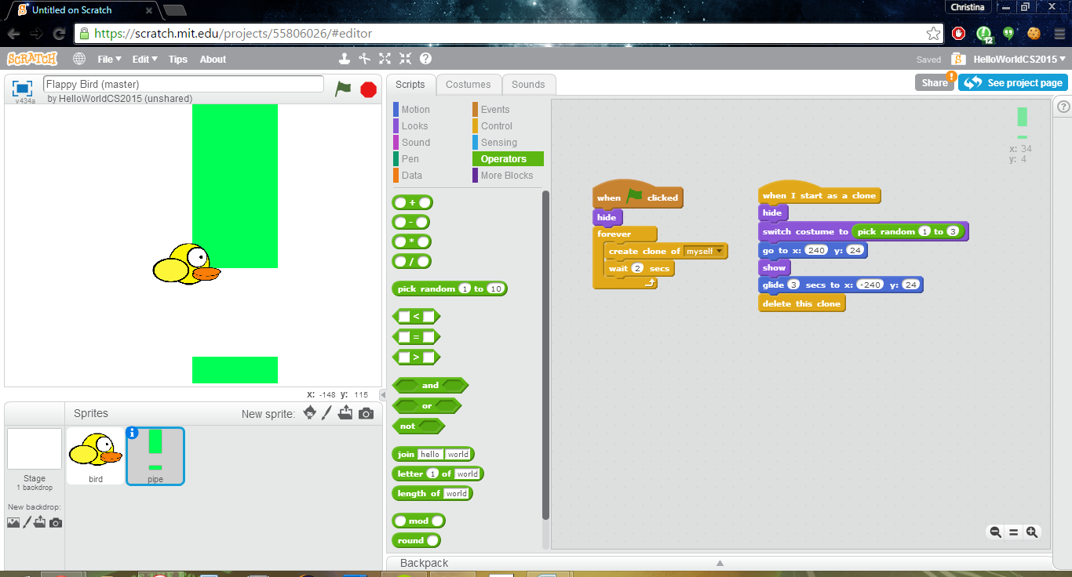
Pipes code
Notes:
When the green flag is clicked, the pipes should be hidden and moved to the far right of the screen to begin.
Next, there should be a forever loop that creates new clones of the pipe.
Whenever a new clone is made
It should hide itself first. Then, it should move to the far right of the screen (240) and change costumes
To change costumes, generate a random number between 1 and 3 because we have 3 different costumes for the pipe
Then, it should show itself and glide to the left side of the screen (-240) in 3 seconds.
After it reached the far left, it should delete itself so there’s not just a bunch of copies of the same pipe on the screen.
The pipes create clones really really fast, so we’re going to add in a wait 2 seconds in there.

Slide 16
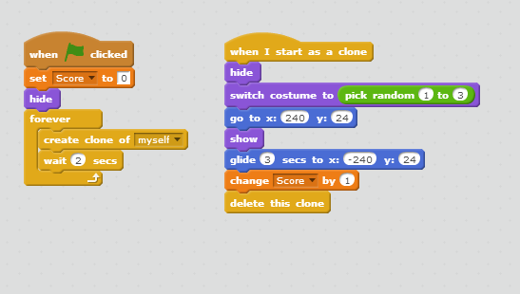
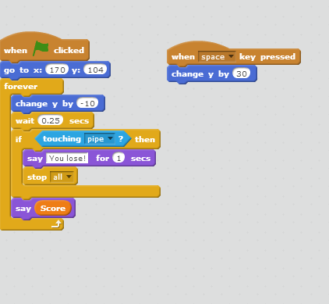
Score code
Notes:
Make a data variable called Score. Make sure all sprites can use it. This is called a global variable, which means everything in your world can use it. If you made a variable that only that sprite can use, it’s called a local variable.
In the pipe code, when the green flag is clicked, it should set score to 0
Every time the bird passed through the pipe (when it reached -240), it should increase the score
Switch back to the bird sprite. Have it say the score every time

Slide 17
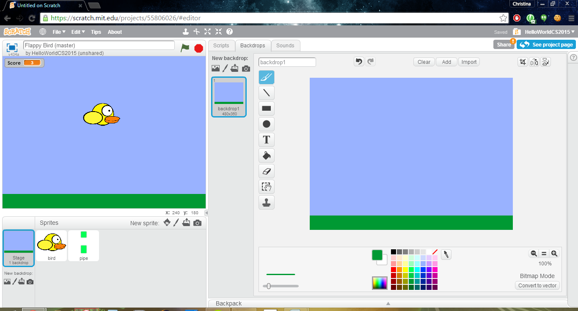
Background
Notes:
Make the background with the backdrop.

Slide 18
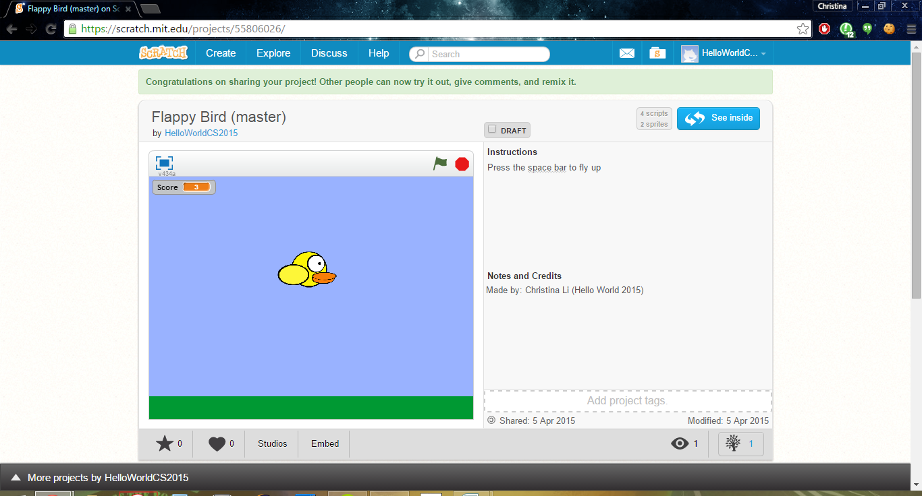
Share
Notes:
Share your project!
Instructions: press the space bar to fly up
Notes and Credits: By [your name here]

