Slide 1



Developing a Todo List App with Angular & .NET

Slide 2
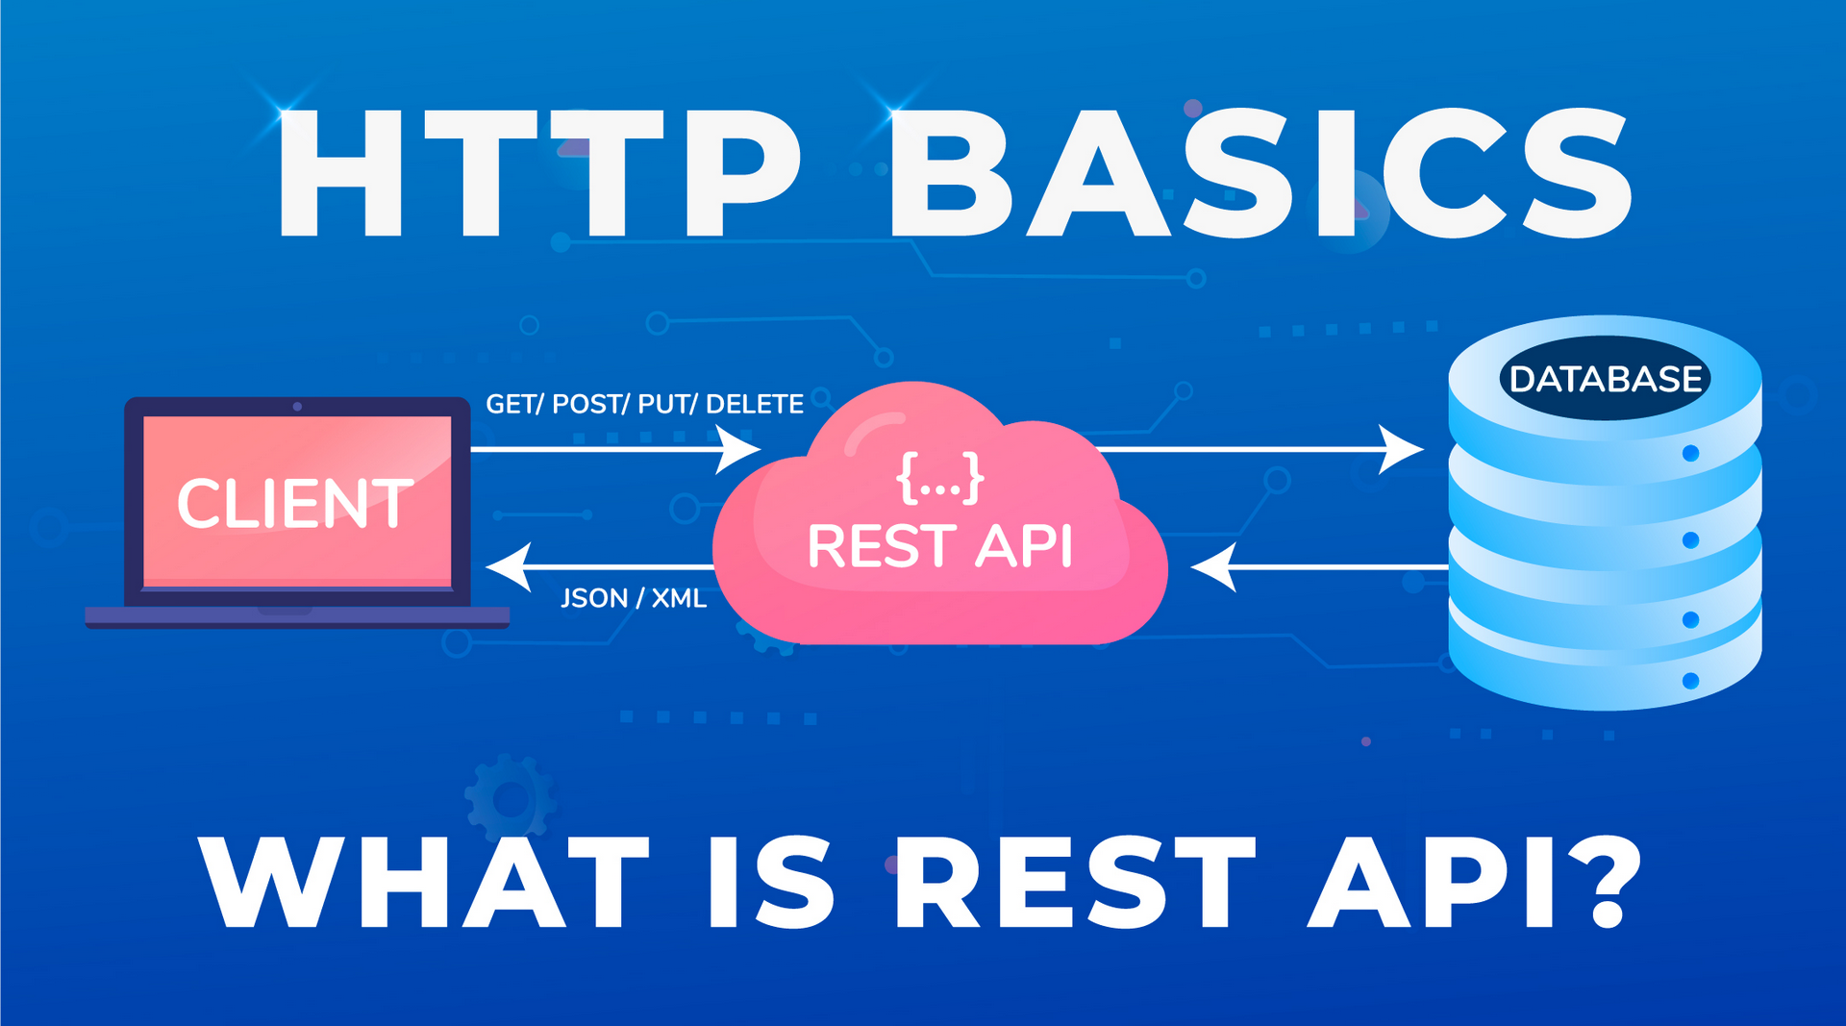
What is a Rest API?

Slide 3
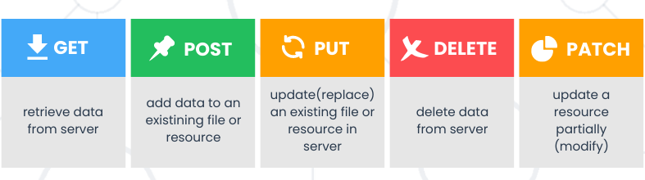
HTTP Request Methods

Slide 4
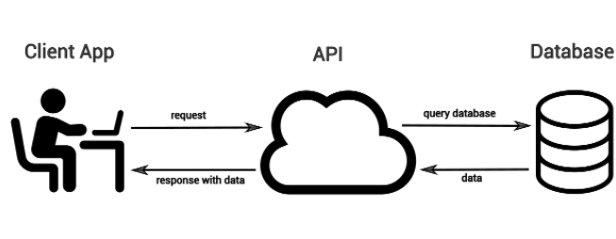
A Basic Full Stack Application

Slide 5
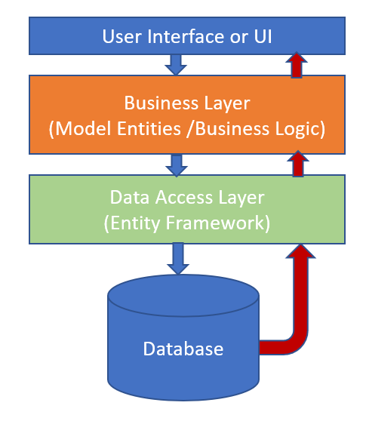
Asp.NET Web API and Entity Framework

Slide 6
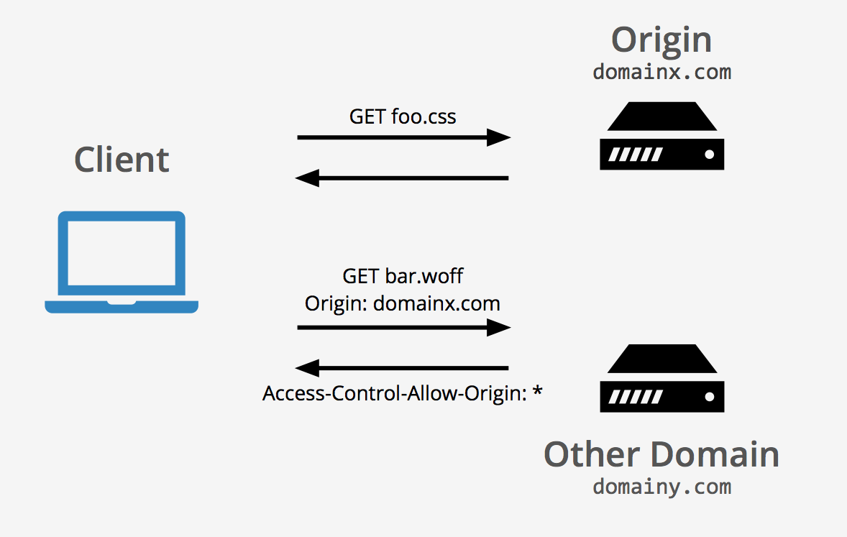
Cross Origin Resource Sharing (CORS)

Slide 7
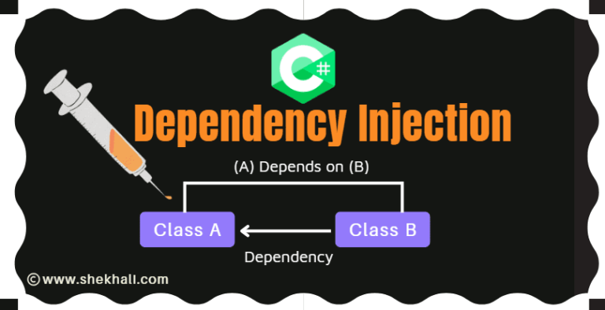
Dependency Injection

