Slide 1
PG4200: Algorithms And Data Structures Lesson 03: Runtime Analysis and Sorting
Bogdan Marculescu

Slide 2
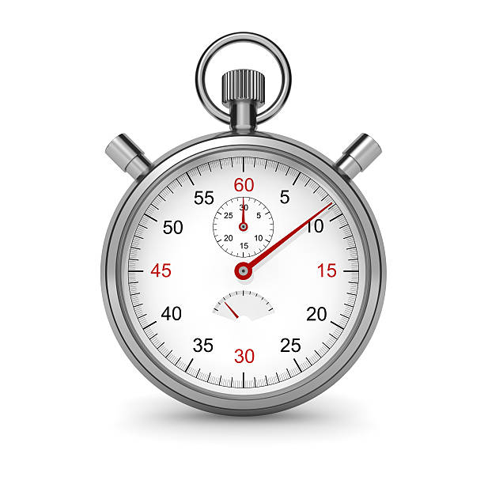
How Long?
You want fast algorithms
You could just run some “experiments”, and check how long your algorithm takes
But what if algorithm will need to be run on a larger problem than I used in the experiments?
If the problem is twice as big, will my algorithm take just twice as long???

Slide 3
public static int sum(int[] array){ int sum = 0; for(int i=0; i<array.length; i++){ sum += array[i]; } return sum; }
“Cost” can be measured in number of executed statements
Given size of array N, the loop will be taken N times
There is some constant cost independent of N, eg creation of “int sum” variable
If N doubles, would expect function will be roughly twice as slow

Slide 4
instructions(N)= 3N + 4
instructions(N=3)=13
instructions(N=0)=4
int sum = 0;
int i=0;
i<array.length;
return sum;
int sum = 0;
int i=0;
i<array.length;
sum += array[i];
i++
i<array.length;
sum += array[i];
i++
i<array.length;
sum += array[i];
i++
i<array.length;
return sum;
Number of instructions depends on size N of the array, plus some constant cost
Can be represented with a function, eg f(N)=3N+4
For large N, constants are not important

Slide 5
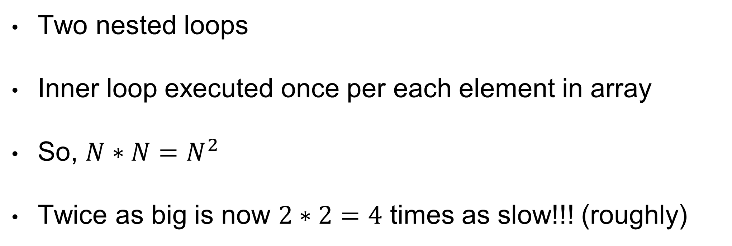
/* On my machine, repeated 100 times: N=100 seconds=0.005 N=200 seconds=0.005 N=400 seconds=0.012 N=800 seconds=0.072 N=1600 seconds=0.211 N=3200 seconds=0.754 N=6400 seconds=2.829 N=12800 seconds=11.48 */
public static int pairs(int[] array){ int pairs = 0;
for(int i=0; i<array.length; i++){ for(int j=0; j<array.length; j++){ if(i!=j && array[i] == array[j]){ pairs++; } } } return pairs; }
Two nested loops
Inner loop executed once per each element in array
So, $N∗N=N^{2}$
Twice as big is now $2∗2=4$ times as slow!!! (roughly)

Slide 6
Scalability
When analyzing algorithms, we will not look at the low level optimization details
N as representation of the problem size (eg, length of array or number of elements in a container)
How does the algorithm scale for larger sizes???
Example: if my website works fine with a load of 100 users, what will happen with 2,000??? Will I just need 20 times the resources?

Slide 7
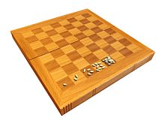
Wheat/Rice and Chessboard Problem
1 rice grain on first square
Double at each square
How many grains on the board?
18,446,744,073,709,551,615
ie, 18 Quintillions

Slide 8
Analysis of Algorithms
Mathematically define the cost as a function of the input size
Precise functions can be impractical, so we need approximations
Usually, we are interested in upper and lower bounds

Slide 9
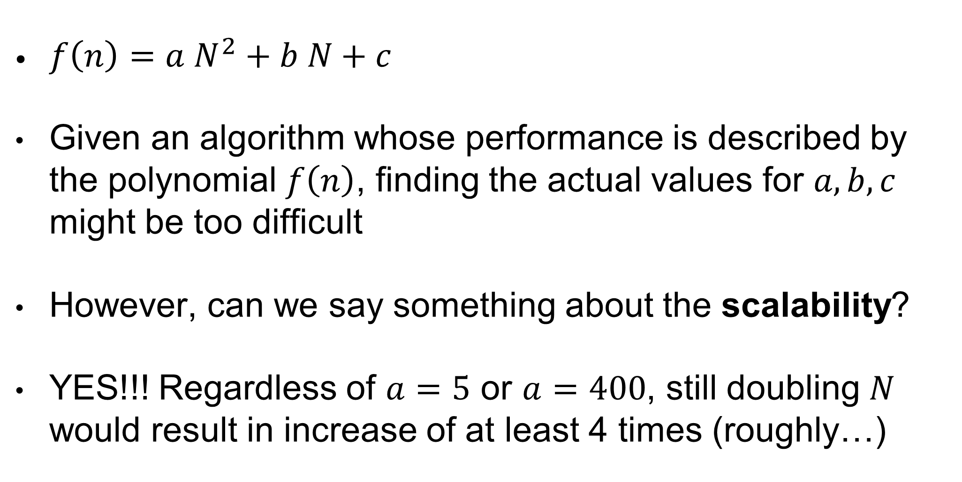
Example
$f\left(n\right)=a N^{2}+b N+c$
Given an algorithm whose performance is described by the polynomial $f\left(n\right)$, finding the actual values for $a,b,c$ might be too difficult
However, can we say something about the scalability?
YES!!! Regardless of $a=5$ or $a=400$, still doubling $N$ would result in increase of at least 4 times (roughly…)

Slide 10
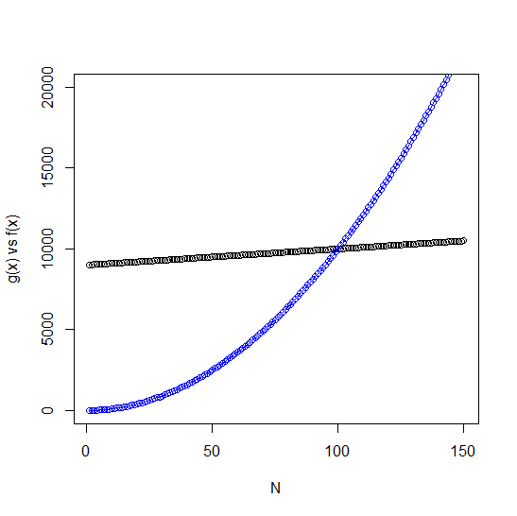
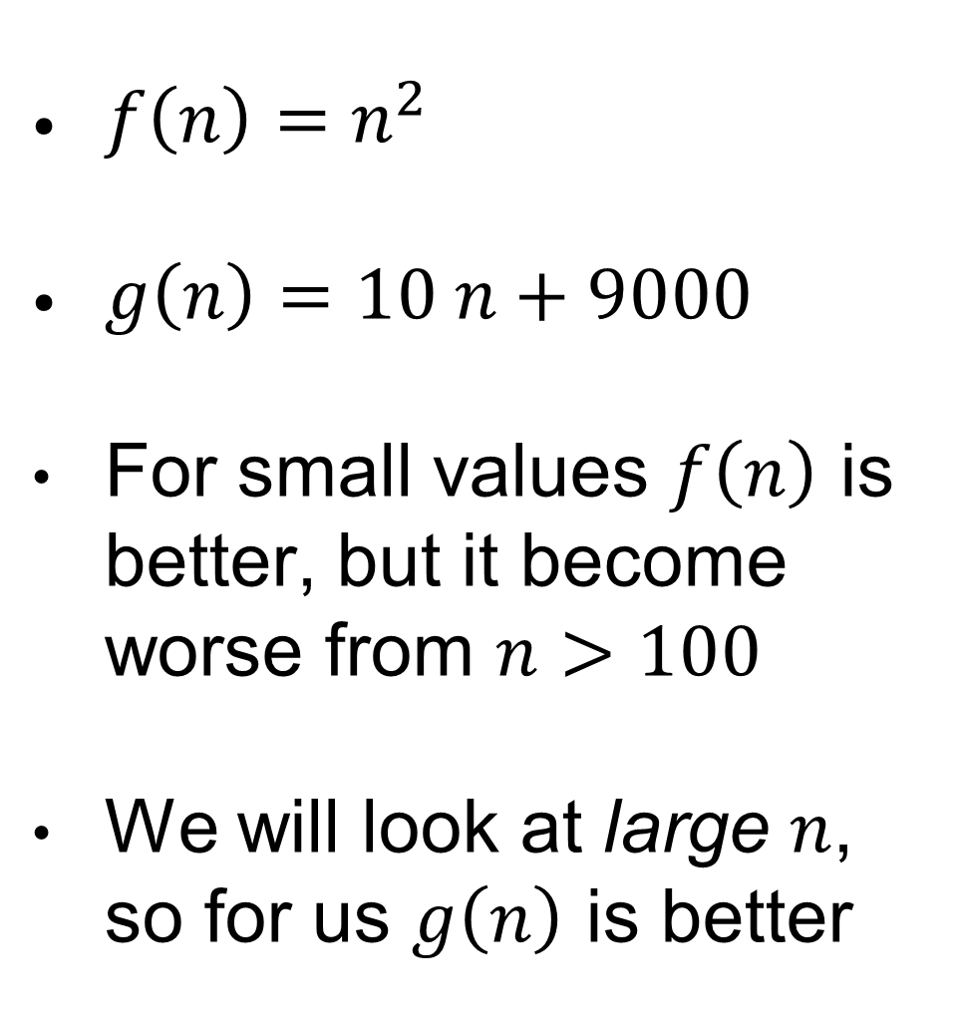
Which Is Better?
$f\left(n\right)=n^{2}$
$g\left(n\right)=10 n+9000$
For small values $f\left(n\right)$ is better, but it become worse from $n>100$
We will look at large $n$, so for us $g\left(n\right)$ is better

Slide 11
Large N???
How do we define large?
10? 50? 10000000000000000???
We can’t really say… however, things grow so fast… what we think is large today, is likely going to be considered tiny in few years…
Today I know how fast my algorithms are, because I run them. But I want to know how they will scale to the larger problem instances of tomorrow.
Eg, when my apps get more users

Slide 12
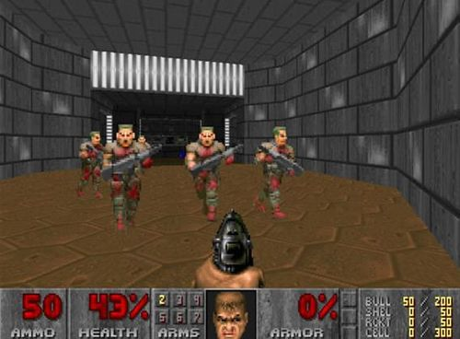
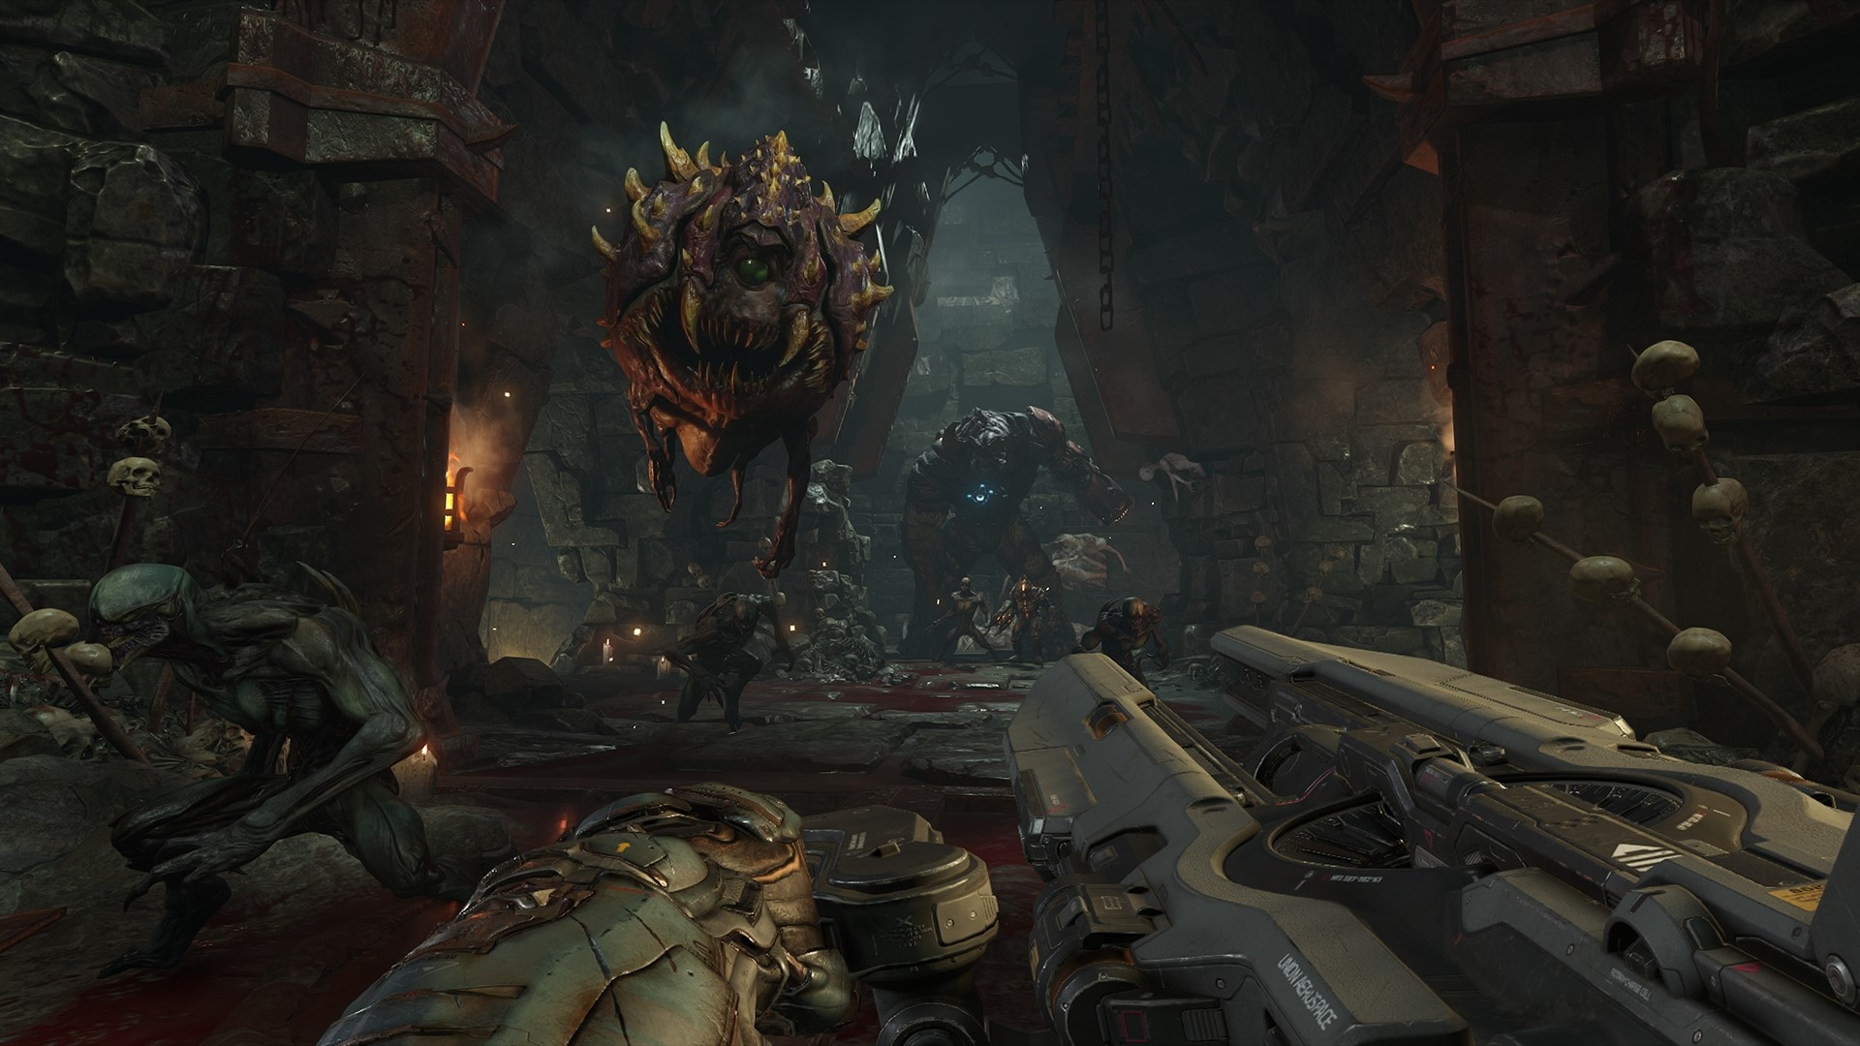
FPS… large increase in number of polygons to render…
Doom (2016)
Doom (1993)

Slide 13
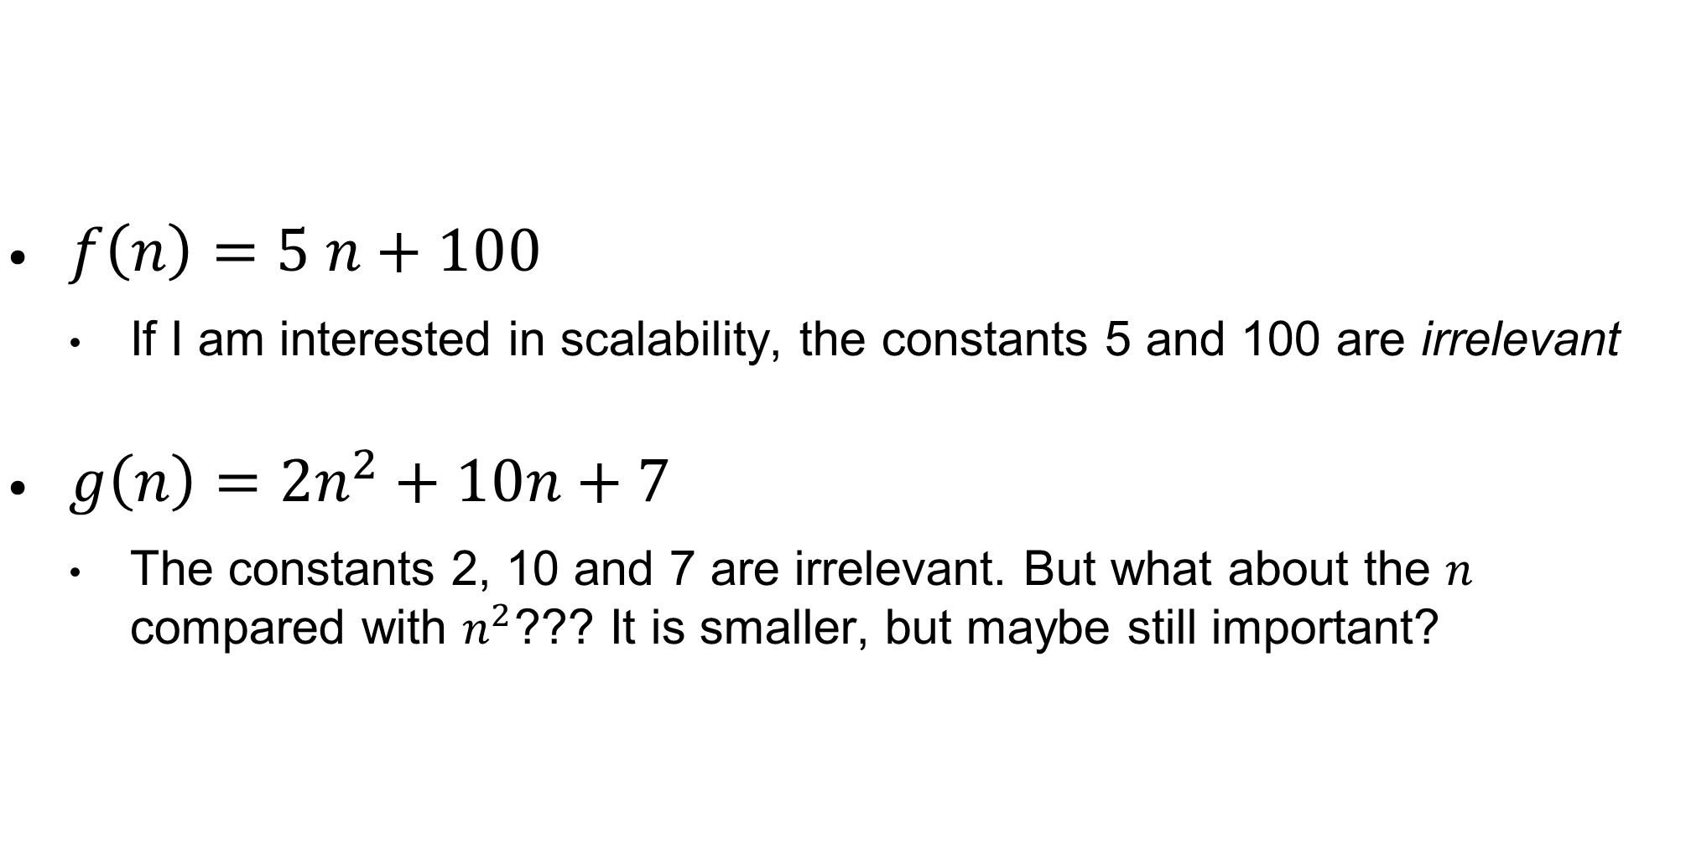
Scalability
$f\left(n\right)=5 n+100$
If I am interested in scalability, the constants 5 and 100 are irrelevant
$g\left(n\right)=2n^{2}+10n+7$
The constants 2, 10 and 7 are irrelevant. But what about the $n$ compared with $n^{2}$??? It is smaller, but maybe still important?

Slide 14
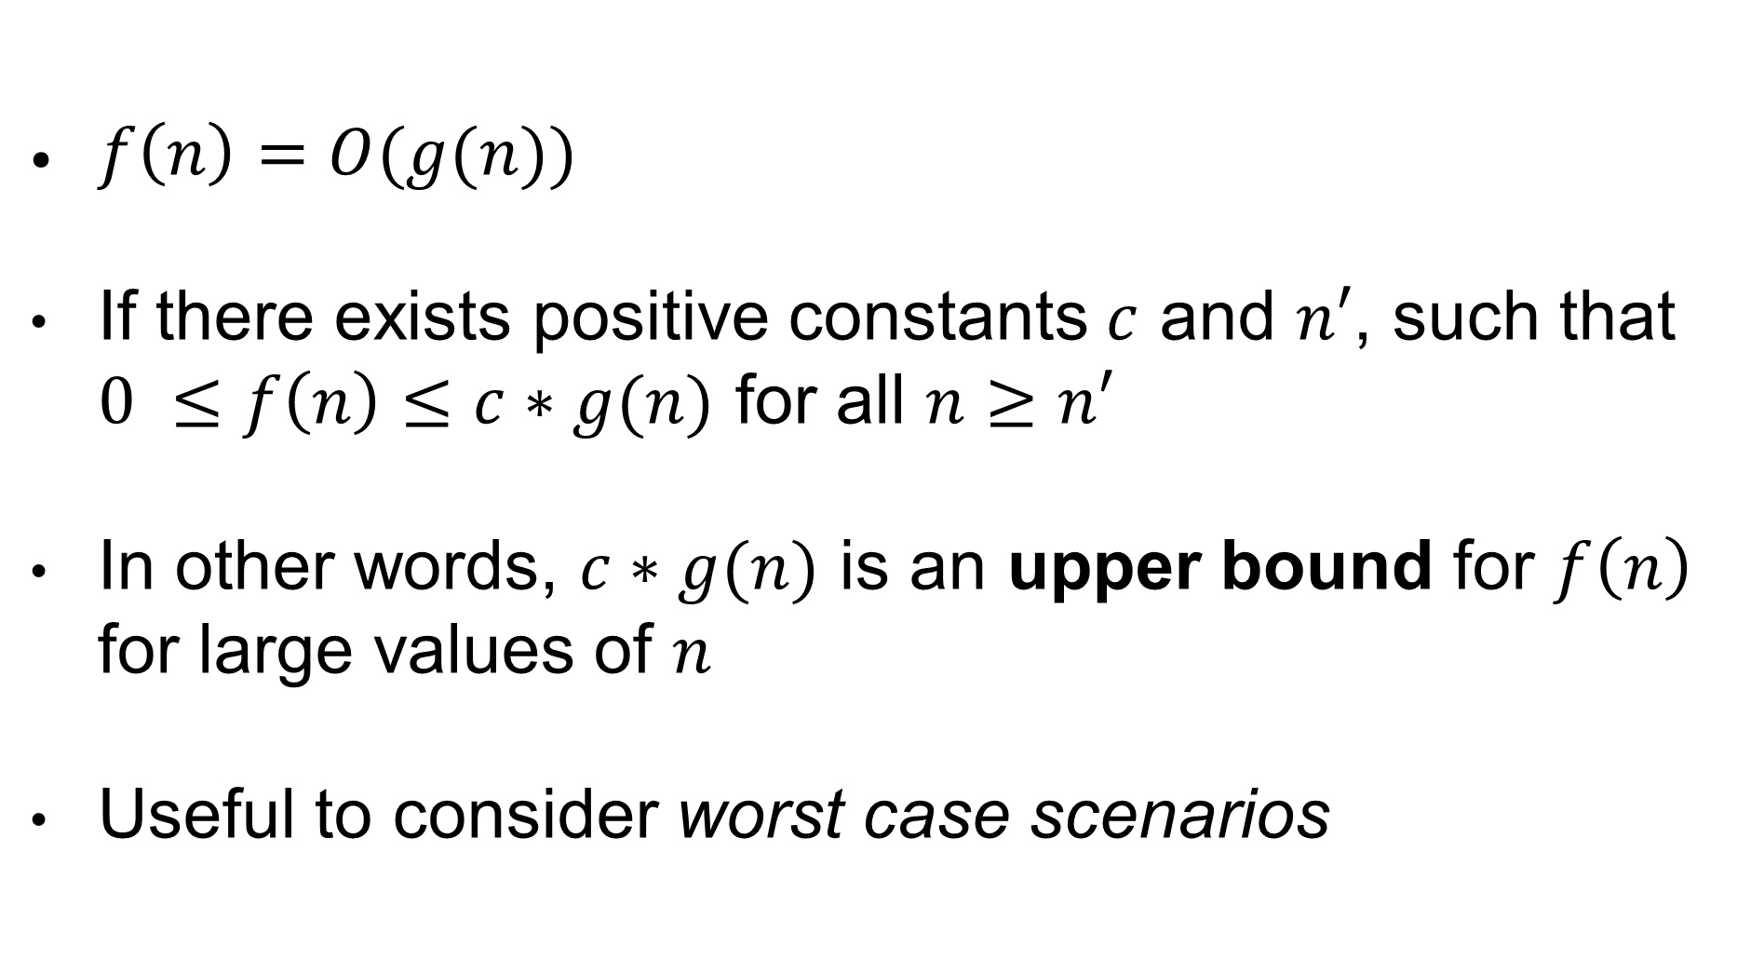
Big O Upper Bound
$f\left(n\right)=O(g(n))$
If there exists positive constants $c$ and $n′$, such that $0 ≤f\left(n\right)≤c∗g(n)$ for all $n≥n′$
In other words, $c∗g(n)$ is an upper bound for $f\left(n\right)$ for large values of $n$
Useful to consider worst case scenarios

Slide 15
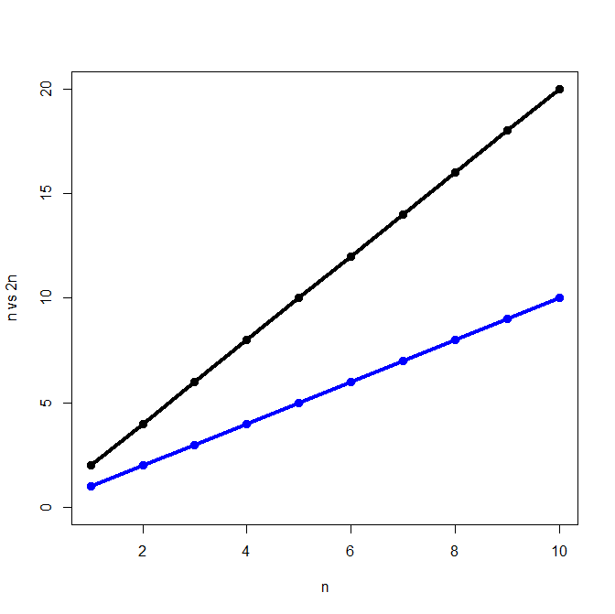

$$n=O\left(n\right)$$
g(n) = n
Examples: c = 2, n’ = 1
n < 2n for n >= 1

Slide 16
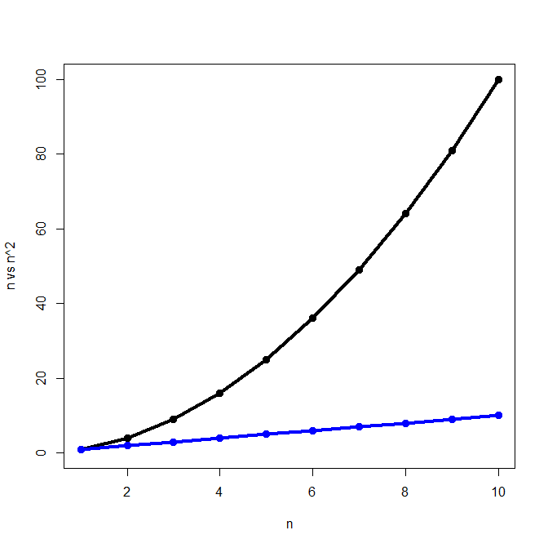


$$n=O\left(n^{2}\right)$$
g(n) = $n^{2}$
Examples: c = 1, n’ = 2
n < $n^{2}$ for n >= 2

Slide 17
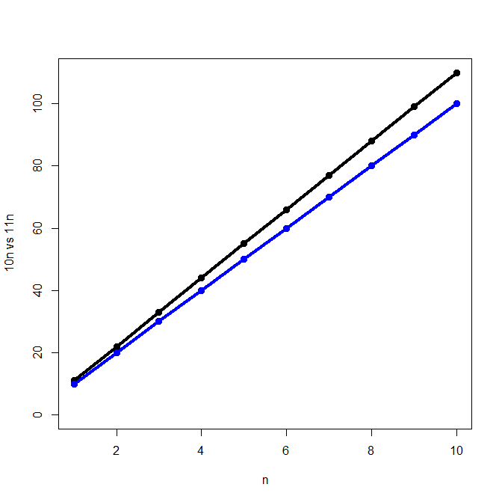

$$10n=O\left(n\right)$$
g(n) = n
Examples: c = 11, n’ = 1
10n < 11n for n >= 1

Slide 18
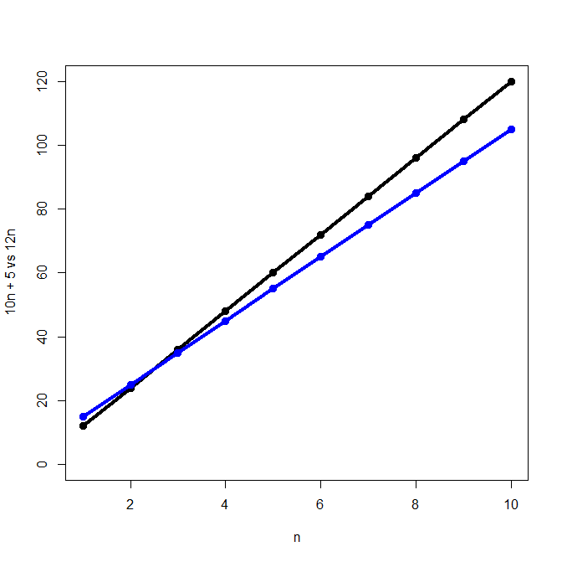
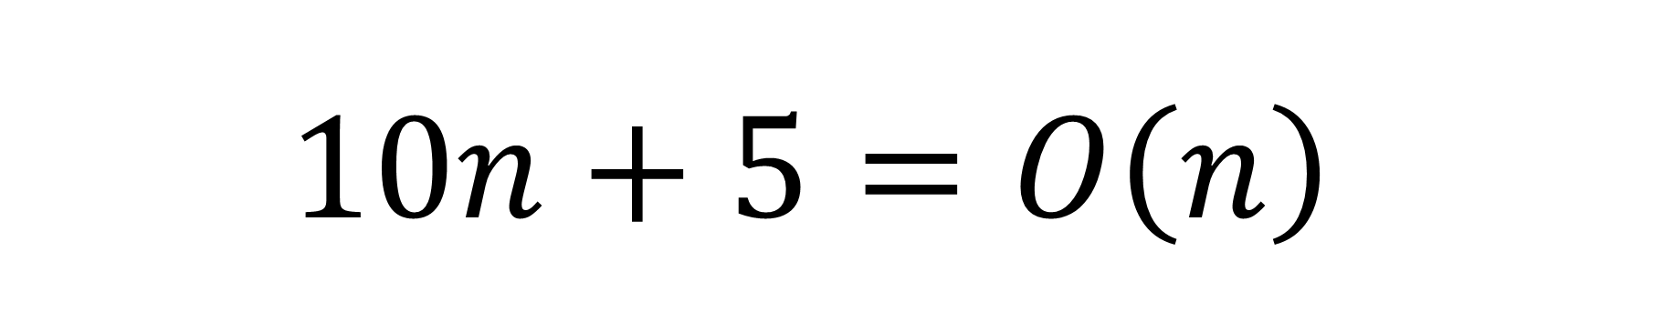
$$10n+5=O\left(n\right)$$
g(n) = n
Examples: c = 12, n’ = 3
10n + 5 < 12n for n >= 3
Eg: n=3 -> f(n)=35, g(n)=36
Note: for n<=2, f(n) is actually larger

Slide 19
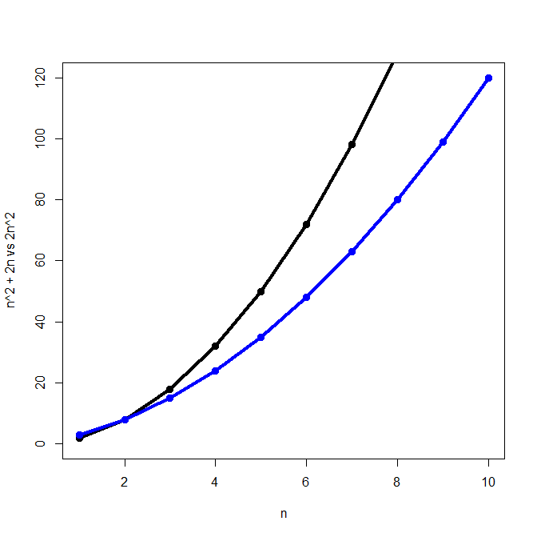
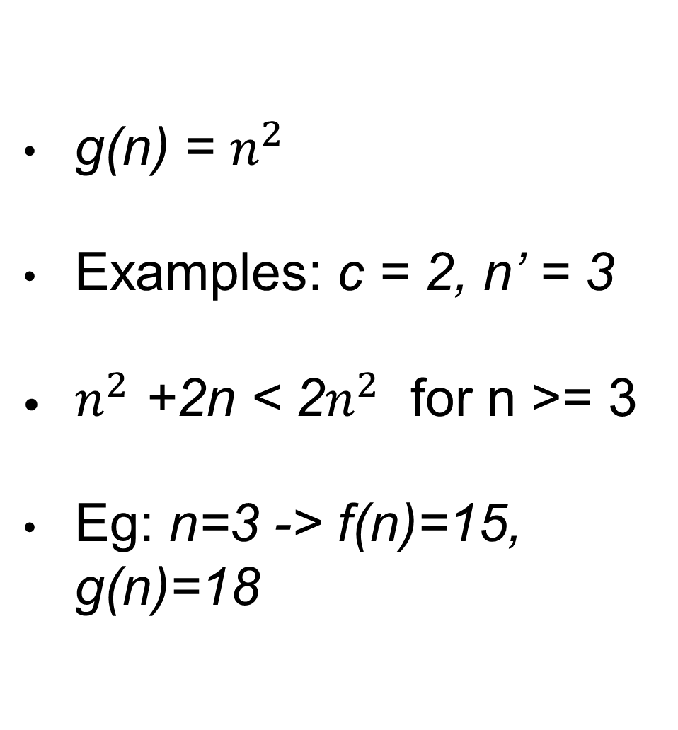
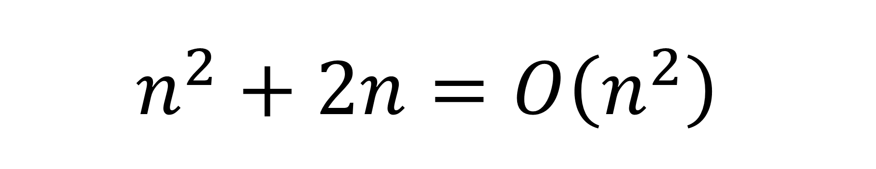
$$n^{2}+2n=O\left(n^{2}\right)$$
g(n) = $n^{2}$
Examples: c = 2, n’ = 3
$n^{2}$ +2n < 2$n^{2}$ for n >= 3
Eg: n=3 -> f(n)=15, g(n)=18

Slide 20
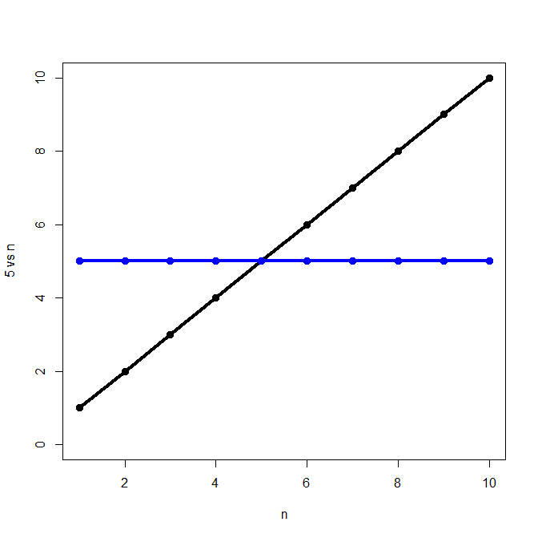

$$5=O\left(n\right)$$
g(n) = n
Examples: c = 1, n’ = 6
5 < n for n >= 6

Slide 21
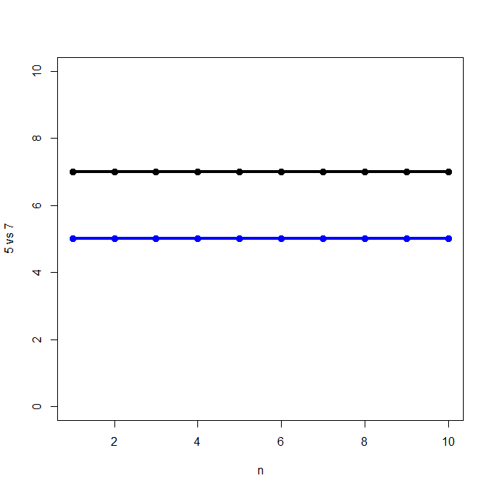

$$5=O\left(7\right)$$
g(n) = 7
Examples: c = 1, n’ = 1
5 < 7 for regardless of n

Slide 22

$$5=O\left(1\right)$$
g(n) = 1
Examples: c = 7, n’ = 1
5 < 7 for regardless of n

Slide 23

$$n≠O\left(1\right)$$
g(n) = 1
Whatever c I use (eg 5), f(n)<c will not hold for n’>c, eg n’=c+1

Slide 24
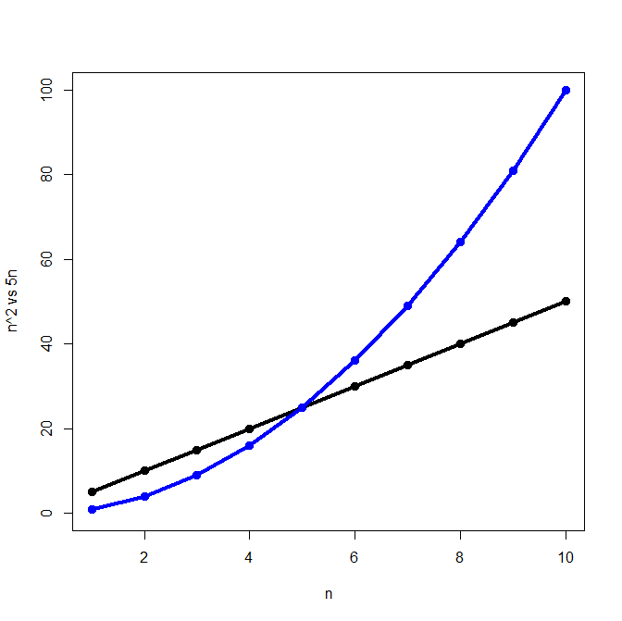

$$n^{2}≠O\left(n\right)$$
g(n) = n
Whatever c I use (eg 5), f(n)<cn will not hold for n’>c, eg n’=c+1

Slide 25
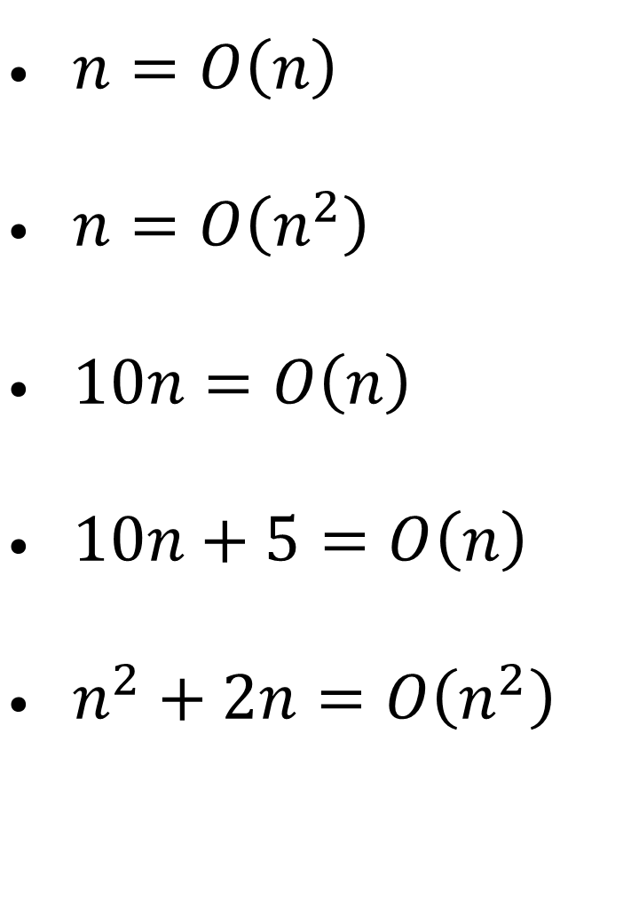

Big O Examples
$5=O\left(n\right)$
$5=O\left(7\right)$
$5=O\left(1\right)$
$n≠O\left(1\right)$
$n^{2}≠O\left(n\right)$
$n=O\left(n\right)$
$n=O\left(n^{2}\right)$
$10n=O\left(n\right)$
$10n+5=O\left(n\right)$
$n^{2}+2n=O\left(n^{2}\right)$

Slide 26
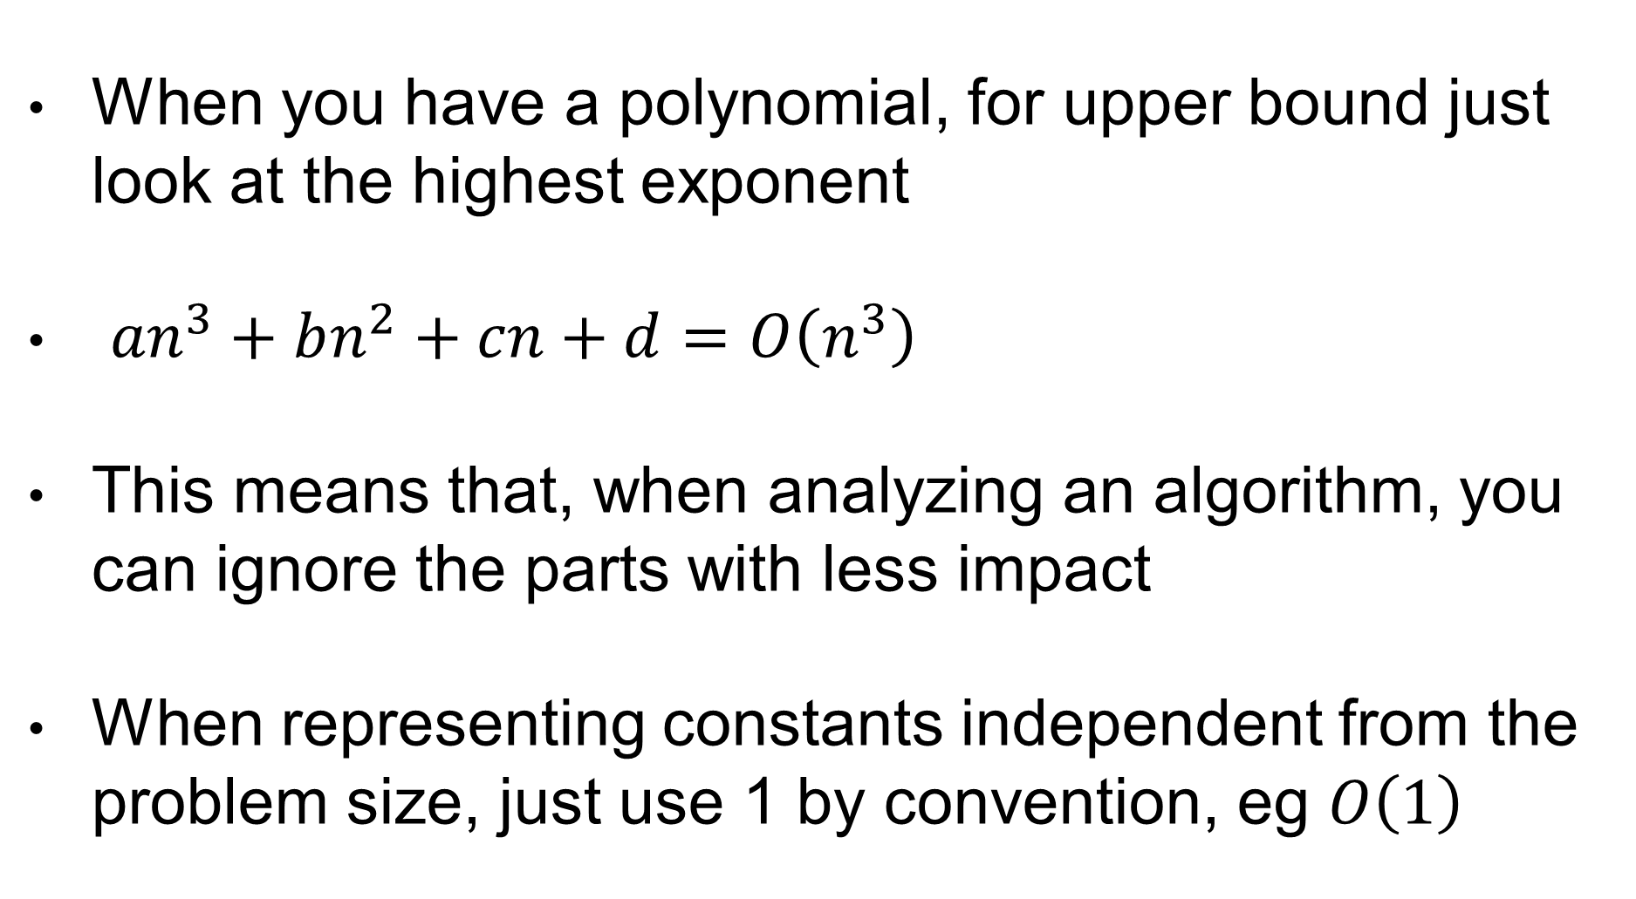
Big O Rules of Thumb
When you have a polynomial, for upper bound just look at the highest exponent
${an}^{3}+bn^{2}+cn+d=O\left(n^{3}\right)$
This means that, when analyzing an algorithm, you can ignore the parts with less impact
When representing constants independent from the problem size, just use 1 by convention, eg $O\left(1\right)$

Slide 27
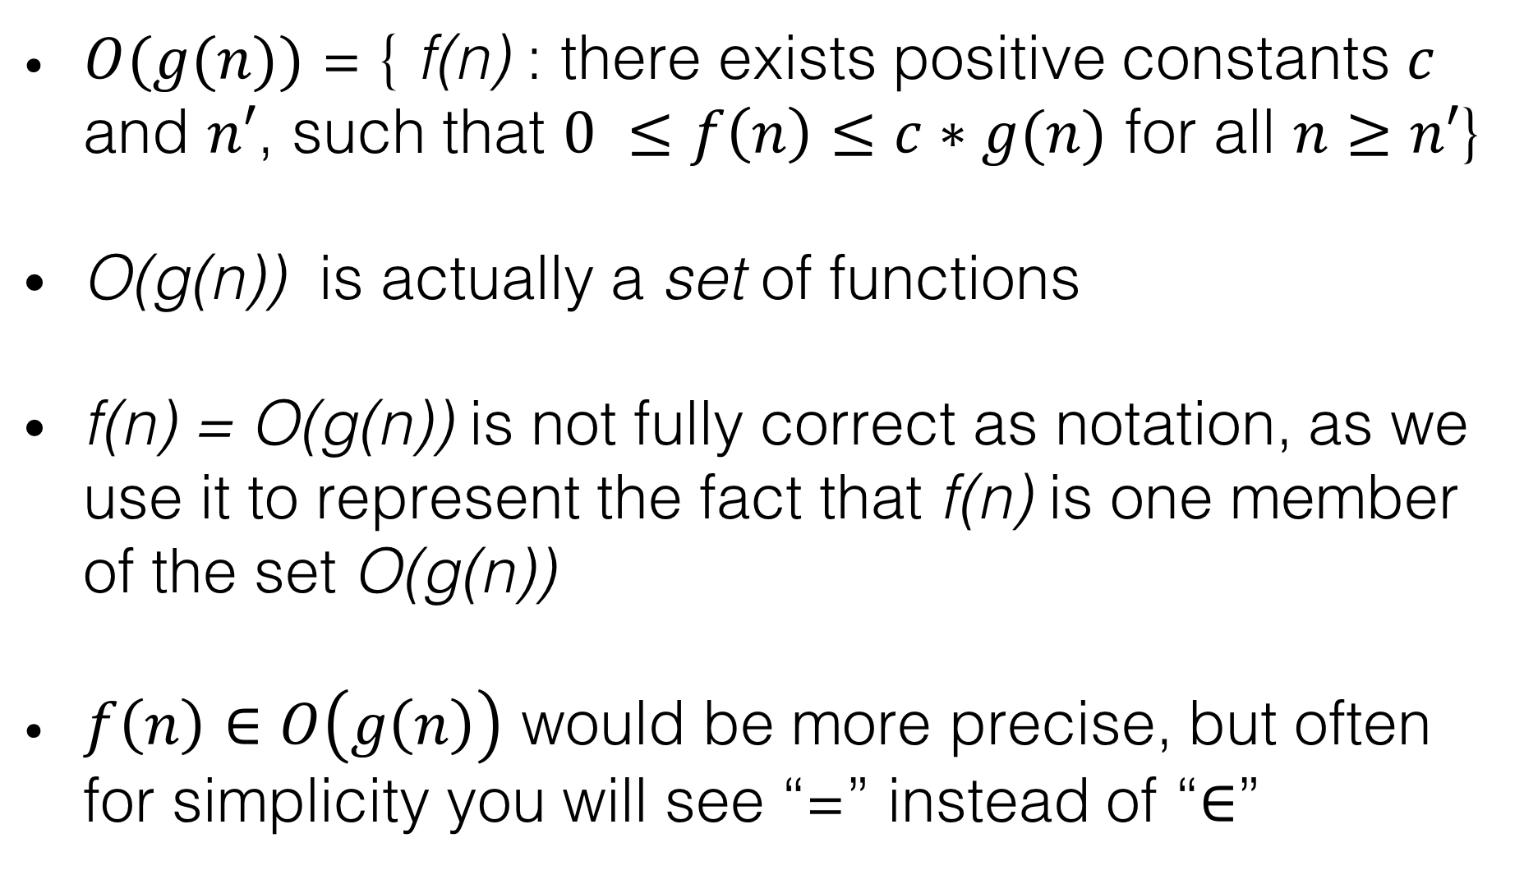
Notation
$O(g(n))$ = { f(n) : there exists positive constants $c$ and $n′$, such that $0 ≤f\left(n\right)≤c∗g(n)$ for all $n≥n′$}
O(g(n)) is actually a set of functions
f(n) = O(g(n)) is not fully correct as notation, as we use it to represent the fact that f(n) is one member of the set O(g(n))
$f\left(n\right)∈O\left(g\left(n\right)\right)$ would be more precise, but often for simplicity you will see “=” instead of “$∈$”

Slide 28
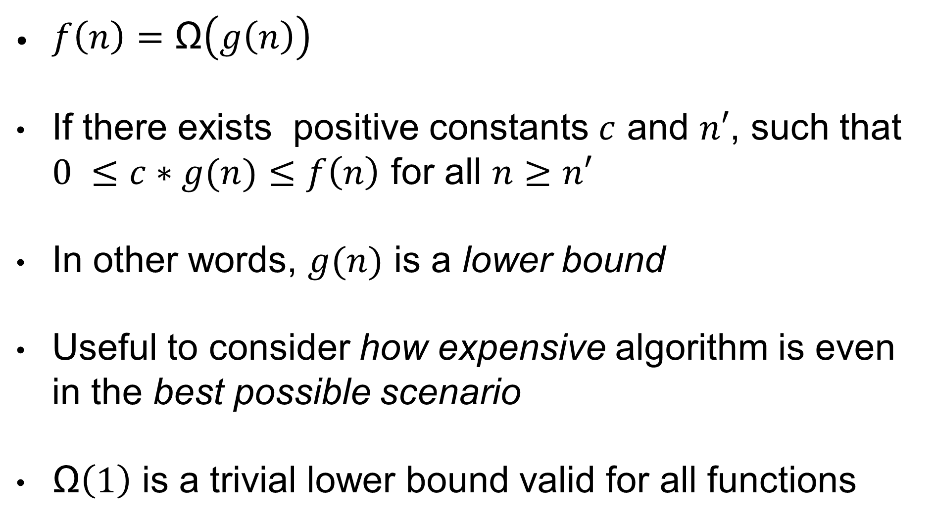
Big Ω Lower Bound
$f\left(n\right)=\text{Ω}\left(g\left(n\right)\right)$
If there exists positive constants $c$ and $n′$, such that $0 ≤c∗g(n)≤f\left(n\right)$ for all $n≥n′$
In other words, $g(n)$ is a lower bound
Useful to consider how expensive algorithm is even in the best possible scenario
$\text{Ω}\left(1\right)$ is a trivial lower bound valid for all functions

Slide 29
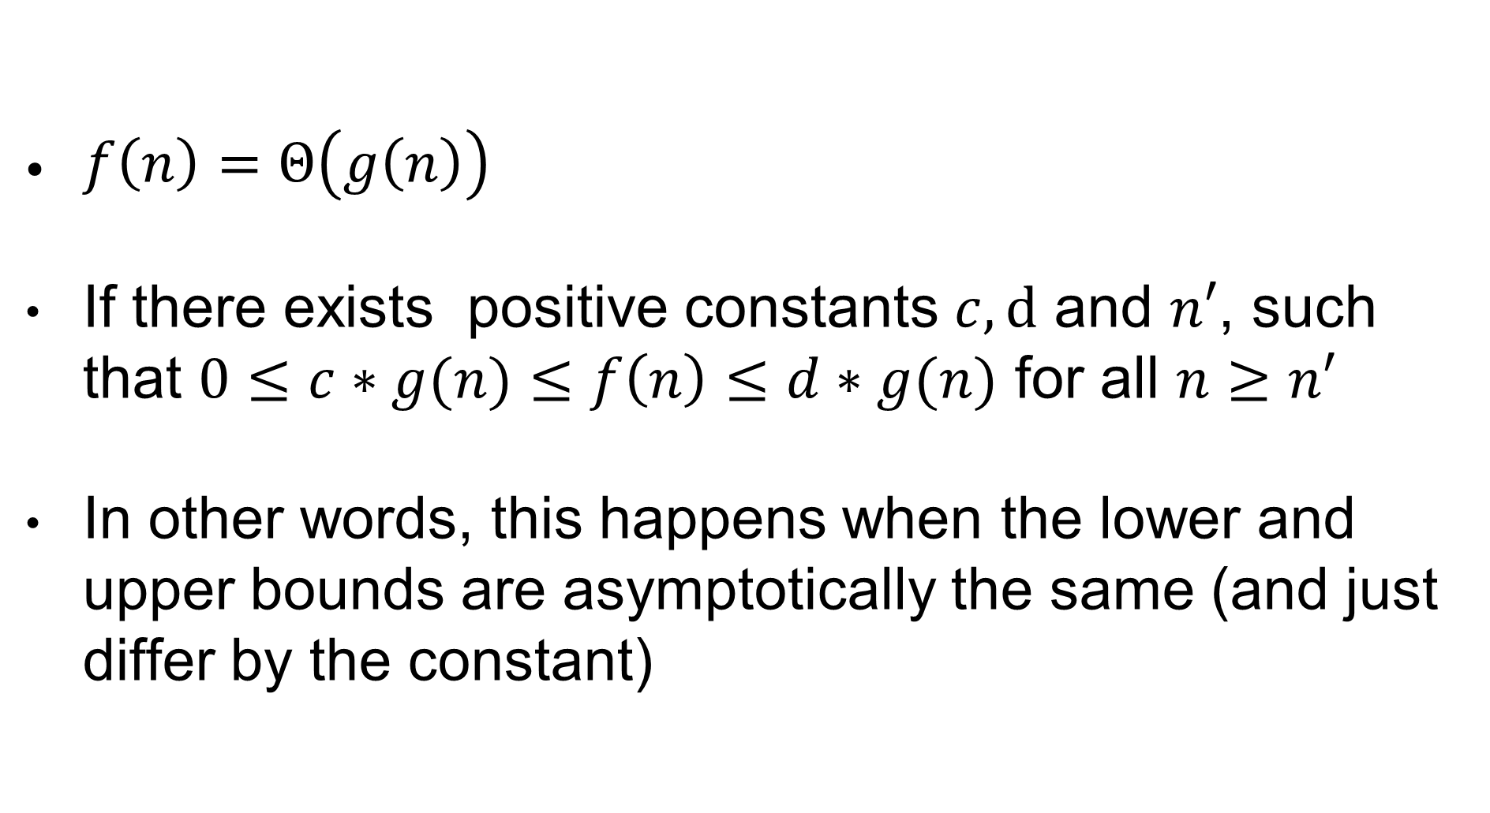
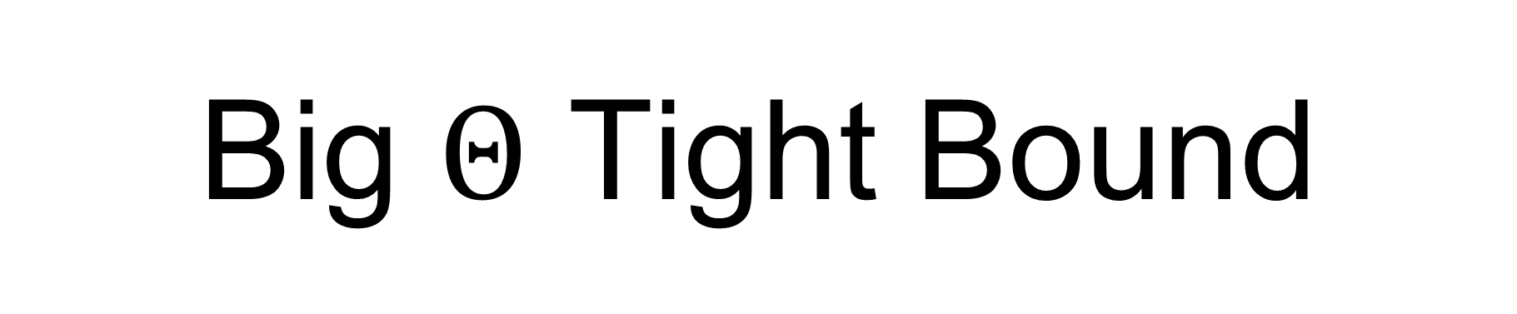
Big $Θ$ Tight Bound
$f\left(n\right)=Θ\left(g\left(n\right)\right)$
If there exists positive constants $c, d$ and $n′$, such that $0≤c∗g(n)≤f\left(n\right)≤d∗g(n)$ for all $n≥n′$
In other words, this happens when the lower and upper bounds are asymptotically the same (and just differ by the constant)

Slide 30
public static int sum(int[] array){ int sum = 0; for(int i=0; i<array.length; i++){ sum += array[i]; } return sum; }
In this case, the actual cost in number of instructions is f(n) = 3n + 4
Asymptotically, we can say that 3n+4 = Θ(n)
As the number of instructions does not depend on the content of the array, the best case and worst case for the runtime are the same

Slide 31
Order Of Growth Classification
1: constant (best you can have)
log(N): logarithmic (very, very efficient)
N: linear (OK for most cases)
N log(N): linearithmic (OK for most cases)
N²: quadratic (bearable, but things start to get expensive)
N³: cubic (becoming painful)
2^{N}: exponential (completely hopeless, time to cry in a corner)

Slide 32
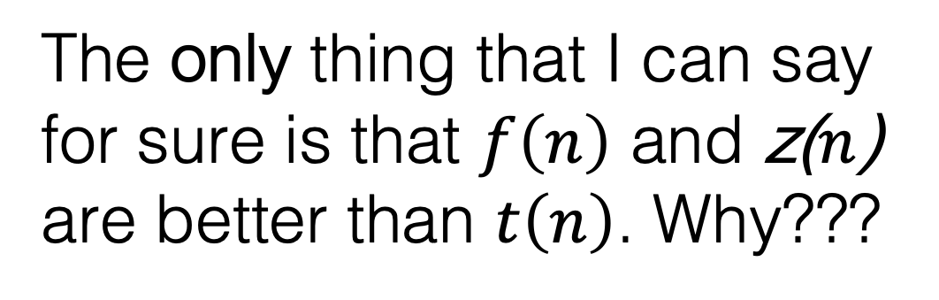
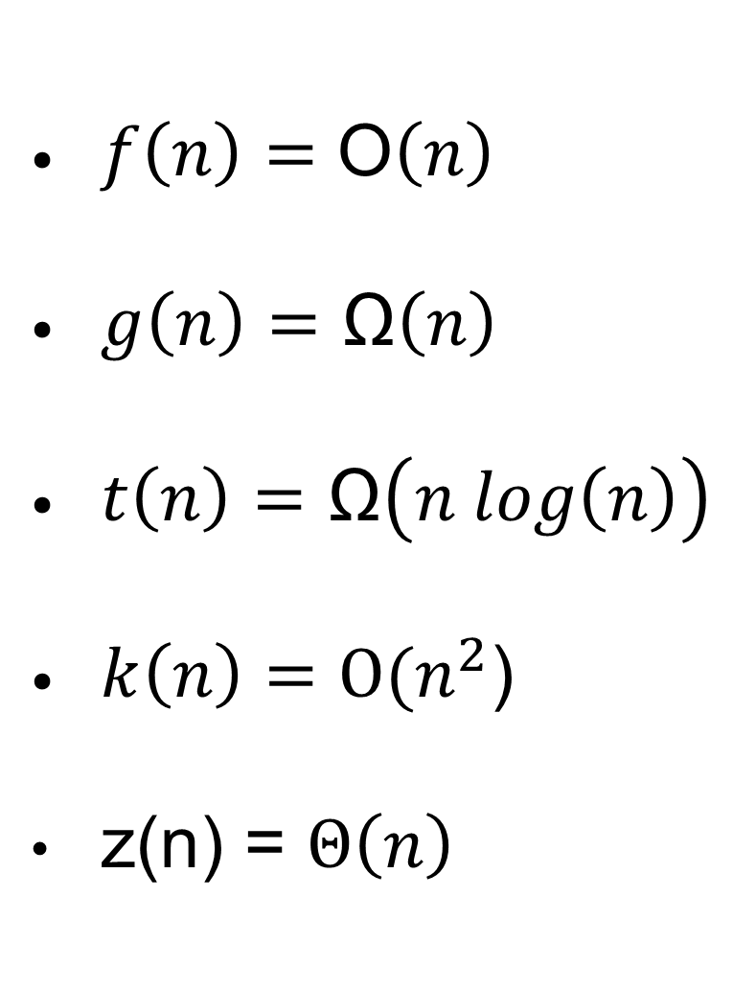
Which Scales Best?
$f\left(n\right)=\text{O}\left(n\right)$
$g\left(n\right)=\text{Ω}\left(n\right)$
$t\left(n\right)=\text{Ω}\left(n log\left(n\right)\right)$
$k\left(n\right)=\text{O}\text{(}n^{2}$)
z(n) = $Θ\left(n\right)$
The only thing that I can say for sure is that $f\left(n\right)$ and z($n$) are better than $t\left(n\right)$. Why???

Slide 33
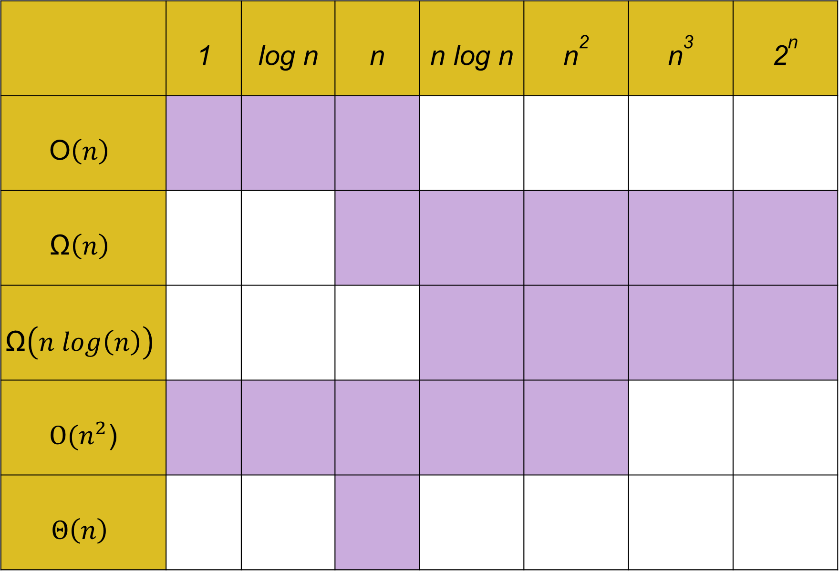
Purple represents possible actual runtimes for those bounds
 | 1 | log n | n | n log n | n² | n³ | 2^{n}
$$\text{O}\left(n\right)$$
$$\text{Ω}\left(n\right)$$
$$\text{Ω}\left(n log\left(n\right)\right)$$
$\text{O}\text{(}n^{2}$)
$$Θ\left(n\right)$$

Slide 34
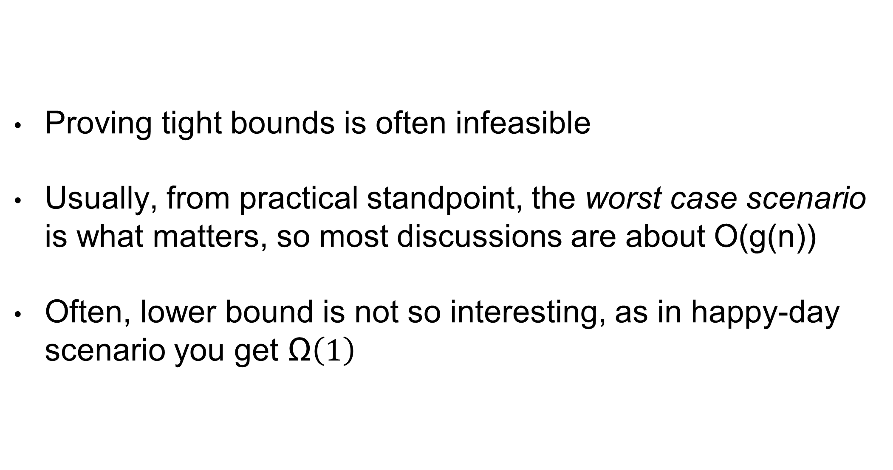
In Practice
Proving tight bounds is often infeasible
Usually, from practical standpoint, the worst case scenario is what matters, so most discussions are about O(g(n))
Often, lower bound is not so interesting, as in happy-day scenario you get $\text{Ω}\left(1\right)$

Slide 35
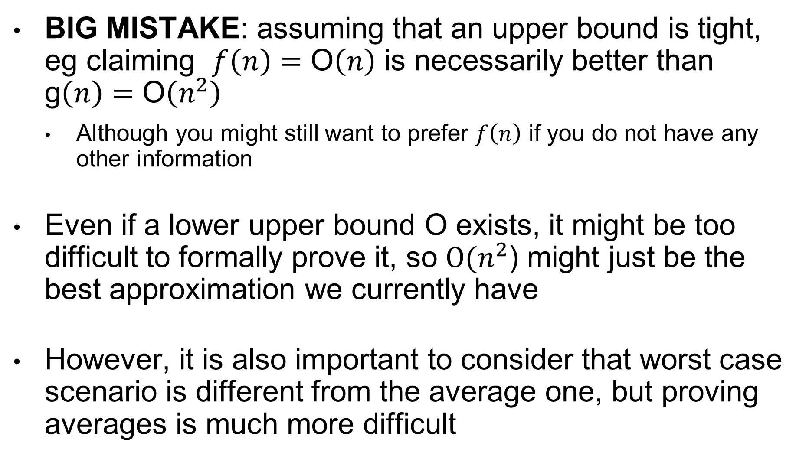
A Big Mistake
BIG MISTAKE: assuming that an upper bound is tight, eg claiming $f\left(n\right)=\text{O}\left(n\right)$ is necessarily better than g$\left(n\right)=\text{O}\left(n^{2}\right)$
Although you might still want to prefer $f\left(n\right)$ if you do not have any other information
Even if a lower upper bound O exists, it might be too difficult to formally prove it, so $\text{O}\text{(}n^{2}$) might just be the best approximation we currently have
However, it is also important to consider that worst case scenario is different from the average one, but proving averages is much more difficult

Slide 36
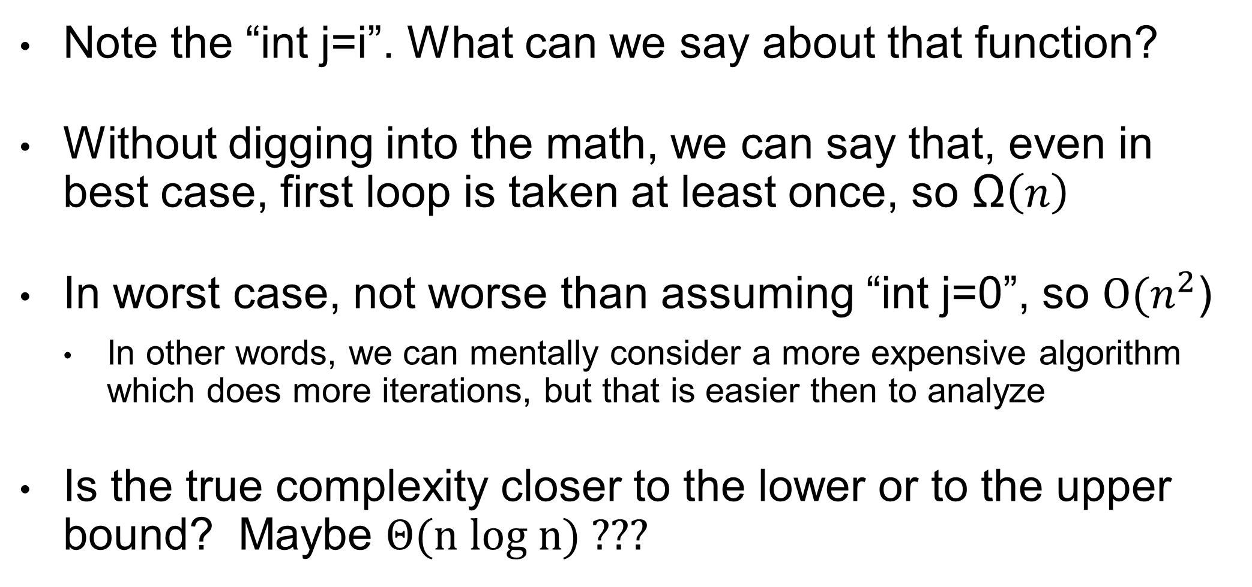
public static void doSomething(int[] array){ for(int i=0; i<array.length; i++){ for(int j=i; j<array.length; j++){ //... something } } }
Note the “int j=i”. What can we say about that function?
Without digging into the math, we can say that, even in best case, first loop is taken at least once, so $\text{Ω}\left(n\right)$
In worst case, not worse than assuming “int j=0”, so $\text{O}\text{(}n^{2}$)
In other words, we can mentally consider a more expensive algorithm which does more iterations, but that is easier then to analyze
Is the true complexity closer to the lower or to the upper bound? Maybe $Θ\text{(}\text{n} \text{log} \text{n}\text{) ???}$

Slide 37
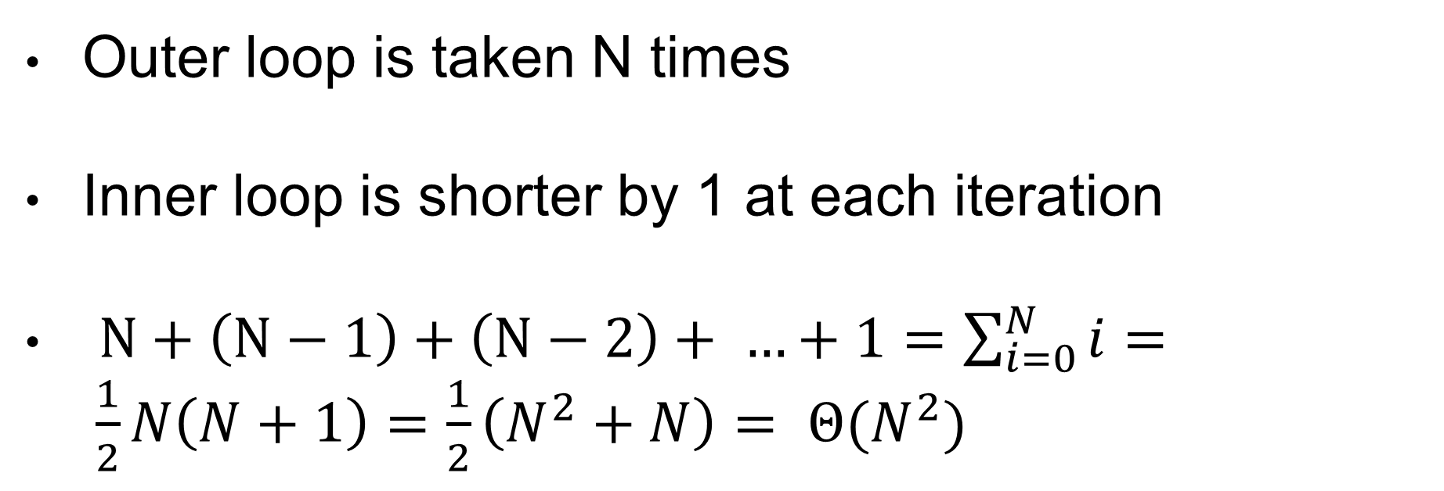
Let’s Dig Into the Math…
public static void doSomething(int[] array){ for(int i=0; i<array.length; i++){ for(int j=i; j<array.length; j++){ //... something
Outer loop is taken N times
Inner loop is shorter by 1 at each iteration
$N+\left(N−1\right)+\left(N−2\right)+ …+1=\sum_{i=0}^{N}{i}= \frac{1}{2}N\left(N+1\right)=\frac{1}{2}\left(N^{2}+N\right)= Θ(N^{2})$

Slide 38
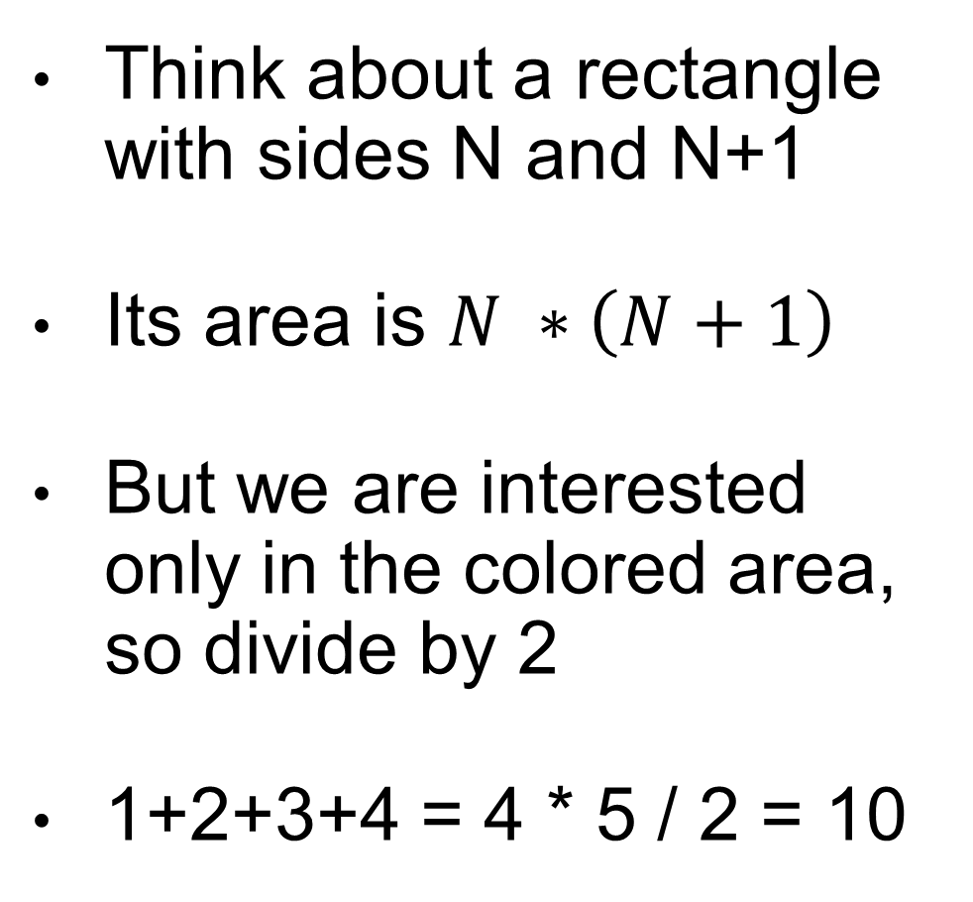

$$\sum_{i=0}^{N}{i}= \frac{1}{2}N\left(N+1\right)$$
Think about a rectangle with sides N and N+1
Its area is $N ∗\left(N+1\right)$
But we are interested only in the colored area, so divide by 2
1+2+3+4 = 4 * 5 / 2 = 10

Slide 39
Sorting

Slide 40
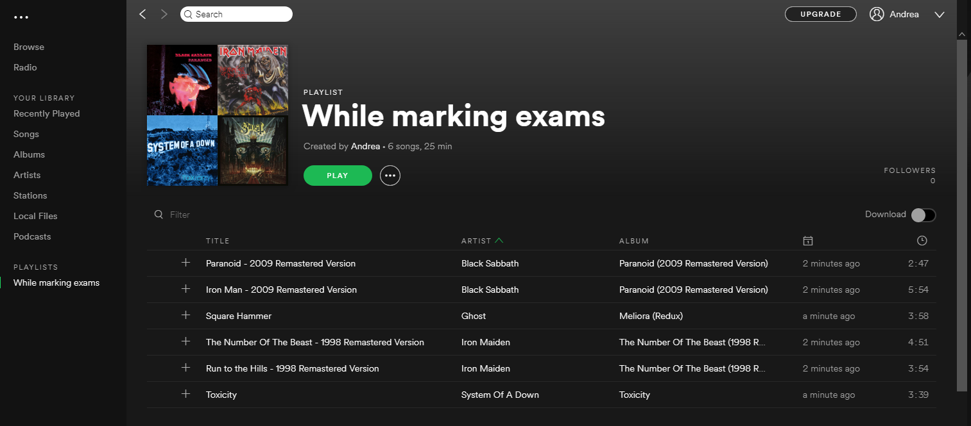
Consider a Playlist

Slide 41
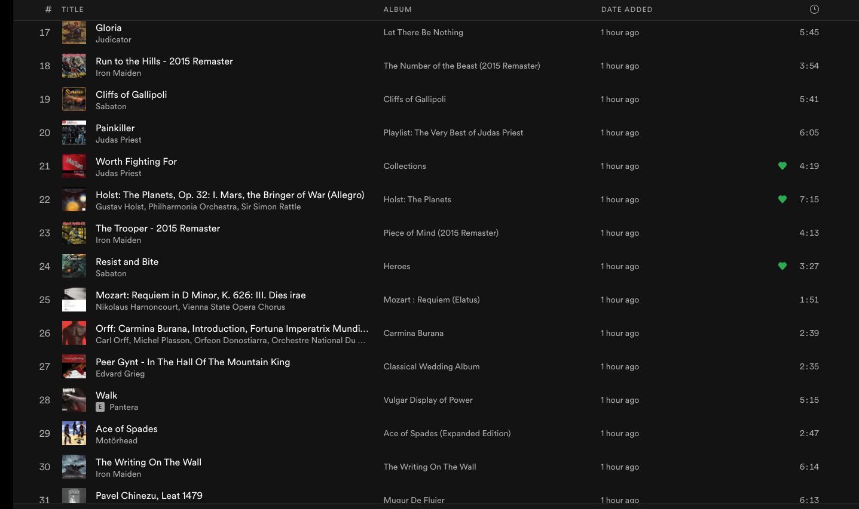
Consider a Playlist

Slide 42
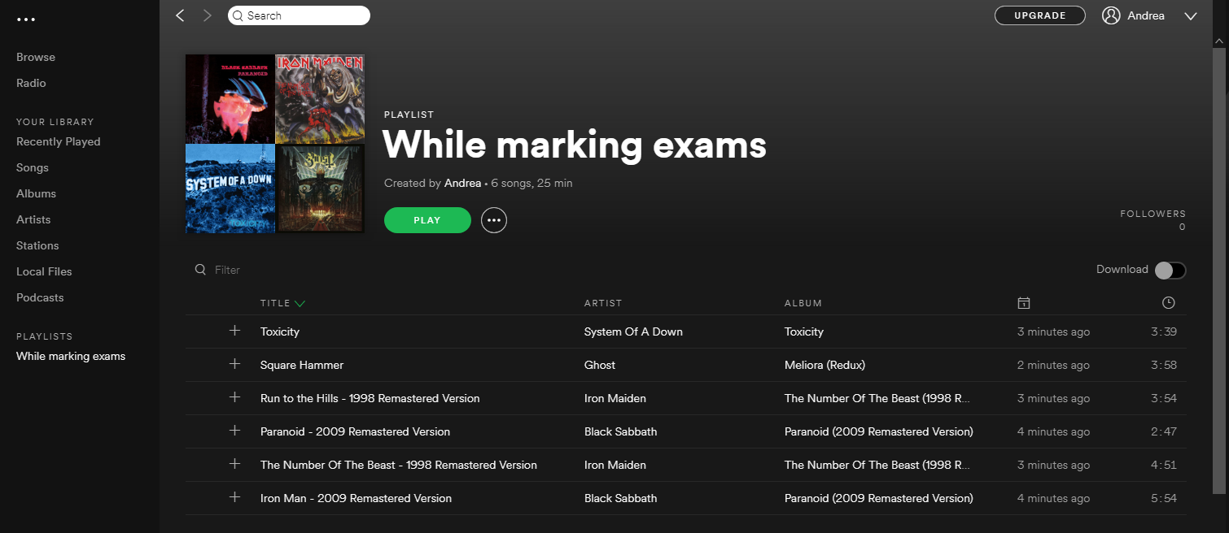
Sort by Title or Artist, Ascending or Descending

Slide 43



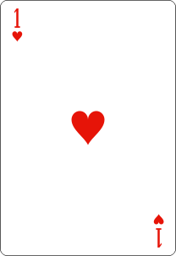
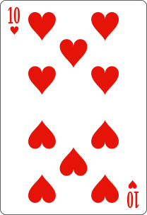
How do you sort when playing cards?

Slide 44
Sorting Algorithms
Many different sorting algorithms, with different properties
Given two items A and B, just need a comparator that can state which one is greater or equal
easy to say that 5 greater than 2, but what does it mean that song A is greater than song B? e.g., could look at alphabetic ordering of titles or artist names
Most language APIs provides good defaults
Unless very large data, default will be fine 99% of the cases
Sorting is very popular in programming
Important to understand how it works under the hood
Tractable mathematically
So good example to show how to analyze algorithms

Slide 45
Sorting Algorithms
Bubble Sort
Insertion Sort
Merge Sort (next class)
Quick Sort (next class)
There are more, but those are the most famous that you need to know
Good way to see a problem been solved in many different ways

Slide 46
Bubble Sort
Easiest sorting algorithms
From left to right
Look at adjacent cards, and swap them if not in order
Repeat from left to right till no more swap

Slide 47
No swap, they are in order
Swap
No swap, they are in order

Slide 48
Swap
Restart from beginning.
At each iteration, at least one card will be in right position, as it bubbles up to the to top.

Slide 49
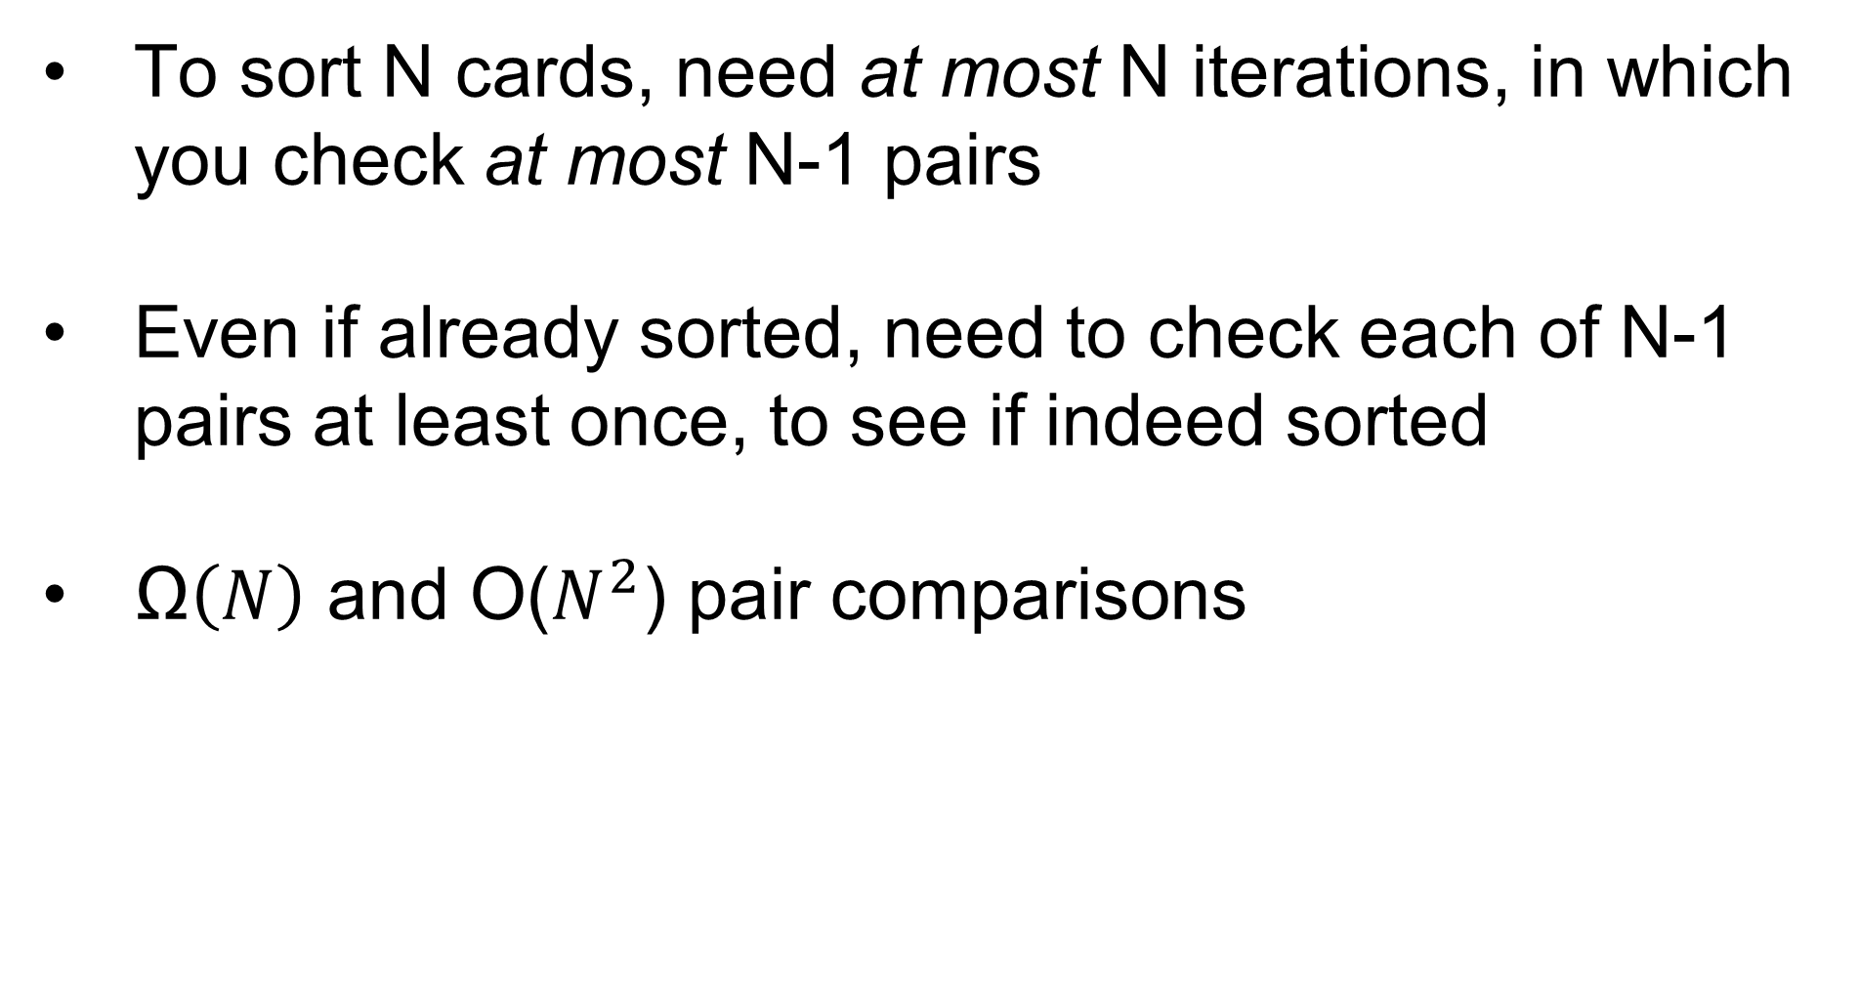
Runtime of Bubble Sort
To sort N cards, need at most N iterations, in which you check at most N-1 pairs
Even if already sorted, need to check each of N-1 pairs at least once, to see if indeed sorted
$\text{Ω}\left(N\right)$ and O($N^{2}$) pair comparisons

Slide 50
Insertion Sort
An array of size 0 or 1 is always considered sorted
From left to right, till length N
K-leftmost values are sorted
Position K+1 is not sorted, insert it in the first K
by swapping adjacent elements, like in Bubble Sort
4 | 5 | 1 | 3 | 2 | 6
K=0
4 | 5 | 1 | 3 | 2 | 6
K=1
4 | 5 | 1 | 3 | 2 | 6
K=2
4 | 5 | 1 | 3 | 2 | 6
K=3
4 | 1 | 5 | 3 | 2 | 6
swap
1 | 4 | 5 | 3 | 2 | 6
swap

Slide 51
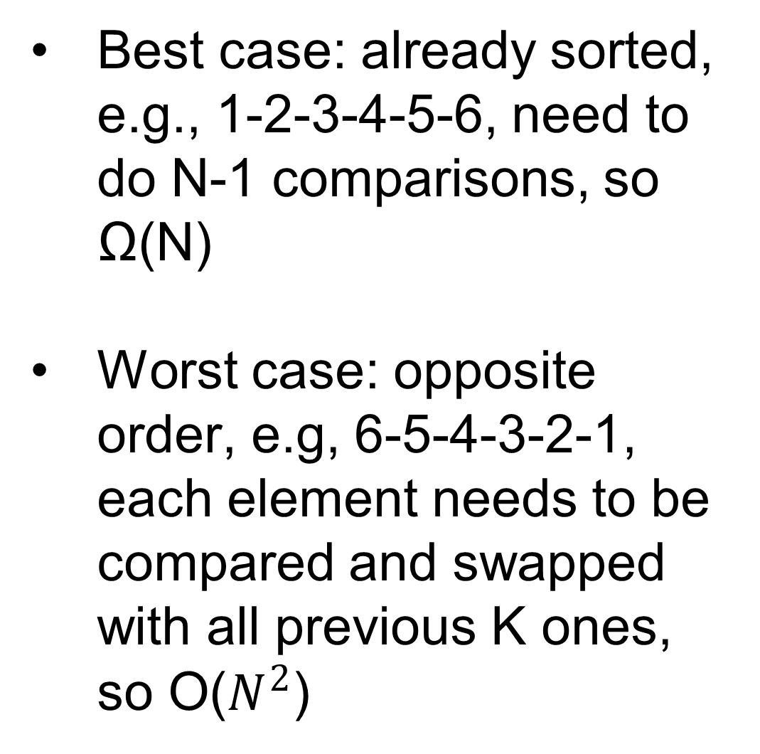
Cont.
1 | 4 | 5 | 3 | 2 | 6
K=4
Best case: already sorted, e.g., 1-2-3-4-5-6, need to do N-1 comparisons, so Ω(N)
Worst case: opposite order, e.g, 6-5-4-3-2-1, each element needs to be compared and swapped with all previous K ones, so O($N^{2}$)
1 | 4 | 3 | 5 | 2 | 6
swap
1 | 3 | 4 | 5 | 2 | 6
swap
1 | 3 | 4 | 5 | 2 | 6
K=5
1 | 3 | 4 | 2 | 5 | 6
swap
1 | 3 | 2 | 4 | 5 | 6
swap
1 | 2 | 3 | 4 | 5 | 6
swap
1 | 2 | 3 | 4 | 5 | 6
K=6

Slide 52
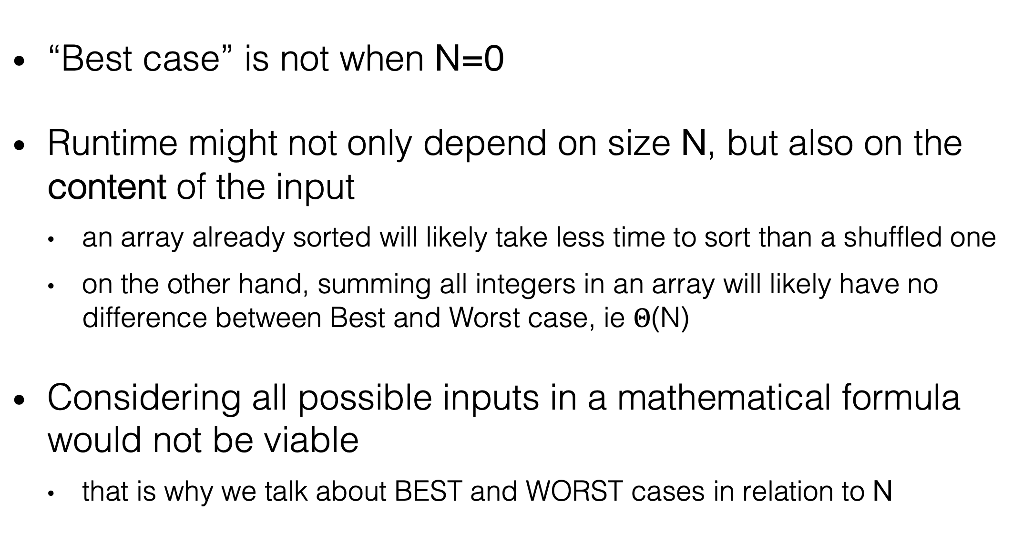
Best vs. Worst Case
“Best case” is not when N=0
Runtime might not only depend on size N, but also on the content of the input
an array already sorted will likely take less time to sort than a shuffled one
on the other hand, summing all integers in an array will likely have no difference between Best and Worst case, ie $Θ$(N)
Considering all possible inputs in a mathematical formula would not be viable
that is why we talk about BEST and WORST cases in relation to N

Slide 53
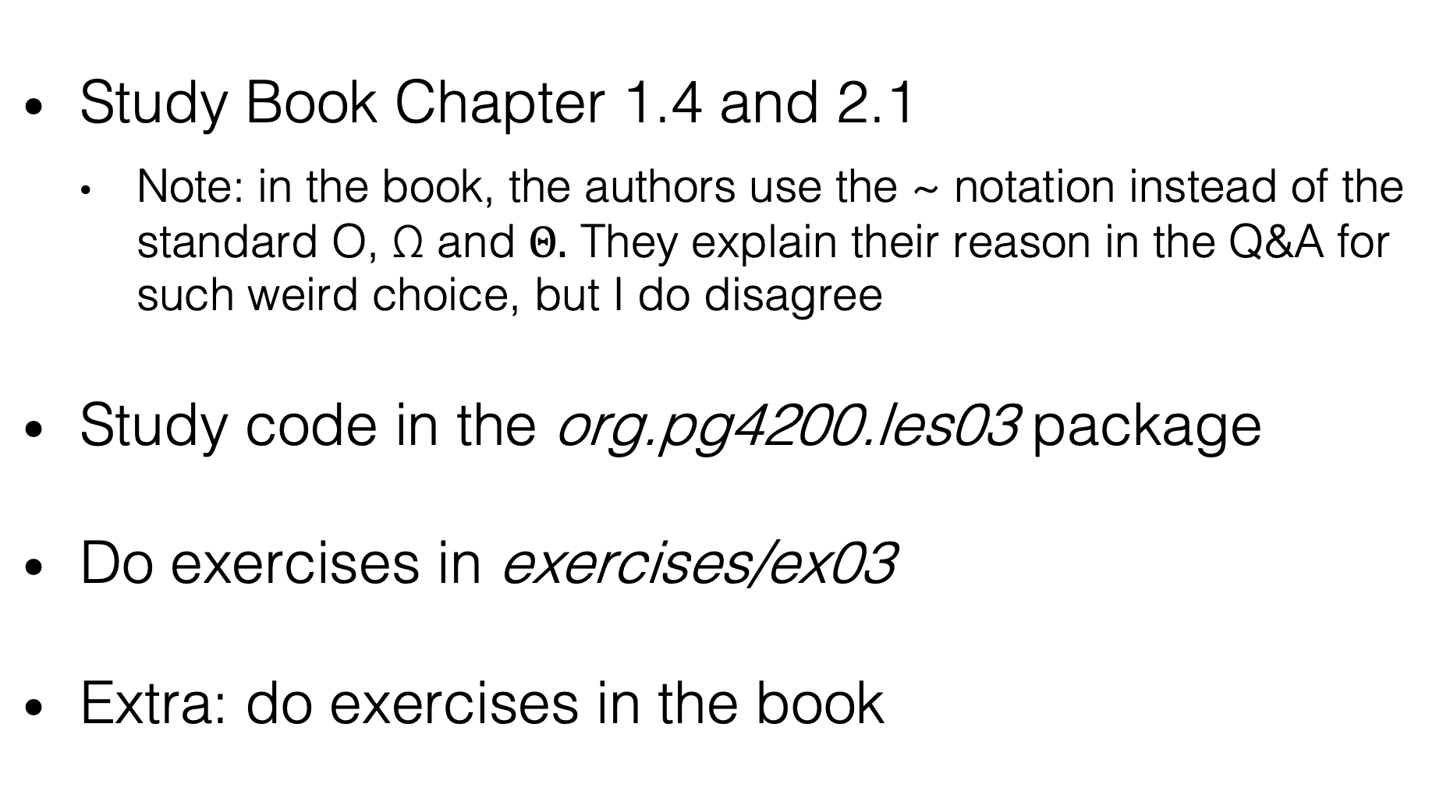
Homework
Study Book Chapter 1.4 and 2.1
Note: in the book, the authors use the ~ notation instead of the standard O, $\text{Ω}$ and $Θ.$ They explain their reason in the Q&A for such weird choice, but I do disagree
Study code in the org.pg4200.les03 package
Do exercises in exercises/ex03
Extra: do exercises in the book

