Slide 1
PG4200 – Algorithms and Data Structures - Quick Recap -
Bogdan Marculescu

Slide 2
3 Basic areas
Algorithms
Analysis tools
Additional stuff

Slide 3

Arrays and lists
[0] | [1] | [2] | [3] | [4]
5 | 9 | 7
LinkedList
head
5
next
9
next
7
next
NULL

Slide 4
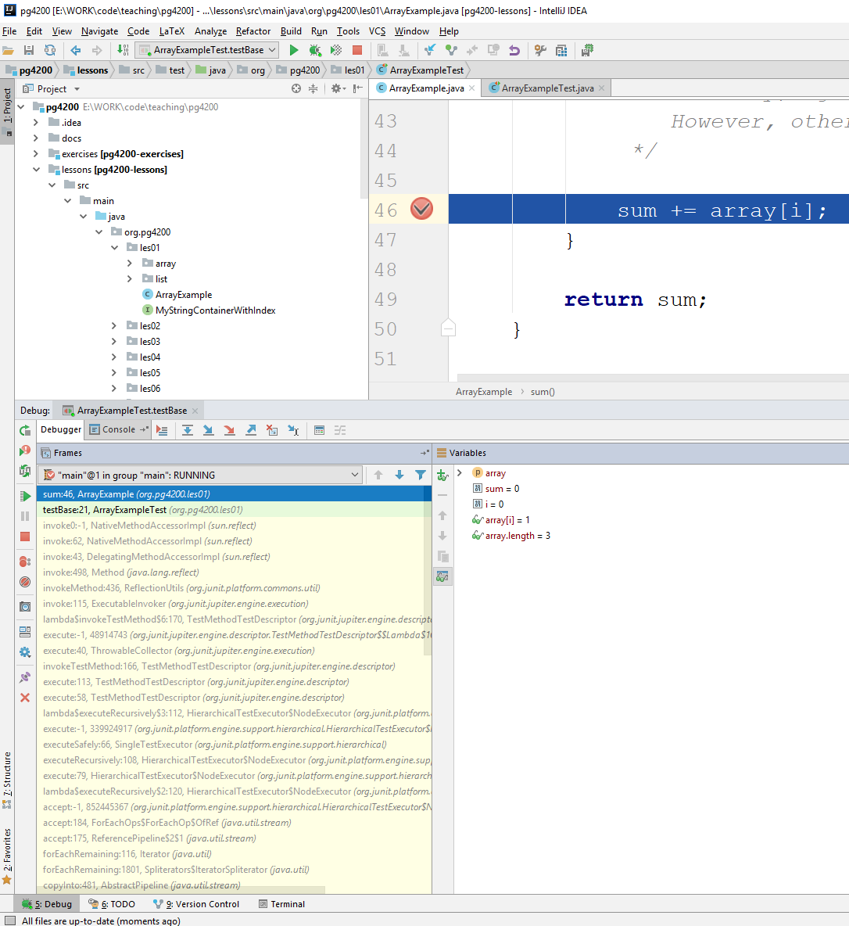
Breakpoints
One step forward
Run till next
breakpoint
Evaluate code on the fly
in current context
Step inside function call
State of variables

Slide 5
3 Basic areas
Algorithms
Arrays and Lists
Analysis tools
Additional stuff
Testing and expected behaviour

Slide 6

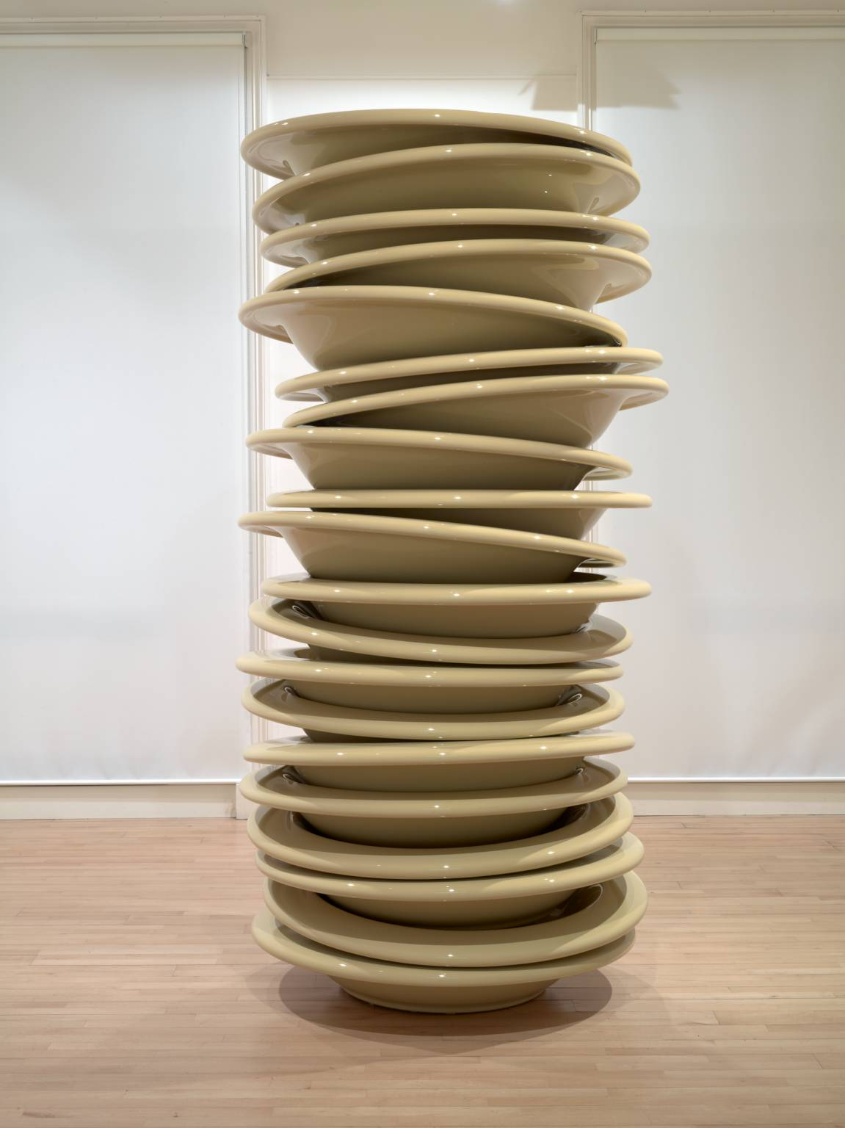
Stacks and Queues

Slide 7
Memory model
a | b | c | d | x | k | y | z | Remaining Space on FCS | Heap | Data of x | Heap

Slide 8
3 Basic areas
Algorithms
Arrays and Lists
Stacks and Queues
Analysis tools
Additional stuff
Testing and expected behaviour
Memory model

Slide 9
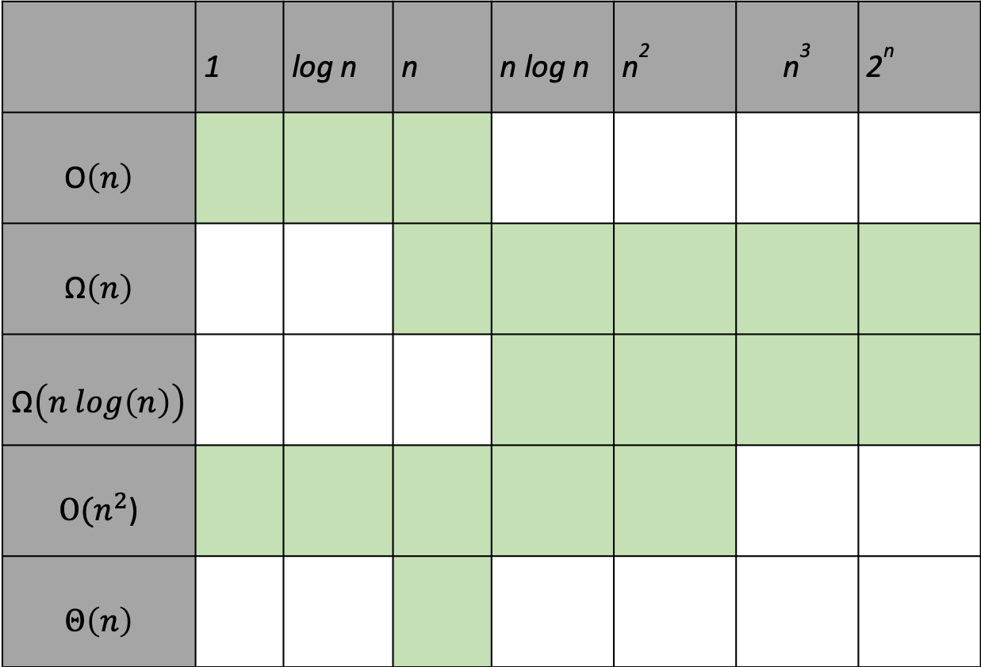
Runtime complexity
 | 1 | log n | n | n log n | n² | n³ | 2^{n}
$$\text{O}\left(n\right)$$
$$\text{Ω}\left(n\right)$$
$$\text{Ω}\left(n log\left(n\right)\right)$$
$\text{O}\text{(}n^{2}$)
$$Θ\left(n\right)$$

Slide 11
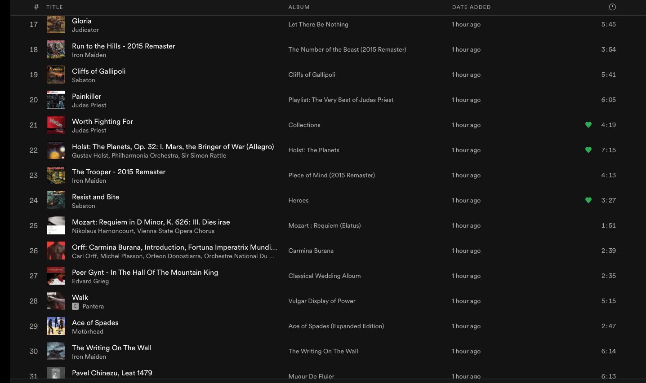
Sorting – bubble and insertion

Slide 12

3 Basic areas
Algorithms
Arrays and Lists
Stacks and Queues
Sorting
Bubble
Insertion
Analysis tools
Runtime complexity analysis:
O, Ω, $Θ$
Additional stuff
Testing and expected behaviour
Memory model

Slide 13
Recursion
3 main aspects in recursive functions
Stopping Criterion: otherwise no end, until a stack overflow
Reduced Input: aim at least at halving it
Combine Results: once recursive calls finished, combine their outputs together for the final result
often it is not as trivial as doing a +

Slide 14
3 Basic areas
Algorithms
Arrays and Lists
Stacks and Queues
Sorting
Bubble
Insertion
Merge
Quick
Recursion
Analysis tools
Runtime complexity analysis:
O, Ω, $Θ$
Additional stuff
Testing and expected behaviour
Memory model
Test driven development

Slide 15
Tree-based Maps
Data structures resembling a tree
Nodes contain values, and links to child nodes
Starting point is the root of the tree
Two main / most famous versions
Binary Trees (“simple”)
Red-Black Trees (“very complex”, but high performance)
7
4
11
2
8
14
0
3
9

Slide 16
2-3 Search Trees
Before discussing RBT, let’s consider 2-3 Trees
2-3 Tree: composed of 2-nodes and 3-nodes
2-node: 1 value, 2 children (left and right)
3-node: 2 values, 3 children (left, middle and right)
M
E J
R
A C
H
L
P
S X

Slide 17
Right
Rotation
Left
Rotation
Color flipping
Apply recursively to parent till 2-node, or root

Slide 18
3 Basic areas
Algorithms
Arrays and Lists
Stacks and Queues
Sorting
Recursion
Tree maps
Binary
2-3
Red-Black Trees
Analysis tools
Runtime complexity analysis:
O, Ω, $Θ$
Additional stuff
Testing and expected behaviour
Memory model
Test driven development

Slide 19
Hash Maps and Sets
put(“foo”, v)
put(“bar”, z)
h(“foo”)=h(“bar”)
ie, collision due to same hash
Use list at each position sharing same hash
Nodes containing keys and values
Internal array buffer of size M=10
“foo”
v
“bar”z

Slide 20
3 Basic areas
Algorithms
Arrays and Lists
Stacks and Queues
Sorting
Recursion
Tree maps
Hash Maps
Sets
Analysis tools
Runtime complexity analysis:
O, Ω, $Θ$
Additional stuff
Testing and expected behaviour
Memory model
Test driven development
Deep Copy

Slide 21
H
A C

