Slide 1
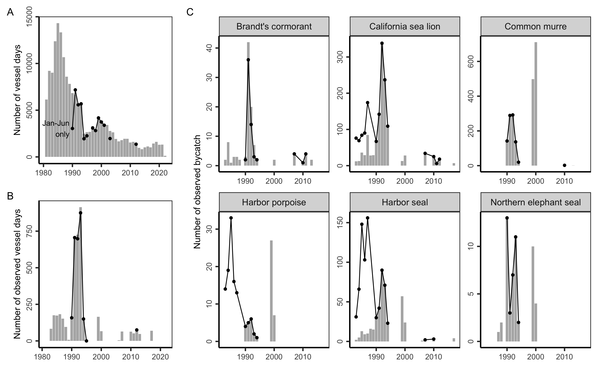
Number of logged trips
Number of trips
Number of observed trips

