Slide 1
Social Media Project “From Likes to Loyalty: Unlocking Insights for Smarter Marketing”
By Tina Kapse
Tools Used – MySQL Workbench, MS-Excel
Professional certificate course in data science - December 2024

Slide 2
Agenda
Problem Statement
Data Description
Objective Key Metrics and Visualizations
Subjective Question for Insights

Slide 3
The Problem
You are hired as a data analyst at Meta and asked to collaborate with Marketing team. Marketing teams wants to leverage Instagram's user data to develop targeted marketing strategies that will increase user engagement, retention, and acquisition. Provide insights and recommendations to address the following objectives

Slide 4
Data Description
❖Total 7 Tables are present in the given dataset.
❖Total number users are 100.
❖Total number of posts made so far is 257.
❖Total number of likes posted by the users on posts is 8782.
❖Total number of comments on all posts are 7488.
❖Total number of engagement is calculated by adding total likes and total comments by an user.
❖Engagement rate is calculated by dividing total engagements by number of posts.

Slide 5
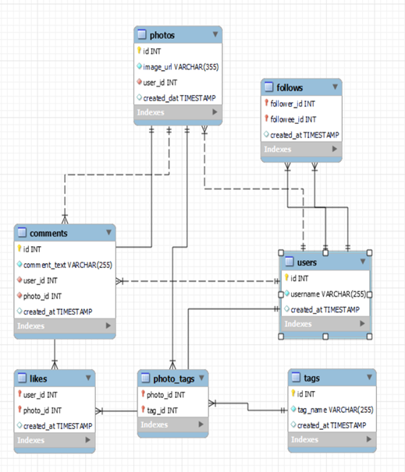
Data Overview

Slide 6
Approach
❖Understanding Statistics: Calculated basic statistics like total number of users and respective posts posted, likes, comments achieved
❖Data Cleaning and Validation: Checked and removed duplicates in the data sets also treated null values.
❖Analysis: Utilized sql techniques such as Common Table Expressions (CTE), Aggregate Functions:(AVG, COUNT,ROUND, etc), Subqueries, Group By clause, Rank,Window functions.
❖Data Visualization: Visualized key metrics such as total posts, likes, and comments to provide a clear representation of user activity levels. Created charts and graphs to rank users based on engagement rates and to highlight the most influential hashtags.
❖Strategy Making: Prepared plans and strategies for increasing user retention and increasing engagement activities.
Implementation-Implementation of the plans and strategy are also discussed for optimised and better results

Slide 7
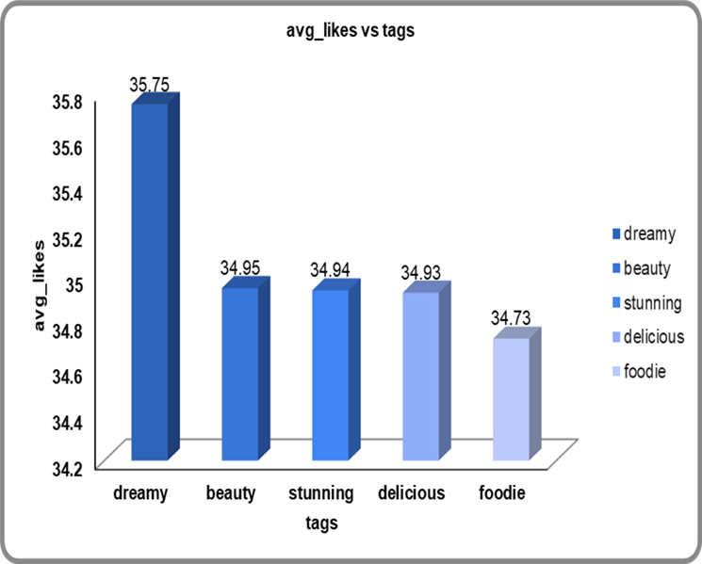
Content Performance
❖Dreamy Tag has the highest likes where as foodie tags has lowest number of likes.
❖Hashtags with high count of Likes are the popular tags among all.
❖Popular tags will be promoted and influencers will promote popular tags by using them in their posts.
❖Contents related to these tags should be frequently shown on explore pages of the users to engage them.
❖Tags other than dreamy have very much same no. of likes so they should also be optimised.

Slide 8
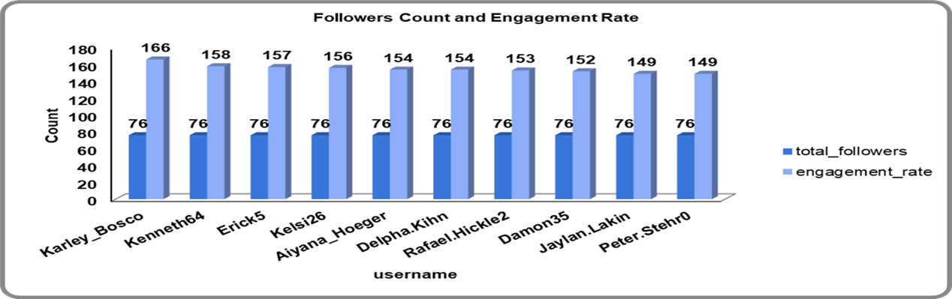
Advertisement Strategy
❖Ad campaigns on the basis of user’s category.
❖Utilise user data for personalised ad and content.
❖ Notifications and recommendations should be given on the basis of content users follow and like the most.
❖Collaborations with the Highly engaged users to encourage others for re-engaging on the platform.

Slide 9

Campaigns and Projections
❖Target audience on the basis of categories and content they brows.
❖Personalised notification and emails should be send the the users to increase engagement.
❖Notification should be catchy and funny so user may not feel disturbed and irritated.
❖Analyse the ad campaigns which are getting low response and substitute them.
❖Collaborations should be done with brands and users, pay the user for paid posts who have better reach and engagement.

Slide 10
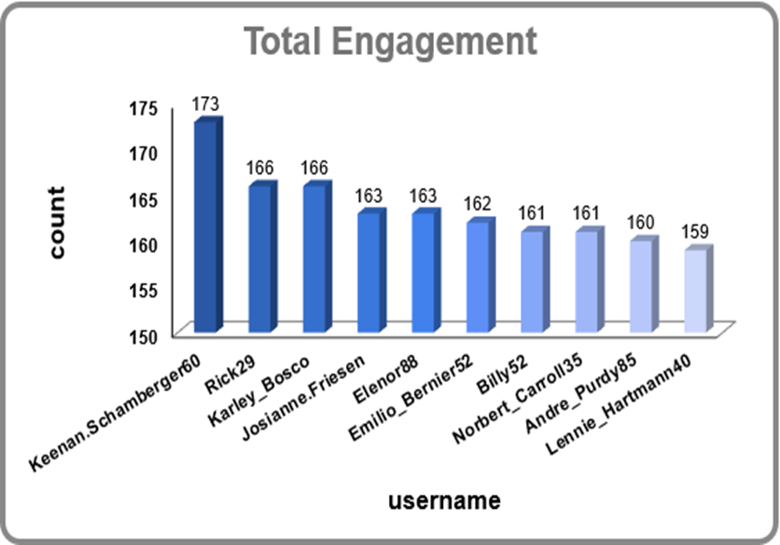
Engagement Analysis
❖Top Users have engagement from 149 to 166.
❖Average engagement rate of all users is 65.
❖Only 31 users have more than average engagement rate and 18 users have more than 100.
❖We will track their posts that gets most of the likes and comments and promote those kind of content.

Slide 11
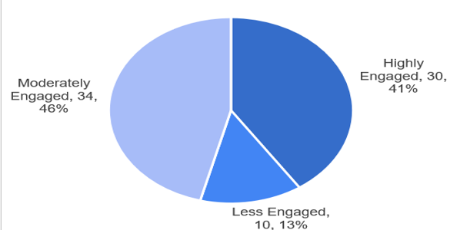
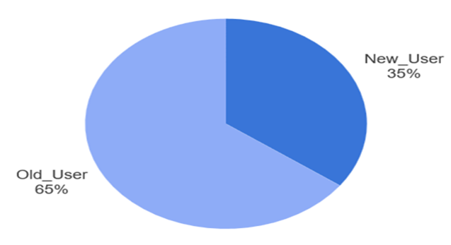

User Classification
❖There are 30 Users who come under Highly Engaged category.
❖34 Users come under Moderately Engaged category.
❖10 user come in Less Engaged category.
❖65% of the current total users are old users. (Joined before 2017)
❖Remaining 35% users are New means they joined after 2017.
●These classification is so that personalized ads and campaigns can be made for different class to improve engagement rates and make interface user friendly.

Slide 12
Conclusion
❖According to the analysis of current data users divided into 3 categories i.e Highly engaged, Moderately engaged and Less engaged.
❖Special focus should be given on Less engaged users.
❖Hashtags play a very vital role is user engagement and promoting any content.
❖Hashtags should be properly monitored and utilised according to the trending and hot topics.
❖Reels are now more liked and engaging among new users.
❖Making reels should be promoted among users and influencers should be motivated to make reels related to trending hashtags.
❖Ads and Campaigns should regularly be made optimising with trends.
❖Promotion through notification should be done via tests and mails.

Slide 13
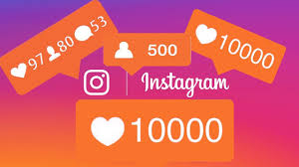
Thank You

