Slide 1
Yelp Review Analysis
Tina Lin

Slide 2
Motivation
Yelp Review contains a lot of data that can be mined and infer meaning

Slide 3
Data Sources
https://www.kaggle.com/yelp-dataset/yelp-dataset/data

Slide 4
Description & Analysis
1. Find the most popular words users have written in positive reviews
nltk (tokenize & remove stopwords)
text analysis
2. Find the 10 most frequent part of speech tags in the review text
map reduce
regex expression

Slide 5
Description & Analysis
3. Find whether there is a correlation between useful, funny and cool.
.corr function
Pairplot
4. Predict whether a review is positive or negative according to yelp review text.
feature importance (“useful”, “funny”, “cool”, “length”, “word_count”, “flesch_score”, “flesch_kincaid_score”, “has_poswords”, “avg_sim”, “min_sim”, “max_sim” and “order”)
random forest classification (80%: train data 20%: test data)

Slide 6
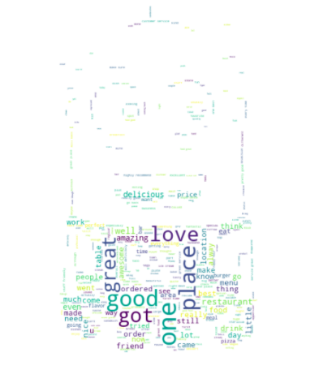
Results & Findings

Slide 7
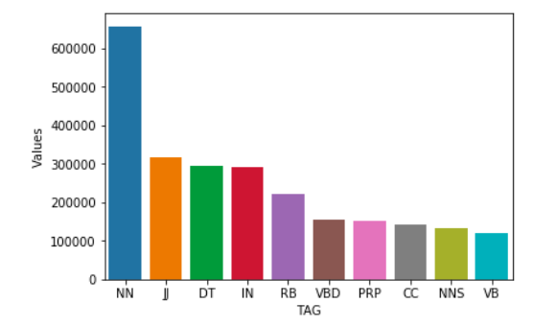
Results & Findings

Slide 8
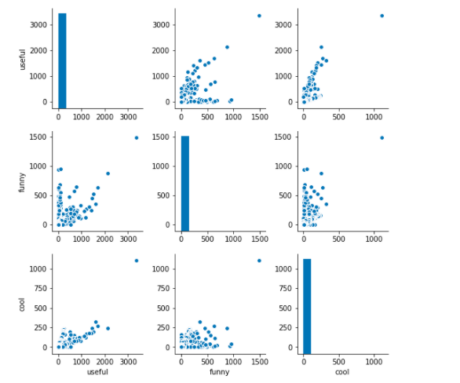
Results & Findings

Slide 9
Results & Findings
The most reasonable feature importance: has_poswords (0.32)
Accuracy for Random Forest Classifier: 0.71

