Slide 1
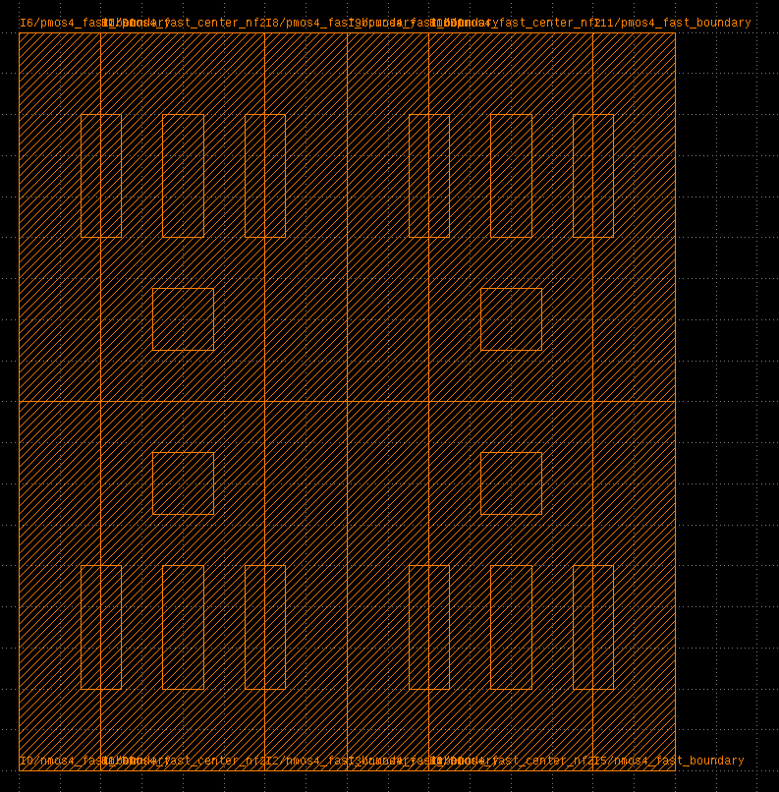
nmos4_fast_boundary
nmos4_fast_center_nf2
(virtual NMOS layout)

Slide 3
(instname)
B0
NL[0:1]
B1
B2
NR[0:1]
B3
(cellname)
BND
NMOS_NF2
NMOS_NF2
BND
BND
NMOS_NF2
NMOS_NF2
BND
G0
G0
(c) via(ref=NL.D0)
G0
G0
D0
D0
D0
D0
(route grid-y)
S0
S0
S0
S0
S0
S1
S1
S1
(route grid-x)
(a) NL=relplace(‘NMOS_NF2’, shape=[2,1], ref=B0.right)
(b) route(ref0=NL[0].S0, ref1=NR[1].S1)
Instance
Pin
Horizontal/vertical routes
Vias

Slide 4
(instname)
B0
N[0:1]
B1
(cellname)
BND
NMOS_NF2
NMOS_NF2
BND
G0
G0
(c) via(ref=NL.D0)
D0
D0
(route grid-y)
S0
S0
S0
S1
(route grid-x)
(b) route(ref0=N[0].S0, ref1=N[1].S1)
(a) N=relplace(‘NMOS_NF2’, shape=[2,1], ref=B0.right)
Instance
Pin
Horizontal/vertical routes
Vias

Slide 5
TemplateDB
GridLayoutGenerator
+ relplace() + route() + via() + load_template() + load_grid() + export_BAG()
GridDB
LayoutDB
LayoutObject
LayoutIO
Instance, Rect, Pin, …
BagProject

Slide 6
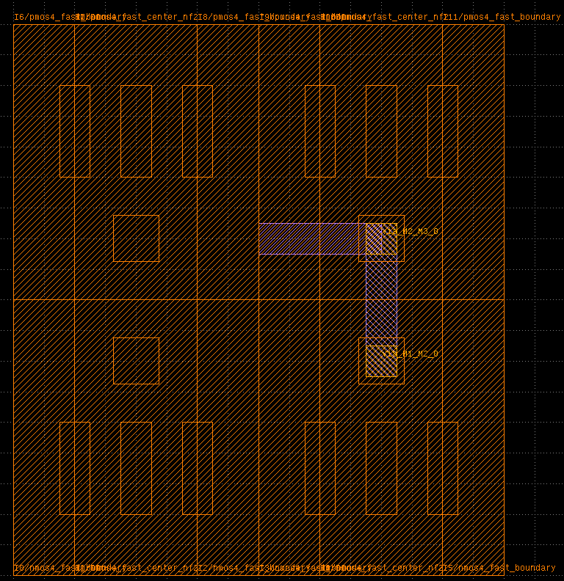
r1 (M2 horizontal)
r0 (M1 vertical)
ra0 (M3 vertical)
2vias

Slide 7
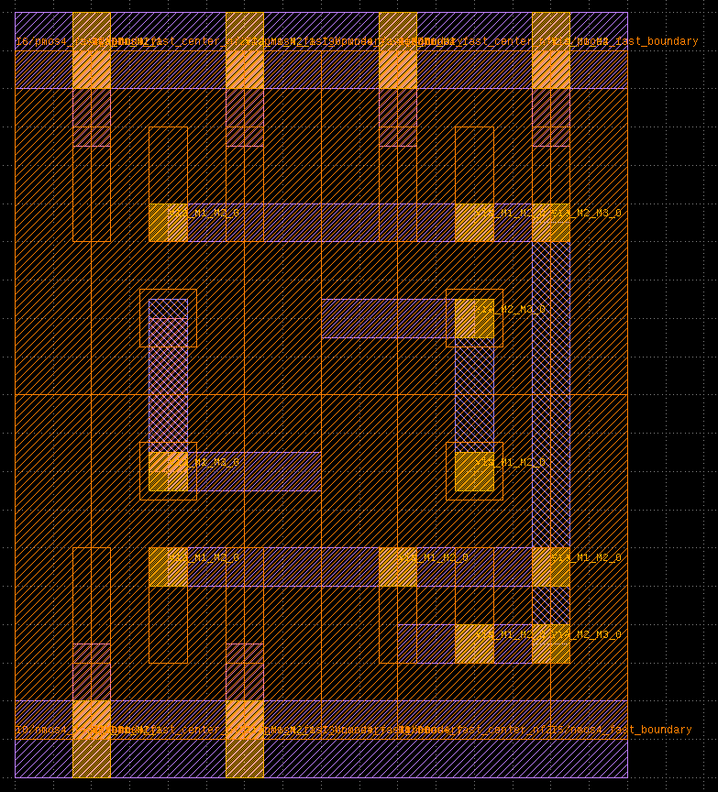
vdd
output
a
b
internal
vss

Slide 8
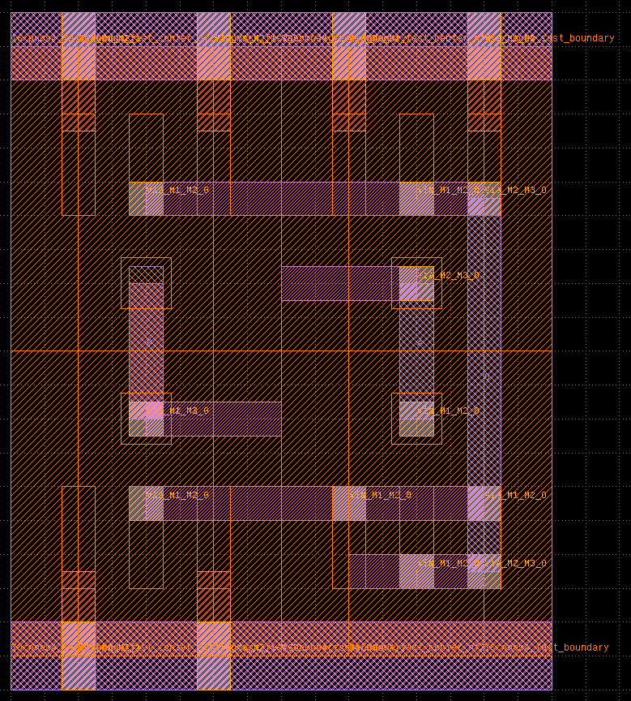
vdd
o
a
b
vss

Slide 9
inst0
(1,3)
inst0
(1,3)
mygrid
mygrid

Slide 10
inst0
inst1
inst0
inst1
inst2
mygrid
mygrid

Slide 11
inst0
inst1
inst3
inst2
mygrid

Slide 12
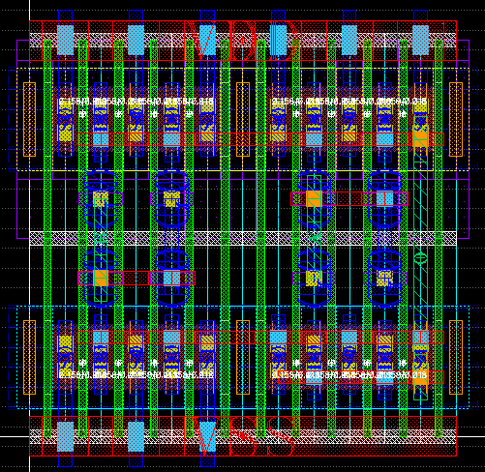
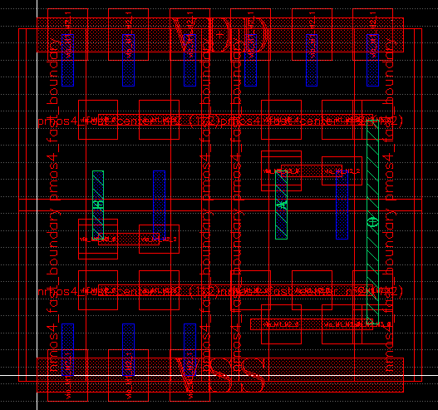

Slide 13
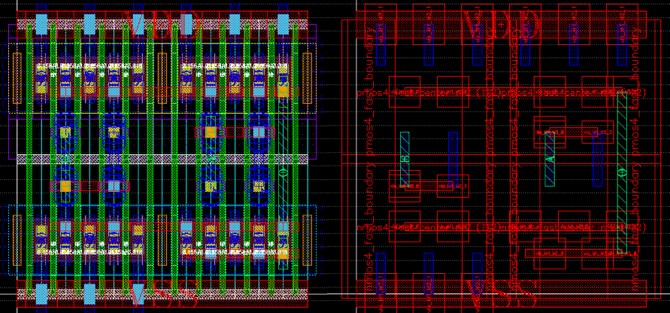

Slide 14
BaseLayoutGenerator
LayoutDB
LayoutObject
LayoutIO
BAG export
GDSIO/GDSHelper
GDS export
GridLayoutGenerator
TemplateDB
TemplateObject
GridDB
GridObject
GridLayoutGenerator2

Slide 15
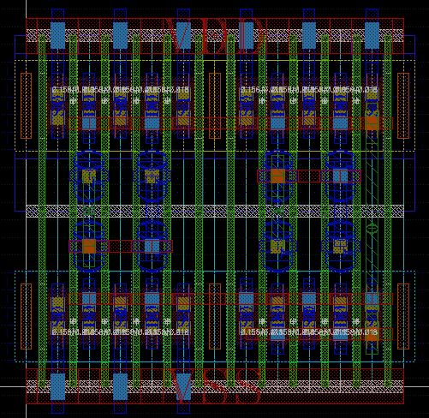
routing grid
r1
r0
r0

