Slide 1
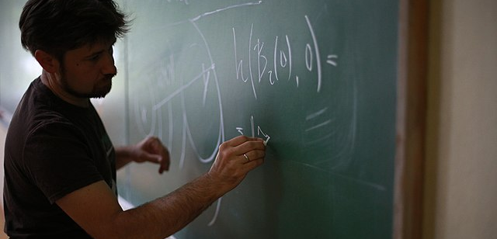
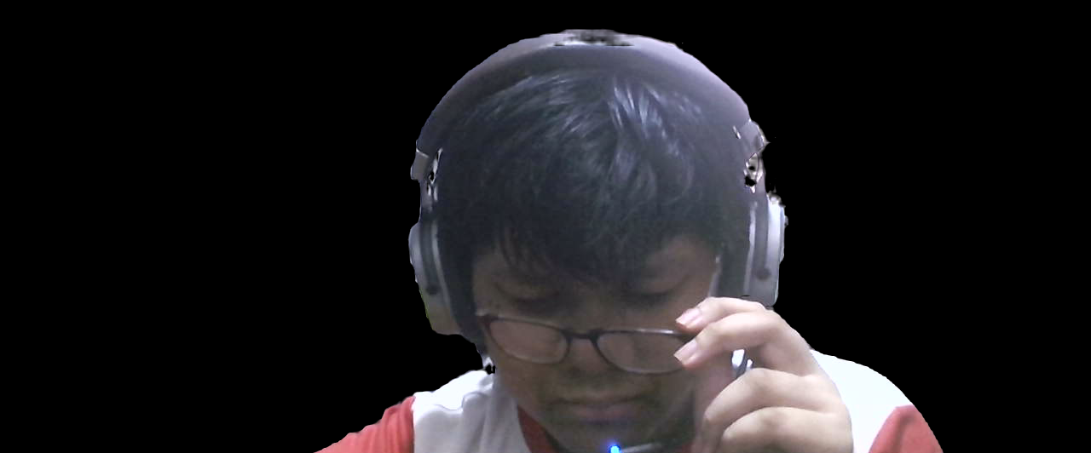
Math in our daily life
Presentation by Tinnaphat Somsang

Slide 2
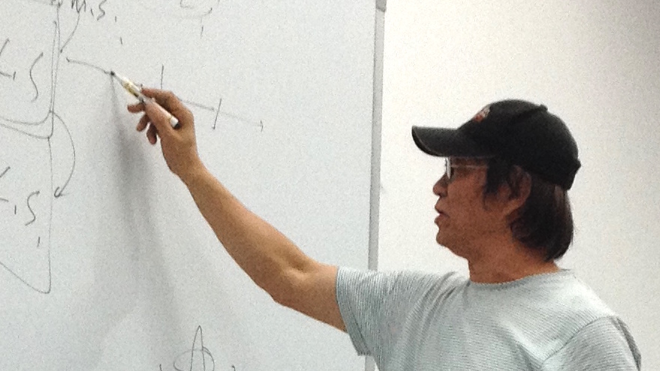
“ Why should we study Mathematics ”
Mathematics doesn't seem very useful in real life and you just give up on it.
But if I tell you that Mathematics is very useful in real life.
I know you're thinking "What are the possibilities of using math in real life?“
It is very common to use math in our daily life. And sometimes you might not even notice that you are using it.

Slide 3
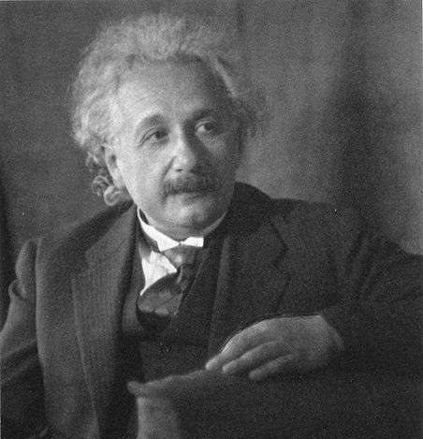
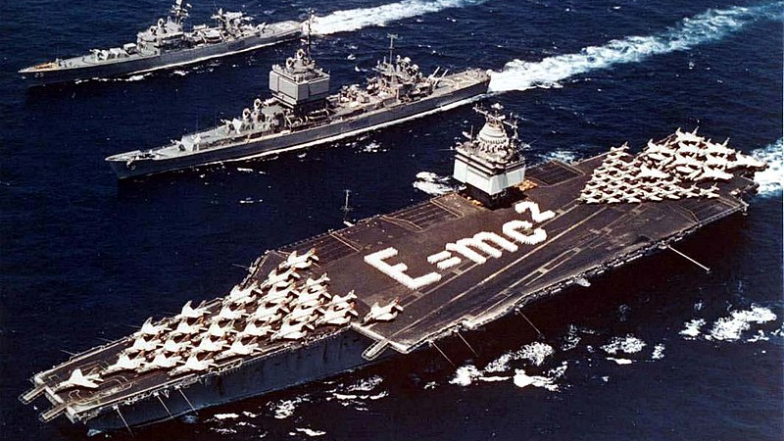
“ What is the importance of Math to us? ”
I think math is the best innovation that human could ever think of.
Using a number it can represent everything from finding the area of square to finding out how the universe works.
The most popular mathematics equation is from Albert Einstein “E=mc²” which is from the General Relativity Theory

Slide 4
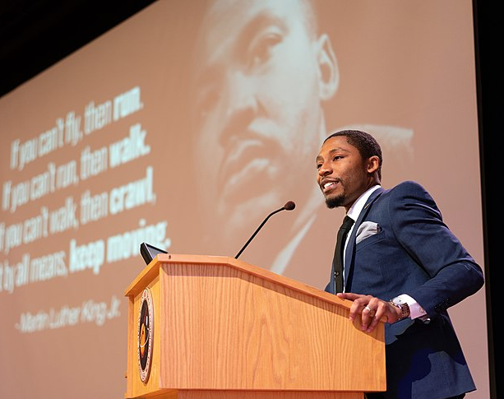
“ Math in our daily life ”
Math is use in various of jobs or career, everyone in the world use mathematics.
Everything in the world is made of mathematics.
Mathematics can make beautiful things like “The Golden Ratio”
I will show you 5 examples that math is literally every where in our daily life.

Slide 5
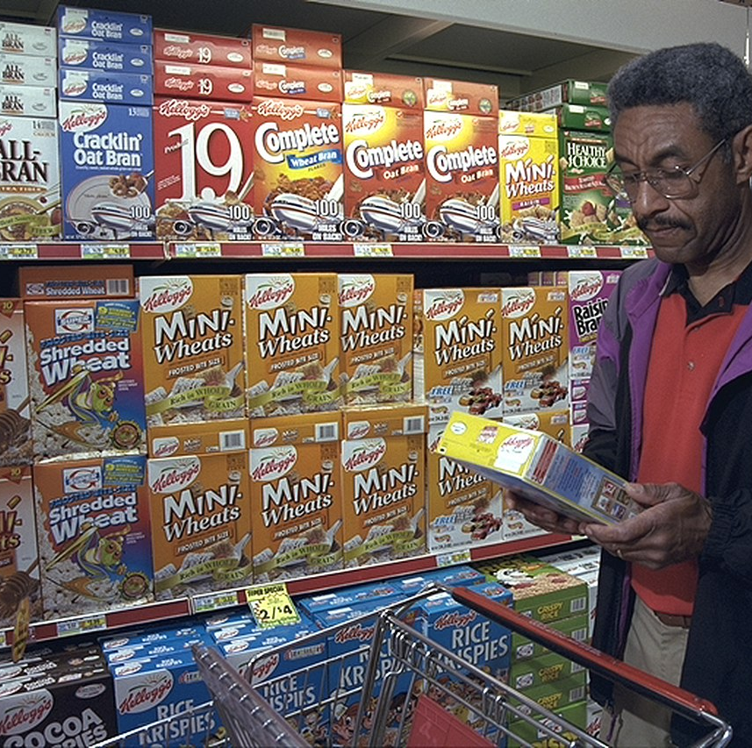
Shopping
You would need to calculate the amount money that you will pay.
Or calculating how much money in account after paid. Not a very serious task but it needs Math to operate

Slide 6
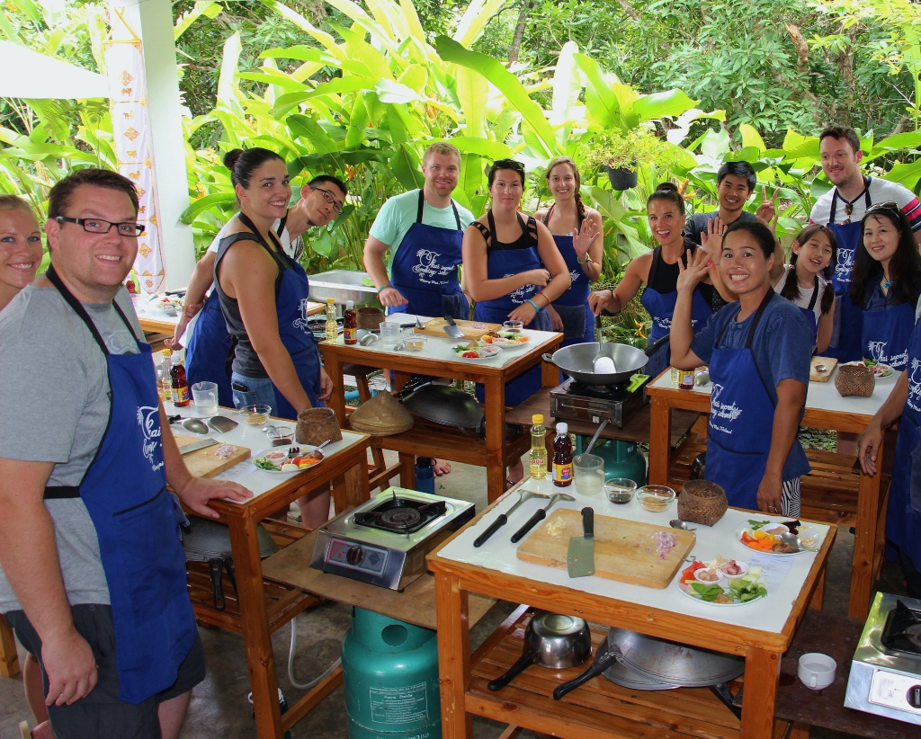
Cooking
You need to measure the ingredients that in the recipe.
Or your food will be thrown away. Because cooking isn’t a simple task, You can’t just throw a ton of sugar in it.

Slide 7
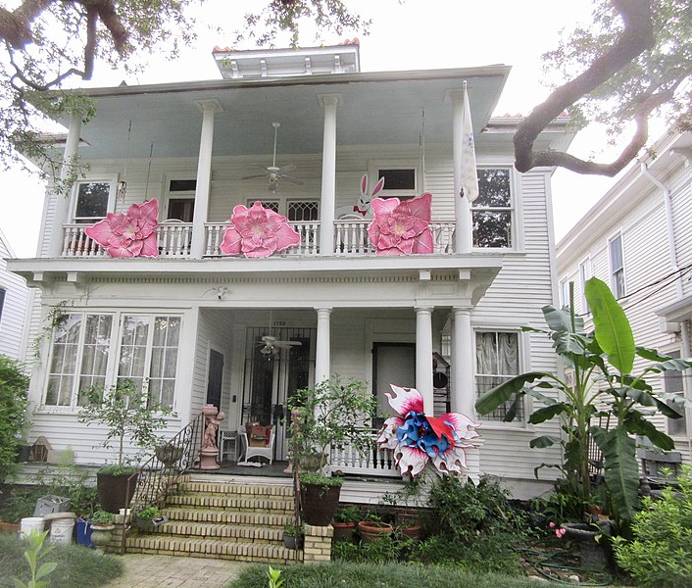
Home decoration
Sometimes you just want your house to looking clean. So you decide to decorate the house.
Home decoration also need math, to properly place the items, calculating the area or length. Like placing sofa, Placing television, etc.
Or your sofa won’t fit in your house well and you just wasting your own money.

Slide 8
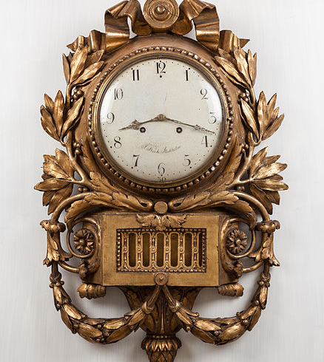
Time management
Time management is nothing without time calculation.
You need to calculate the time or date to manage your time.
Or you will forget to do your homework.

Slide 9
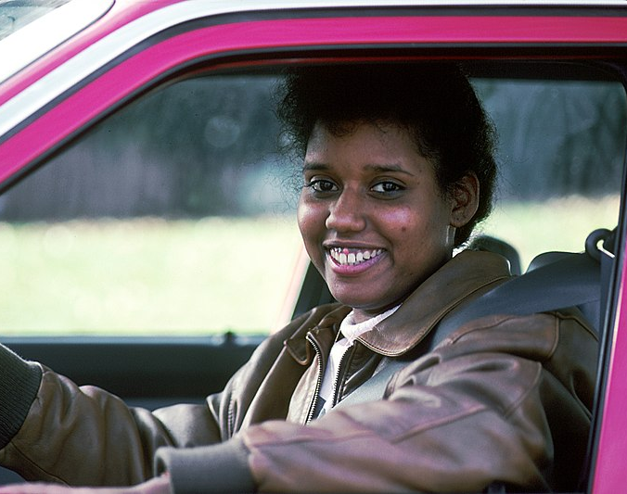
Driving
Even driving, you need math.
Calculate how long you will reach your friend’s house or When to increase or decrease speed.
Or you will late to your friend’s party

Slide 10
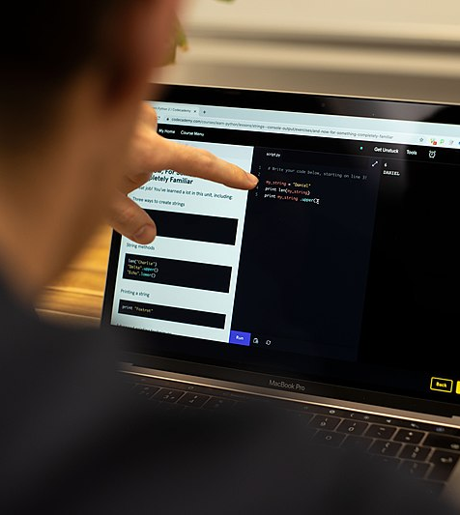
Thank you for listening!
All image is from Wikimedia under Creative Commons Attribution 2.0 Generic license.
Want this slideshow? https://blog.tinnaphat.xyz/#download
Music: Slot Machine – คำสุดท้าย
Font: Sarabun
Storyboard: Tinnaphat Somsang
Speech: Tinnaphat Somsang
Recorder: Tinnaphat Somsang
Editor: Tinnaphat Somsang
Research: Tinnaphat Somsang
Speaker: Tinnaphat Somsang
Slideshow: Tinnaphat Somsang

