Slide 1
Lecture 01
Introduction to OOP

Slide 2
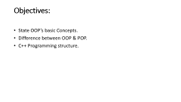
Objectives:
State OOP’s basic Concepts.
Difference between OOP & POP.
C++ Programming structure.

Slide 3
Contents
1.1 Its need & requirement, Procedure Oriented Programming (POP) verses Object Oriented Programming (OOP), Basic concepts of Object Oriented Programming, Object Oriented Languages, and Applications of OOP.
1.2 Beginning with C++: What is C++? , keywords, variables, constants, basic data types, operators, scope resolution operator, memory management operators, console input/output, structure of C++ program.

Slide 4
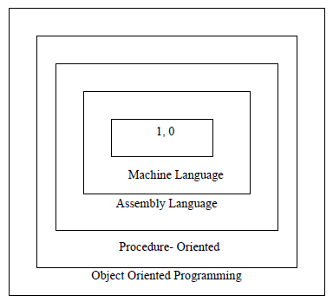
1.1 Its need & requirement

Slide 5
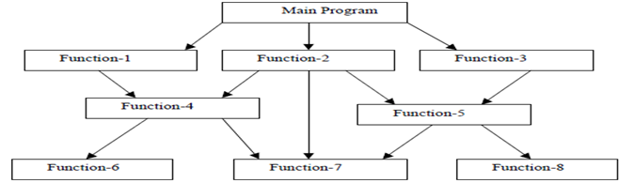
A STRUCTURE OF PROCEDURAL PROGRAMMING:

Slide 6
A STRUCTURE OF PROCEDURAL PROGRAMMING:
Conventional programming languages such as COBOL, FORTRAN, C are commonly known as procedural oriented programming.
In procedural oriented programming the primary focus is on functions. A number of functions are written to accomplish a specific task.
The main concentration is done on development of function and very little attention is given to data that are being used by various functions.
The following diagram shows the general structure of procedural languages

Slide 7
Drawbacks/Limitations of Procedural language
In multi-function program many important data items are placed as global so that they may be accessed by all the functions.
In large program it is very difficult to identify what data is used by which function.
Another drawback of procedural approach is that it does not model the real world problems very well..

Slide 8
Characteristics of Procedural oriented programming:
Emphasis on doing things (algorithm) rather than data.
Large programs are divided into smaller programs known as functions.
Most of the functions share global data.
Data move openly around the system from one function to another.
Functions transform data from one form to another form.
Employs Top-Down approach in program design.

