Slide 1

Does ChatGPT enhance student learning? A systematic review and meta-analysis of experimental studies
Deng et al. (2024)
Maria Clara Escanuela dos Santos
Marina Tatjana Hofer
Christina Sophie Knes

Slide 2

Why this meta-analysis?
The review logic
Deng et al. focus on experimental and quasi-experimental studies. This makes the review more relevant for causal claims: what happens when students use ChatGPT compared with a control condition?
Problem
ChatGPT is already used for explanations, writing, feedback and learning support. But many early studies only measured perceptions or correlations, which cannot tell us whether ChatGPT actually causes learning gains.
Core message: The paper moves the debate from opinions about ChatGPT to experimental evidence about learning.
Notes:
The question of the enhancement of student learning is relevant because:
ChatGPT entered educational settings very quickly
Students already use it: for explanations, brainstorming, writing support, feedback, coding help, and exam preparation
Teachers and institutions:
“How to deal with it?”
Is it a useful learning tool?
Does it support deeper understanding?
Does it mainly reduce effort and create risks such as overreliance?
The meta-analysis tries to move beyond opinions and perceptions.
early studies on ChatGPT asked:
liked the tool,
found it helpful,
whether they intended to use it
interesting, but NOT tell us if ChatGPT causes better learning
focus on experimental and quasi-experimental studies studies with a ChatGPT group and a control group
Leads to stronger conclusions than purely descriptive studies.
Core idea of review:
NOT: “Do students like ChatGPT?”
BUT: “What happens to learning outcomes when ChatGPT is actually used in an educational intervention?”
Ziel dieser Folie: kurz begründen, warum diese Meta-Analyse überhaupt wichtig ist.
Sprechtext:
ChatGPT ist sehr schnell in Bildungskontexte hineingekommen. Studierende verwenden es für Erklärungen, Ideensammlung, Feedback oder Schreiben. Gleichzeitig gibt es Sorgen: Academic Integrity, Overreliance oder dass tiefere Verarbeitung verloren geht. Viele frühe Studien waren aber Wahrnehmungsstudien oder Querschnittsstudien. Die können zeigen, dass ChatGPT-Nutzung mit Leistung zusammenhängt, aber nicht, ob ChatGPT die Leistung verursacht. Genau hier setzt Deng et al. an: Sie betrachten experimentelle und quasi-experimentelle Studien, also Evidenz, die näher an Kausalität ist.

Slide 3
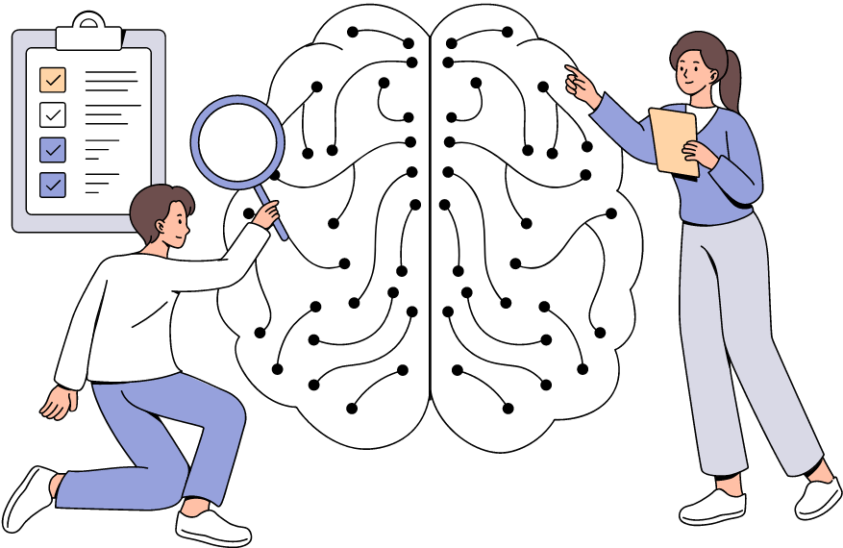
Research Questions
RQ1: Where and how is ChatGPT used?
educational stage
subject area
setting
duration
application mode
RQ2: What outcomes change?
academic performance
motivation
higher-order thinking
self-efficacy
mental effort
RQ3: How robust are the studies?
sample size estimation
baseline-difference control
Not: “Does ChatGPT work?”
But: “For which outcomes, in which contexts, and with what methodological quality?”
Notes:
The authors structure the review around 3 main research questions.
Descriptive: Where and how is ChatGPT used in experimental studies?
educational stages
subject areas
intervention settings
duration
how ChatGPT was applied
Eg. direct learning tool / writing assistant / tutor …
outcomes: The authors ask how ChatGPT affects different dimensions of student learning.
not only academic performance
affective and motivational states
higher-order thinking
self-efficacy
mental effort important because “learning” is not one single thing tool could improve test performance but reduce independent thinking increase motivation but not improve actual performance the meta-analysis separates different outcome categories
methodological: The authors examine how robust the included experimental studies are.
They ask if studies justify their sample sizes
Have experimental and control groups similar baseline? These points matter because strong effects are less convincing if the study design is weak.
For our presentation, this distinction is important. My part focuses on the general review and the main results. Christina will go deeper into PRISMA, quality assessment, and methodological limitations.
Ziel dieser Folie: die Forschungsfragen zusammenfassen
Sprechtext:
Die Meta-Analyse fragt nicht nur: Wirkt ChatGPT? Die erste Frage ist deskriptiv: Wo wird ChatGPT überhaupt experimentell untersucht, also in welchen Bildungsstufen, Fächern, Settings, über welche Dauer und in welcher Nutzungsform. Die zweite Frage ist die eigentliche Effektfrage: Welche Lernoutcomes verändern sich? Und die dritte Frage ist methodisch: Wie gut sind diese experimentellen Studien abgesichert, etwa durch Stichprobengröße, Randomisierung oder Pretests. Das ist wichtig, weil positive Effekte nur dann überzeugend sind, wenn die Studienqualität mitgedacht wird.

Slide 4
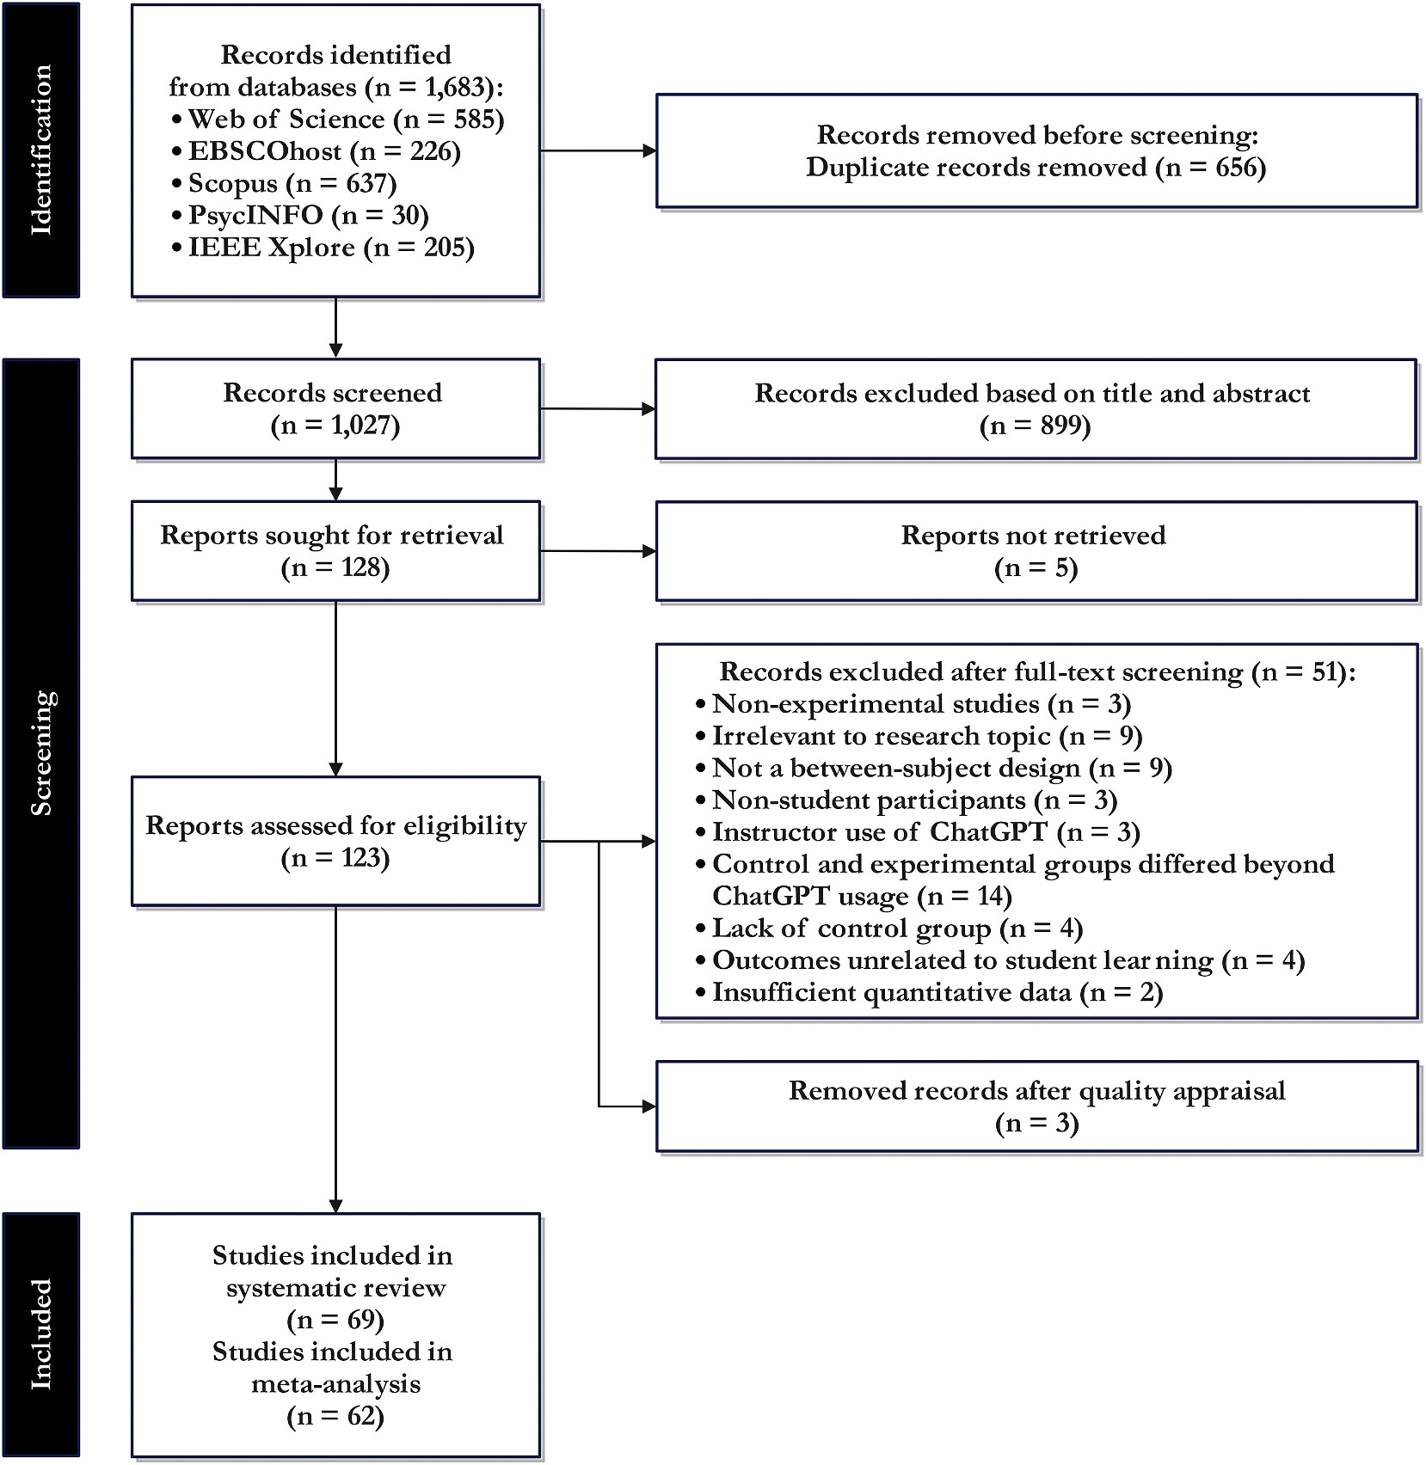
PRISMA-guided study selection
Search keywords (e.g. ChatGPT,…)
Inclusion criteria (e.g. used ChatGPT, used experimental and quasi-experimental designs,…)
Exclusion criteria (e.g. no focus on rich qualitative data, focus on broader impact of non-gen AI,…)

Slide 5
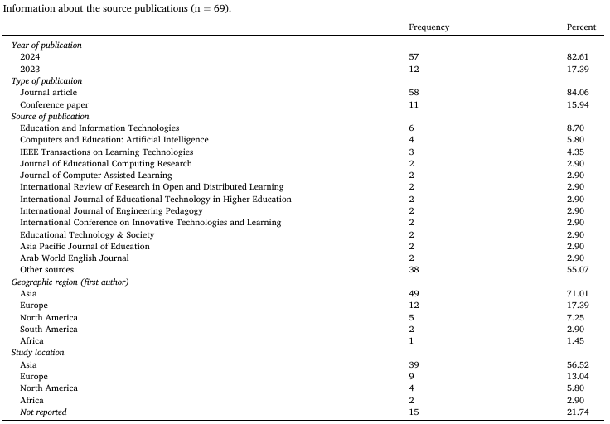

Slide 6
Quality Assessment using MAGIC
Criterion | Assessment
Magnitude | Positive overall effect
Articulation | Clear research question and methods
Generality | Multiple educational contexts
Interestingness | High relevance for education
Credibility | PRISMA and quality appraisal

Slide 7

What does the evidence base look like?
69
studies in the systematic review
62
studies in the meta-analysis
84%
conducted at university level
80%
used ChatGPT as a direct learning tool
Subjects / Context
Mainly: language education, computing and health
Fewer: physics and education
Settings
Mainly: classroom environments
Fewer: short isolated lab task
Duration
Many interventions lasted several weeks
very short interventions behaved differently in the moderator analyses
Interpretation: the evidence is broad, but strongly shaped by university-level classroom studies.
Notes:
After the screening process, Deng et al. included 69 studies in the systematic review. Out of these, 62 studies were included in the meta-analysis.
evidence base - not evenly distributed across all educational contexts
Most studies were conducted at university level. (~84% were higher education studies)
a smaller part focused on K-12 education.
This matters because the results may not generalize equally → to younger students University students:
more autonomy
more prior knowledge
more experience with independent learning
So: ChatGPT might work differently for them than for school students.
Most common subject area:
mainly language education
also included studies from other fields: computing, health, physics, and education
distribution is uneven!
Take in mind: “ChatGPT supports learning,” for some domains more relevant
How ChatGPT was used?
Mainly: direct learning tool - dir. interaction with ChatGPT
rather than using a highly structured AI-supported learning environment designed by teachers or researchers
This is interesting from a human factors perspective: Much freedom, but much responsibility
quality depends on: prompting, verification, prior knowledge, and critical thinking.
Many interventions in classroom settings (several lasted multiple weeks) not only based on very short lab tasks However, the authors also found that duration matters in some moderator analyses, → to be careful when comparing short and long interventions.
My takeaway from this slide is: the evidence base is broad enough to be meaningful, but it is strongly shaped by university-level classroom studies and by rather direct forms of ChatGPT use.
Ziel dieser Folie: die Studienlandschaft zeigen.
Sprechtext:
Nach der Auswahl bleiben 69 Studien im systematischen Review, und 62 davon gehen in die Meta-Analyse ein. Wichtig ist: Diese Evidenzbasis ist nicht gleichmäßig über alle Bildungskontexte verteilt. Der Großteil stammt aus Universitäten, nur ein kleinerer Teil aus K-12. Auch inhaltlich gibt es einen Schwerpunkt auf Sprache beziehungsweise Language Education. Außerdem wird ChatGPT meistens direkt genutzt, also als normales ChatGPT-Tool, nicht als speziell entwickelte Lernapp. Für die Interpretation heißt das: Die Meta-Analyse ist breit, aber die stärkste Evidenz betrifft vor allem Hochschulkontexte.

Slide 8
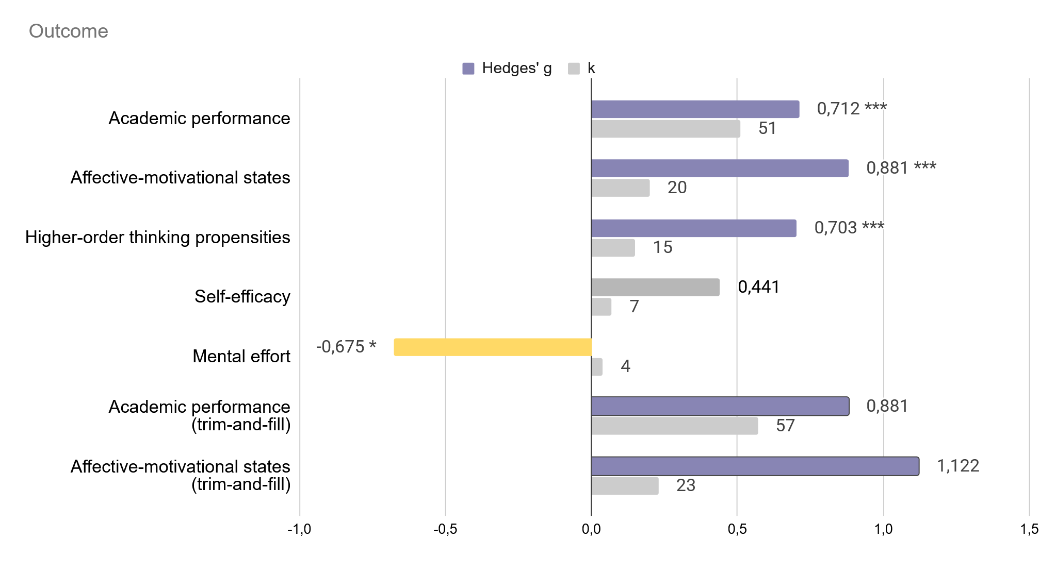
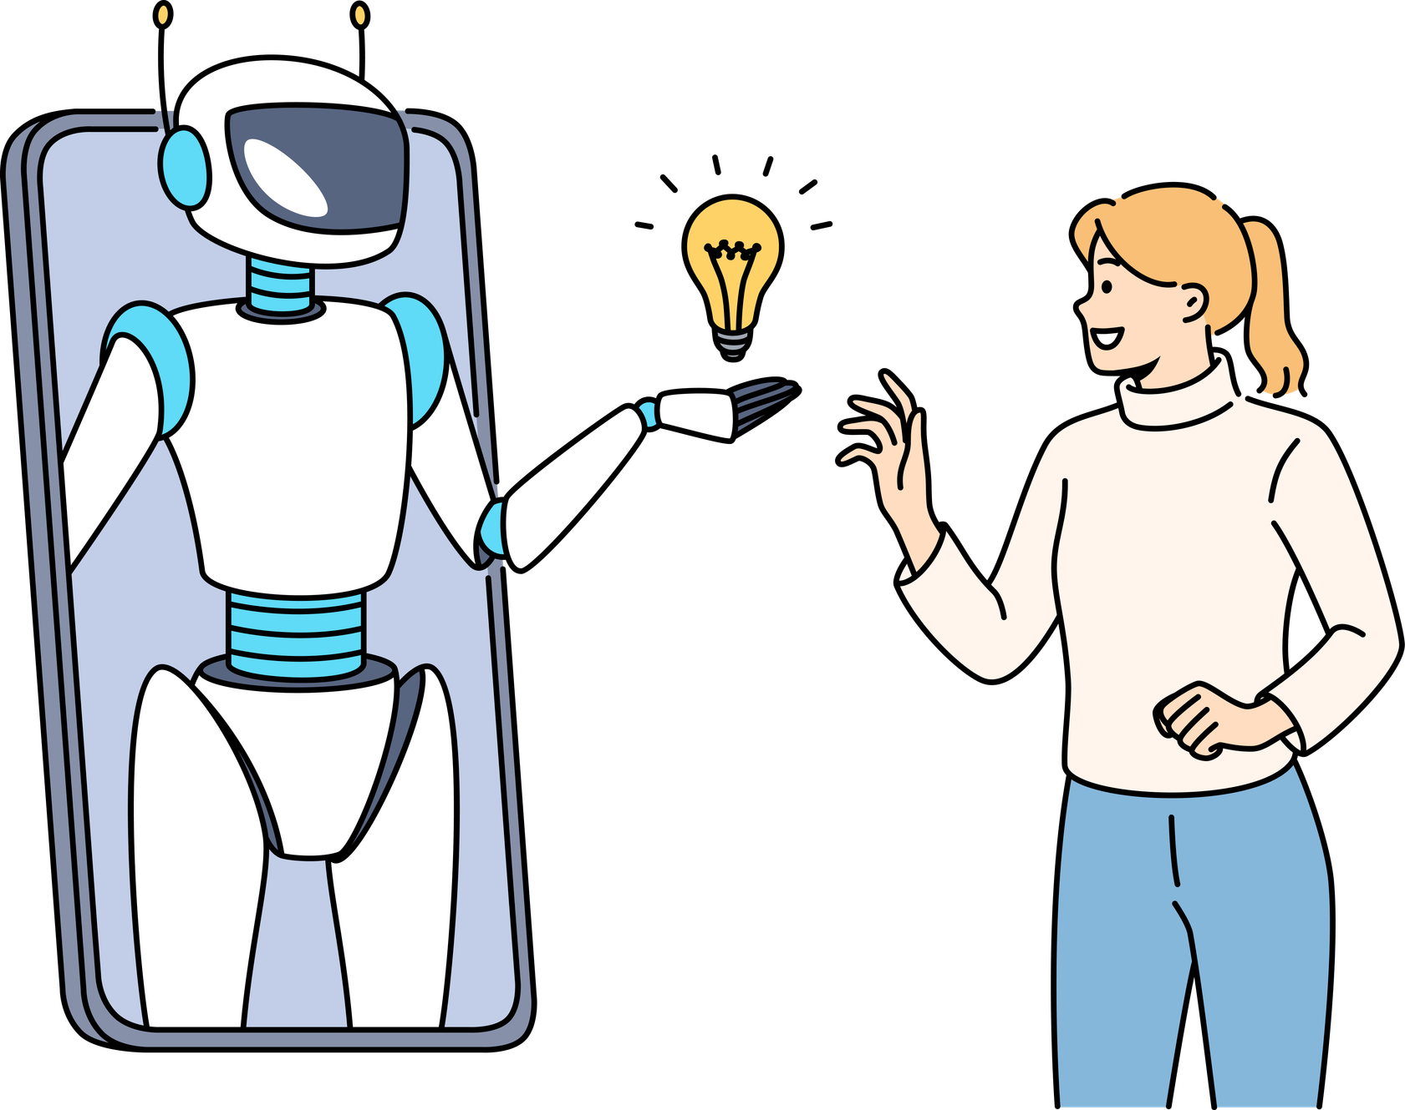
Main results: promising, but outcome-specific
Takeaway: ChatGPT interventions show positive effects for several learning outcomes, but the pattern depends on what is measured.
Notes:
The authors report effect sizes using Hedges’ g (a standardized effect size). It tells us how far apart the ChatGPT group and the control group are, measured in standard deviations.
As a rough interpretation: effect 0.2 = small, 0.5 = medium, 0.8 = large, >1 = very large but especially in education research such large effects should always be interpreted carefully.
academic performance - large effect 0.712 (44 out of 51 effect sizes were positive) Average, students using ChatGPT performed better than students in the control conditions
large positive effect for affective and motivational states ~ 0.88 (17 out of 20 effect sizes were positive) ChatGPT may positively influence: feel about learning, e.g. motivation, engagement, or attitude.
higher-order thinking propensities: positive and large, around 0.70. (14 of 15 effect sizes were positive) There are concerns about ChatGPT might reduce deeper thinking. The meta-analysis suggests: at least in experimental studies, ChatGPT can also support outcomes related to higher-order thinking
However, self-efficacy was different. The effect was positive, but not statistically significant. (5 out of 7 effect sizes were positive) We cannot confidently say that ChatGPT improves students’ belief in their own abilities.
Mental effort: negative effect, ~minus 0.68. (3 of 4 negative) Does not mean bad - students reported lower mental effort
Positive: reduces unnecessary cognitive load
Critical: if lower effort means processing material is less deeply
Trim-and-fill validates if the effect size is distorted: (If the funnel plot is asymmetrically - then potential missing studies are added in calculation and recalculated), a strong reduction would be the problem (here not true)
So the overall picture is promising, but not simple!
ChatGPT seems to have positive effects on several learning outcomes
effects differ by outcome
interpreted together with study quality, heterogeneity, and possible bias.
Ziel dieser Folie: wichtigsten Main Results berichten
Sprechtext:
Die Ergebnisse sind insgesamt eher positiv. Academic Performance zeigt einen großen positiven Effekt mit g = 0.712. Auch affektiv-motivationale Zustände und Higher-order Thinking Propensities zeigen große positive Effekte. Self-efficacy ist dagegen nicht signifikant. Mental Effort ist negativ, was hier bedeutet: Die wahrgenommene mentale Anstrengung wurde reduziert. Wichtig ist aber, dass diese Outcomes unterschiedlich stark belegt sind. Academic Performance basiert auf vielen Effektgrößen, Mental Effort nur auf wenigen. Deshalb würde ich als Takeaway sagen: ChatGPT sieht vielversprechend aus, aber nicht für alle Outcomes gleich, und die Interpretation hängt davon ab, was genau gemessen wurde. Damit kann Christina gut mit Qualität, Heterogenität und PRISMA anschließen.

Slide 9
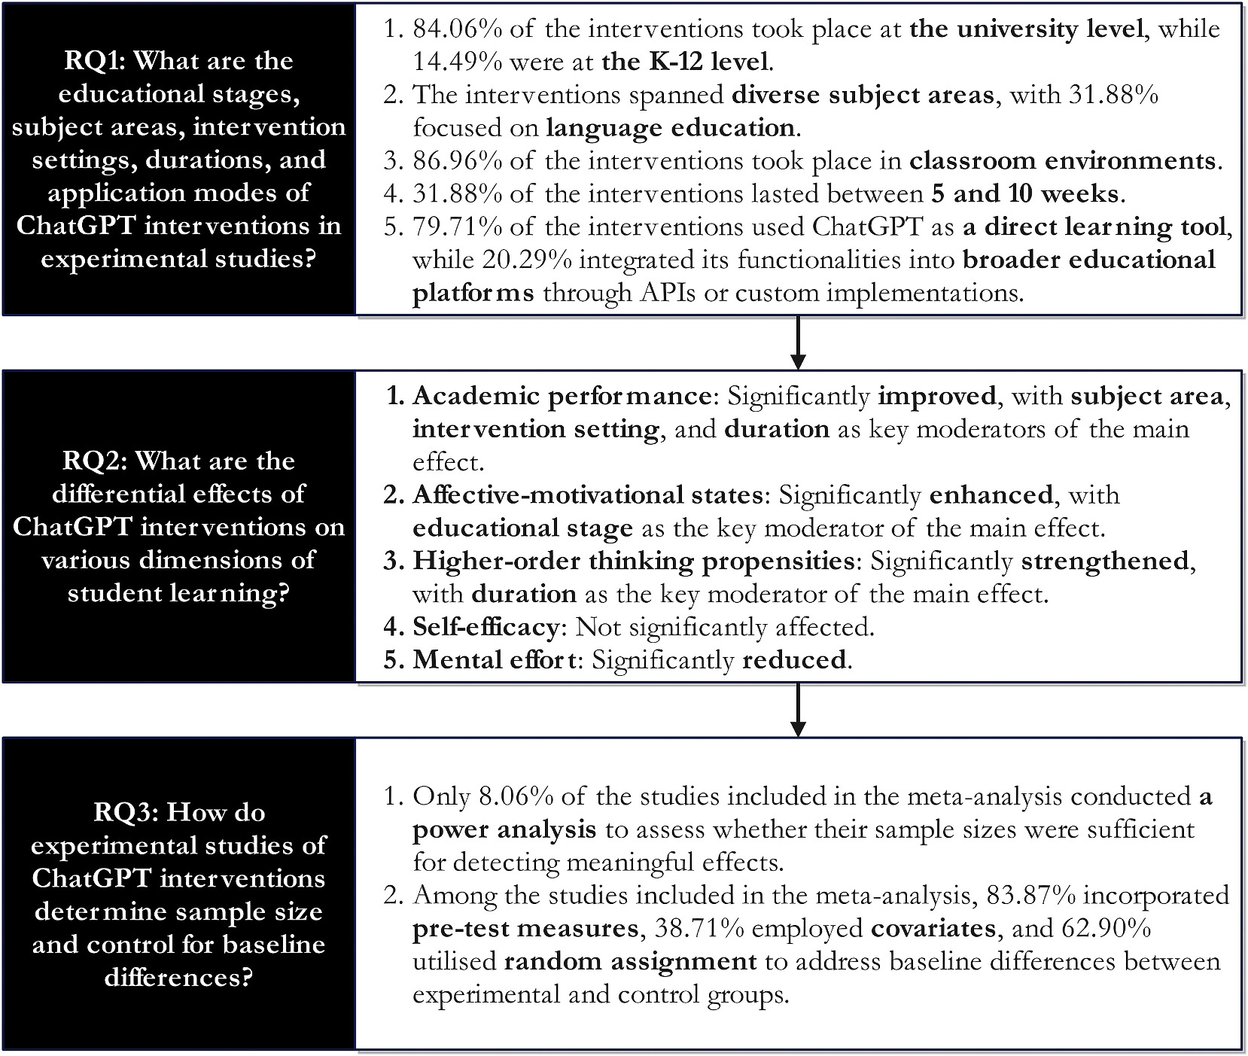

Key Findings Summary
Notes:
RQ3: only 8% included a power analysis (assessment if sample size is sufficient)
nearly 84% have pre test measures
more than 60% random assignment
This leads nicely into the next part of the presentation: even if the main results look positive, we still need to ask how reliable the evidence is, how the studies were selected, and what limitations remain.

Slide 10
Limitations and Potential Biases
Limitations
Rapidly evolving technology
Short-term interventions
Limited long-term evidence
Heterogeneity across studies
Potential Biases
Publication bias
Small study effects
Novelty effect
Different ChatGPT versions
Key Message: Results are promising, but should be interpreted cautiously.

Slide 11
Stakeholders
Students
Cultivate AI literacy, foster their prompt skills together and critical evaluate the AI generated content, ensuring more accuracy of the explanations.
Teachers
Focus more on developing critical thinking and problem-solving skills, shifting to project-based assessments.
Universities
Need to incorporate authenticity and quality metrics and tasks that involves unique contexts and personal experiences, together with more quality evaluations.
Researchers
Must develop experimental designs, conduct power analyses to ensure sufficient sample sizes and evaluate long-term impacts.
Policy makers
Prioritize evidence based on AI integration to a more responsible implementation grounded in a comprehension of its impacts on learning outcomes.

Slide 12
Conclusion
Early research focus on perceptions and attitudes of students and instructors
Do not provide concrete evidence of the actual impact.
Effort to manage determining sufficient sample sizes.
Cross-sectional research
Do not determine if it can lead to an improvement or diminishment of performance or vice-versa.

Slide 13
Conclusion
Systematic review and meta – analysis to sinthesize the research findings.
Contributions to the field of technology – enhanced learning.
ChatGPT interventions
University level
Authentic classroom environments
Emphasis on language education
Direct learning tools
ChatGPT can potentially improve academic performance, but there is a need of caution interpreting the results.

Slide 14
Conclusion
Can potentially improve academic performance.
Caution when interpreting the results.
Interventions enhance affective motivational states and higher order thinking propensities, reducing mental effort.
Lack of experimental research
Future research: explore long term impact, disentangle the quality from the intervention effects and assess if the students' improvements are related to the skills.

Slide 15
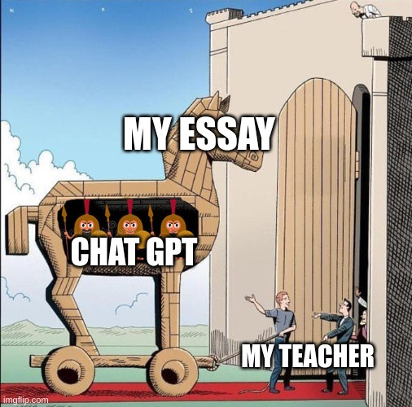
THANK
YOU!
Discussion time!
Website
Source: imgflip.com

