Slide 1
OpSec Track and Trace Mobile Tool
Project goals | Provide convenient scanning, storing and tracking capabilities via hand-held mobile device
Target audience | Warehouse staff, inventory managers, auditors, other personnel
Cost | Lean, focus on freeware
Time frame | Summer 2016 launch
Presentation focus | Android mobile device UX
Notes:
1

Slide 2
Strategy
Don't reinvent the wheel
Keep things simple and clean
For first iteration: sacrifice form for better function
Seek as much internal third party opinion as possible
Notes:
2

Slide 3
Design Pointers
Avoid Uncertainty: implement progress bar/wheel
User working conditions:
- “One-thumb pilot” command: convenient functionality in a busy inventory room?
- Tablet and electronic pen in a formal setting?
- Bright outdoor lighting or uneven indoor lighting?
Scalability: a fluid layout adjustable between diverse screens
- Mobile screen for physical application
- Desktop screen for webEx meetings
- Large screen for in-person group meetings

Slide 4
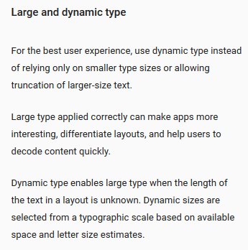
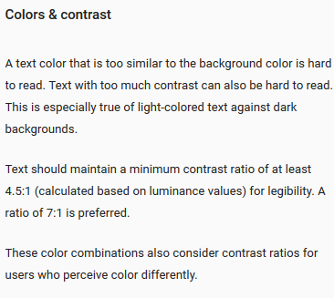
Google Design Tips
https://www.google.com/design/spec/style/typography.html#typography-language-categorization

Slide 5
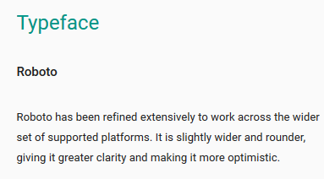
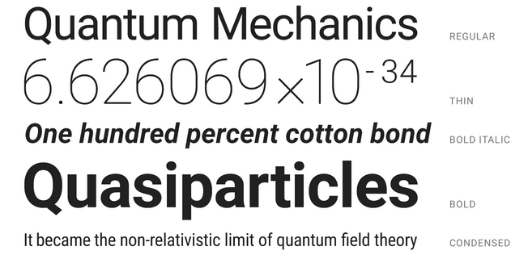
https://www.google.com/design/spec/style/typography.html#typography-language-categorization

Slide 6
Inspiration
Google Play Store scanner apps
https://play.google.com/store/apps/details?id=tool.scanner.qrscan.barcodescan
https://play.google.com/store/apps/details?id=la.droid.qr.priva
https://play.google.com/store/apps/details?id=appinventor.ai_progetto2003.SCAN
https://play.google.com/store/apps/details?id=com.kaspersky.qrscanner
UPS
http://www.windowsphonearea.com/track-shipments-using-ups-mobile-app/
OpSec Security homepage theme http://www.opsecsecurity.com/

Slide 7
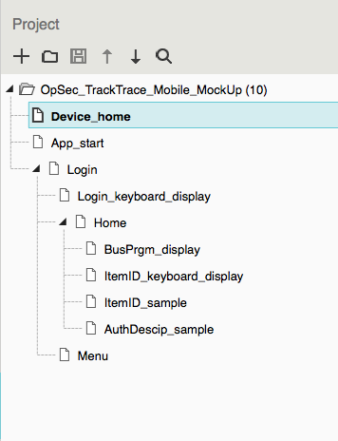

Slide 8
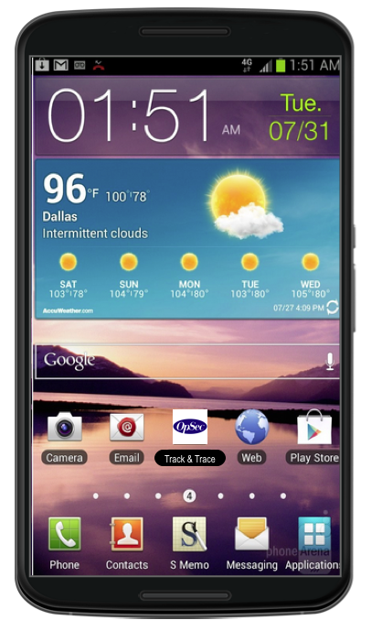

Slide 9
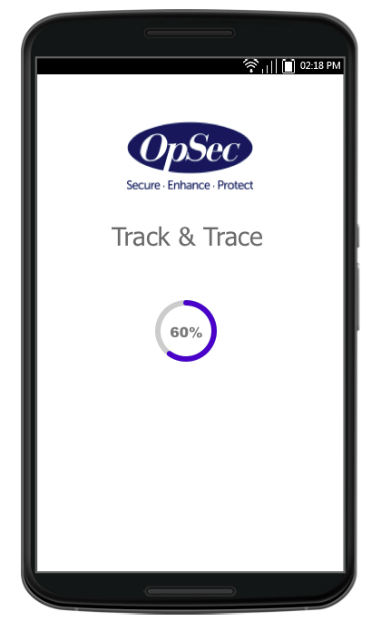

Slide 10
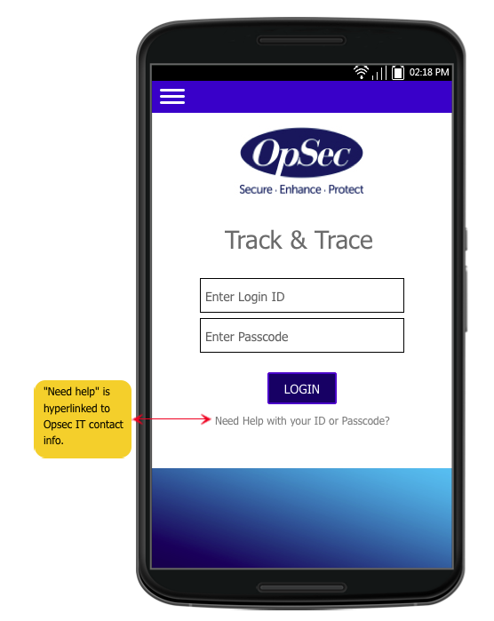
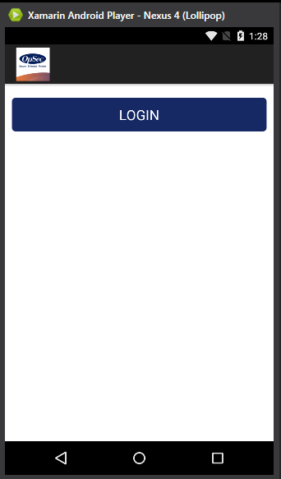

Slide 11
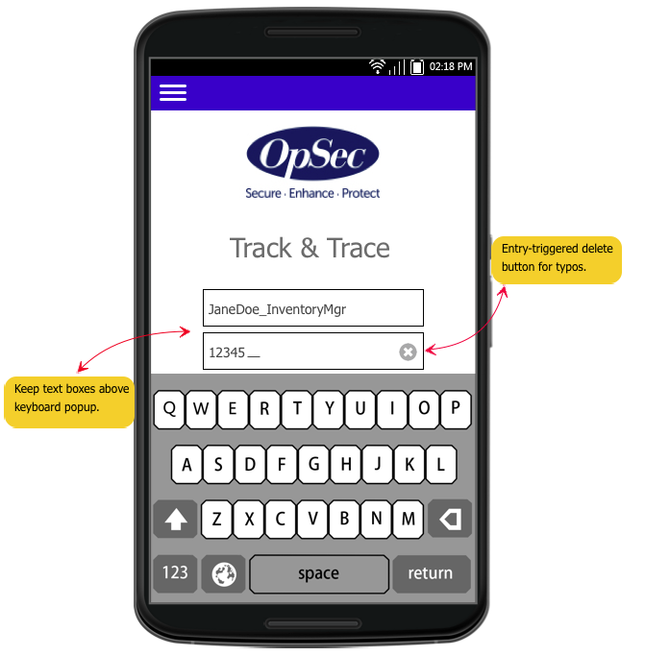
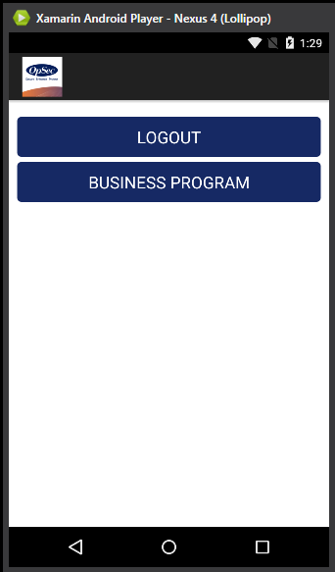

Slide 12
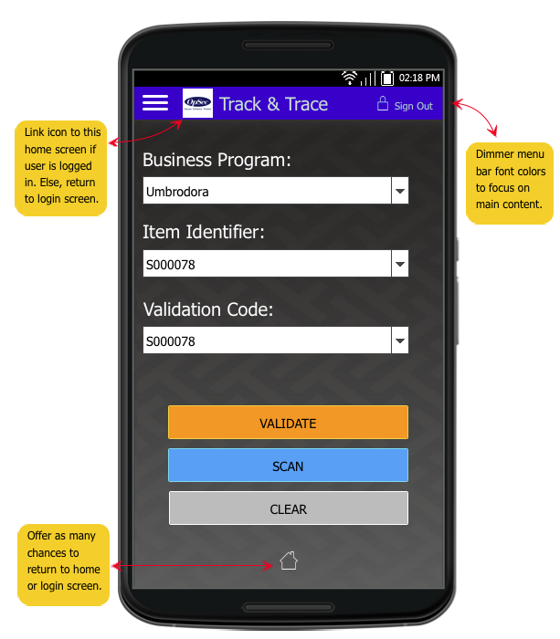
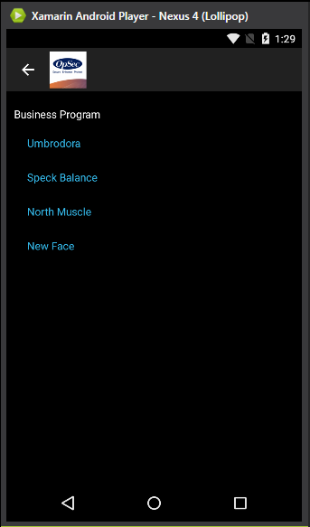

Slide 13
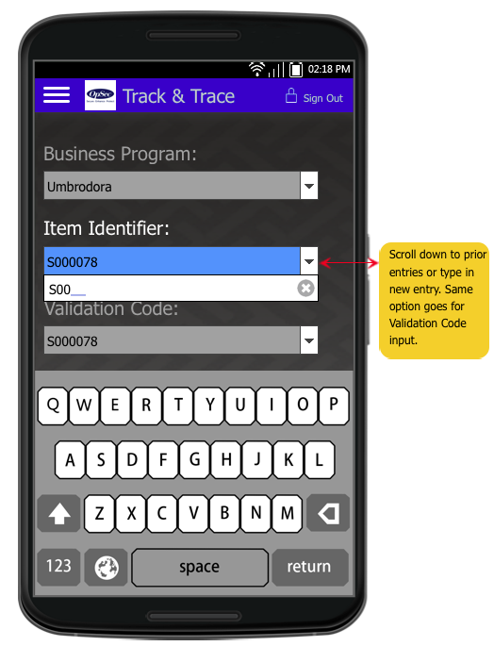
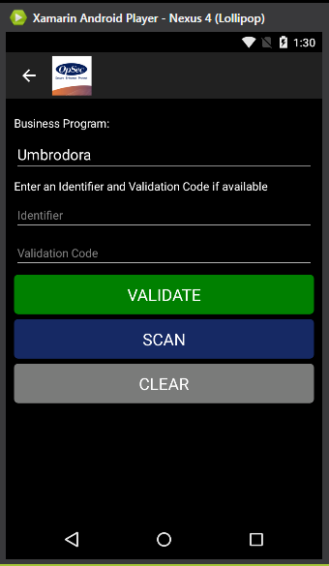

Slide 14
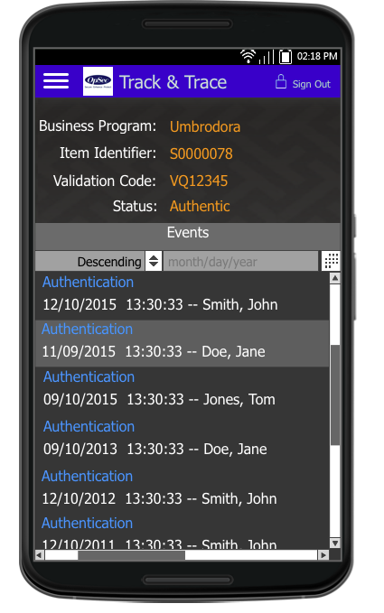
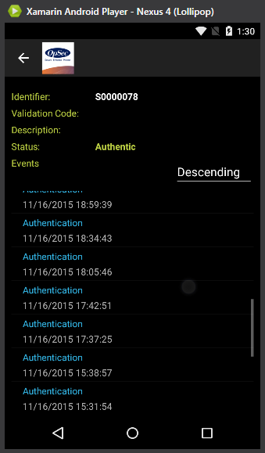

Slide 15
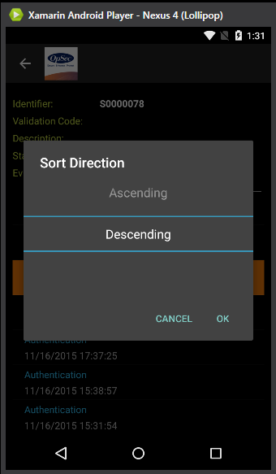

Slide 16
