Slide 1
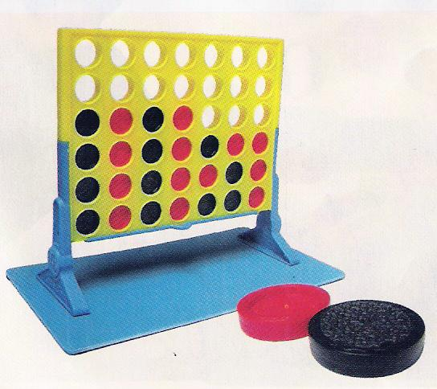
A Fast Thinking Connect Four Machine!
6.846 Final Project
Presented by Tina Wen

Slide 2
Goal
Write a fast connect k game on m by n grid from scratch
Small m and n: exhaustive search
n
Big m and n: search to a good depth
k
m

Slide 3
Basic Idea
Negamax search (recursively call expand and combine)
ROOT
Me: Max
4
Oppo: Min
4
3
3
Me: Max
4
5
9
3
5
5
8
6
3
Oppo: Min
2
4
1
5
4
2
1
7
9
2
0
3
4
5
2
1
3
5
7
8
4
6
5
4
3
2
1

Slide 4
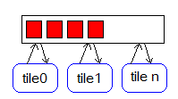
Approaches
1. Sequential exhaustive search
2. One dynamic queue in shared memory (TSP)
3. Master-Slave Message Passing
tile1
5
tile4
2
0
Tile 0
tile2
3
tile3
6
COMBINE

Slide 5
Approaches
4. Master-Slave Individually allocated shared memory (no mutex)
tile1
Where to get work
tile0
Where to write to to distribute work?
Ready? | work
0
To which tile | Pointer
1
2
Where to return work?
tile2
Where to get work
Where to get the results?
Ready? | work
0
From which tile | Ready? | Result
1 | 0
2 | 0
Where to return work?

Slide 6












Heuristic
Search for 4 in a row in 4 different orientations
Out of 4:
# for black
# for red
Count only rows that consist of one color and space (either red or black == 0)
If we are red
If one color has 4 in a row, then score =
(infinity + spaces)
2
2
Else score +=

Slide 7




Heuristic
1
score
2
2
9 + 4 + 1 = 14
score +=
2
9 + 4 + 4 = 17
3
9 + 4 +1 = 14
4
9 + 9 + 4 = 22

Slide 8
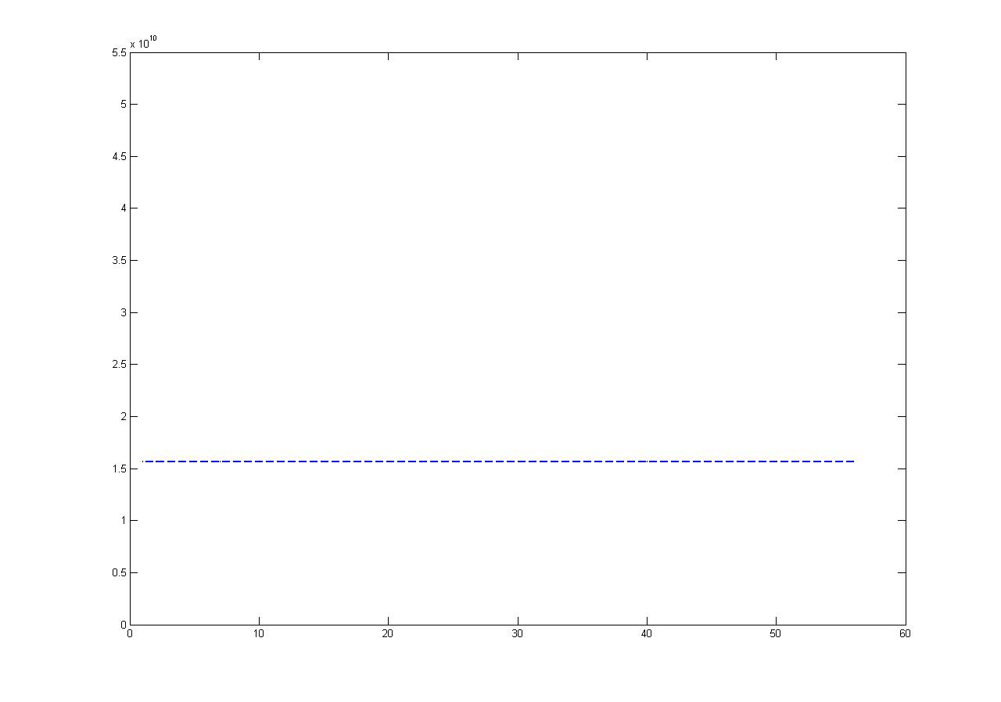
Performance Comparison (connect 3)
Performance of connect 3 on 4x4 grid
Number of cycles
Purple: sequential no pruning
Number of processors (P)

Slide 9
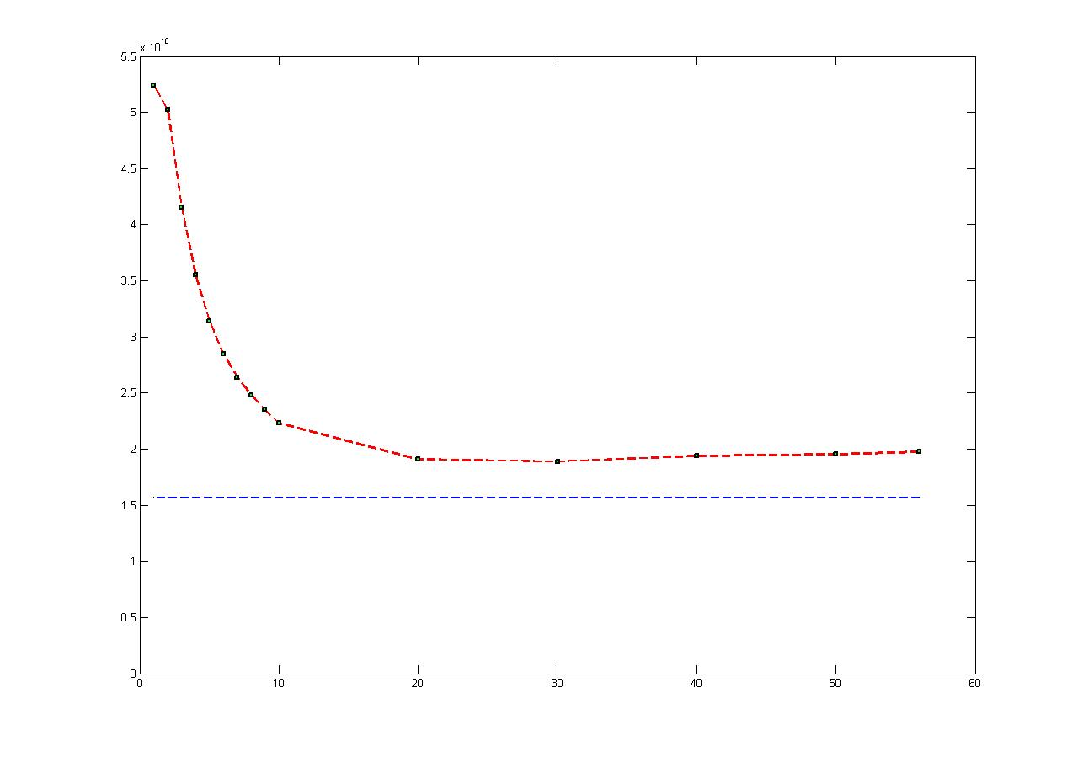
Performance Comparison (connect 3)
Performance of connect 3 on 4x4 grid
Number of cycles
0.83
Purple: sequential no pruning
Red: dynamic queue
Number of processors (P)

Slide 10
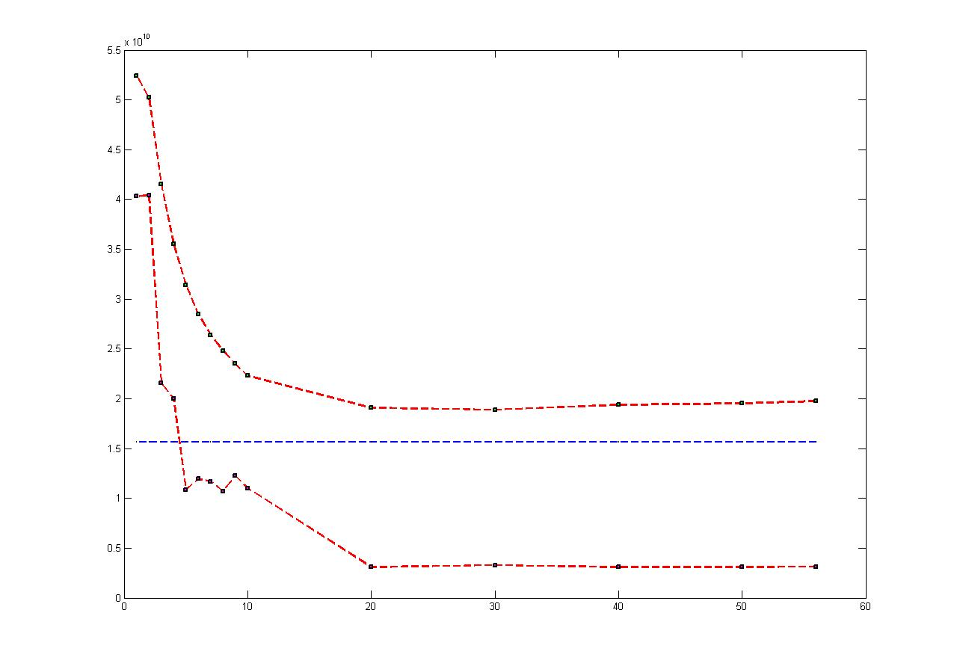
Performance Comparison (connect 3)
Performance of connect 3 on 4x4 grid
Number of cycles
Purple: sequential no pruning
Upper Red: dynamic queue
Lower Red: message passing
Number of processors (P)

Slide 11
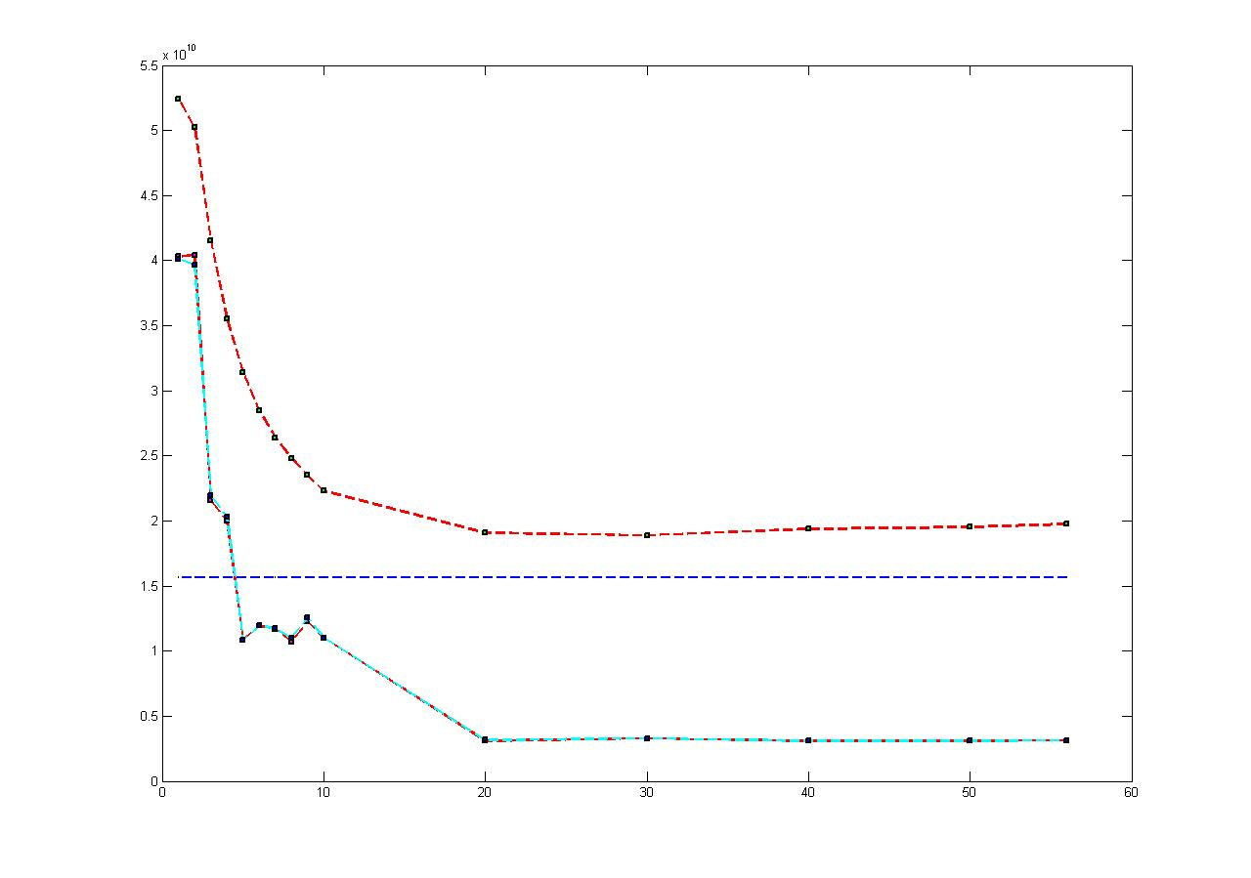
Performance Comparison (connect 3)
Performance of connect 3 on 4x4 grid
Number of cycles
0.83
5.05
Purple: sequential no pruning
Upper Red: dynamic queue
Lower Red: message passing
Blue: individually allocated shared memory
Number of processors (P)

Slide 12
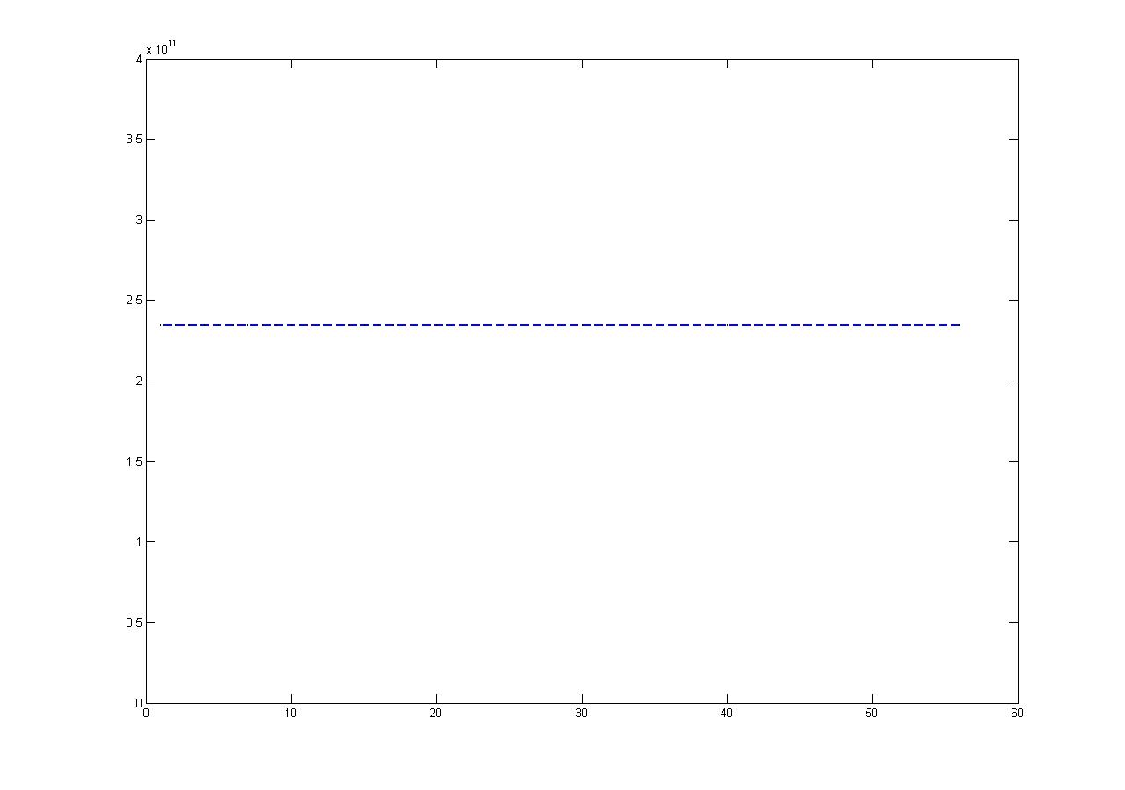
Performance Comparison (connect 4)
Performance of connect 4 on 4x4 grid
Number of cycles
Purple: sequential no pruning
Number of processors (P)

Slide 13
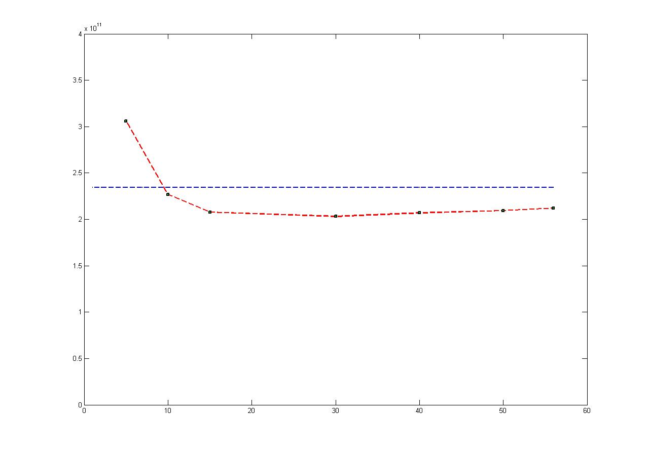
Performance Comparison (connect 4)
Performance of connect 4 on 4x4 grid
Number of cycles
1.15
Purple: sequential no pruning
Red: dynamic queue
Number of processors (P)

Slide 14
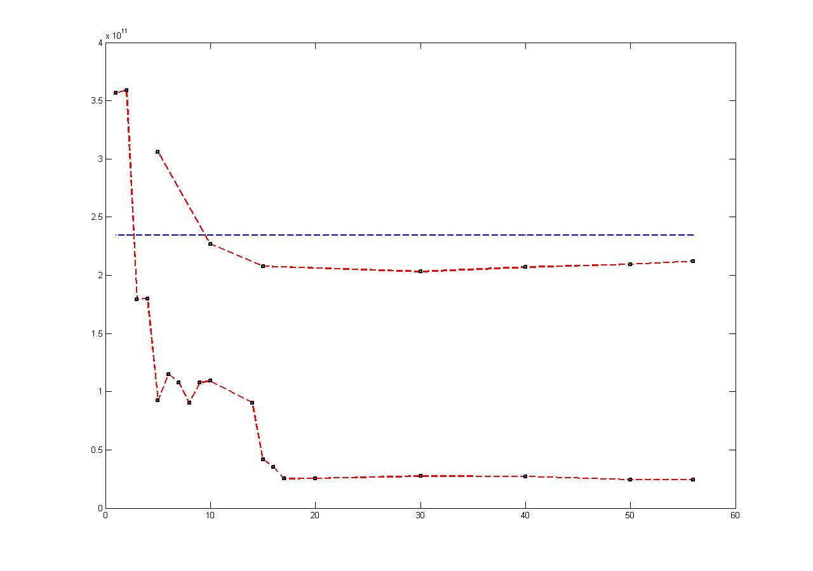
Performance Comparison (connect 4)
Performance of connect 4 on 4x4 grid
Number of cycles
1.15
9.59
Purple: sequential no pruning
Upper Red: dynamic queue
Lower Red: message passing
Number of processors (P)

Slide 15
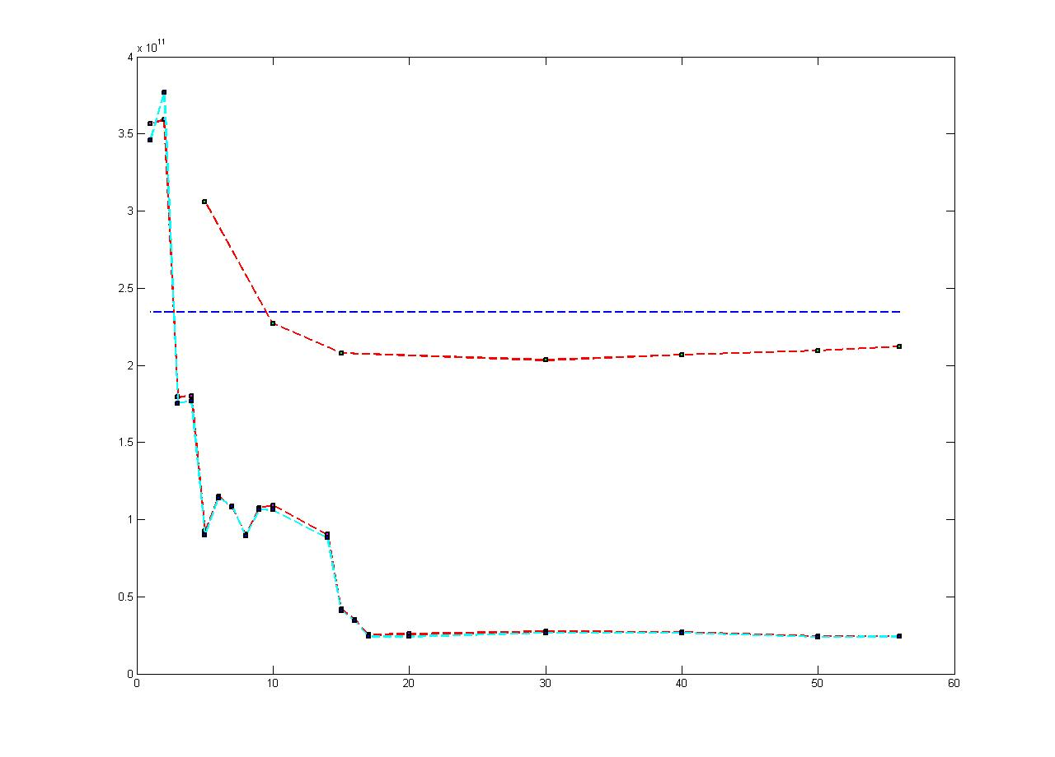

Performance Comparison (connect 4)
Performance of connect 4 on 4x4 grid
Number of cycles
Purple: sequential no pruning
Upper Red: dynamic queue
Lower Red: message passing
Blue: individually allocated shared memory
Number of processors (P)

Slide 16
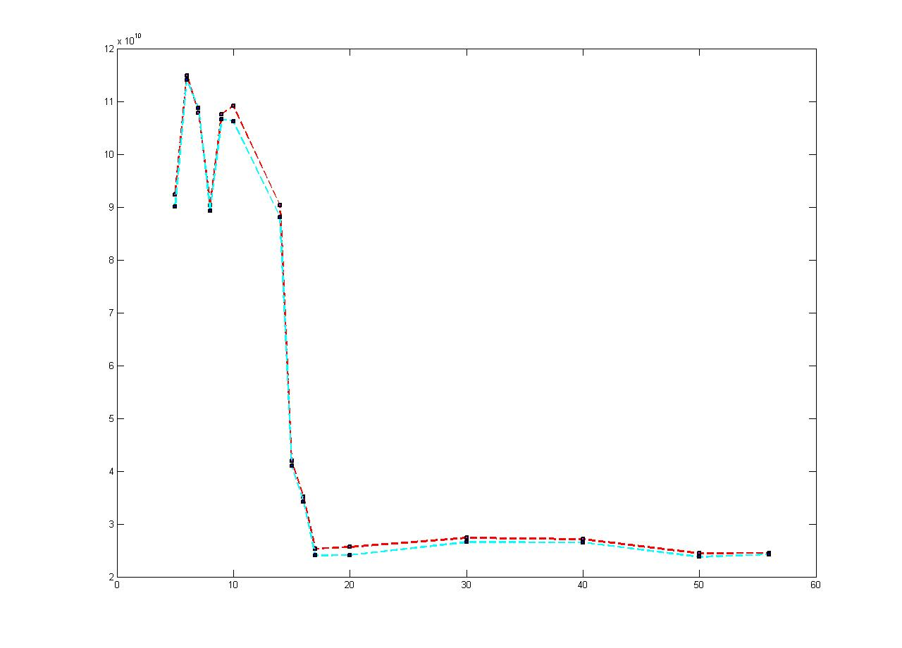
Performance Comparison (connect 4)
Performance of connect 4 on 4x4 grid
Number of cycles
9.59
9.87
Blue: individually allocated shared memory
Red: message passing
Number of processors (P)

Slide 17
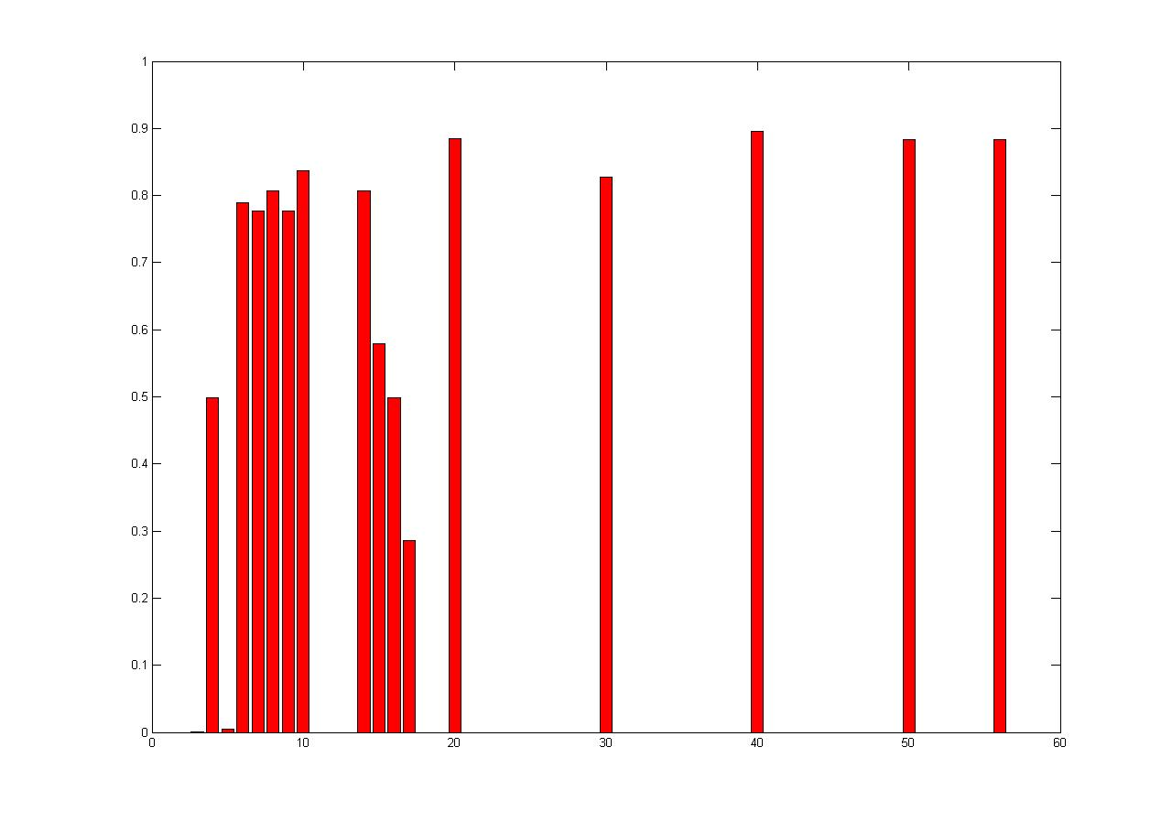
Load Balancing
114 billion cycles
Worse balanced
177 billion cycles
Load balancing spread
4 children
7 children
90 billion cycles
Better balanced
Number of processors (P)

Slide 18
Sequential Pruning
Me: Max
>=5
Oppo: Min
5
<=2
Me: Max
2
Number of cycles | Sequential pruning | Individually allocated shared memory (min)
3x3 connect 3 | 0.157 billion | 3 billion
3x3 connect 4 | 0.162 billion | 23 billion

Slide 19
Final Version
Tile 0
Other tiles: sequential pruning
Pros: Take advantage of both dynamic queue for load balancing and pruning
Cons: Can’t do pruning between processors
Number of cycles | Sequential pruning | Individually allocated shared memory (min) | Final Version (min)
3x3 connect 3 | 0.157 billion | 3 billion (P=50) | 0.069 billion (P=20)
3x3 connect 4 | 0.162 billion | 23 billion (P=50) | 0.14 billion(P=20)

Slide 20
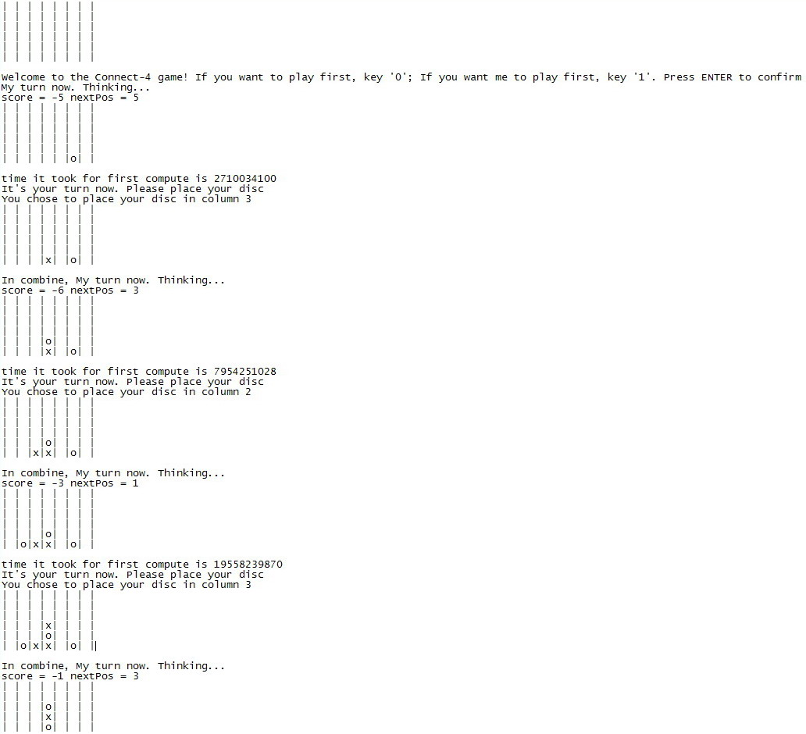
Interactive Mode

Slide 21
Conclusion
By using
Pruning
Master slave structure
Individually allocated shared memory
My connect four
searches fast
has a good heuristic
COME TRY IT!

